Slide 1
Pump Assessment and Pump Inventory using MEASUR

Slide 2
Introduction
Introduction to Pumps
Navigating MEASUR: Pump Assessment
Enhancing System Efficiency: Best Practices
Applying Efficiency Recommendations in MEASUR
Summary and Key Takeaways

Slide 3
Introduction of Pumps

Slide 4
Introduction of Pumps
Mechanical devices used to transfer fluid from one place to another.
Nearly 27% of total industrial energy consumption comes from Pumps( Nearly ¼ of the total)
Notes:
Facilitator’s note: Pumps are essential mechanical devices designed to transfer fluids—whether liquids or gases—from one location to another. They play a critical role in various industrial processes, ensuring the smooth operation of systems like water supply, cooling, heating, and manufacturing.
Interestingly, pumps account for a significant portion of industrial energy consumption—nearly 27% of the total. This means that roughly a quarter of the energy used in industrial operations is dedicated to pump systems alone. Their widespread use and energy demand highlight the importance of optimizing pump systems for energy efficiency and cost savings in industrial settings.

Slide 5
Usage of Pumps
HVAC systems
Power generation
Water supply systems
Notes:
Facilitator’s note: Pumps play a critical role across various applications, ensuring the efficient movement of fluids within essential systems:
HVAC Systems: In heating, ventilation, and air conditioning (HVAC) systems, pumps are used to circulate chilled or hot water, facilitating temperature regulation in buildings. They ensure consistent comfort while maintaining energy efficiency in climate control.
Power Generation: In power plants, pumps are indispensable for circulating water in cooling systems, feeding water to boilers, and supporting various other processes. Their reliability and efficiency are vital for maintaining continuous power production.
Water Supply Systems: Pumps are integral to municipal and industrial water supply systems. They help draw water from natural sources, transport it through pipelines, and ensure adequate pressure and flow for residential, commercial, and industrial needs.
These diverse applications underline the importance of pumps in maintaining essential operations and ensuring energy efficiency in various systems.

Slide 6
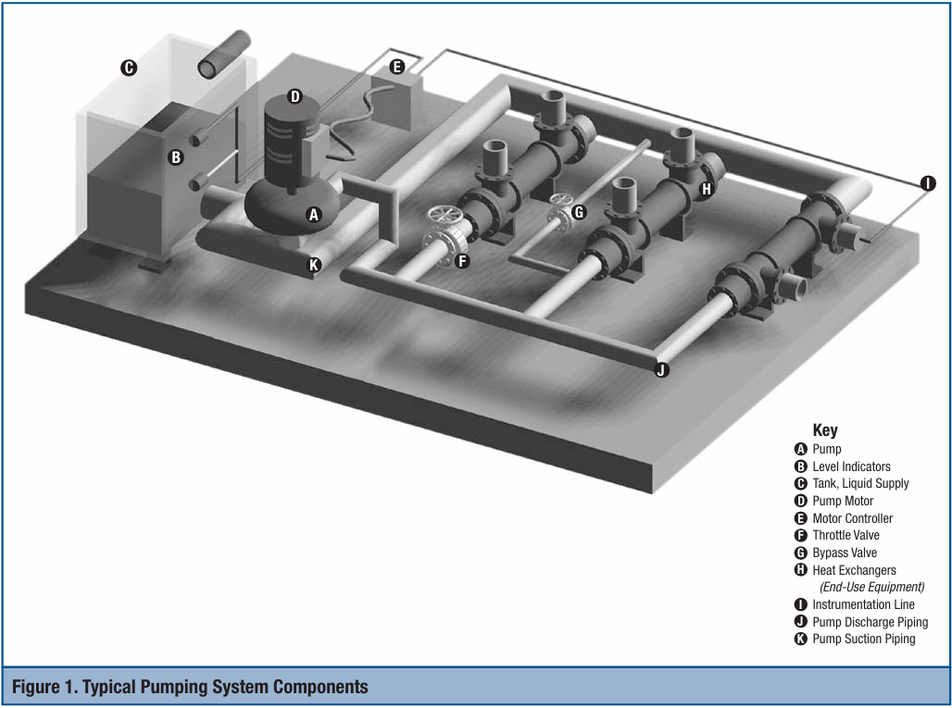
Typical Pumping System
Notes:
Facilitator’s note: A typical pumping system consists of multiple components working together to ensure efficient fluid movement and system operation:
Pump: The central element that provides the mechanical energy needed to move fluid.
Level Indicators: Installed in tanks or reservoirs to monitor liquid levels and ensure adequate supply.
Tank Liquid Supply: Serves as the source of the fluid being pumped.
Pump Motor: Drives the pump, converting electrical energy into mechanical energy.
Motor Controller: Regulates the motor's operation, ensuring proper speed, torque, and energy efficiency.
Throttle Valve: Controls flow rate by adjusting the amount of fluid passing through the system.
Bypass Valve: Allows fluid to flow around the pump or system components for pressure control or maintenance.
Heat Exchangers: Manage fluid temperature, improving system efficiency and protecting components.
Instrumentation Line: Provides measurement points for monitoring system parameters such as pressure, temperature, and flow rate.
Pump Discharge Piping: Carries the fluid from the pump to its destination.
Pump Suction Piping: Brings fluid into the pump from the supply tank or reservoir.

Slide 7
Navigating MEASUR Pumping
MEASUR pump module helps users evaluate the potential energy savings opportunities of pumping systems based on field measured data.It is also intended to help access different system modifications to determine which would be the most energetically beneficial.
Notes:
Facilitator’s note:
The MEASUR Pump Module is a powerful tool designed to assist users in evaluating potential energy savings opportunities within pumping systems. By leveraging field-measured data, the module provides detailed insights into current system performance. It enables users to explore and assess various system modifications, helping them determine the most energy-efficient and cost-effective solutions. This makes it an essential resource for optimizing pumping operations, reducing energy consumption, and improving overall system efficiency.

Slide 8
Step 1: Data Entry

Slide 9
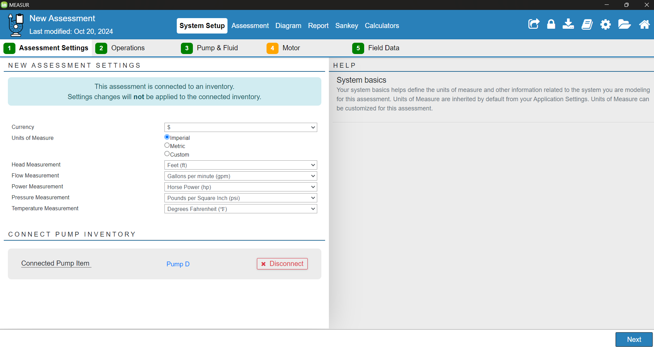
System Settings
Notes:
First step is to enter the currency and units of measurement for flow, power, pressure, and temperature. Next, select the appropriate pump model based on system specifications and operating conditions.

Slide 10
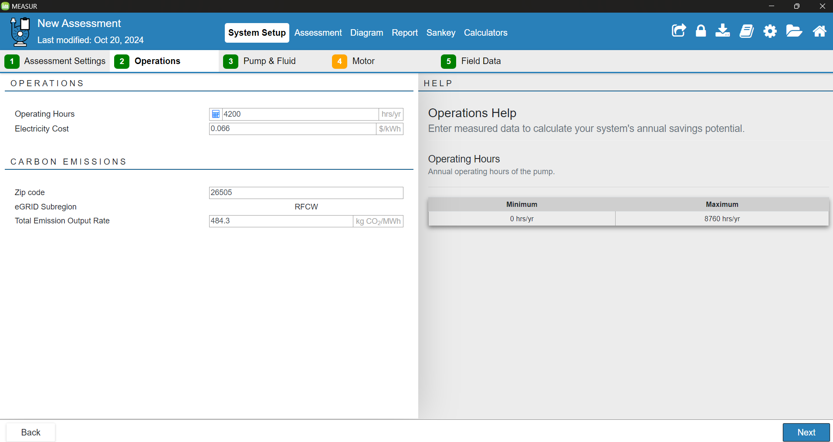
Operations
Notes:
Enter the operating hours of your facility and electricity usage cost as per your utility company. Enter the Zip code of your area.

Slide 11
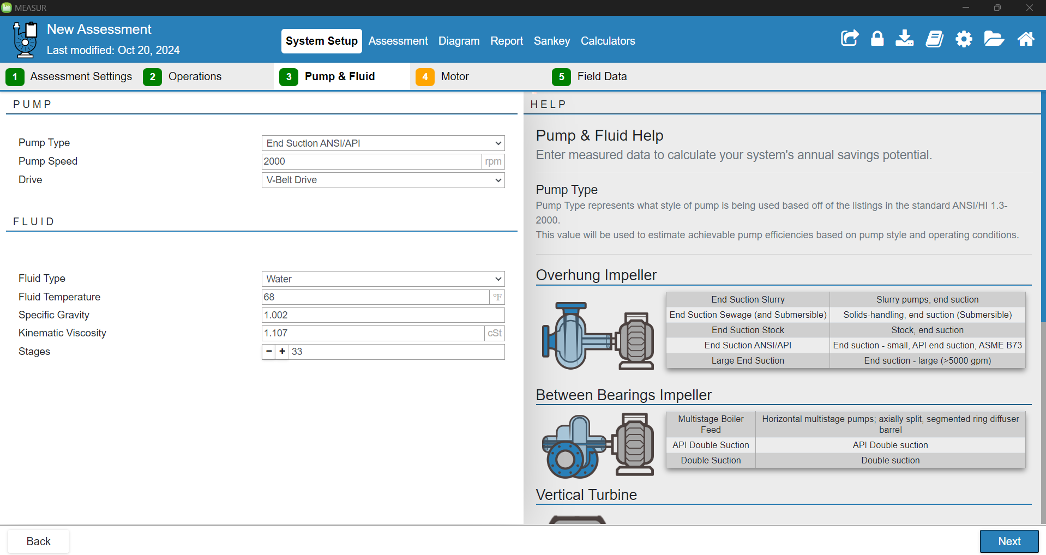
Pump and Fluid Characteristics
Notes:
Select pump type, pump speed and the type of belt drive (v, flat, crossed, timing, etc.).
Also select the properties of fluid you work with (fluid type, temperature, specific gravity, kinematic viscosity, and number of stages)

Slide 12
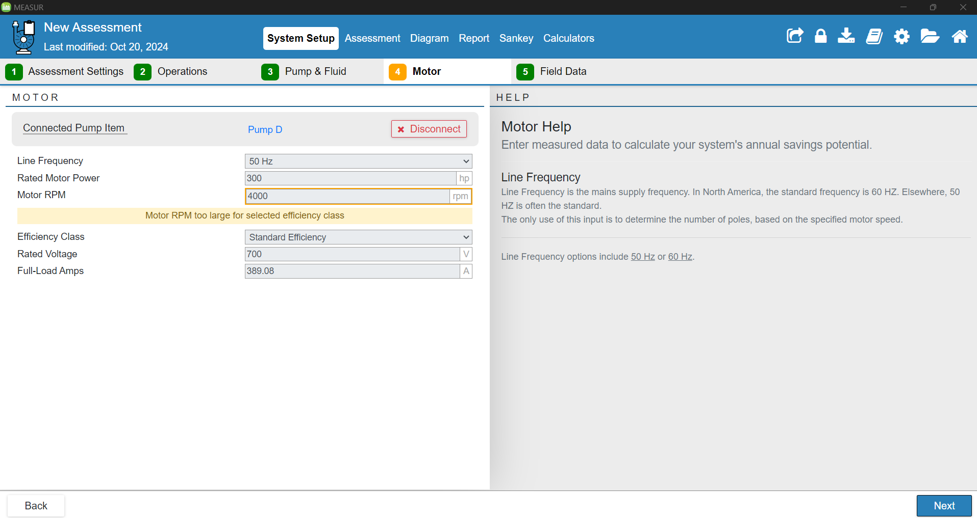
Motor Settings
Notes:
Here, you need to enter the rating of the pump (frequency of the supply source, rated motor power, rated RPM, rated voltage and FLA (Full Load Amps)- i.e. maximum current drawn by a motor when operating at its full load capacity

Slide 13
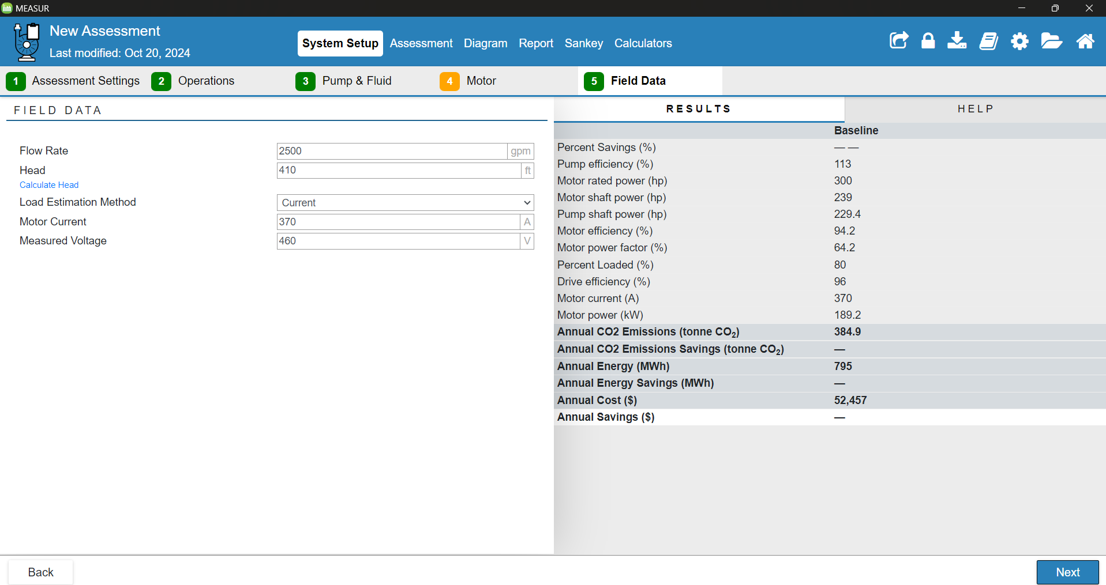
Field Data
Notes:
In this tab, we need to enter flow rate of our pumping system and total head and the system will show load motor current and measured voltage using load estimation method (which includes current and power)

Slide 14
Step 2: Assessment

Slide 15
Assessment
Now, we can move forward to the Assessment Section.
The Assessment section of the module allows you to explore how modifications scenarios for your system may provide cost, energy and carbon emissions. Your baseline must be setup completely prior to making modifications.
There are two ways to conduct assessment :
Explore Opportunities(Novice View)
Modify all Conditions( Expert View)
Notes:
Facilitator’s note:
Let’s proceed to the Assessment section of the module. This section enables you to evaluate potential modifications to your system and their impact on cost, energy consumption, and carbon emissions. It is important to ensure your baseline is fully set up before exploring modifications. The module offers two approaches for conducting assessments: the "Explore Opportunities" option, tailored for a simplified, beginner-friendly view, and the "Modify All Conditions" option, designed for users who require detailed control and an advanced perspective.

Slide 16
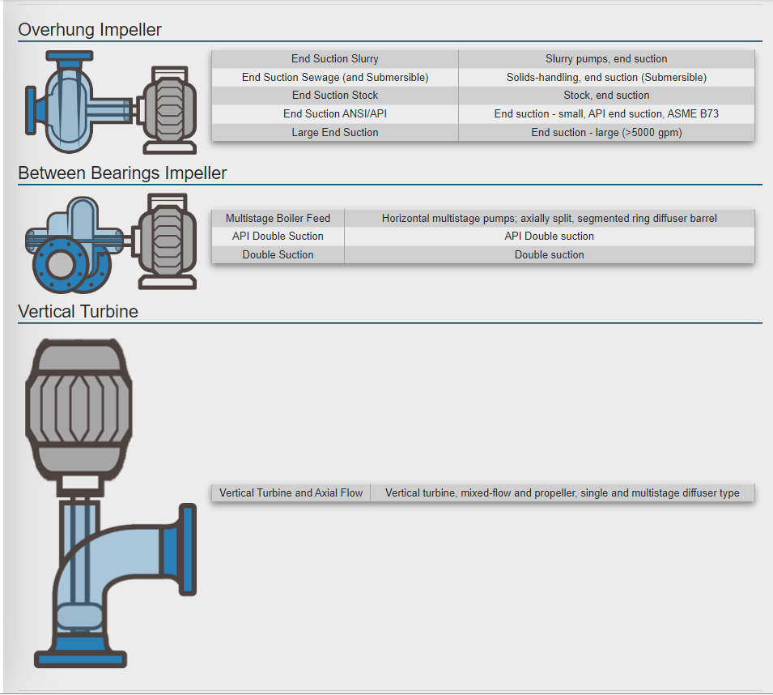
Notes:
This image shows different ways pump and motor can be connected

Slide 17
Best Practice for System Efficiency
Install a Variable Frequency Drive.
Install more efficient drive/pump.
Reduce system flow rate
Reduce System overhead requirement
Adjust Operational Data
Install More efficient Motor
Notes:
Facilitator’s note:
To enhance system efficiency, consider implementing several best practices. Start by installing a Variable Frequency Drive (VFD) to regulate pump speed based on real-time demand, reducing energy use during low-flow conditions. Upgrading to a more efficient drive or pump can significantly improve system performance while lowering energy consumption. Reducing the overall system flow rate and overhead requirements further minimizes unnecessary energy usage. Adjusting operational data, such as pump schedules or flow parameters, can optimize performance and align with actual needs. Finally, upgrading to a more efficient motor enhances energy savings and contributes to long-term sustainability.

Slide 18
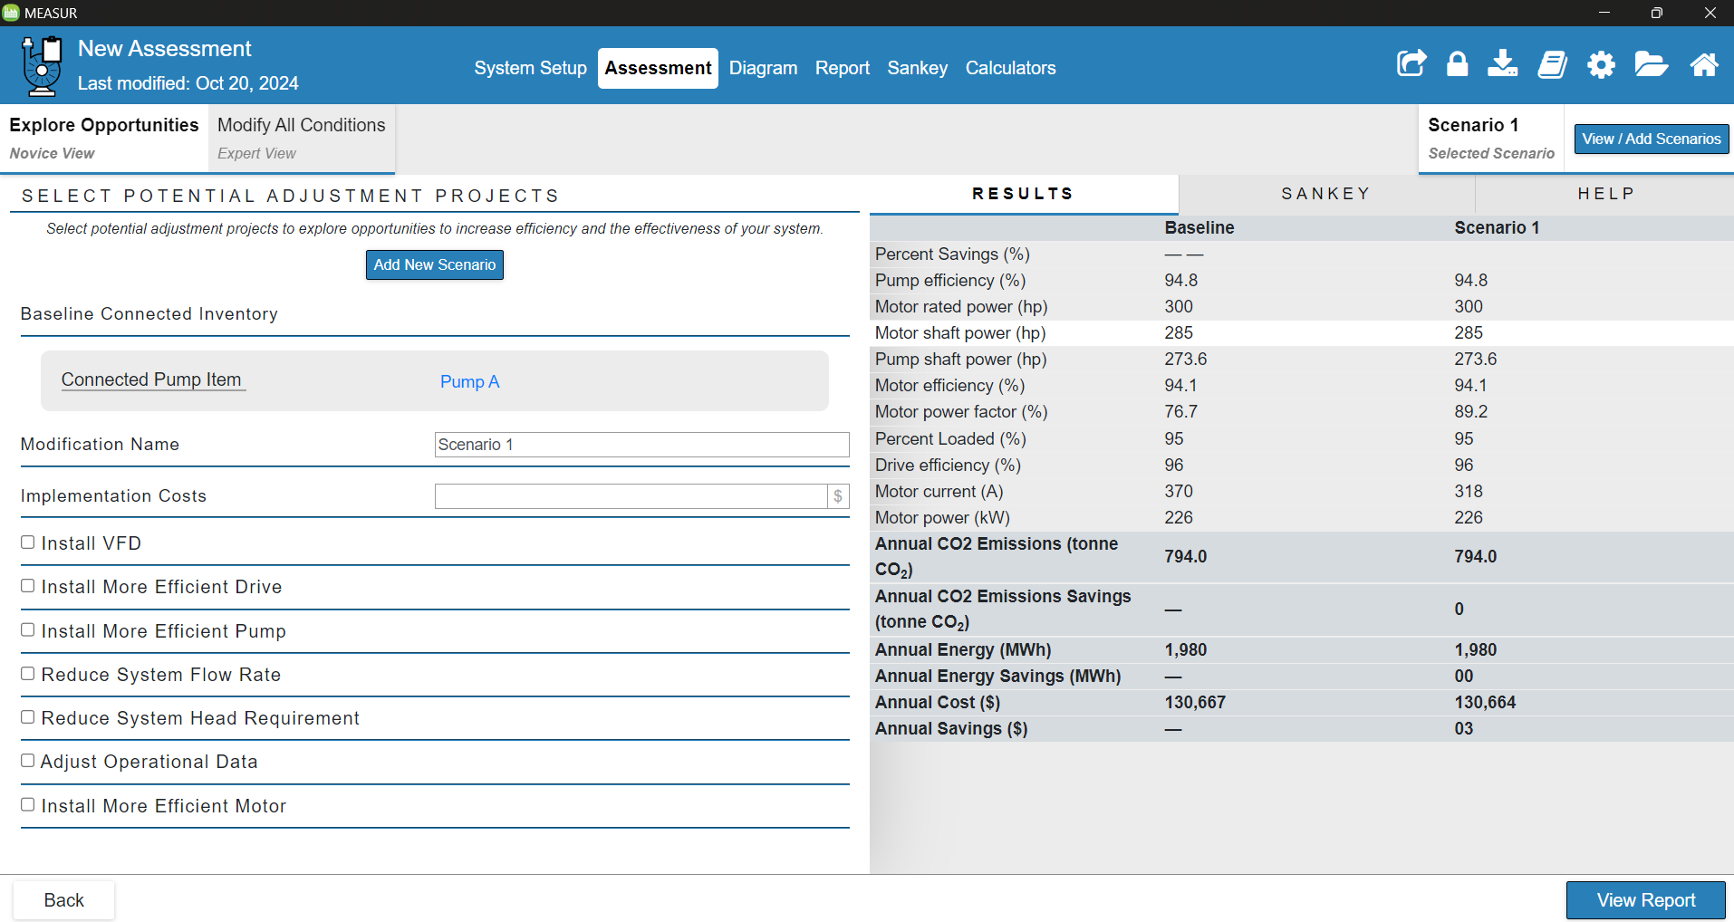
Notes:
In this tab, we can see the setup in novice view- a relatively shorter way to assess our pump with less options

Slide 19
Installing a more effective Drive

Slide 20
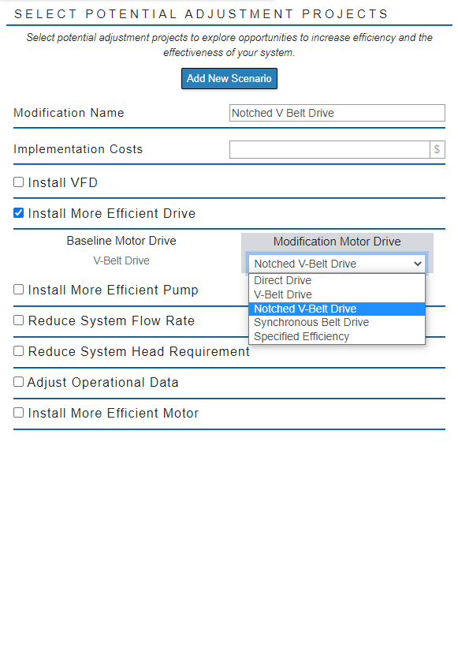
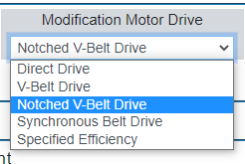
Notes:
We can modify the drive of our existing motor and pump and change to drive which increases the efficiency of the system. Drives available are shown in the image on right.

Slide 21
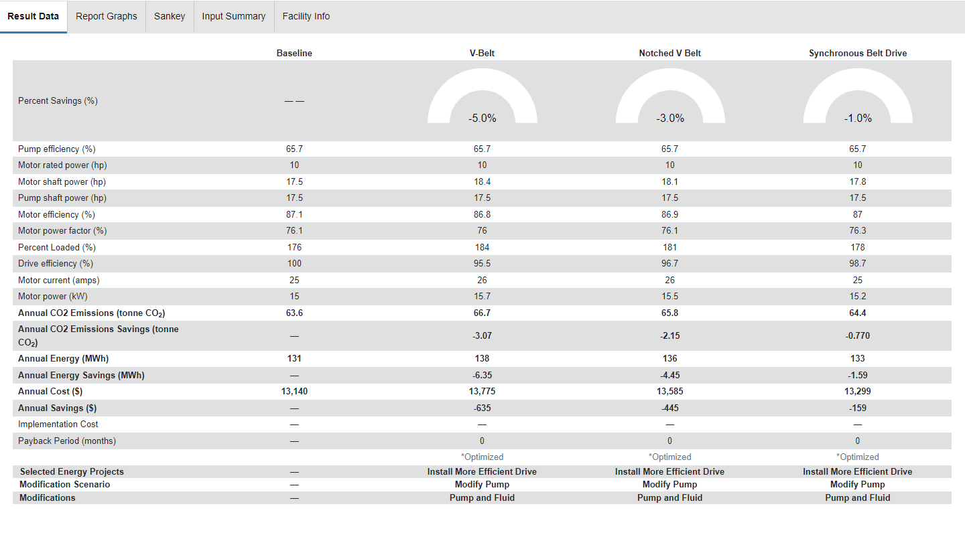
Notes:
This table shows the result obtained after we input the parameters. This will show the baseline condition and updated conditions after changing the drive. We can see the change in % savings on top. This data is only due to change in drive system.

Slide 22
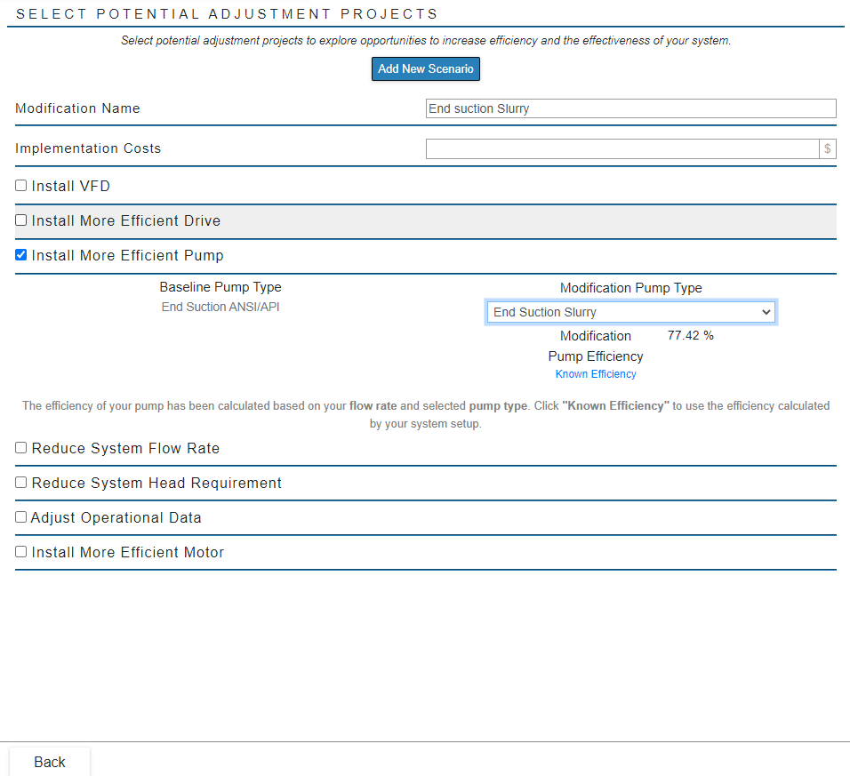
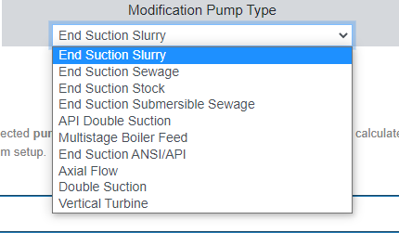
Using a More Efficient Pump
Notes:
This is where we can assign more efficient pump in novice view. Here we can modify the pump type to different types shown in the image on right. This will also show the modification pump efficiency.

Slide 23
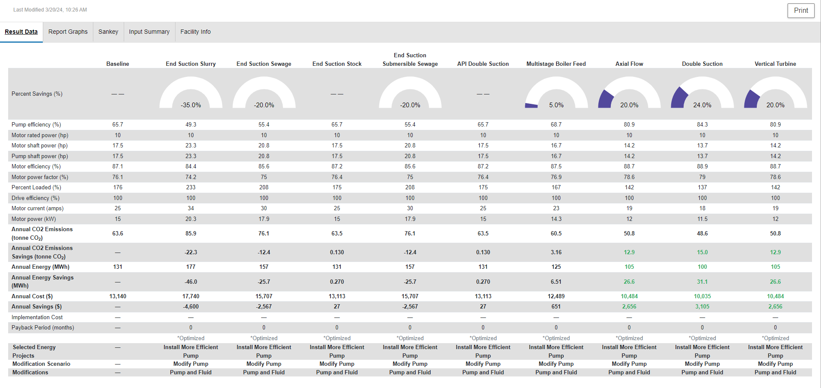
Using a More Efficient Pump
Notes:
This is the result obtained after assigning the more efficient pump. Here, we can explore the efficient pump and observe the difference in energy savings and assign the best one for our use.

Slide 24
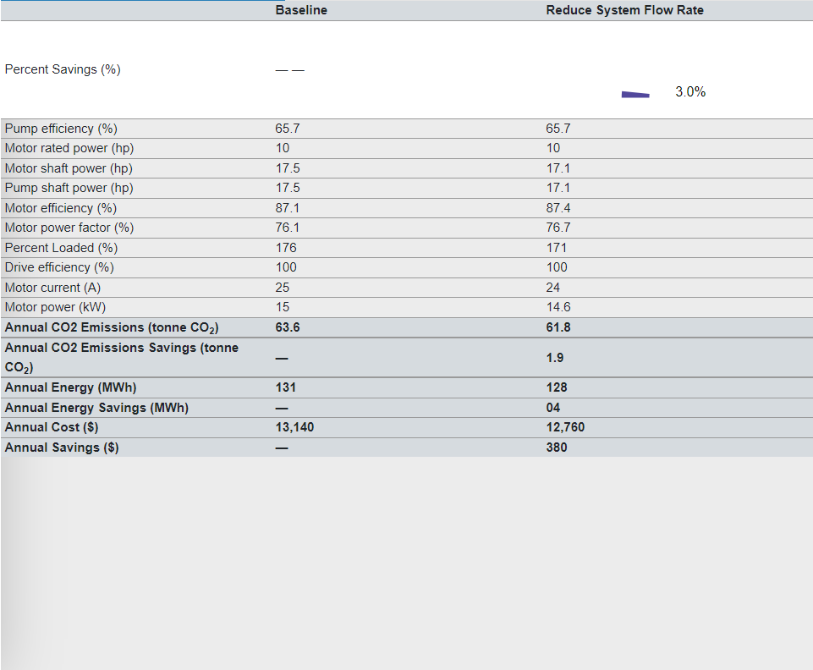
Reduce System Flow Rate
Notes:
Another variable is changing the system flow rate. Here we can see our current flow rate of 2500 gpm. By reducing the flow rate from 2500 to 2400, we can increase our savings by 3% and save $380 in a year.

Slide 25
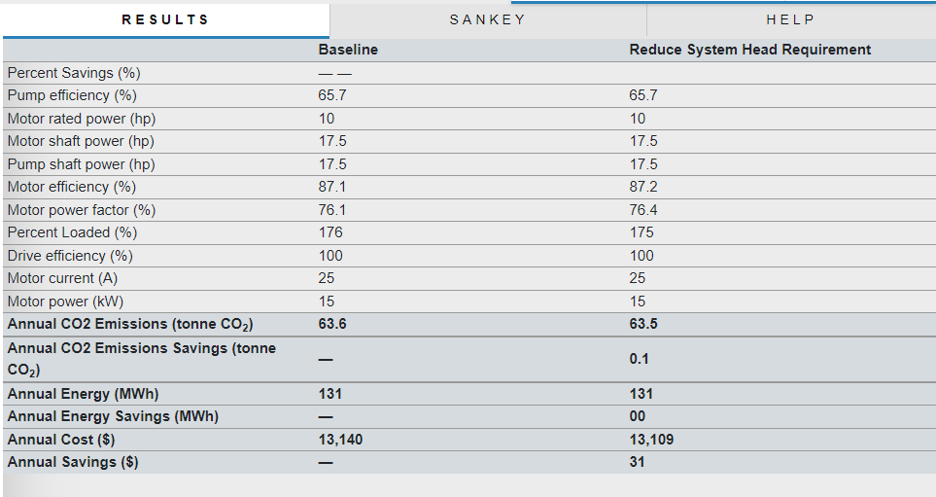
Reduce System Head Requirement
Notes:
This is where we assign the modified head. The current head of our system is 410 ft and if we can reduce the head to 400 ft or lower, we can significantly increase our savings.

Slide 26
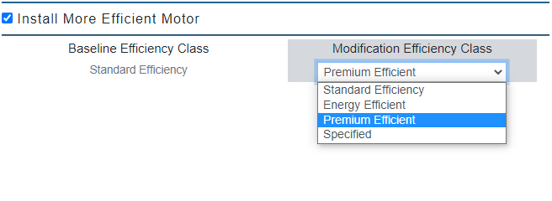
Install Energy Efficient Motor
Notes:
Just by installing energy-efficient motor, we can increase our savings. We can update our system to energy efficient, premium efficient or just specify the efficiency of motor that we want to install.

Slide 27
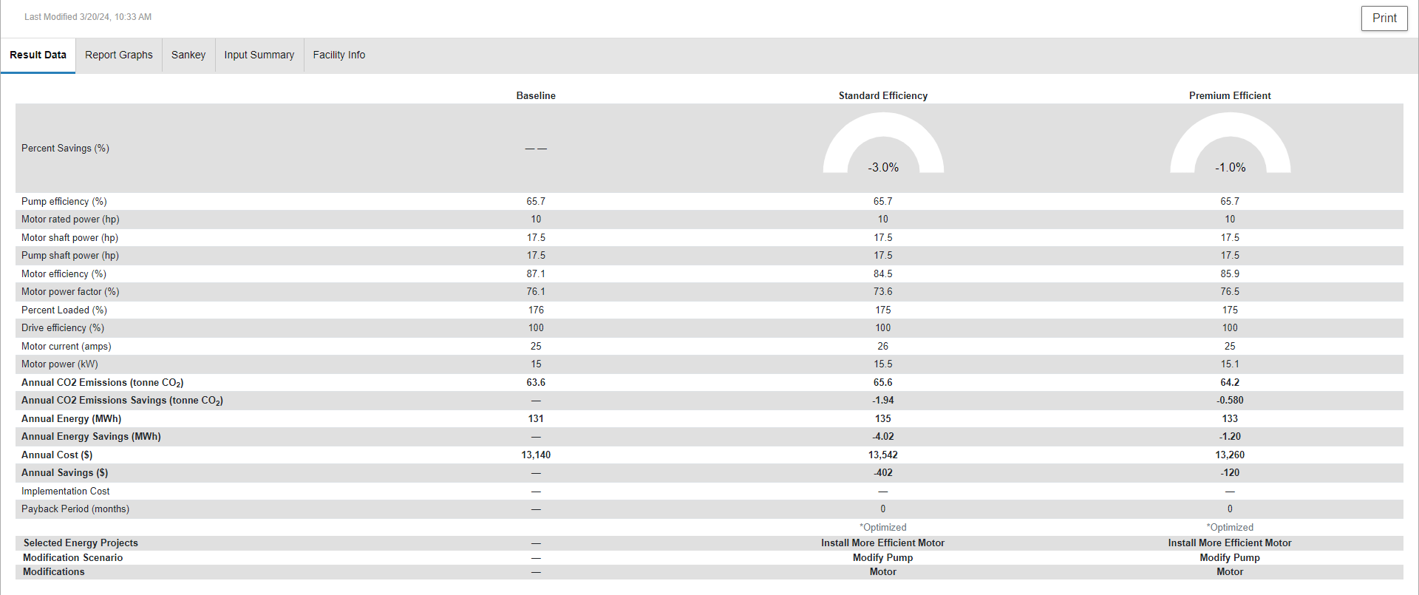
Notes:
Result shows by using more efficient motor, we can reduce the energy usage. By using standard efficiency motor, we can reduce energy savings by 3% whereas premium efficient motor reduces by 1%. It doesn’t always mean premium would do better.

Slide 28
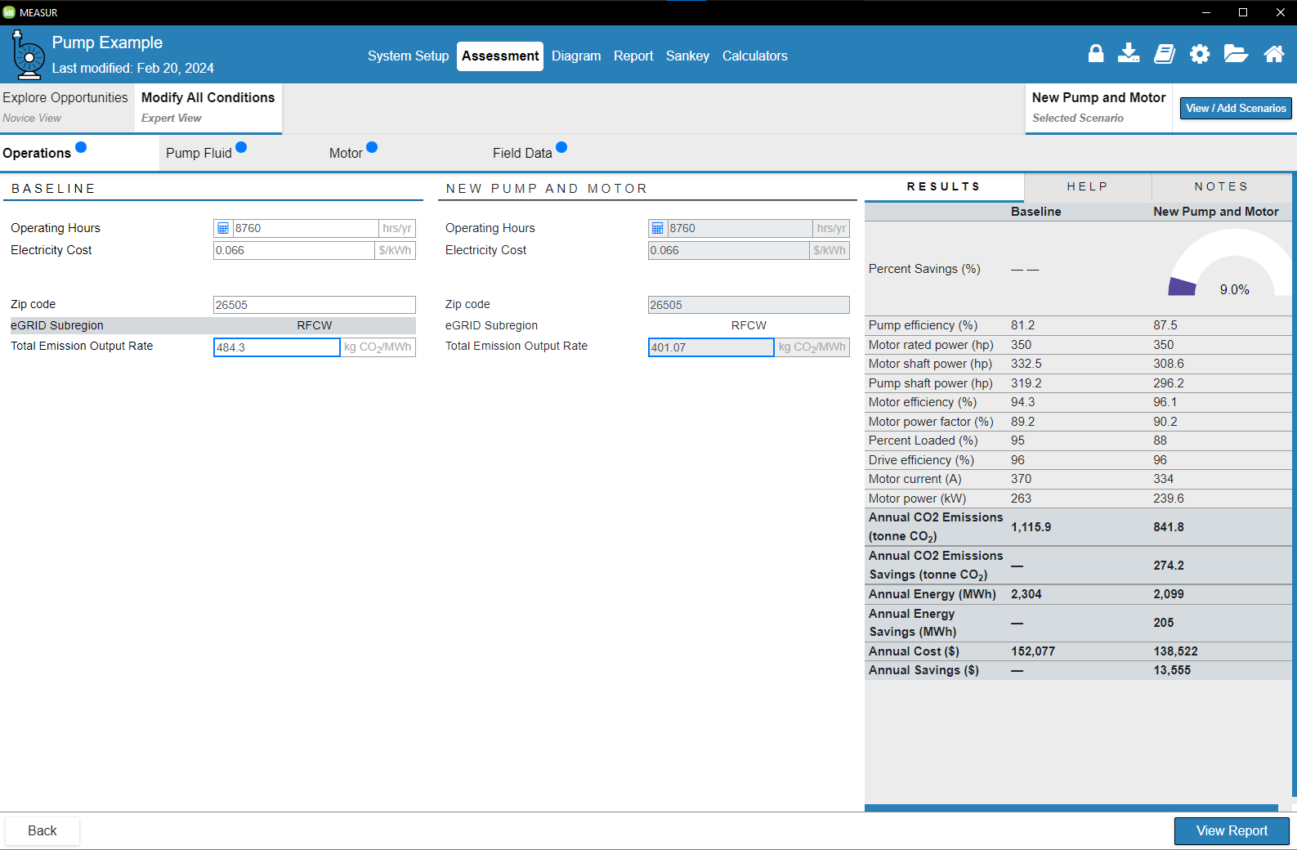
Expert Mode
Notes:
In expert mode, there are sections to modify operating conditions, pump fluid, motor and field data. We can change scenarios different than our current system and observe the difference.

Slide 29
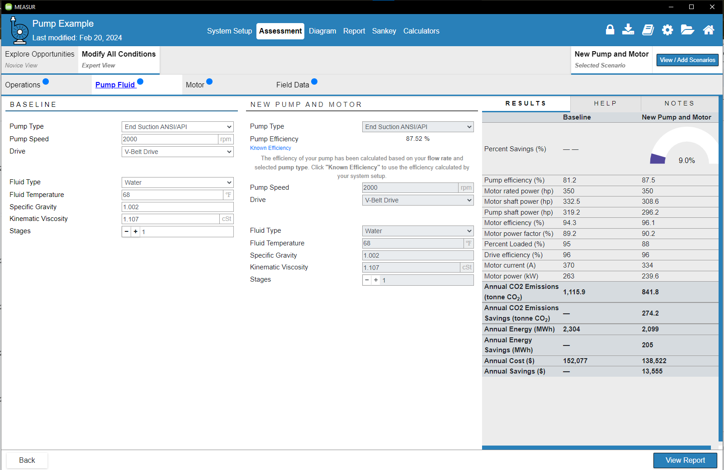
Expert Mode
Notes:
We can see the baseline conditions of the system and modify the conditions for updated system i.e. pump and motor where we can select new pump type, efficiency, pump speed, drive, fluid properties all at once and observe the results.

Slide 30
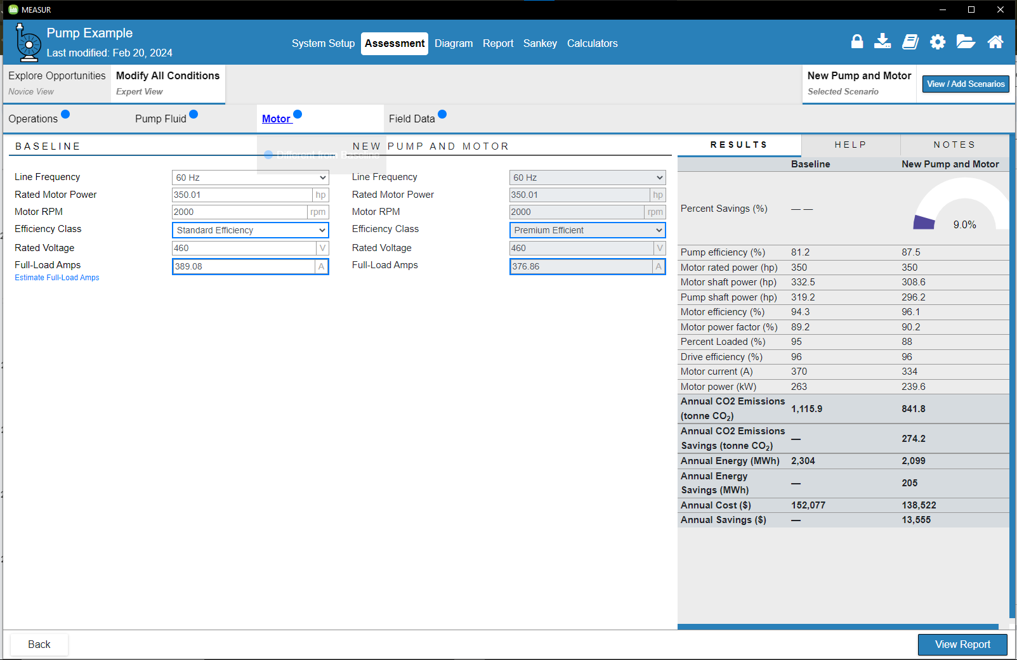
Expert Mode
Notes:
In this tab, we can modify the conditions for new pump and motor by specifying frequency, rated power, RPM, voltage and Full-Load Amps. The table on right gives the tentative savings on this update.

Slide 31
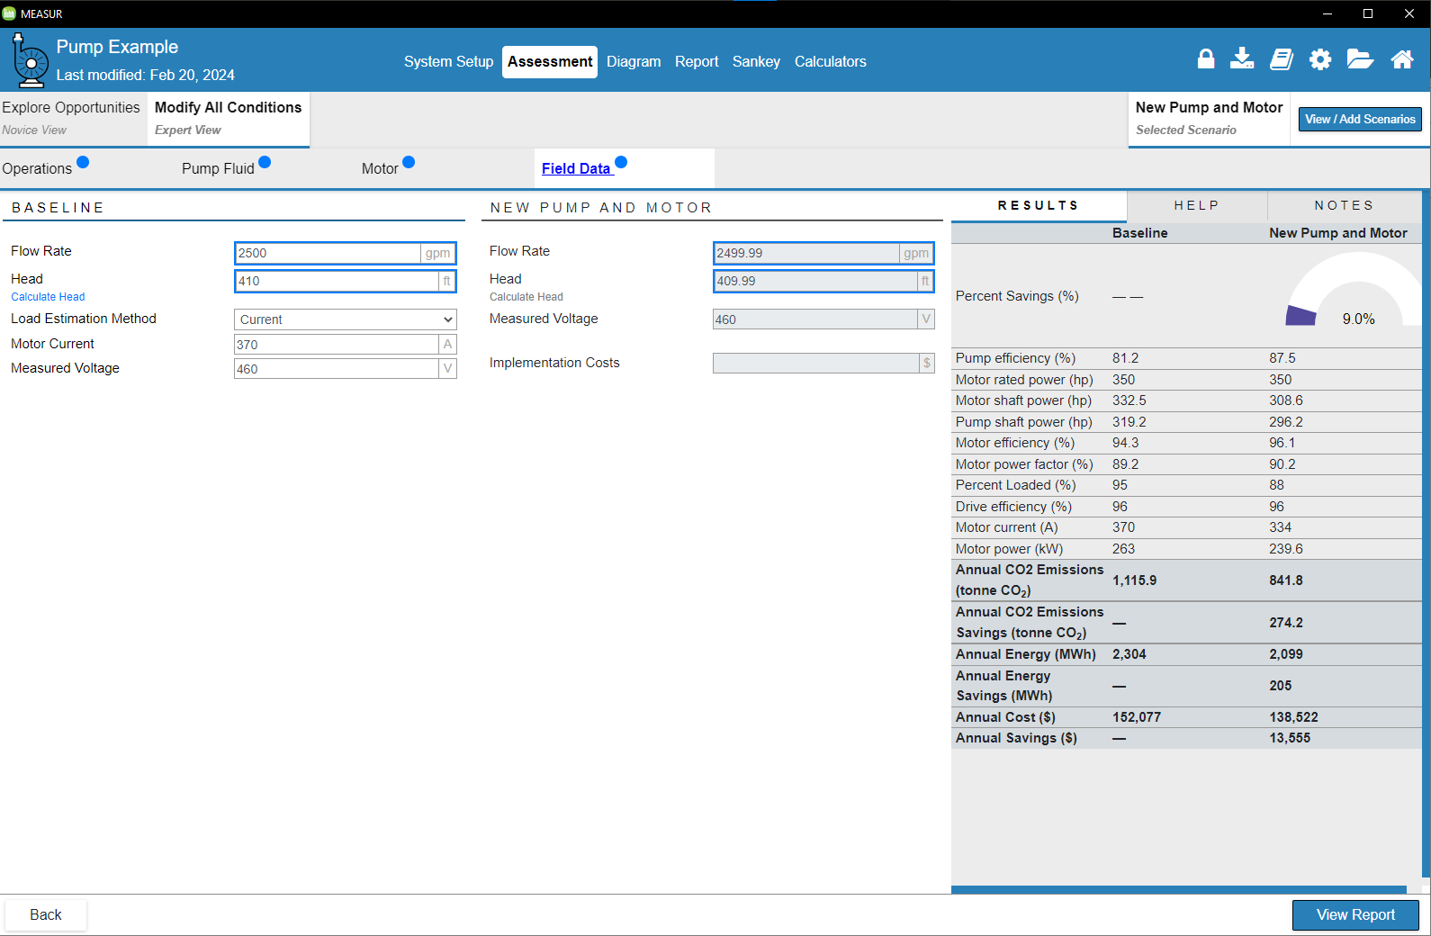
Expert Mode
Notes:
Finally, there is a section to modify field data which includes flow rate, head, measured voltage, and implementation costs. We can see, just reducing the flow rate and head by 0.01, we can increase the savings by 9%.

Slide 32
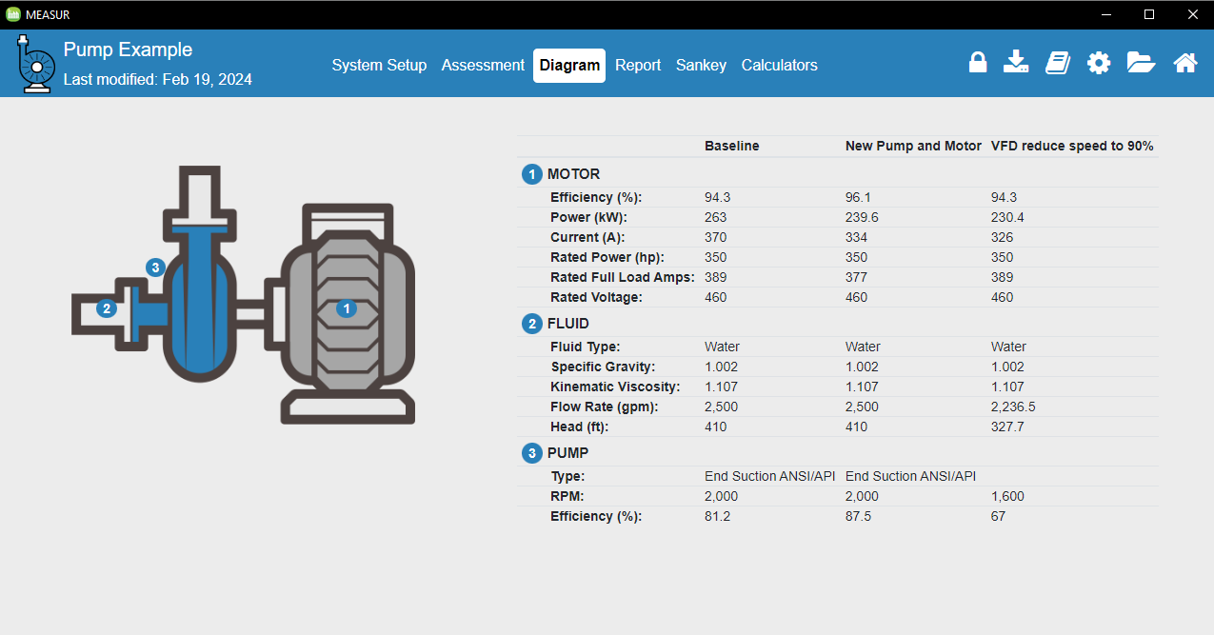
Diagram
Notes:
This gives the snapshot of the system parameters of our baseline model, and our two scenarios- new pump and motor and install VFD.

Slide 33
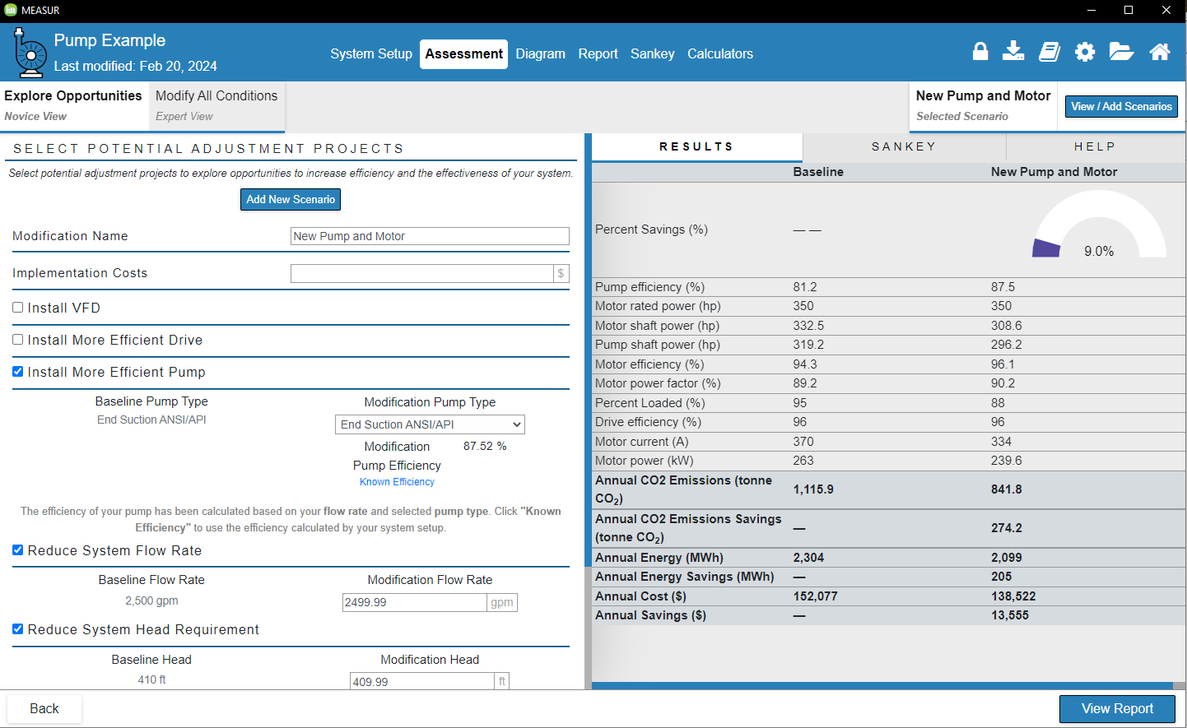
Novice View
Notes:
Facilitator’s note: The assessment section of the module enables users to examine how various modification scenarios can lead to cost, energy, and emissions savings. It is crucial to establish a complete baseline before implementing any modifications. There are two approaches to conducting assessments, which will be discussed in detail later in this section: Explore Opportunities (Novice View) allows users to select basic modifications, while Modify All Conditions (Expert View) provides advanced control over system settings starting from the System Setup, allowing for precise baseline adjustments. Individual opportunities can also be modified for a more tailored analysis.

Slide 34
Generating Report

Slide 35
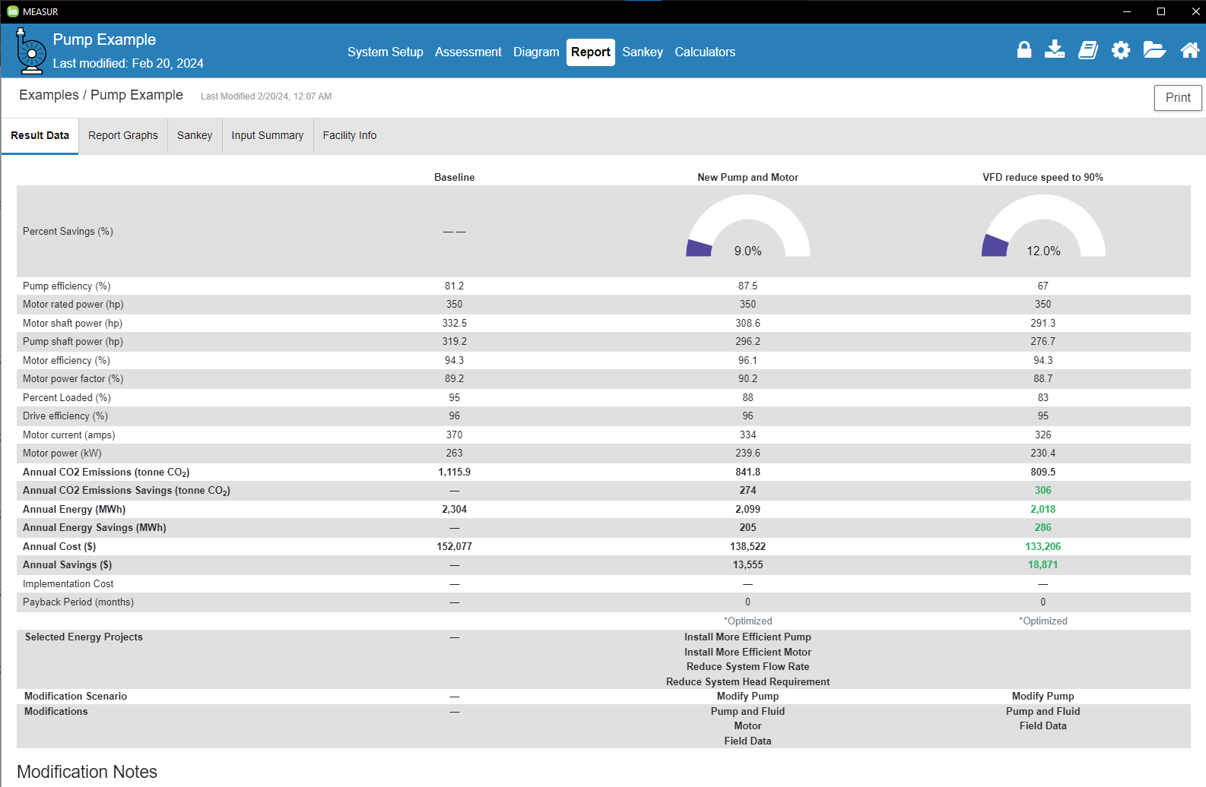
Report
Notes:
We can generate report by clicking on the report section on top. The report section will show all the parameters of our current model and updated model with the summary of energy and cost savings with implementation cost and payback period.

Slide 36
Generating Sankey Diagram

Slide 37
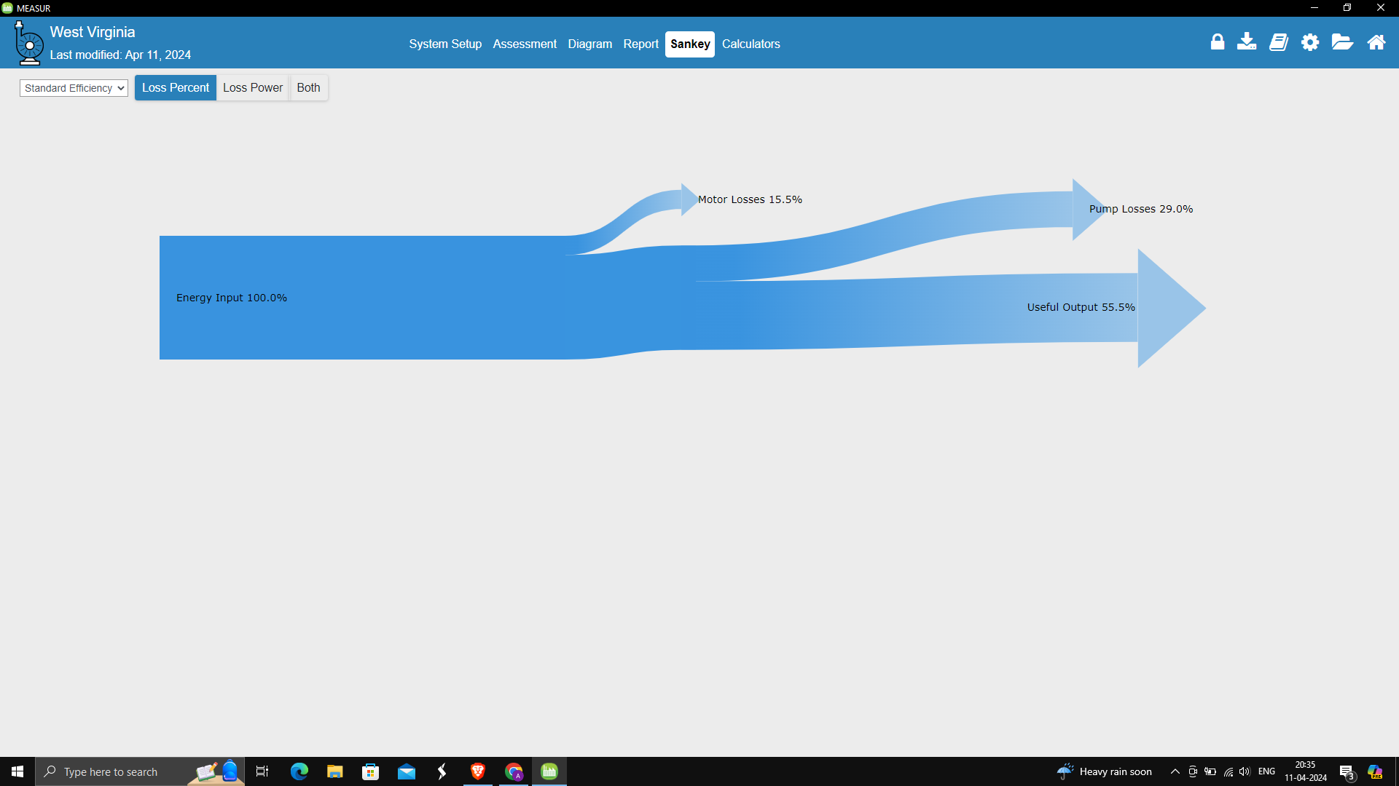
Sankey Diagram
Notes:
A Sankey diagram is a type of flow diagram that tracks the flow of energy from raw or primary sources of energy up to the final stage of consumption. The width of the arrows in the diagram is proportional to the flow rate of energy. This diagram shows the losses in our motor and pump system.
Sankey diagrams can also be used to visualize the energy material flow.

Slide 38
Calculators
Notes:
The Calculator tab includes tools for estimating energy use, efficiency, and savings for equipment like motors, pumps, fans, and compressors. It offers calculators for specific parameters, such as flow rate, pressure, and temperature, allowing users to analyze system-specific energy impacts.

Slide 39
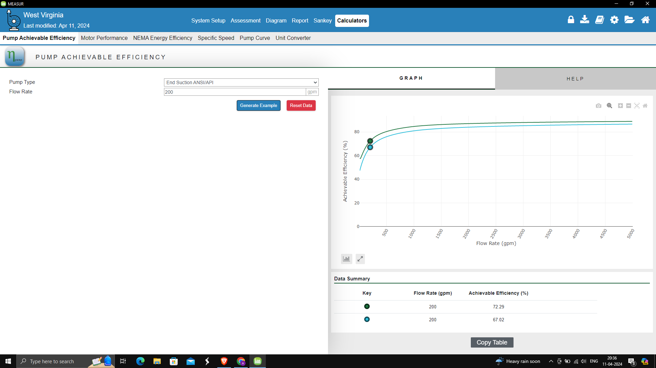
Calculators
Notes:
By just inputting the pump type and flow rate, we can see efficiency chart and maximum achievable efficiency and compare it with the baseline model, the calculator helps assess the pump’s efficiency.

Slide 40
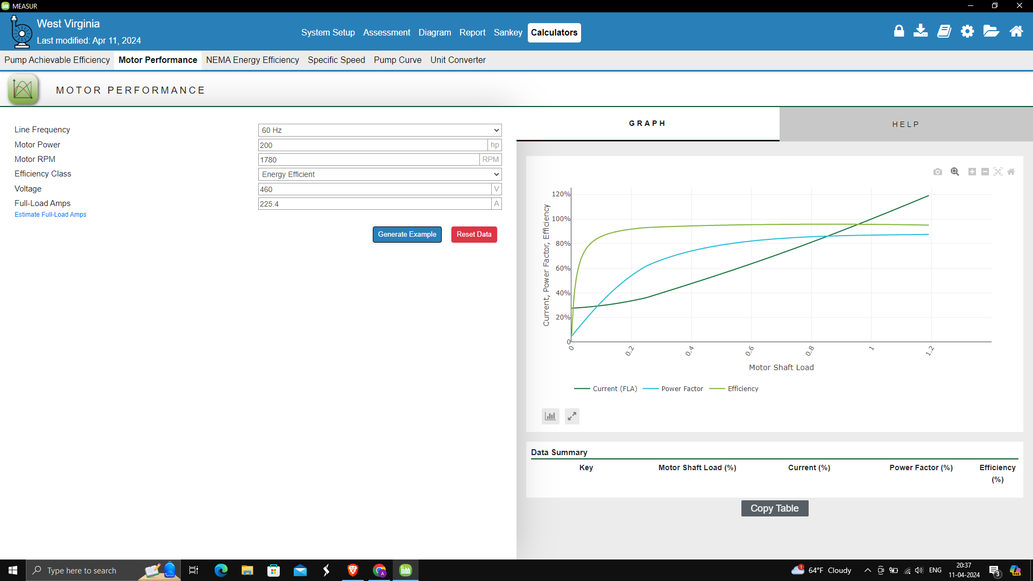
Calculators
Notes:
Here, we need to assign line frequency, motor power, motor RPM, voltage and full load amps (FLA) and charts on the right will show the plot of FLA, power factor,and efficiency at different shaft load.

Slide 41
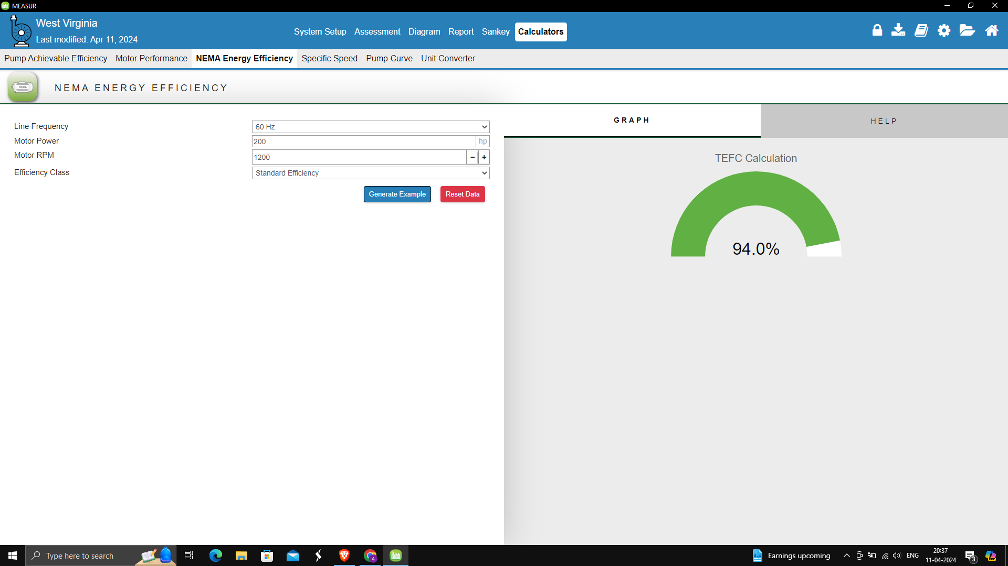
Calculators
Notes:
NEMA stands for National Electrical Manufacturers Association and just by selecting line frequency, motor power, RPM and efficiency class, we can find out the efficiency for TEFC (Totally Enclosed Fan Cooled) pump.

Slide 42
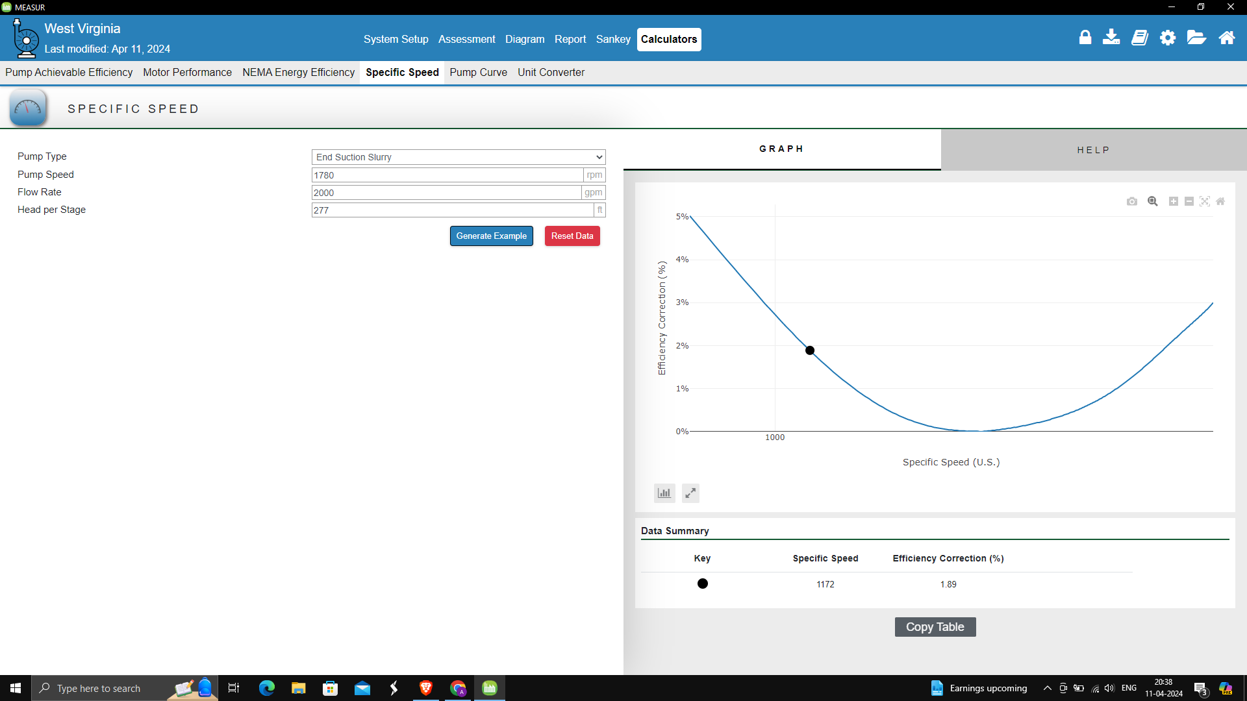
Calculators
Notes:
Specific speed calculator helps to visualize the operating range of the pump with efficiency correction. For this we need to enter pump type, pump speed, flow rate and head per stage in a multi-stage pump.

Slide 43
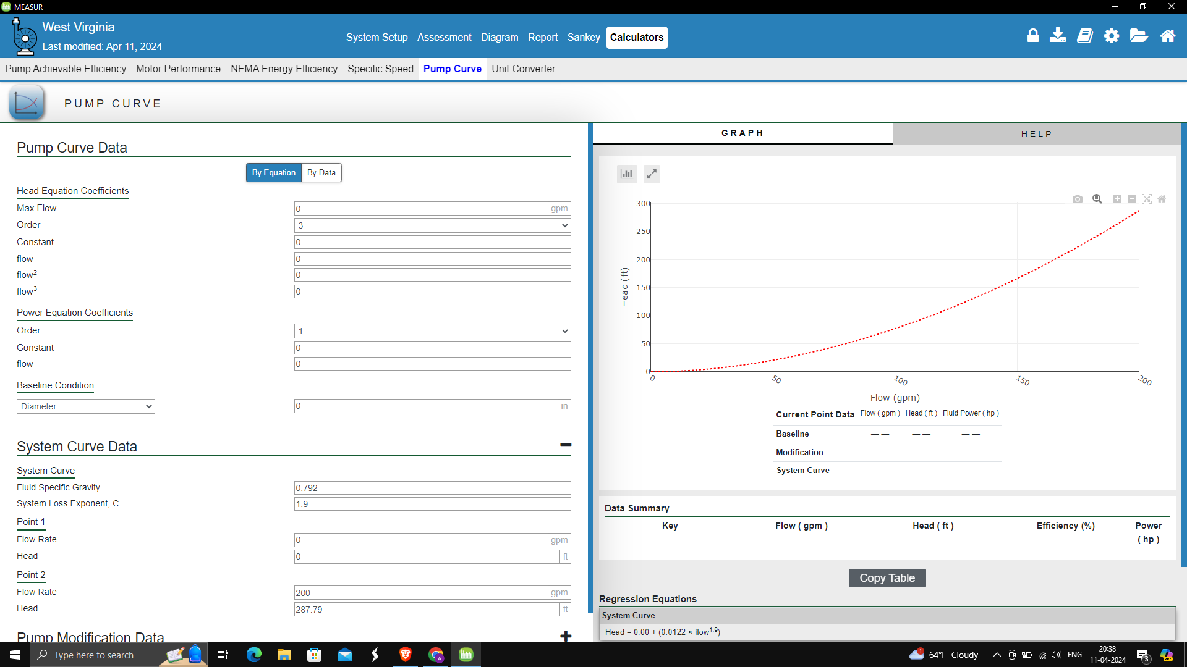
Calculators
Notes:
Pump curve provides flow versus head diagram which helps to visualize the baseline and updated model. For this we need to assign the parameter that are on the left. This includes max flow, specific gravity of the fluid, flow rate and different constants that are required to generate the plot.

Slide 44
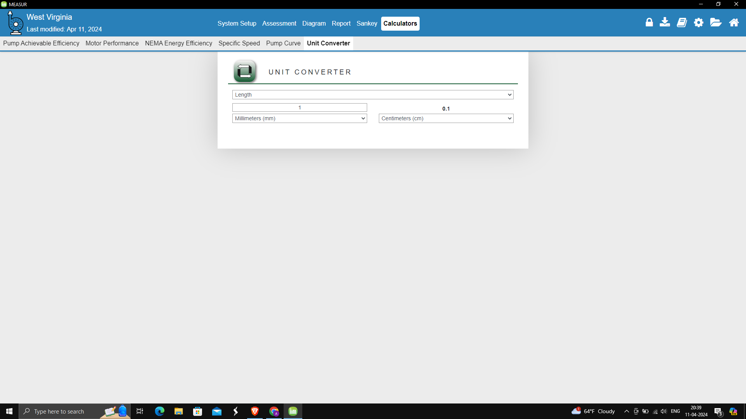
Calculators
Notes:
MEASUR has a built-in feature for unit conversion and allows you to convert a value from one unit of measurement to another, making it easier to work with various measurement systems. It comes handy specially when converting gallons per minute (GPM) to liters per second (L/s) and feet to meter and vice versa.

Slide 45
Pump Inventory

Slide 46
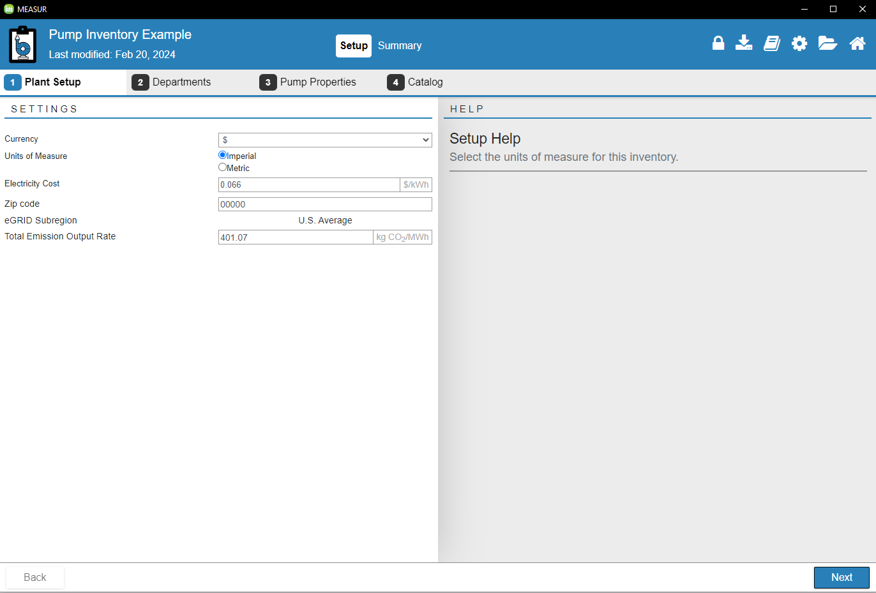
Example
Notes:
If you want to learn about the pump assessment, MEASUR provides example and you can learn how it can be done which makes it easier when you do the real assessment. It follows the same pattern we discussed above. You just need to insert the value and it will give you the summary.

Slide 47
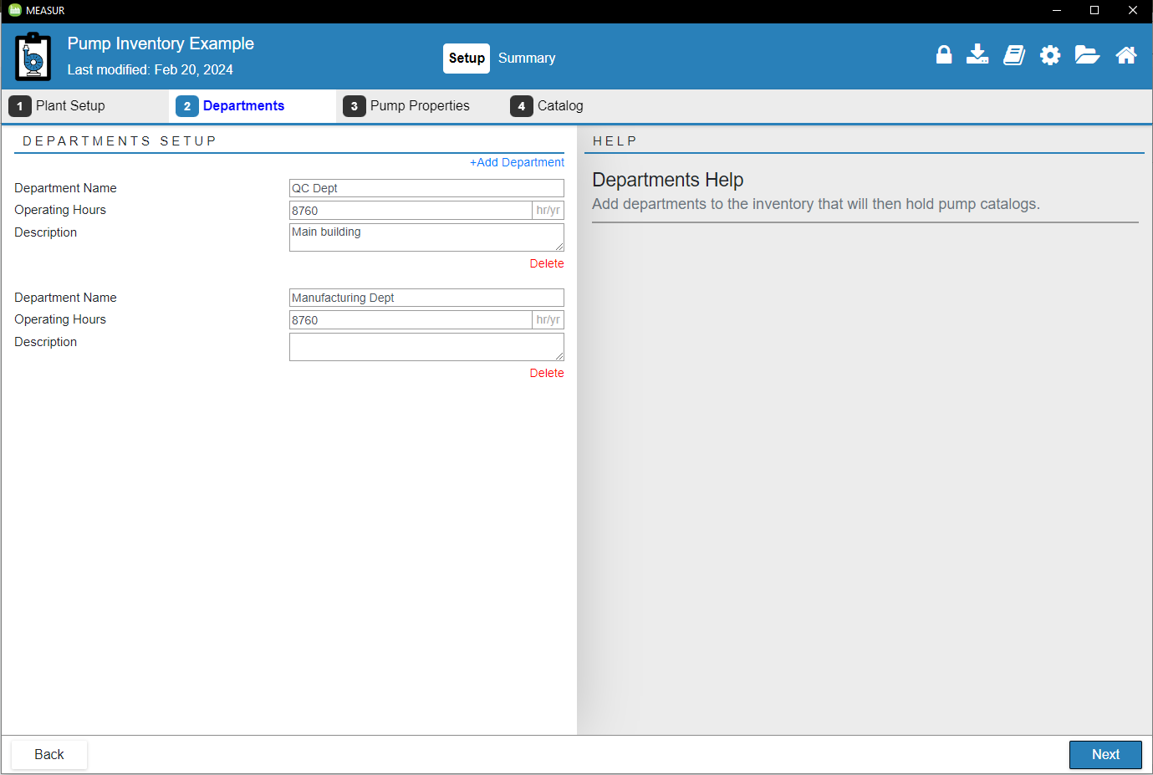
Example
Notes:
Select the department pump is located and operating hours.

Slide 48
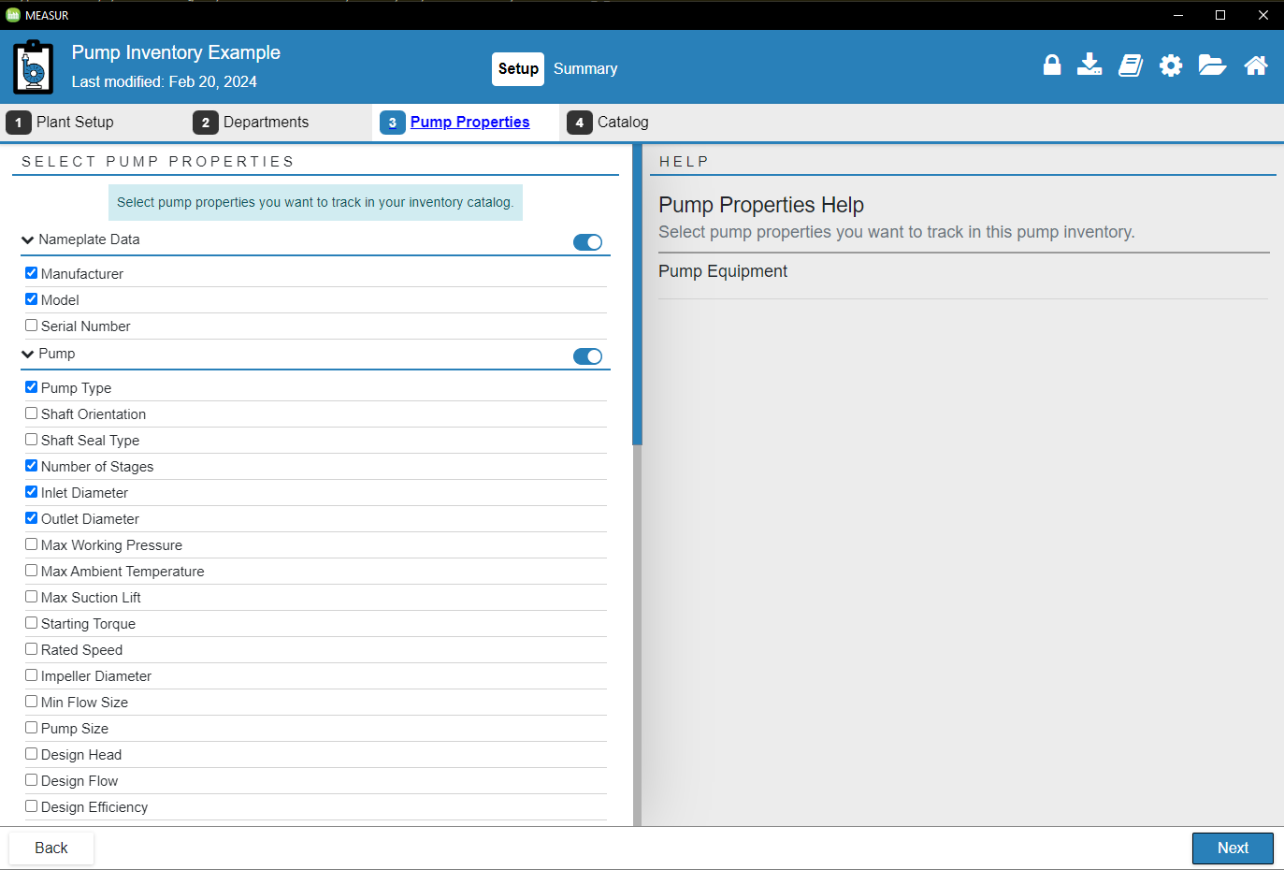
Example
Notes:
In pump properties, it gives you the options to select multiple parameters that are required in the next stage. You can select the variable you like to proceed to the next stage.

Slide 49
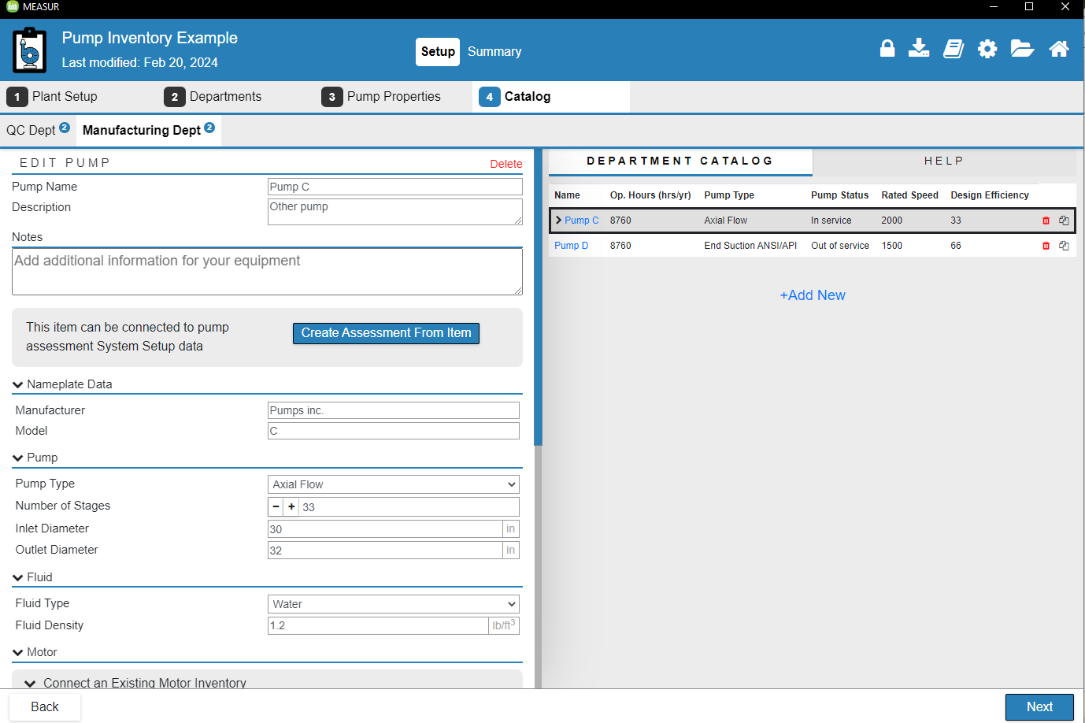
Example
Notes:
After selecting the parameters in pump properties, you can now enter the corresponding values to go to next step that generates the summary of the improvements.

Slide 50
Summary

Slide 51
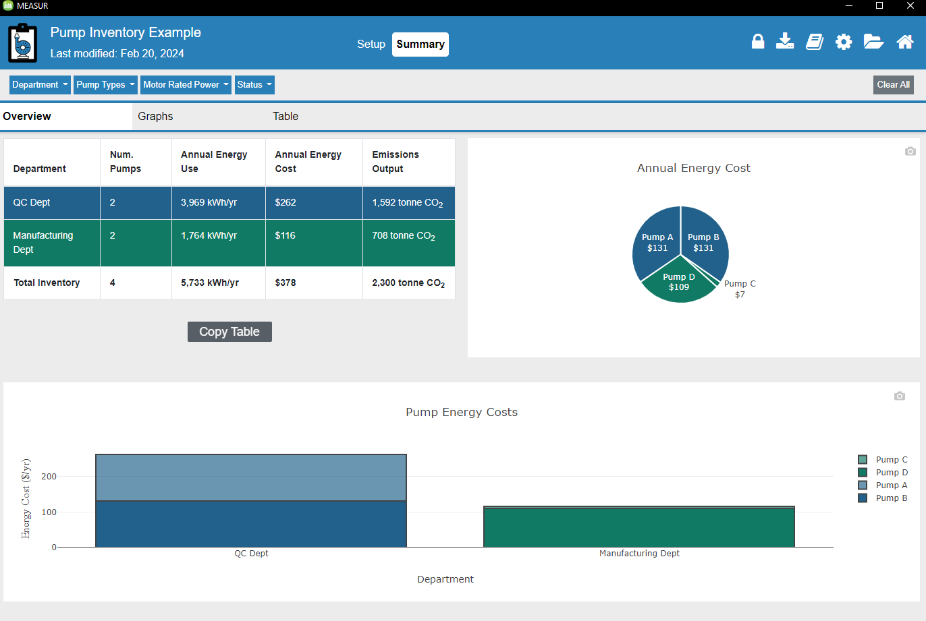
Summary of Pump Inventory
Notes:
The summary tab gives the summary of the total pump in use with their annual usage and cost with total CO2 emission.
Breaks down the cost and usage in charts and graphs of individual motor in each department.

Slide 52
References
https://www.energy.gov/eere/iedo/measur
For the Introduction to DOE's MEASUR tool suite:
U.S. Department of Energy, "Introduction to DOE's New Energy Assessment Tool Suite MEASUR," [Online]. Available: https://betterbuildingssolutioncenter.energy.gov/sites/default/files/slides/Introduction%20to%20DOE%27s%20New%20Energy%20Assessment%20Tool%20Suite%20MEASUR.pdf.
For the OSTI (Office of Scientific and Technical Information) reference:
Office of Scientific and Technical Information, "MEASUR," [Online]. Available: https://www.osti.gov/biblio/1856108.

Slide 53
Questions?

