Slide 1
Motor Inventory with MEASUR

Slide 2
Outline of the Presentation
Introduction to Motor Inventory
Motor Inventory in MEASUR Module
Navigating MEASUR
Finding Energy Savings in Motor System
Motor Inventory Reporting
Summary and Key Takeaways

Slide 3
Introduction to Motor Inventory

Slide 4
Introduction to Motor Inventory
Inventory Management Capabilities:
Allows users to create and maintain a detailed inventory of all motors within an organization.
Enables efficient tracking of motor assets, including location, condition, and ownership details.
Tracking Motor Data and Performance Metrics:
Collects and stores data related to motor performance, such as energy consumption, operating hours, efficiency ratings, etc.
Provides tools for analyzing this data to identify trends, assess performance, and make informed decisions.
Notes:
Facilitator Notes:
What is the The Motor Inventory Module? It is a specialized tool within the MEASUR platform designed to streamline the management of motor assets within an organization.
It provides a centralized database for storing comprehensive information about motors, including specifications, maintenance history, and performance data.

Slide 5
Motor Inventory in MEASUR

Slide 6
Motor Inventory in MEASUR
Notes:
Facilitator Notes:
Motor inventory module can be accessed by clicking on the icon highlighted in red.

Slide 7
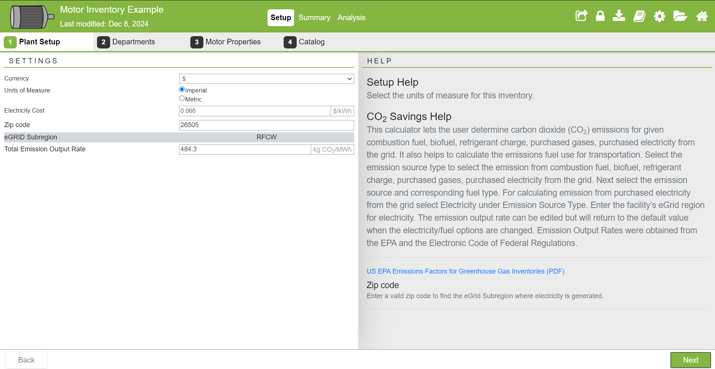
Interface
Notes:
Facilitator Notes:
Use the top banner to navigate around the module.
The system setup is where you enter the baseline data for your facility. The system setup is broken up into four tabs, each with a related set of input fields to be filled out. Field-by-field help text is provided for each input field, it will appear in the help panel when an input field is clicked on.
Plant Setup – Select the units of measure to be used for the inventory.
Departments – Setup departments that each motor will belong to.
Motor Properties – Chose which motor fields to include in your inventory catalog.
Catalog – Data entry area in which you add the motors and their properties for each department.

Slide 8
Setup
Notes:
Facilitator Notes:
Use the top banner to navigate around the module. A footer bar with “Next” and “Back” button can also be used to move through the Setup.
The system setup is where you enter the baseline data for your facility. The system setup is broken up into four tabs, each with a related set of input fields to be filled out. Field-by-field help text is provided for each input field, it will appear in the help panel when an input field is clicked on.

Slide 9
Setup- Departments
Notes:
Facilitator Notes:
Under Departments, create all departments where your motors are going to belong to. The department could be anything from designing and painting, toy molding, etc. You can also assign individual operating hours to each department.

Slide 10
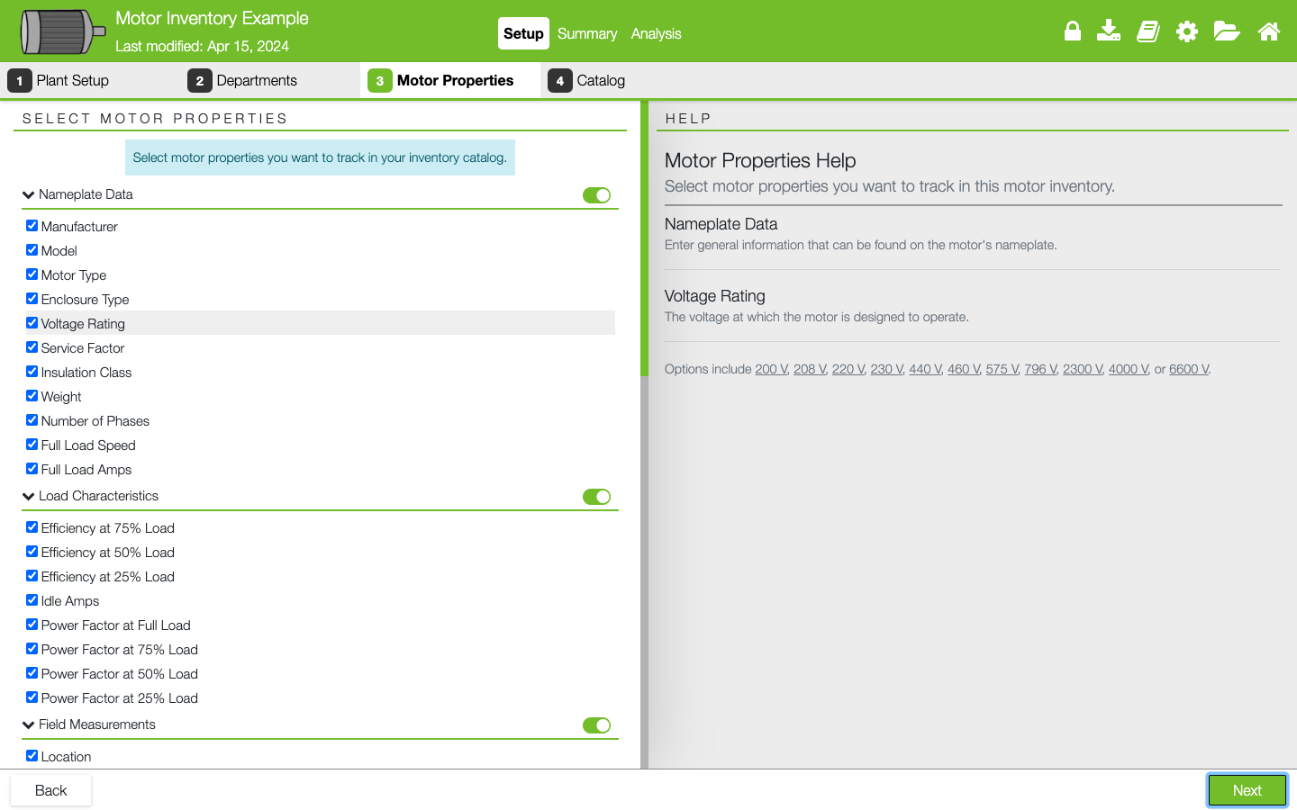
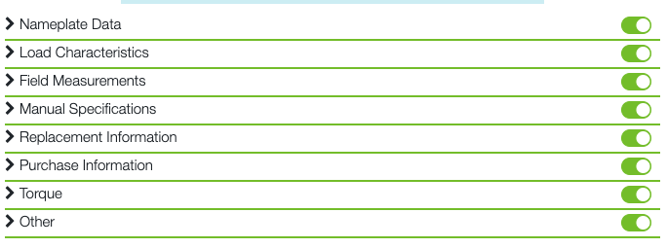
Setup- Motor Properties
Notes:
Facilitator Notes:
Select the motor properties you want to track in your inventory catalog. An exhaustive list of properties is provided and turned on by default.
Only a few are required for the catalog, and a few others are required for the Batch Analysis. Those required properties are indicated in the application.
Help text in the panel on the right will give a description of any property that is clicked on.
The properties are broken up into like sections, toggle entire sections on/off with the slider on the right side of the section label.

Slide 11
Setup- Nameplate
Notes:
Facilitator Notes:
Select the motor properties you want to track in your inventory catalog. An exhaustive list of properties is provided and turned on by default.
Only a few are required for the catalog, and a few others are required for the Batch Analysis. Those required properties are indicated in the application.
Help text in the panel on the right will give a description of any property that is clicked on.
The properties are broken up into like sections, toggle entire sections on/off with the slider on the right side of the section label.

Slide 12
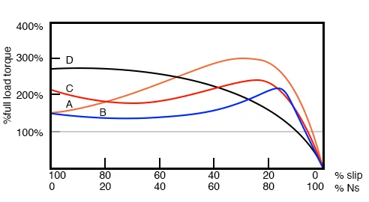
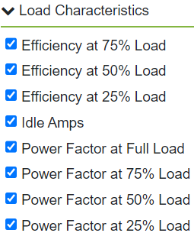
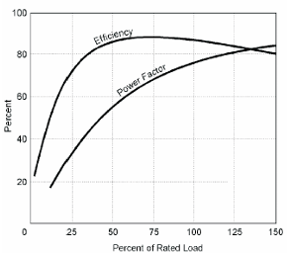
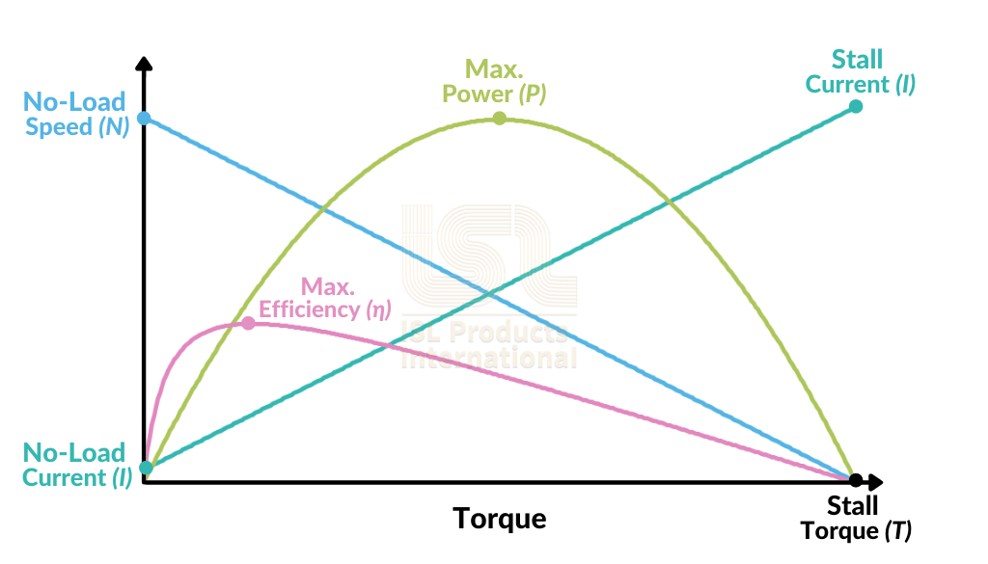
Setup- Load Characteristics
Notes:
Facilitator Notes:
Motor load characteristics describe how a motor behaves under various operating conditions. These characteristics are crucial for understanding the relationship between the motor's operating parameters (e.g., torque, speed, power, and efficiency) and the demands of the load it drives. They are key to selecting and operating motors efficiently and ensuring system reliability.

Slide 13
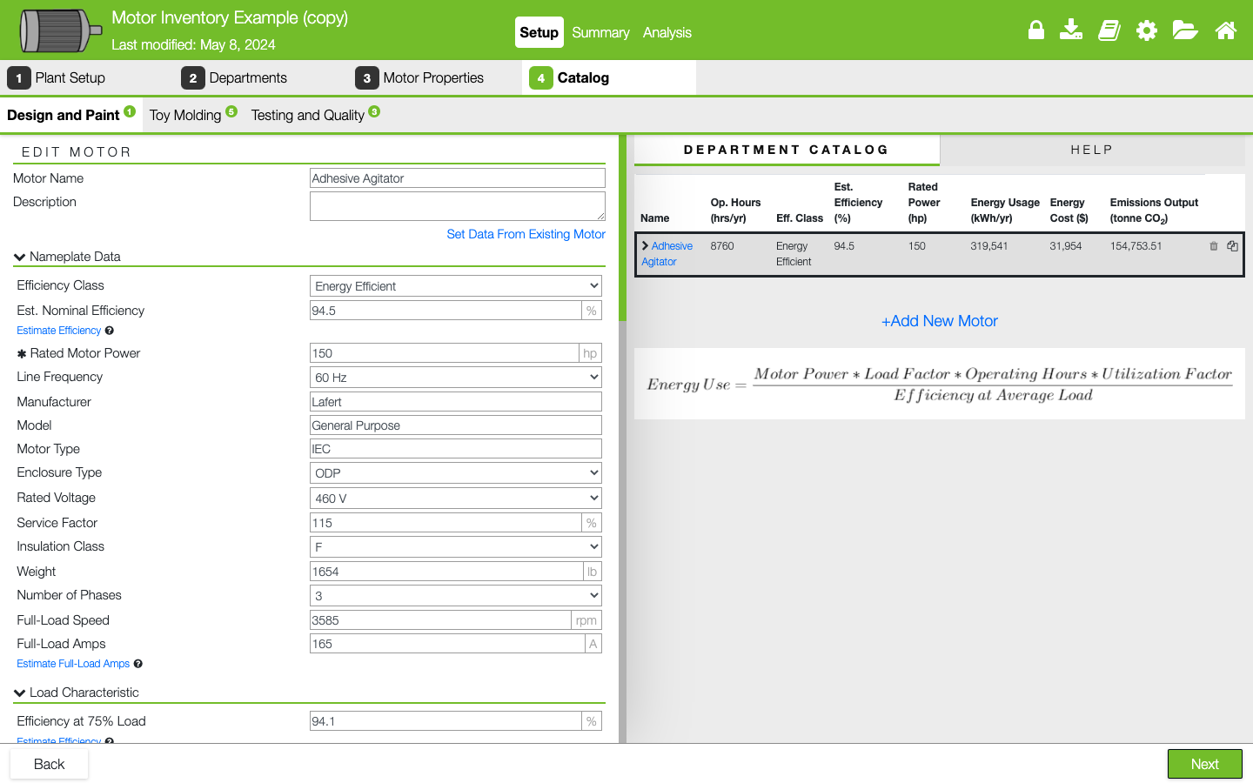
Setup- Catalog
Notes:
Facilitator note:
Catalog – Data entry area in which you add the motors and their properties for each department.
The “Catalog” is where you add and manage your motors. There will be a tab representing each department that is added in the “Departments” tab.
Other links will be provided underneath input labels that can be used to calculate field values.

Slide 14
Setup- Catalog
Notes:
Facilitator note: “Set Data From Existing Motor” will open a modal with a list of generic motors for you to choose from to fill out many of the input fields.

Slide 15
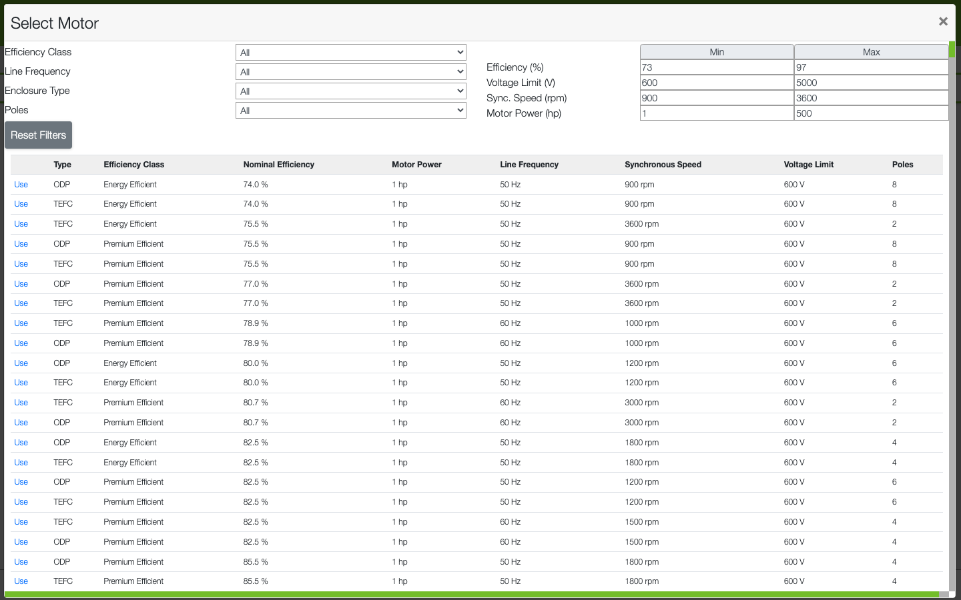
Existing Motor Dataset
Notes:
Facilitator note:
Able to select from a dataset of existing motors. Can filter for efficiency class, line frequency, enclosure type and poles.
The motors are also sorted by Efficiency %, Voltage limit, speed, and power.

Slide 16
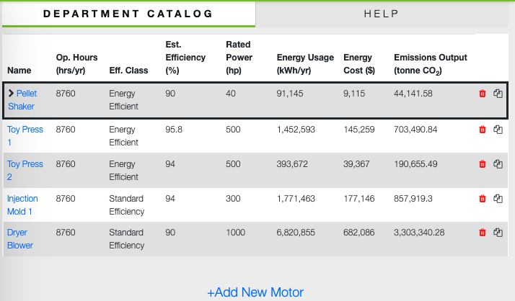
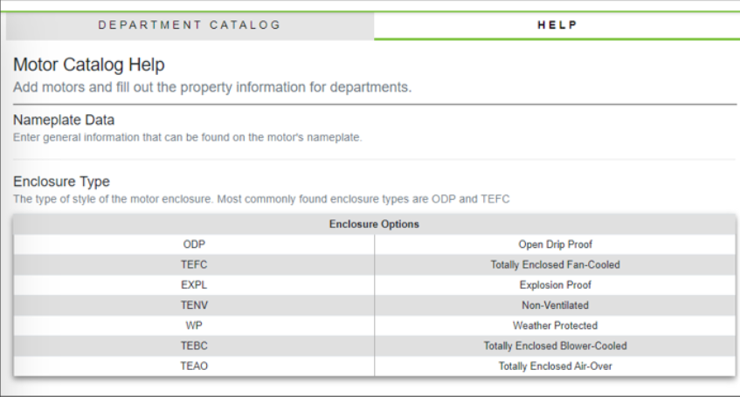
Setup- Catalog
Notes:
Facilitator note:
The right-hand panel has the “Department Catalog”, all the motors added to that department. Here you can add new motors, delete existing motors or select them to make changes.
Field by field help text is also found in the right-hand panel under the “Help” tab. As input fields are clicked the panel will update with corresponding help text.

Slide 17
Summary

Slide 18
Summary- Overview
Notes:
Facilitator note:
The summary provides a space to view all of your motors together. It provides table and graphical representations of the individual motors and department summaries.
Use the dropdown filters to adjust which motors are included in the summary.
Overview: Cost, energy use and emissions breakdowns of motors and departments.

Slide 19
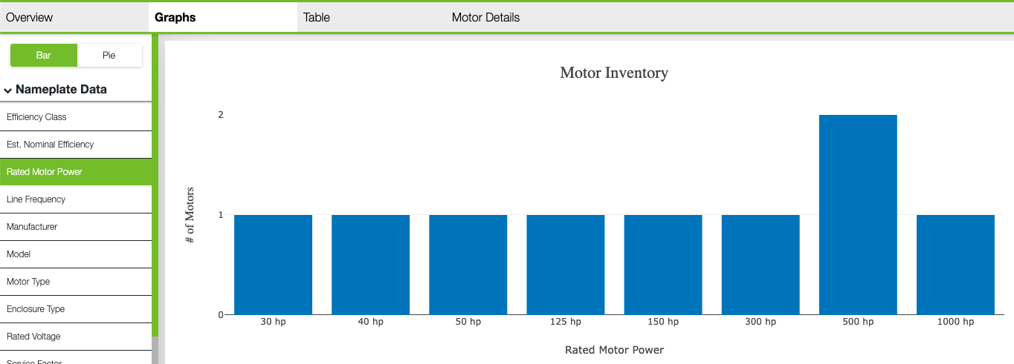
Summary- Graphs
Notes:
Facilitator note:
Graphs: Bar or pie charts representing the number of motors having each motor property.

Slide 20
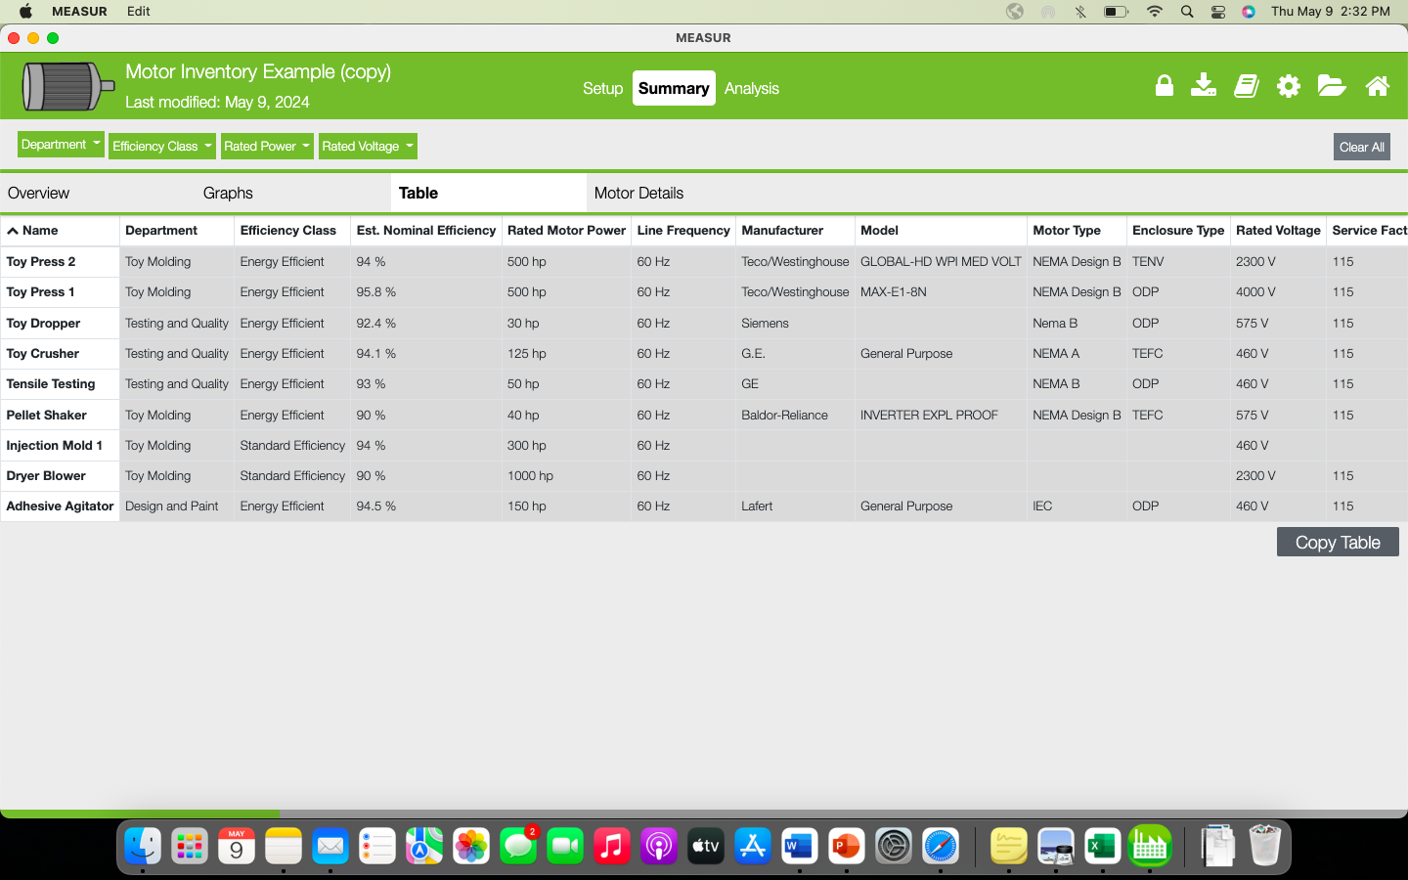
Summary- Table
Notes:
Facilitator note:
Table: A table that can be copied to clipboard with all the motors selected and their properties.

Slide 21
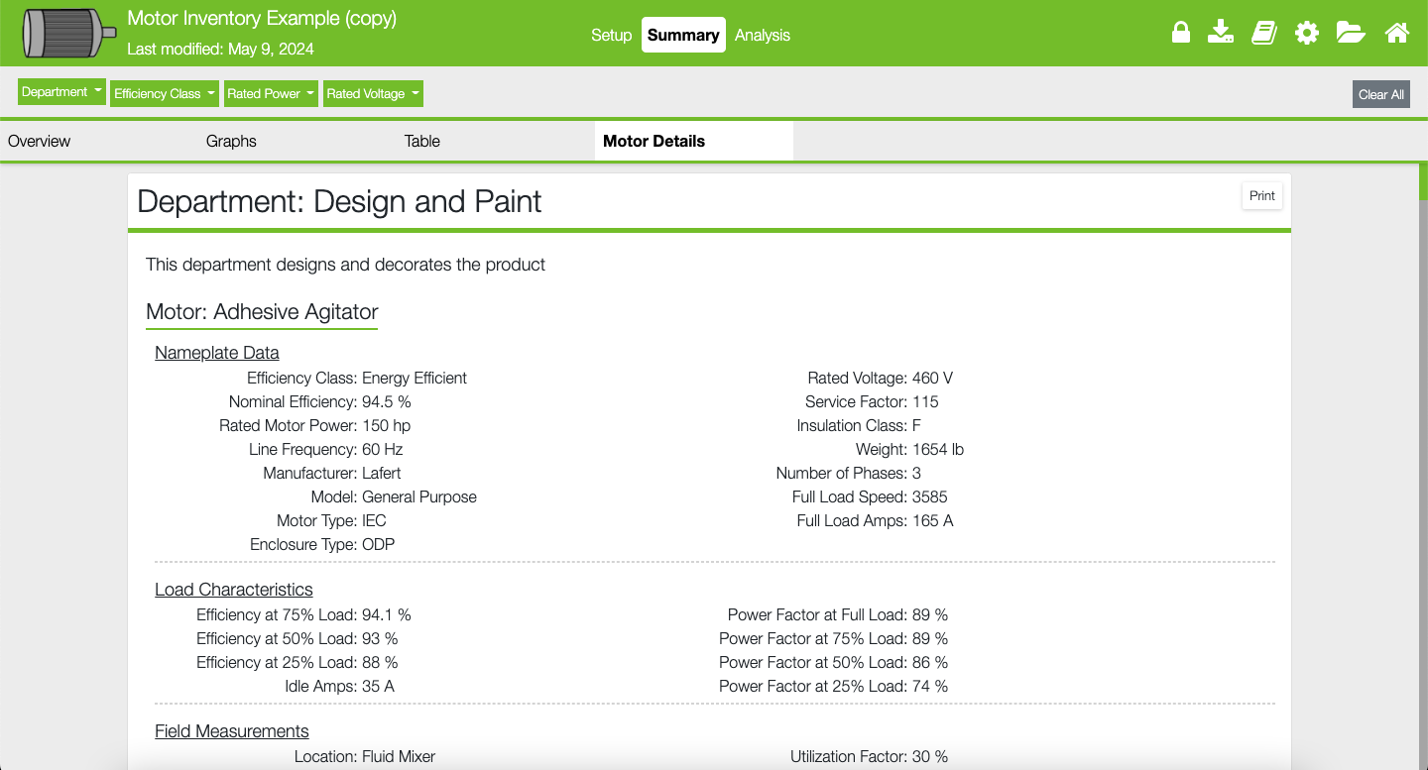
Summary- Motor Details
Notes:
Facilitator note:
Motor Details: A printable report with the details of each motor and their departments.

Slide 22
Analysis

Slide 23
Analysis- Table
Notes:
Facilitator note:
The analysis provides a simple batch analysis to help estimate the benefits of replacing or rewinding your motors. Use the same filters as the summary section to select which motors to include.
Toggle between table or graphical representations of the analysis on the left.
Choose the “Payback Threshold”, the number of years to determine replacing vs rewinding. Incomplete motors cannot be determined, use the toggle on the right to hide them in the analysis.

Slide 24
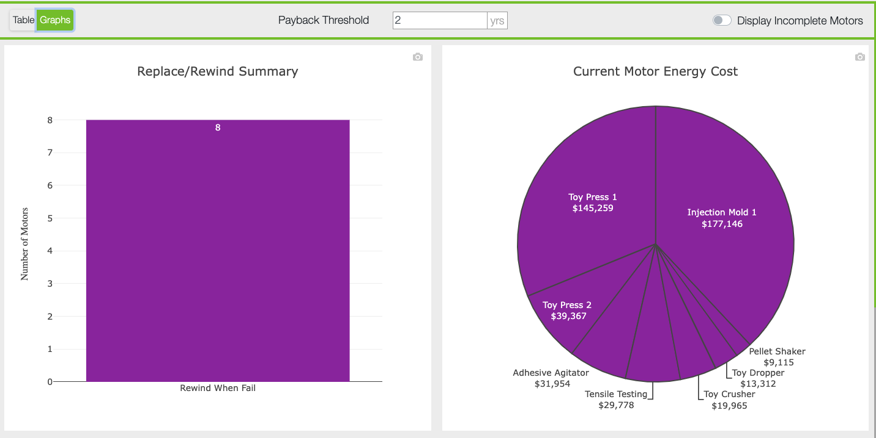
Analysis- Graphs
Notes:
Facilitator note:
All of the previous cost are shown in charts and graphs for easy interpretation.

Slide 25
Best Practices

Slide 26
Motor Inventory Best Practices
Comprehensive Data Collection:
Gather detailed information for each motor (specifications, maintenance records, etc.).
Maintain accurate and up-to-date records for informed decision-making.
Regular Inspections and Audits:
Conduct scheduled inspections to assess motor condition.
Identify potential issues early and ensure compliance with safety standards.
Notes:
Facilitator Notes:
What is the The Motor Inventory Module? It is a specialized tool within the MEASUR platform designed to streamline the management of motor assets within an organization.
It provides a centralized database for storing comprehensive information about motors, including specifications, maintenance history, and performance data.

Slide 27
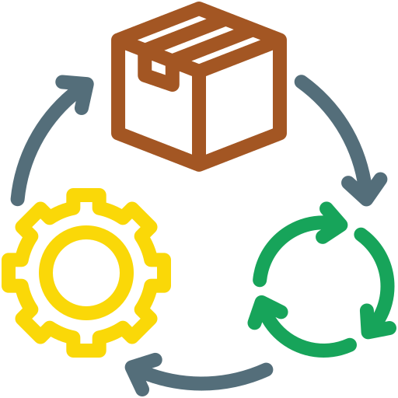
Motor Inventory Best Practices
Asset Tagging and Tracking:
Implement a unique identification system for each motor.
Use barcode labels or RFID tags for efficient tracking and management.
Lifecycle Management:
Develop a comprehensive strategy covering procurement to disposal.
Align maintenance activities with manufacturer specifications for optimal performance
Notes:
Facilitator’s note: Asset tagging and tracking, along with lifecycle management, are essential strategies for effective motor management. By implementing a unique identification system for each motor, such as barcode labels or RFID tags, organizations can achieve efficient tracking and streamlined management of their assets. This allows for better monitoring, quick identification, and improved inventory control. On the other hand, lifecycle management involves developing a comprehensive strategy that spans the entire lifecycle of a motor, from procurement to disposal. Aligning maintenance activities with manufacturer specifications ensures optimal performance, prolongs the motor's lifespan, and minimizes downtime. Together, these practices provide a structured approach to enhance operational efficiency and reduce overall costs.

Slide 28
Conclusion
1. The Motor Inventory Module organizes motor assets to identify underperforming units and prioritize upgrades.
2. It evaluates motor energy performance, highlighting opportunities for efficiency improvements and savings.
3. The module aids in cost-benefit analysis, calculating savings and ROI for energy-efficient motor upgrades.
4. It supports energy reduction goals and sustainability compliance through proactive motor management.
Notes:
Facilitator’s note: The Motor Inventory Module is a powerful tool for optimizing motor management and driving energy efficiency. By organizing motor assets, it identifies underperforming units and prioritizes upgrades, ensuring resources are allocated effectively. Its ability to evaluate motor energy performance highlights key opportunities for efficiency improvements and cost savings. Additionally, the module facilitates informed decision-making through detailed cost-benefit analysis, including savings and ROI calculations for energy-efficient upgrades. Ultimately, it supports organizations in achieving energy reduction goals and sustainability compliance, promoting proactive motor management and long-term operational success.

Slide 29
References
https://measur.ornl.gov/assets/user-manuals/MEASUR-User-Manual.pdf
https://energyefficiency.ornl.gov/wp-content/uploads/2023/03/FMJ.Mar-Apr-2023.MEASUR-UP.pdf

Slide 30
Questions?

