Slide 1
MEASUR Training Module Summary
Notes:
Welcome to the summary module of MEASUR, the Manufacturing Energy Assessment Software for Utility Reduction. This module provides an overview of everything MEASUR has to offer. In this summary, we’ll explore the scope of MEASUR, its various modules, and the key features that make it an essential tool for energy managers, engineers, and consultants. We’ll also touch on how MEASUR enables users to compare baseline performance with energy-efficient alternatives, generate detailed reports, and visualize savings through intuitive charts and diagrams.
Whether you’re a beginner exploring energy efficiency or an industry specialist looking for advanced tools, MEASUR is accessible to everyone. Let’s dive in and see how MEASUR can help you achieve your energy and sustainability goals!

Slide 2
MEASUR At a Glance
Comprehensive Energy Assessment Tool
Modular Design for Targeted Analysis
Baseline vs. Energy-Saving Alternatives
User-Friendly Interface for All Levels
Insightful Reports and Visualizations
Notes:
MEASUR is a versatile tool designed to optimize energy systems in industrial and commercial facilities.
Modules include Fans, Compressed Air, Motors, Process Heating, Steam, Pumps, Wastewater, and Treasure Hunts.
Each module focuses on specific systems, providing tailored recommendations for energy efficiency.
MEASUR allows users to compare baseline scenarios with energy-saving alternatives to identify the most cost-effective solutions.
Offers simple setups for beginners, advanced configurations for industry specialists, and suitable for engineers, energy managers, and anyone interested in energy efficiency.
Generates detailed reports, including energy savings, cost reductions, and CO₂ emissions avoided, visualizes savings through intuitive charts and diagrams for better decision-making.

Slide 3
Scope of MEASUR
Target Users: Energy managers, auditors, facility engineers. Includes intuitive interfaces for professionals with varying levels of technical expertise.
Applications: Industrial systems across manufacturing, wastewater, and energy-intensive sectors.
Food Processing
Industry
Mining and Extraction
Commercial Facilities
Public Infrastructure
Energy Intensive Sectors
Notes:
Manufacturing: Includes industries like automotive, food processing, and steel plants, where MEASUR helps optimize systems such as pumps, compressed air, and process heating to reduce energy consumption and costs.
Mining and Extraction: Energy savings in process heating, pumps, and compressors. Efficiency improvements in material transport systems, ventilation, and process water pumping.
Commercial and Institutional Buildings: Supports energy optimization in HVAC, lighting, and steam systems for hospitals, universities, and government buildings.
Public Infrastructure: Reducing energy in pumping and filtration systems. Energy-efficient aeration, pumping, and UV disinfection.
Energy-Intensive Sectors: Focuses on industries like chemical and paper manufacturing to improve energy efficiency in high-demand systems such as steam generation, fans, and process heating.

Slide 4
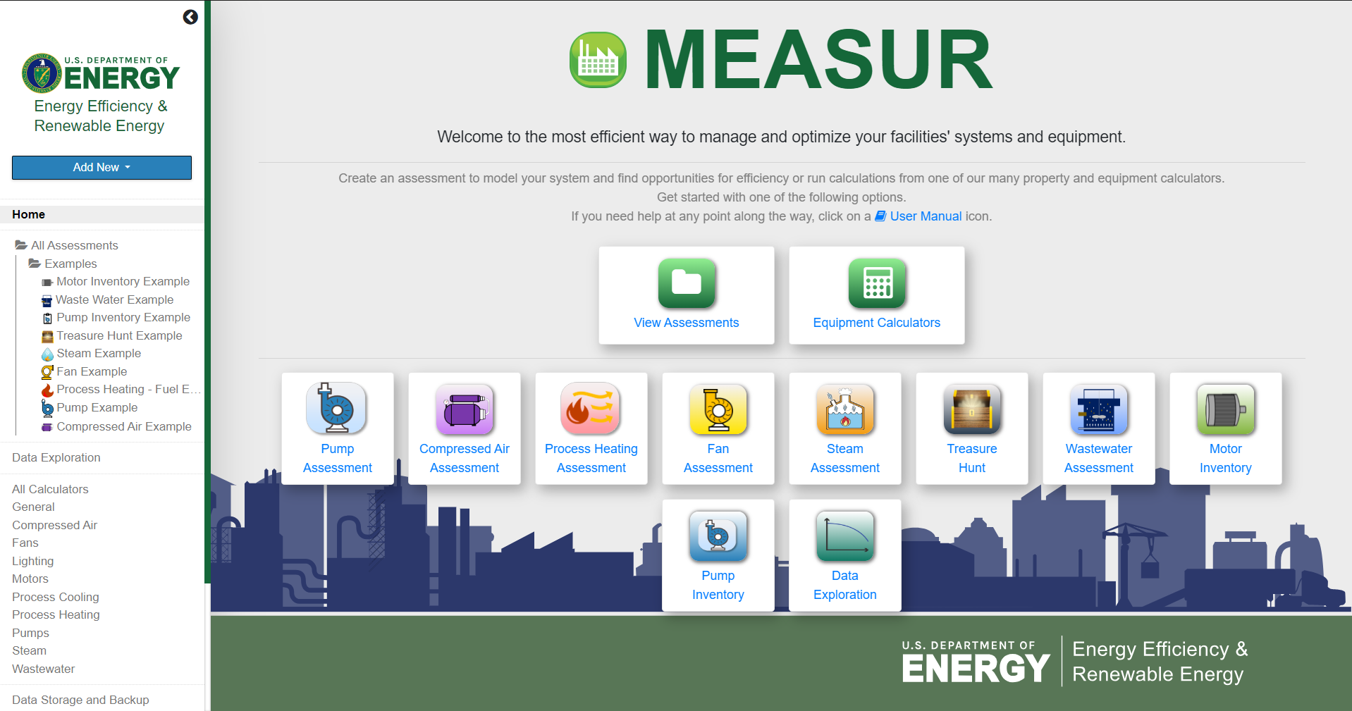
MEASUR Dashboard
Notes:
MEASUR can be used in a variety of ways of analyze and optimize your facilities’ energy performance. You can conduct assessments of systems, track equipment inventory, and do quick calculations with over 70 different calculators. The dashboard is where all of those possibilities come together!

Slide 5
Key Takeaways
Wide Applicability Across Industries
Tailored Energy Solutions
Informed Decision-Making
Quantifiable Benefits
Proven Tool for Energy Savings
Flexible for Future Energy Goals
"Start using MEASUR today to achieve energy savings, reduce costs, and contribute to a sustainable future!"
Notes:
MEASUR supports energy optimization in manufacturing, wastewater treatment, commercial buildings, and energy-intensive sectors.
The modular design helps analyze specific systems (e.g., fans, compressors, motors) and identify actionable improvements.
Compare baseline performance with energy-saving measures to choose the best solutions, visual tools (charts and diagrams) simplify complex data, making insights easy to interpret.
Provides reports with detailed energy savings, cost reductions, and environmental impacts (e.g., CO₂ emissions avoided).
Helps organizations align with sustainability goals while reducing operational costs.
MEASUR has enabled facilities to save energy, reduce carbon footprints, and improve system reliability.
MEASUR adapts to evolving energy standards, ensuring it remains a relevant tool for efficiency improvements.

Slide 6
Questions?

