Slide 1
Process Heating Assessment with MEASUR

Slide 2
Outline of the Presentation
Introduction to Industrial Systems
Introduction to MEASUR Module
Navigating MEASUR- Process Heating
Enhancing System Efficiency: Best Practices
Applying Efficiency Recommendations in MEASUR
MEASUR Report Analysis
Summary and Key Takeaways

Slide 3
Introduction to Industrial Systems:
Process Heating

Slide 4
Introduction to Process Heating
Definition
Process heating encompasses all operations where heat is used in manufacturing processes. It involves the transfer of heat to a material to achieve a desired temperature necessary for a manufacturing process.
Importance in Industry
Critical for operations such as melting, drying, preheating, and curing . It represents a significant portion of industrial energy demand.
Notes:
Facilitator’s note: Process heating refers to the use of heat in manufacturing operations to achieve specific temperatures required for various processes. It involves the transfer of heat to materials to facilitate critical functions such as melting, drying, preheating, and curing. This process is vital across numerous industries, as it enables the production of high-quality goods and supports a wide range of manufacturing activities. Process heating also accounts for a significant portion of industrial energy demand, making it a critical focus area for improving energy efficiency and reducing operational costs in industrial facilities.

Slide 5
Introduction to Process Heating
Common Equipments
Includes boilers, furnaces, ovens, kilns, and heaters. It utilizes a variety of energy sources like electricity, natural gas, and fuel oils.
Energy Efficiency Focus
Optimizing process heating is key for energy conservation and cost savings. This involves improving equipment efficiency, process control, and heat recovery.
Notes:
Facilitator’s note: Process heating relies on a range of common equipment, including boilers, furnaces, ovens, kilns, and heaters. These systems utilize various energy sources, such as electricity, natural gas, and fuel oils, to meet the heating requirements of industrial processes.
Optimizing process heating systems is crucial for energy conservation and cost savings. Improving equipment efficiency, enhancing process control, and implementing heat recovery strategies are key measures to reduce energy consumption and improve overall performance. By focusing on energy efficiency, industries can lower operational costs, decrease environmental impact, and meet sustainability goals.

Slide 6
Introduction to MEASUR Module

Slide 7
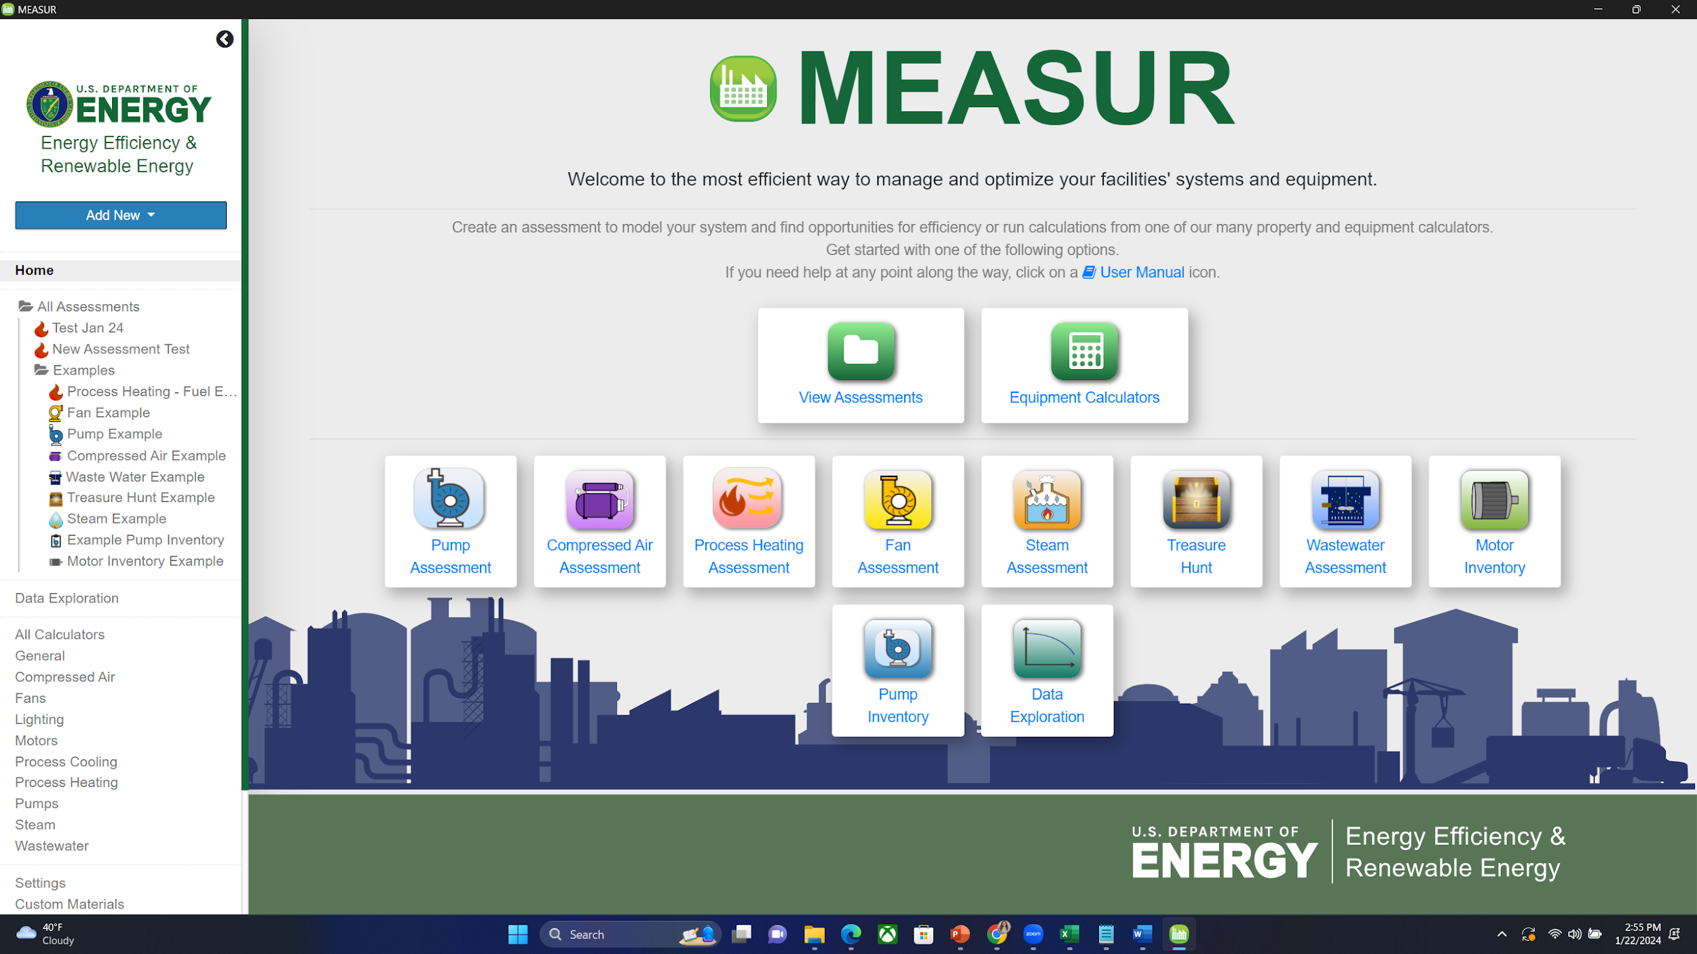
Introduction to MEASUR Module
Notes:
MEASUR can be used in a variety of ways of analyze and optimize your facilities’ energy performance. You can conduct assessments of systems and do quick calculations with over 70 different calculators. The dashboard is where all of those possibilities come together! Process heating can be accessed by clicking on the icon highlighted in red.

Slide 8
Introduction to Process Heating Module

Slide 9
Introduction to Process Heating Module
Efficiency Enhancements
1. Focused on improving thermal and electrical efficiency in process heating equipment.
2. Tailored methods for optimizing energy consumption in industrial settings.
Equipment Surveying
1. Enabling industrial users to audit and monitor fuel or electricity consumption.
2. Identifying the most energy-intensive equipment within process heating systems.
Notes:
Facilitator’s note: Enhancing the efficiency of process heating systems is a key focus in industrial operations. This involves improving both thermal and electrical efficiency in process heating equipment, ensuring optimized energy consumption tailored to the specific needs of industrial settings. By adopting advanced methods and technologies, industries can achieve significant energy savings while maintaining or improving operational performance.
In addition, equipment surveying plays a crucial role in effective energy management. By enabling industrial users to audit and monitor fuel or electricity consumption, it helps identify the most energy-intensive equipment within process heating systems. This targeted approach provides valuable insights for prioritizing efficiency upgrades and optimizing overall energy use, contributing to reduced costs and enhanced sustainability.

Slide 10
Introduction to Process Heating Module
Heat Balance Analysis
1. Performing comprehensive heat balance to map energy usage across operations.
2. Pinpointing major areas of energy expenditure under various operating conditions.
What-If Scenarios
1. Testing hypothetical changes and their impacts on energy use.
2. Exploring different strategies for potential reduction in energy consumption
Notes:
Facilitator’s note:
A heat balance analysis is an essential tool for understanding energy usage in process heating systems. By performing a comprehensive heat balance, industries can map energy flow across operations and identify major areas of energy expenditure under various operating conditions. This analysis provides a clear picture of where energy is being used most intensively, enabling targeted interventions to improve efficiency.
Complementing this is the use of what-if scenarios, which allow users to test hypothetical changes and evaluate their impacts on energy use. By exploring different strategies, industries can assess the potential for energy consumption reductions, optimize processes, and make data-driven decisions for efficiency improvements. Together, these tools are invaluable for maximizing energy savings and operational performance in process heating systems.

Slide 11
Navigating MEASUR

Slide 12
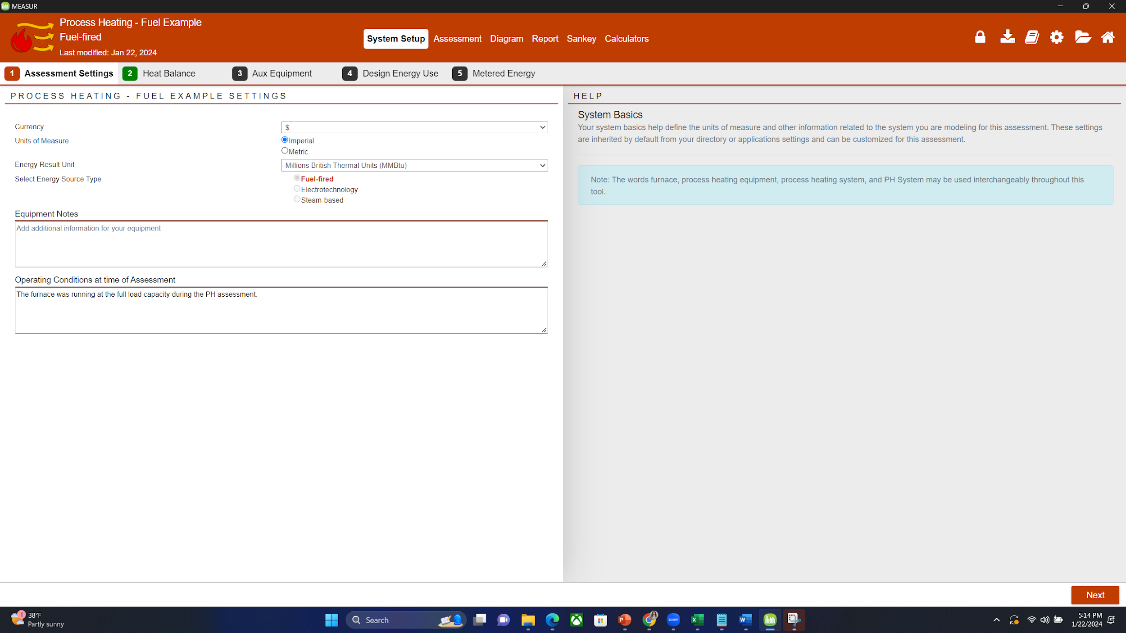
Process Heating
Notes:
Start page of the process heating module. Use the top banner to navigate around the module. A footer bar with “Next” and “Back” button can also be used to move through the System Setup to the Report. Main Tabs consists of System Setup ,Assessment ,Diagram ,Report ,Sankey.

Slide 13
Main Tabs
Table 1: Main Tabs in MEASUR's Process Heating Assessments
Main Tab | Explanation
System Setup | Input baseline data for your system, divided into sub-tabs for detailed entry.
Assessment | Modify system scenarios to explore potential savings; options for novice and expert views.
Diagram | View graphical visualization of the current and modified systems.
Report | Access a full breakdown of the system, savings scenarios, and generate printable reports.
Sankey | See a visual representation of energy consumption and production for different scenarios.
Calculators | Use standalone calculators for additional process heating calculations.
Notes:
Some tabs may be disabled until the System Setup is completed.

Slide 14
Additional Buttons
Button | Explanation
Book | Opens the full Process Heating User Manual in a new window.
Gear | Navigates to the global settings page of MEASUR.
Folder | Takes you to the assessment dashboard for the current assessment.
Home | Brings you to the MEASUR home page.
Next/Back | Found in the footer, these buttons allow navigation through the System Setup to the Report sections.
Notes:
Facilitator’s note: Buttons in the Process Heating Module:
Book: Opens the full Process Heating User Manual in a new window, providing detailed guidance and information about using the module effectively.
Gear: Navigates to the global settings page of MEASUR, allowing users to customize and configure system-wide settings.
Folder: Takes users to the assessment dashboard for the current assessment, offering quick access to ongoing or saved evaluations.
Home: Brings users back to the MEASUR home page, serving as a central navigation point.
Next/Back: Found in the footer, these buttons facilitate step-by-step navigation through the module, enabling users to move smoothly from the System Setup phase to the Report section.

Slide 15
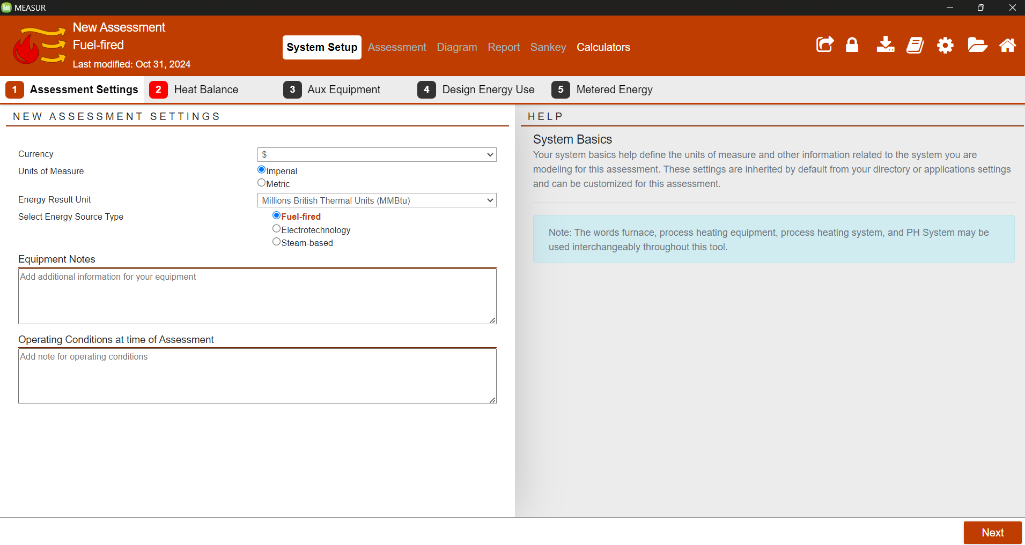
System Setup
Notes:
Start System Setup by providing the properties of your current system or "baseline"! After you've established your baseline, conduct an Assessment by modifying the conditions of your system to view the potential savings!
The first step is the assessment setting where you enter the currency and unit of measurement either in imperial and metric units and the energy source type. After this, click next to go to the heat balance section.
The system setup section consists of five sub-categories: assessment setting, heat balance, Aux Equipment, Design Energy Use, Metered Energy
If you need help at any point along the way, click the user manual (book) icon in the upper right hand corner for detailed instructions on how to complete the process heating assessment!

Slide 16
Navigation
Table 3: System Setup Sections
Setup Section | Description
Assessment Settings | Choose units for the assessment.
Heat Balance | Input data related to heating losses.
Aux Equipment | Enter details for Auxiliary Equipment.
Design Energy Use | Define design specs for comparison.
Metered Energy | Record actual performance data for comparison.
Notes:
Navigate using the second bar in the Setup.
Tabs indicate the data status through color coding.
Green- Valid data entered.
Red- Invalid or missing data.
Yellow- Data entered is outside expected range.
Grey- Disabled tab, preceding data is incomplete.

Slide 17
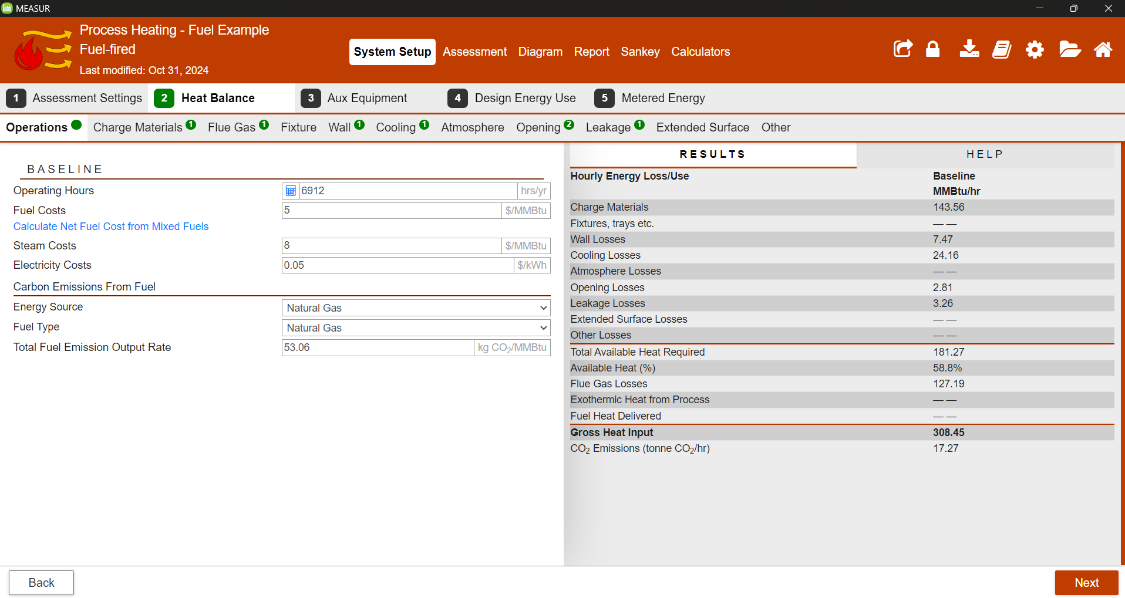
Heat Balance
Notes:
A third set of tabs will appear for heat balance. Each tab corresponds to a loss calculator that are used to add different losses corresponding to the process heating system. The badges will indicate how many losses are entered for each calculator type. They will be three different colors
Green: Valid loss data entered
Red: Invalid loss data entered, needs to be fixed
Orange: Data entered is outside of an expected range

Slide 18
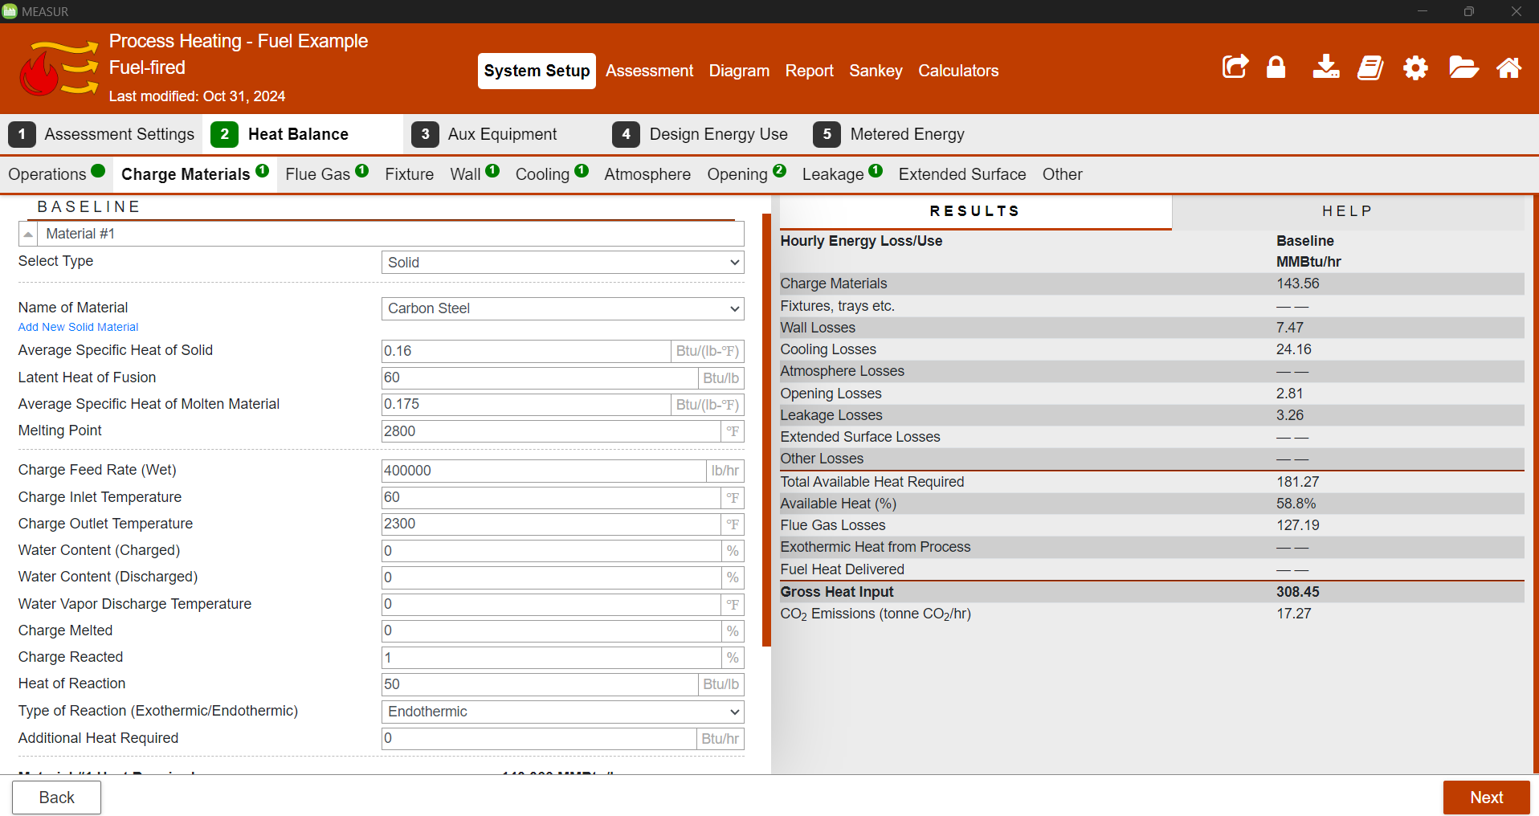
Heat Balance- Data Entry
Notes:
Enter data into the left panel, Click “+Add” to include new losses.
Select from the database for known substance losses
Blue links beneath inputs provide calculations or database additions.
Red alerts indicate unacceptable data ranges.
Loss values are totaled under their calculators.
Inputs outside expected ranges are highlighted yellow.

Slide 19
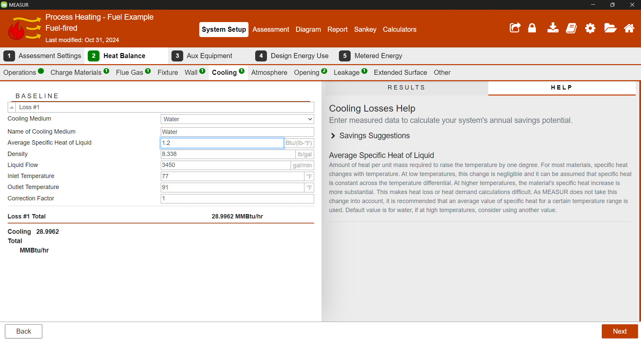
Parameter Information
Notes:
Insert different parameter values to conduct a comprehensive analysis.
To learn about a specific parameter, select it and then choose “HELP” from the right panel.
Definitions and extensive information for the selected parameter will be displayed.
As an example, selecting “average specific heat of liquid” will reveal detailed information on this parameter.

Slide 20
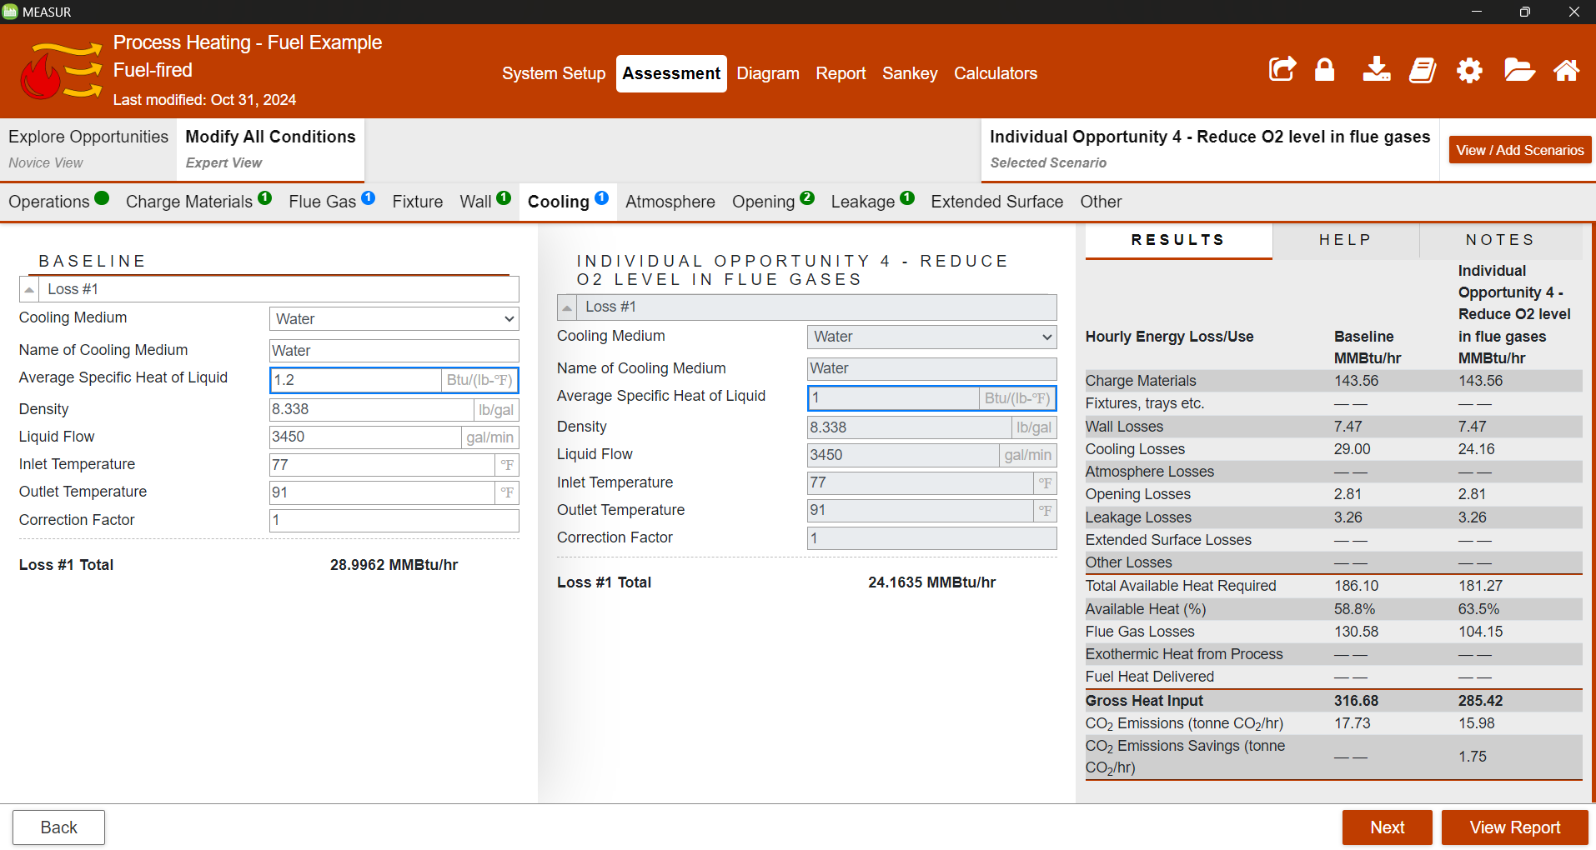
Assessment
Notes:
The assessment section of the module allows to explore how modification scenarios for the system may provide cost, energy and emissions savings. Your baseline must be setup completely prior to making modifications.
There are two ways to conduct assessments which will be explained in further detail later in this section: Explore Opportunities (Novice View) and Modify All Conditions (Expert View)

Slide 21
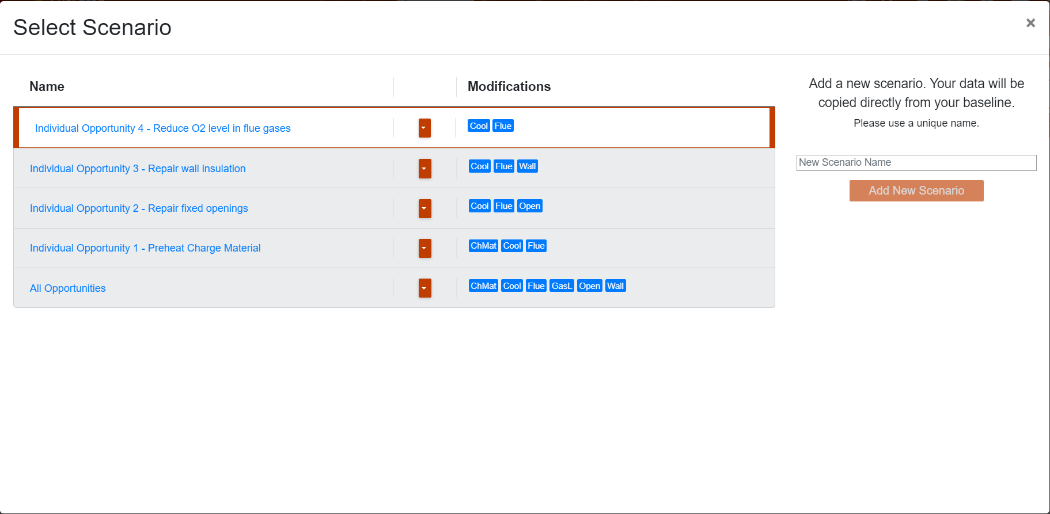
Scenario Added
Notes:
Navigate the assessment options using the secondary tabs, similar to System Setup.
Manage multiple scenarios; the active scenario is shown on the right.
Use the “View / Add Scenarios” button to access the scenario management model. The model can be used to:
Create new scenarios
Create copies of existing scenarios
Delete or rename scenarios
Selecting scenarios for viewing and modifying

Slide 22
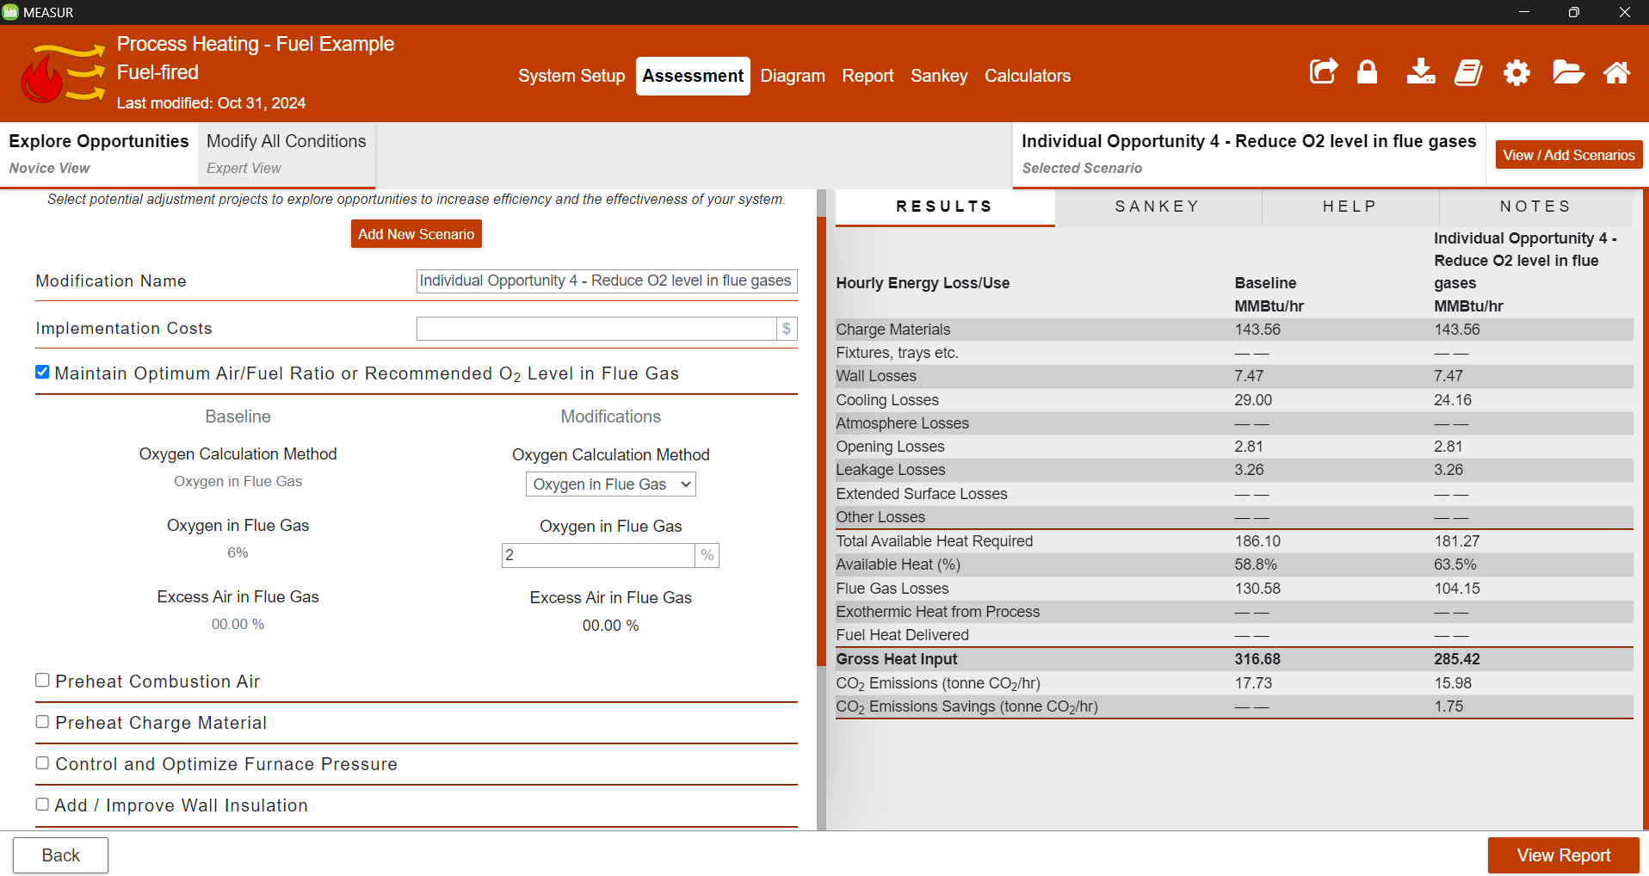
Explore Opportunities (Novice View)
Notes:
Explore Opportunities" offers minimal data entry to identify savings, with a split-screen layout.
The left side presents a checklist for potential system improvements.
On the right, results, a sankey diagram, and detailed help text are displayed.
Checklist items allow for scenario adjustments, alongside baseline data on the left.

Slide 23
Explore Opportunities (Novice View)
Notes:
Results" tab displays savings from scenario changes.
"Sankey" tab visualizes energy flow for baseline or modifications.
Click input fields to view help text in the "Help" panel.
"Notes" section allows for annotations on scenarios for the report.

Slide 24
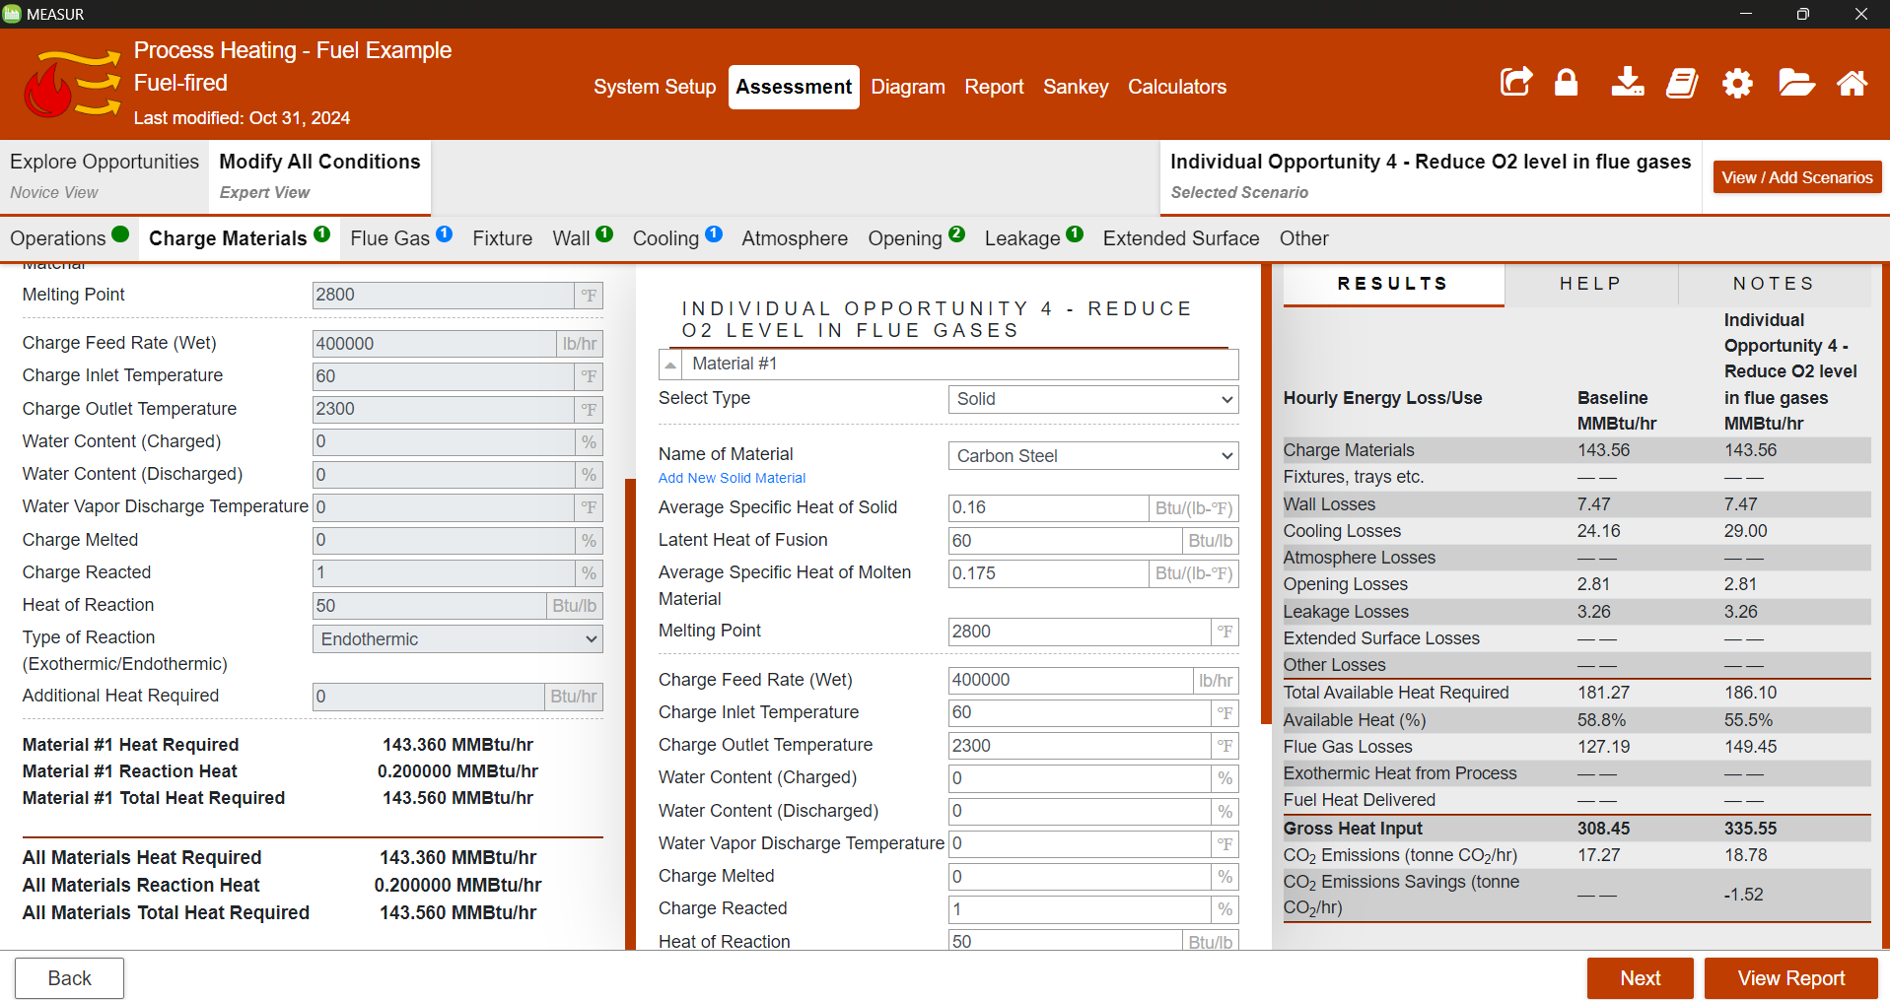
Modify All Conditions (Expert View)
Notes:
"Modify All Conditions" provides full control over system settings from System Setup for precise baseline modifications.
Can be modified for individual opportunities (In this case, we’ve applied changes for Oxygen level in flue gases)
Tabs mirror System Setup, with color-coded dots indicating changes:
Green: Matches baseline
Blue: Altered from baseline
Red: Invalid data present
Orange: Valid but outside expected range

Slide 25
A Quick Demonstration

Slide 26
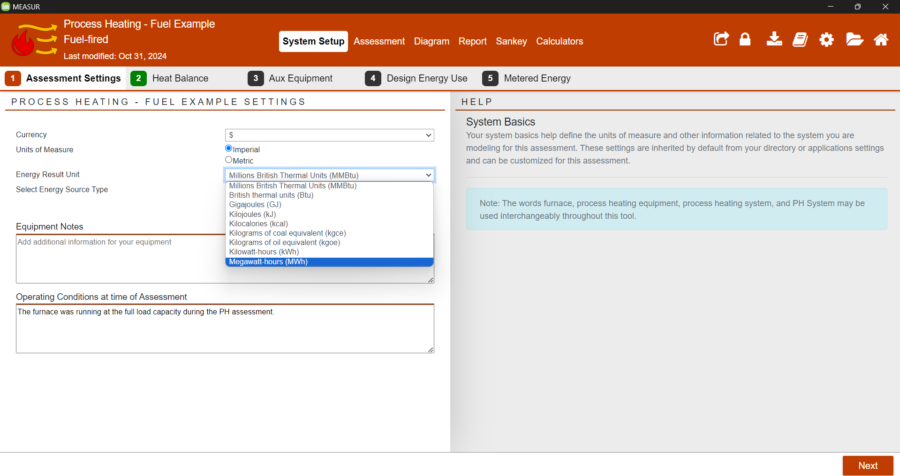
1. System Setup- Assessment Settings
Notes:
Select Currency, Unit of Measurement, Energy Result Unit (Btu, Kilojoules, kWh, MWh, etc.) and Type of Electrical Furnace

Slide 27
2. System Setup- Heat Balance
Notes:
In this tab, you will enter information about operations (operation hours, gas cost, electricity cost, coal cost, electrode and other fuel cost), carbon emissions from fuel and electricity.

Slide 28
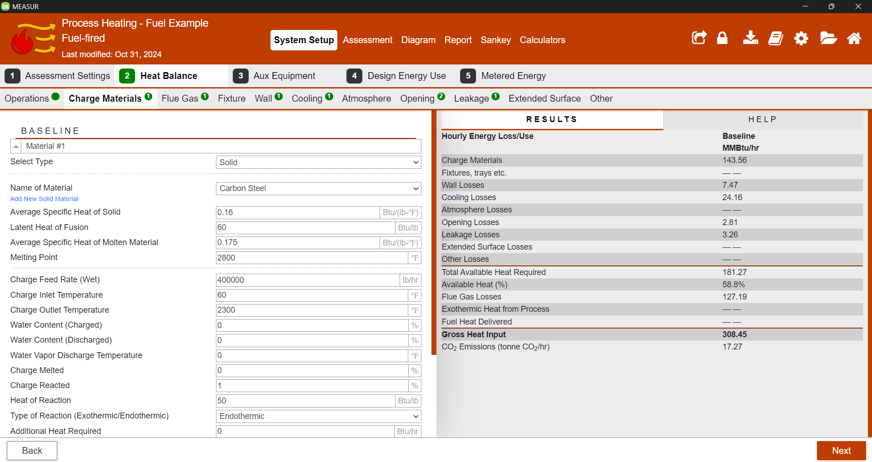
3. System Setup- Heat Balance
Notes:
In this tab, you will enter information about thermal properties of charge material, information about feed rate, inlet temperature, method, etc. You can see the heat requirement which is calculated instantly.

Slide 29
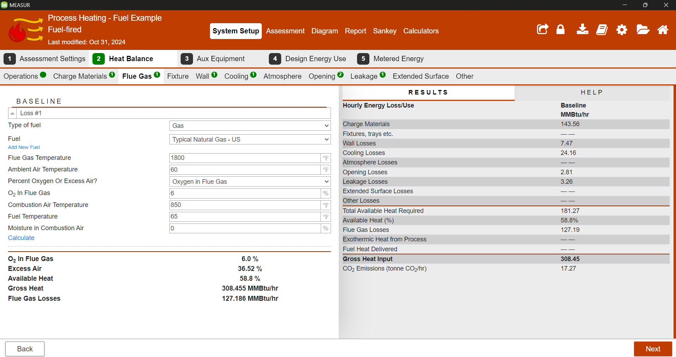
4. System Setup- Heat Balance
Notes:
In this tab, you will enter information about flue gas leaving the system which includes type of fuel, flue gas temperature, ambient air temperature, % excess air, combustion temperature, fuel temperature and moisture.

Slide 30
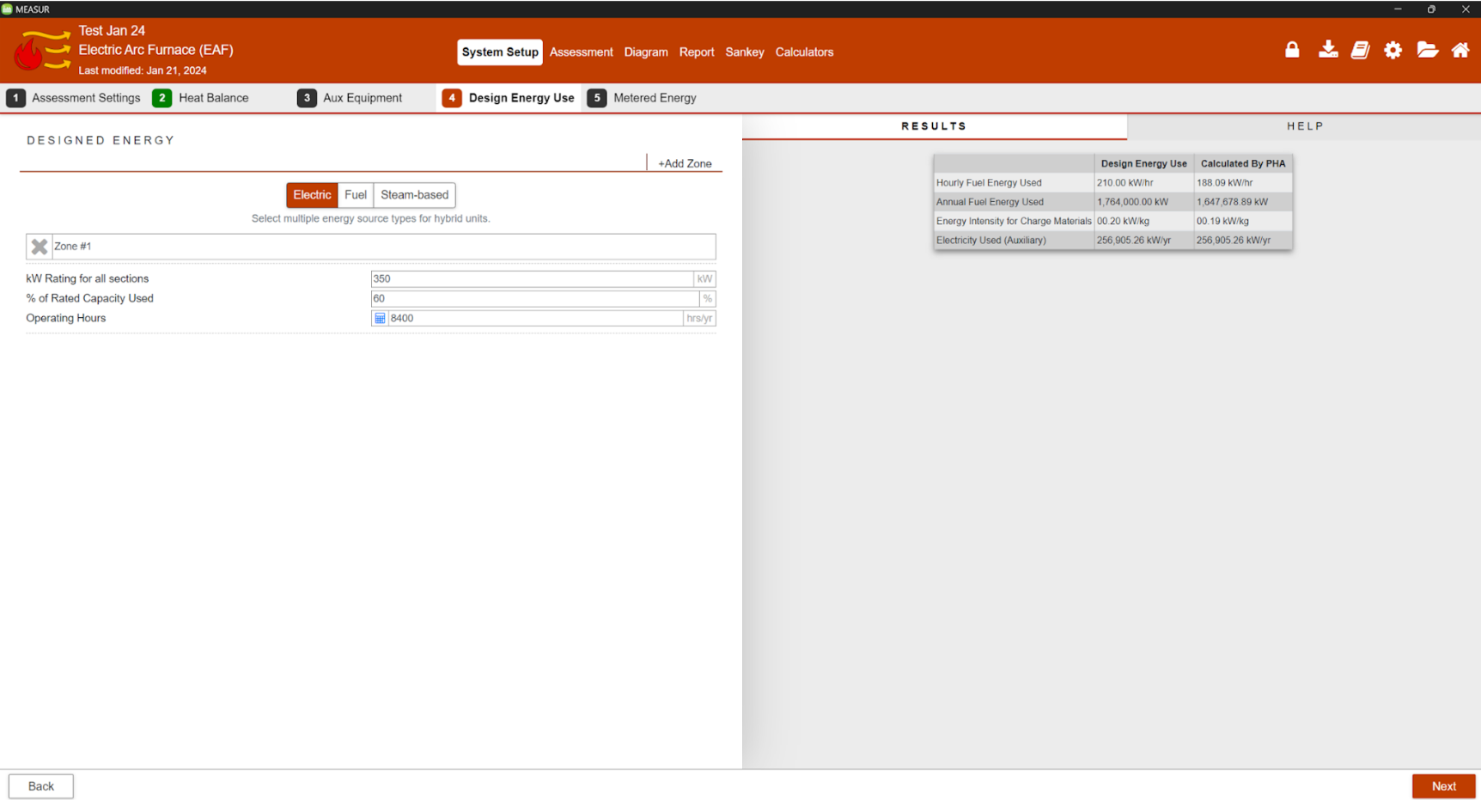
5. System Setup- Design Energy Use
Notes:
In design energy use, Enter data about the design of processing heating equipment. This allows the user to compare Process Heating calculations to the design of the equipment.
Electric: This method calculates total energy used by a furnace by multiplying total rated capacity of the electric furnace (kW) used in different heat zones with annual operating hours, percentage rated capacity used and duty cycle.
Fuel: This method calculates total energy used by a furnace by multiplying total rated capacity of burners (Btu/hr) used in different heat zones with annual operating hours, percentage rated capacity used and duty cycle.
Steam: This method calculates total energy used by a furnace by multiplying total heat of steam (Btu/lb) used in different heat zones with steam flow rate, annual operating hours, percentage rated capacity used and duty cycle.

Slide 31
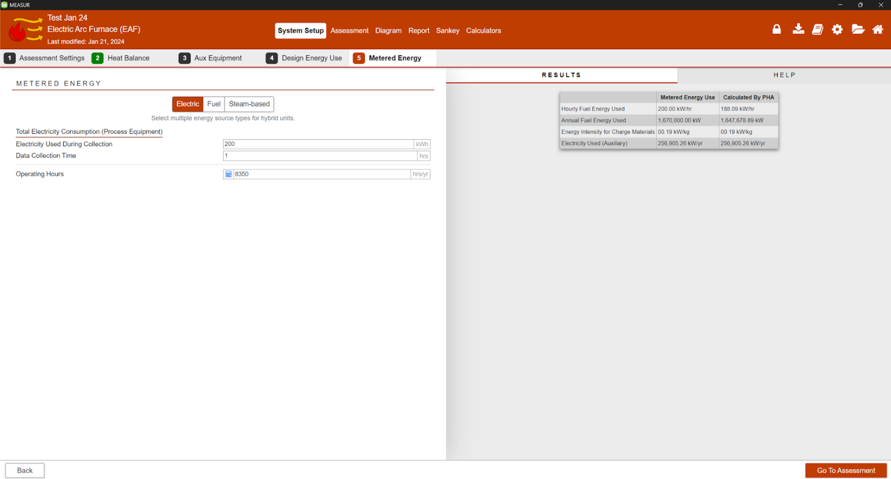
6. System Setup- Metered Energy
Notes:
Enter data about the energy of processing heating equipment based on metered steam/electricity/fuel use. This allows the user to compare PHA calculations to the meter data of the equipment.
Electric: This method calculates total energy used by a furnace by multiplying metered electric energy used by the measurement period (hours/days/weeks).
Fuel: This method calculates total energy used by a furnace by multiplying metered fuel energy used by the measurement period (hours/days/weeks).
Steam: This method calculates total energy used by a furnace by multiplying metered steam energy used by the measurement period (hours/days/weeks).

Slide 32
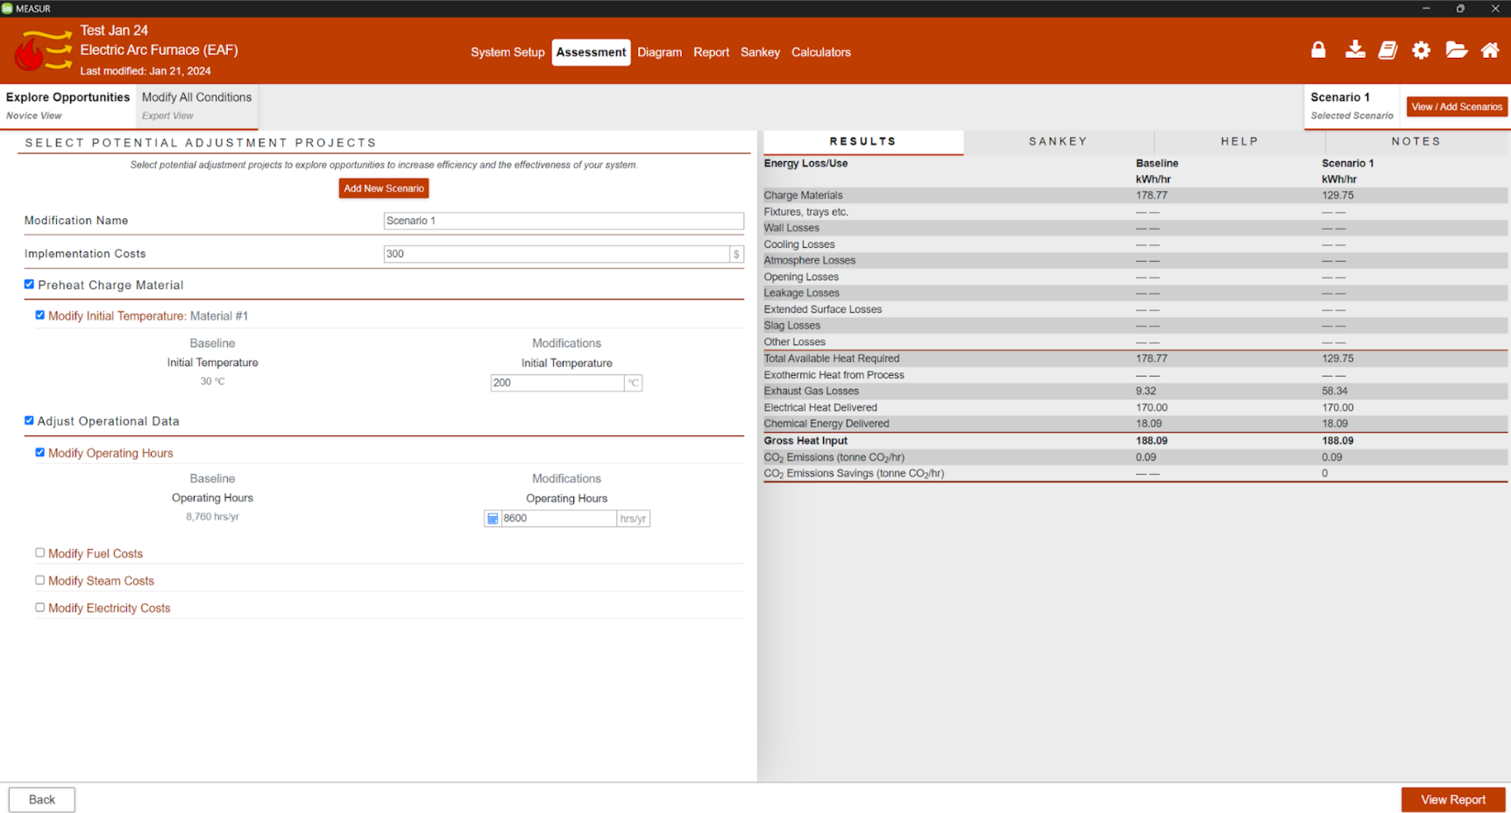
7. Assessment-Novice View
Notes:
Use the list on the left to discover potential opportunities for energy and cost savings within your system.

Slide 33
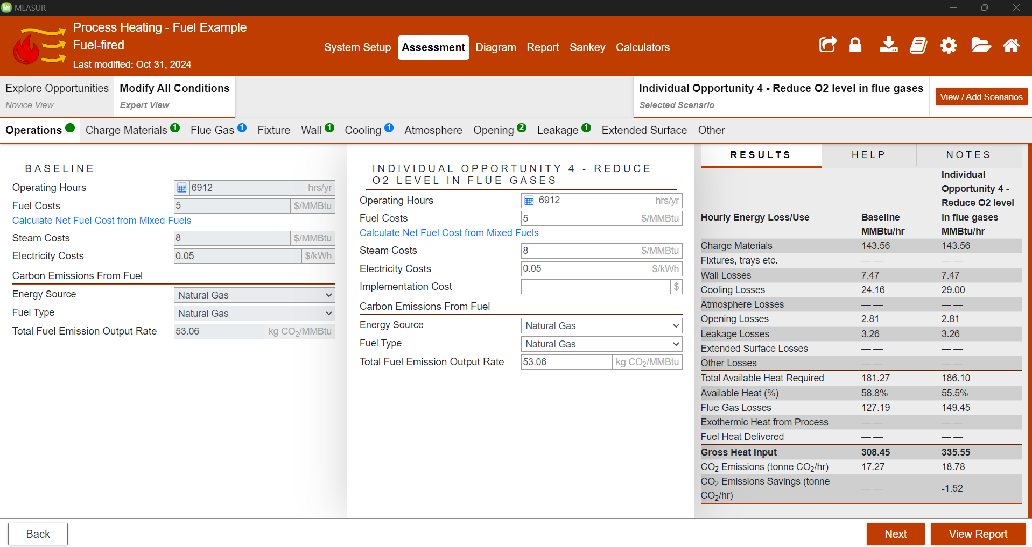
7. Assessment-Expert View
Notes:
Enter data about Operations Settings (operating hours and costs) and the cost of implementing a modification.

Slide 34
8. Diagram
Notes:
This tab shows various heat loss points in an industrial furnace or heating system. It highlights the main areas where energy losses occur, which can help identify opportunities for improving energy efficiency. Here are the specific types of heat losses shown in the image. Each of these points represents potential opportunities for energy-saving improvements, such as insulation, heat recovery, and sealing enhancements, which can contribute to a more efficient operation and reduce overall energy consumption.

Slide 35
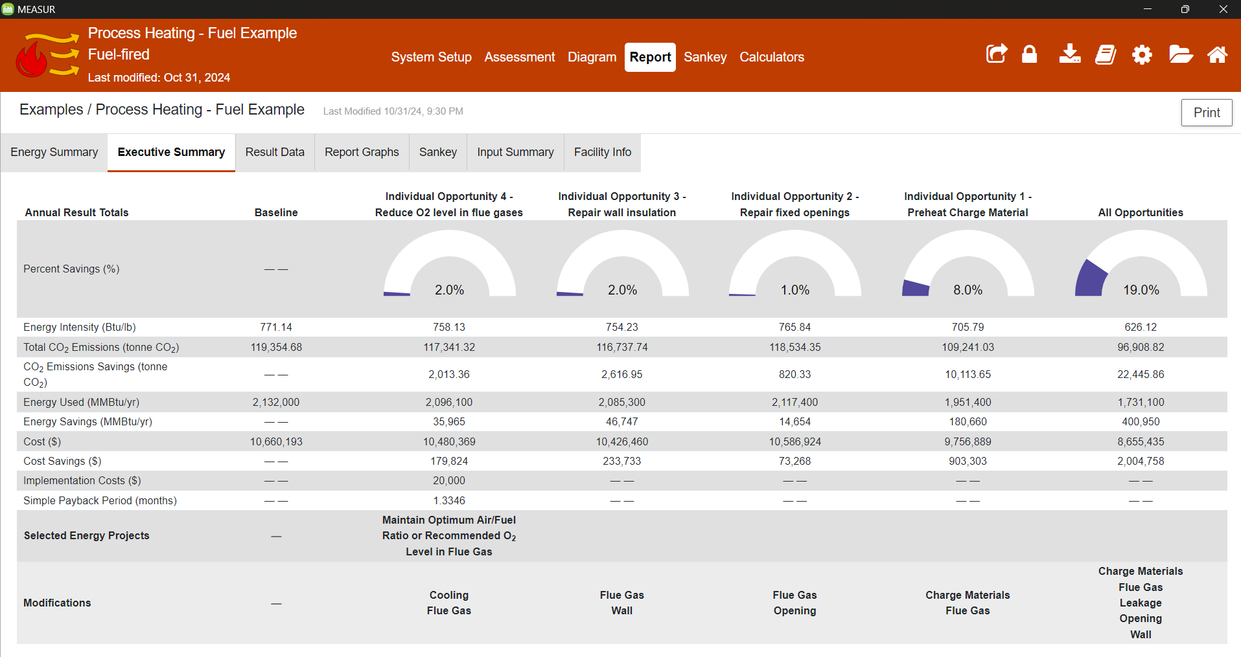
9. Report- Executive Summary
Notes:
The report section provides all the information about the baseline system all all other opportunities. It provides the summary of energy usage and savings, cost savings, implementation costs and payback period. Not only that, it will generate reports, graphs, Sankey and input summary.
A printable summary is generated from the baseline and scenarios created within the assessment.
Comparative analysis is facilitated through tables and graphs, illustrating the impact of changes across scenarios.

Slide 36
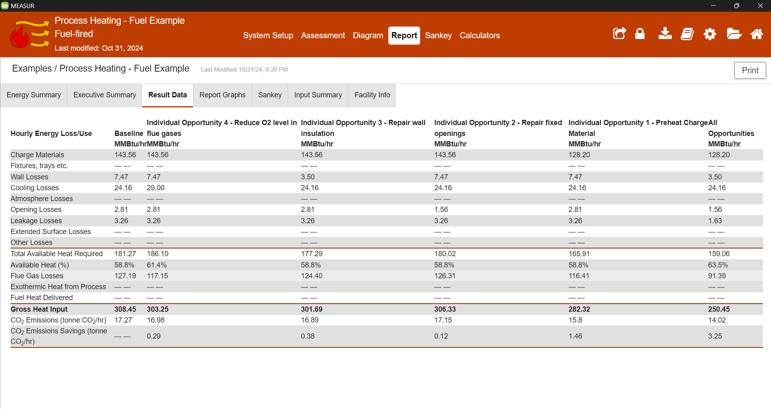
9. Report- Result Data
Notes:
This gives all the losses related to current and modified system. Carbon Dioxide emission and savings, etc.

Slide 37
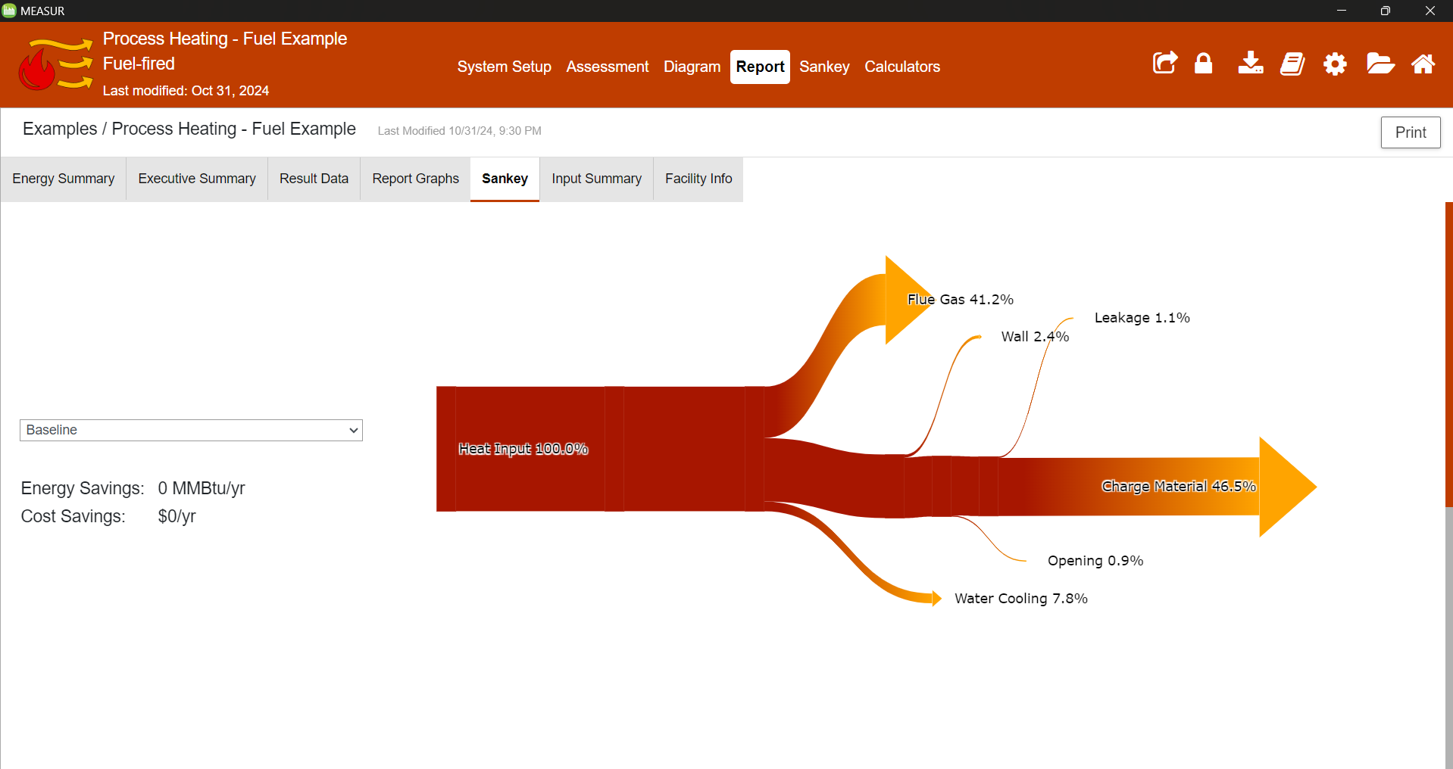
9. Report- Sankey
Notes:
A Sankey diagram is a type of flow diagram that tracks the flow of energy from raw or primary sources of energy up to the final stage of consumption. The width of the arrows in the diagram is proportional to the flow rate of energy. This diagram shows the losses in the process heating system.
Sankey diagrams can also be used to visualize the energy material flow.

Slide 38
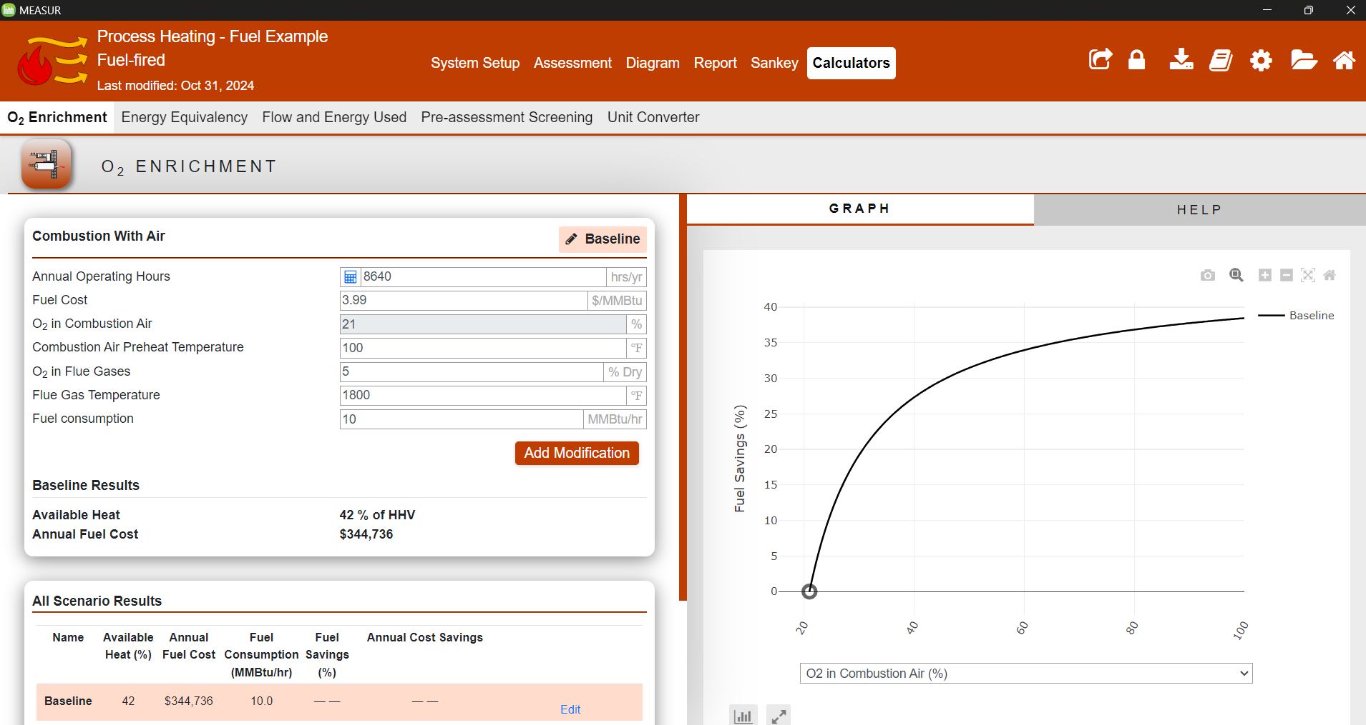
9. Calculators
Notes:
Calculator section helps you in calculating the parameters in case you don’t have idea how to calculate them. It can calculate for Oxygen enrichment, energy equivalency, flow and energy used, pre-assessment screening, and unit conversion.

Slide 39
Enhancing System Efficiency: Best Practices

Slide 40
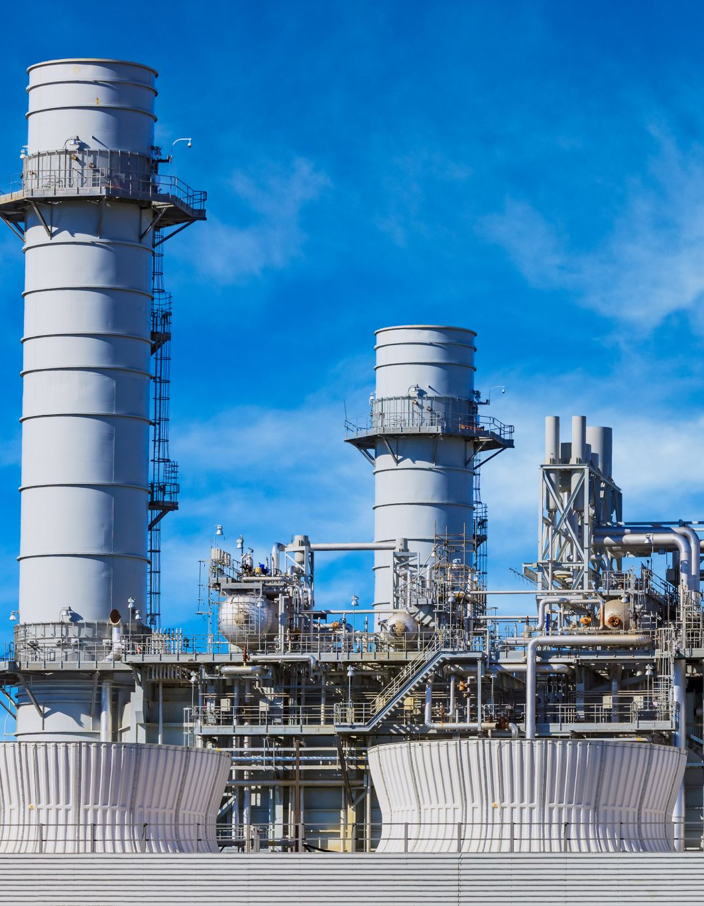
Best Practices
Improve controls systems
Preheat combustion air
Recover furnace waste heat
Improve maintenance on furnaces to reduce heat losses
Install variable speed drives when appropriate
Optimize air-to-fuel ratios
Preheat process materials and equipment
Upgrade equipment to more efficient technologies
Notes:
Facilitator’s note: Implementing best practices in process heating can significantly enhance energy efficiency and reduce operational costs. First, improving control systems helps maintain optimal operation and minimizes energy waste. Preheating combustion air is another effective method to enhance the efficiency of combustion processes. Recovering furnace waste heat and reusing it in the system reduces energy losses and improves overall performance. Regular maintenance of furnaces is crucial to minimize heat losses and ensure equipment operates efficiently. Installing variable speed drives, when applicable, allows for better control of motor-driven systems, reducing energy consumption. Optimizing air-to-fuel ratios ensures complete combustion and reduces unnecessary fuel usage. Preheating process materials and equipment before they enter the system also minimizes the energy required for heating. Lastly, upgrading to more efficient technologies provides long-term savings and aligns with sustainability goals. Together, these practices can drive substantial improvements in process heating efficiency and overall productivity.

Slide 41
Efficiency Recommendations in MEASUR

Slide 42
Efficiency Recommendations in MEASUR
Improve Control System
Upgrading to advanced automated control systems can optimize the EAF operations. This includes precise control of the electric arc, regulation of the power input, and stabilization of the melting process, which can lead to reduced energy consumption and improved productivity.
Preheat Combustion Air
Implementing systems to preheat the combustion air using the waste heat from the exhaust gases can improve the thermal efficiency of any combustion process involved in the EAF operation, such as post-combustion technology or heating of ancillary equipment.
Notes:
Facilitator’s note: Enhancing control systems with advanced automation can significantly improve electric arc furnace (EAF) operations. This includes achieving precise control over the electric arc, regulating power input, and stabilizing the melting process. These improvements not only boost productivity but also reduce energy consumption. Additionally, preheating combustion air by utilizing waste heat from exhaust gases is a highly effective way to increase thermal efficiency. This approach can be applied to various combustion processes within EAF operations, such as post-combustion technologies or heating ancillary equipment, contributing to overall energy savings and operational efficiency.

Slide 43
Efficiency Recommendations in MEASUR
Recover Furnace Waste Heat
Installing waste heat recovery systems, such as recuperators or regenerators, can capture the heat from the exhaust gases to preheat the incoming air or to generate steam for use in other industrial processes, thereby reducing the overall energy demand.
Maintenance
Regular and proactive maintenance ensures that the furnace is operating efficiently. This includes checking for and repairing any insulation damage, sealing leaks, and maintaining proper refractory lining, which can minimize heat losses.
Notes:
Facilitator’s note: Recovering furnace waste heat is an essential step toward improving energy efficiency. By installing waste heat recovery systems, such as recuperators or regenerators, industries can capture heat from exhaust gases and use it to preheat incoming air or generate steam for other industrial applications. This reduces the overall energy demand and enhances system performance. Equally important is regular and proactive furnace maintenance. This involves inspecting and repairing insulation, sealing any leaks, and maintaining the refractory lining to minimize heat losses. Together, waste heat recovery and proper maintenance can lead to significant energy savings and improved operational efficiency.

Slide 44
Efficiency Recommendations in MEASUR
Install VFDs When Appropriate
Variable speed drives (VSDs) can be applied to various auxiliary motors such as those for water pumps or fans. They allow for the precise control of motor speed based on real-time demand, reducing electricity use during lower demand periods.
Optimize Air-Fuel Ratios
For any burners used in the EAF process, ensuring the optimal air-to-fuel ratio can significantly improve combustion efficiency, reduce fuel consumption, and lower emissions of CO2 and other pollutants.
Notes:
Facilitator’s note:
Installing variable speed drives (VSDs) on auxiliary motors, such as those used for water pumps or fans, is an effective way to enhance energy efficiency. VSDs enable precise control of motor speeds based on real-time demand, which reduces electricity consumption during periods of lower demand and minimizes unnecessary energy use. Additionally, optimizing air-to-fuel ratios for burners in the electric arc furnace (EAF) process is critical for improving combustion efficiency. Achieving the ideal ratio not only reduces fuel consumption but also lowers emissions of CO2 and other pollutants, contributing to both cost savings and environmental sustainability.

Slide 45
Efficiency Recommendations in MEASUR
Upgrade Equipments
Investing in new, more energy-efficient technologies for the EAF, like modern burners, high-performance electrodes, and improved refractory materials, can result in substantial energy savings and a lower environmental footprint.
Preheat Process Materials and Equipment
Preheating the scrap or other charge materials before they enter the EAF can reduce the energy required to melt them. Similarly, preheating ladles and other equipment can minimize energy losses when transferring molten steel.
Notes:
Facilitator’s note:
Upgrading equipment to modern, energy-efficient technologies in the Electric Arc Furnace (EAF) can lead to significant energy savings and reduced environmental impact. Investments in advanced burners, high-performance electrodes, and improved refractory materials not only enhance efficiency but also contribute to a lower carbon footprint.
Additionally, preheating process materials and equipment plays a critical role in energy conservation. Preheating scrap or other charge materials before introducing them into the EAF decreases the energy required for melting. Similarly, preheating ladles and other equipment ensures minimal energy loss during the transfer of molten steel, optimizing overall operational efficiency.

Slide 46
Summary and Key Takeaways

Slide 47
Summary
Calculate operating hours
Calculate split in electricity bill
Calculating efficiency of the heating unit
Design power zone-wise
Create scenario for assessment
Recommendation Exploration
Generating Report
Graphs
Notes:
Facilitator’s note: The Process Heating module offers a range of tools and capabilities designed to optimize heating systems and improve energy efficiency. Users can calculate operating hours to understand system utilization and analyze the split in electricity bills for a detailed cost breakdown. The module also enables the calculation of heating unit efficiency, allowing users to assess performance.
Additionally, it supports the design of power zones, creating tailored scenarios for specific assessments, and provides recommendations exploration for potential energy-saving measures. The module helps in generating comprehensive reports and visualizing data through graphs, empowering users with actionable insights for improved process heating performance.

Slide 48
Key Takeaways
The MEASUR Process Heating Module is designed to analyze and optimize process heating systems for energy efficiency.
Users can set up their system's baseline and assess modifications to realize cost, energy, and emissions savings.
Establish a complete baseline before making any system modifications to ensure accurate assessment of potential improvements.
Utilize the "Explore Opportunities" for guided, simplified data entry and modification suggestions.
Opt for the "Modify All Conditions" tab for detailed control over all system aspects, reflecting more complex changes.
Color-coded indicators on the tabs help track changes and highlight data validity and range issues.The tools such as results tabs, sankey diagrams, field-by-field help, and note-taking sections to support comprehensive system assessments and reporting.
Notes:
Facilitator’s note:
The MEASUR Process Heating Module is a comprehensive tool tailored to analyze and optimize process heating systems for enhanced energy efficiency, cost savings, and reduced emissions. The module encourages users to establish a complete baseline of their system’s current performance, ensuring that any modifications or improvements are assessed accurately against a solid reference point. This baseline serves as the foundation for identifying and implementing effective energy-saving strategies.
Users have two primary pathways for making system changes: the "Explore Opportunities" feature provides a guided approach with simplified data entry and tailored modification suggestions, while the "Modify All Conditions" tab allows for more advanced and detailed control over all aspects of the system, ideal for implementing complex changes.
To ensure data accuracy and usability, the module employs color-coded indicators on tabs, which help users easily identify data validity, detect errors, and recognize any input values that fall outside recommended ranges. This proactive system keeps the assessment process efficient and error-free.
Additionally, the module includes several supportive tools to facilitate thorough system evaluations. These include results tabs for analyzing performance metrics, Sankey diagrams for visualizing energy flows, and field-specific help sections for clarifying inputs and outputs. Users can also take notes directly within the tool, streamlining the process of tracking observations and decisions.

Slide 49
References
1. For the Introduction to DOE's MEASUR tool suite:
U.S. Department of Energy, "Introduction to DOE's New Energy Assessment Tool Suite MEASUR," [Online]. Available: https://betterbuildingssolutioncenter.energy.gov/sites/default/files/slides/Introduction%20to%20DOE%27s%20New%20Energy%20Assessment%20Tool%20Suite%20MEASUR.pdf.
2. For the article on energy efficiency in metal and glass manufacturing:
U.S. Department of Energy, "Metal and Glass Manufacturers Reduce Costs by Increasing Energy Efficiency in Process," [Online]. Available: https://www.energy.gov/eere/amo/articles/metal-and-glass-manufacturers-reduce-costs-increasing-energy-efficiency-process.
3. For the OSTI (Office of Scientific and Technical Information) reference:
Office of Scientific and Technical Information, "MEASUR," [Online]. Available: https://www.osti.gov/biblio/1856108.

Slide 50
Questions?

