Slide 1
Compressed Air System using MEASUR

Slide 2
Outline of the Presentation
Introduction to Compressed Air Systems
Navigating MEASUR: Compressed Air Assessment
Enhancing System Efficiency: Best Practices
Applying Efficiency Recommendations in MEASUR
Summary and Key Takeaways

Slide 3
Introduction to Compressed Air Systems

Slide 4
Impact of the System
10% of all electricity consumed in the average industrial facility is by compressed air systems. (DOE, 2004)
This proportion increases significantly to 30% or more depending on the industry (DOE, 2004)
Notes:
Facilitator notes: Compressed air systems are a significant energy consumer in industrial facilities. According to the Department of Energy, they account for about 10% of all electricity consumption in an average industrial facility. However, this percentage can rise dramatically—up to 30% or more—depending on the specific industry. This highlights the importance of targeting compressed air systems in energy audits and efficiency improvement initiatives, as optimizing these systems can yield substantial energy and cost savings.

Slide 5
Typical Efficiency of the System
The typical operating efficiency of compressed air system is between 10-15% (DOE,2000).
The operating cost of the compressor can be calculated as:
Notes:
Compressed air is one of the most expensive sources of energy in a plant. The overall efficiency of a typical compressed air system can be as low as 10%-15%. For example, to operate a 1-horsepower (hp) air motor at 100 pounds per square inch gauge (psig), approximately 7-8 hp of electrical power is supplied to the air compressor. To calculate the cost of compressed air in your facility, use the formula shown.
Where: bhp—Motor full-load horsepower (frequently higher than the motor nameplate horsepower—check equipment specification)
0.746—conversion between hp and kW
Percent time—percentage of time running at this operating level
Percent full-load bhp—bhp as percentage of full-load bhp at this operating level
Motor efficiency—motor efficiency at this operating level

Slide 6
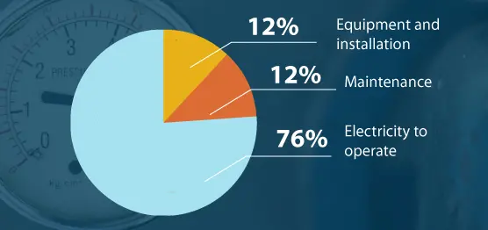
Cost of Compressed Air
Notes:
In case of electromechanical equipments, electricity needed to run the machine and equipment that proves to be the most expensive than the initial purchase of the compressed air system. In fact, the system itself only costs around 10% of the total cost of producing compressed air.
Air Compressor Costs
Equipment and installation: 12%
Maintenance: 12%
Electricity to operate: 76%
Another important factor to consider when determining the cost of compressed air is warranty coverage. Extended warranty coverage on an air compressor will cost more upfront. However, this investment can provide peace of mind and other benefits in the long term.

Slide 7
Use of Compressed Air
Industry | Use
Apparel | Conveying, clamping, tool powering, controls and actuators, automated equipment
Automotive | Tool powering, stamping, control and actuators, forming, conveying
Food | Dehydration, bottling, controls and actuators, conveying, spray coatings, cleaning, vacuum packing
Rubber and Plastics | Tool powering, mold press powering, injection molding
Textiles | Agitating liquids, clamping, automated equipment, loom jet weaving, spinning, texturizing
Notes:
The use of compressed air is versatile. In industries, compressed air powers pneumatic tools, conveyor systems, and actuators. It’s also critical in processes like spraying, packaging, and material handling. It is commonly used in Automobile, Plastics, Manufacturing, Agriculture, Metal Manufacturing industries.

Slide 8
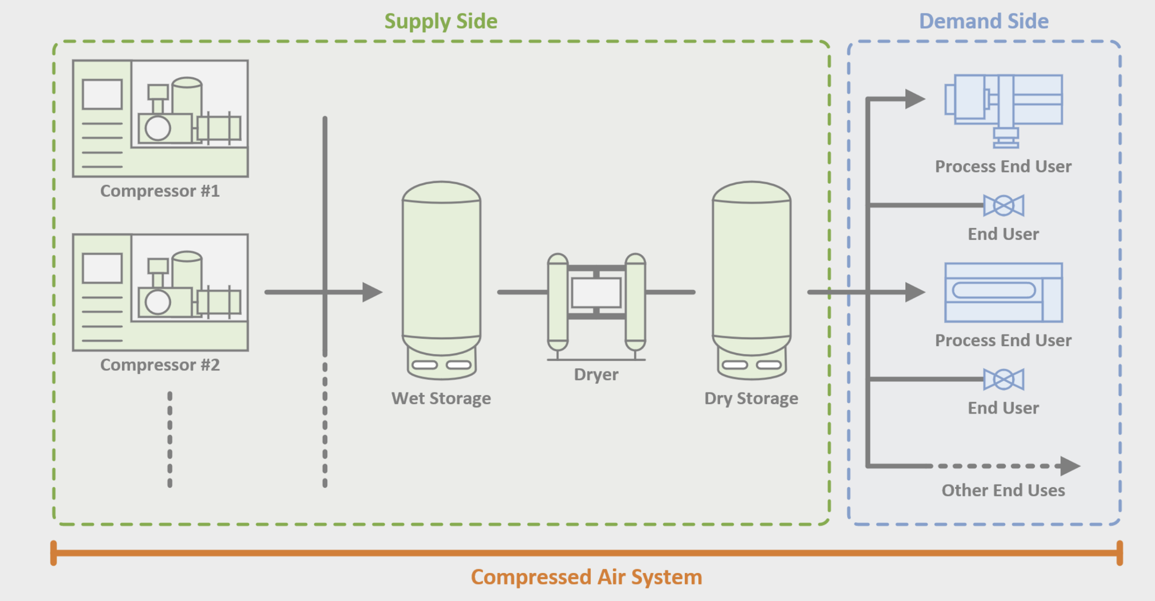
Components of Compressed Air
The components of the compressed air system can be classified into: supply side and demand side.
Fig: Components of Compressed Air
Notes:
Compressed air systems consist of several essential components that work together to ensure efficient operation. The compressor is the core of the system, generating compressed air by drawing in and pressurizing atmospheric air. The wet storage tank serves as an initial reservoir, helping to smooth pressure fluctuations and allowing moisture to separate from the air. To ensure air quality, the dryer removes moisture, preventing equipment damage and contamination in sensitive processes. The dry storage tank stores the dried air, maintaining consistent pressure to meet downstream demands. Finally, the compressed air is used at the process end usage stage for various applications, such as powering pneumatic tools, conveying materials, or supporting manufacturing processes. Proper maintenance and optimization of these components are critical for improving system efficiency and reducing energy costs.

Slide 9
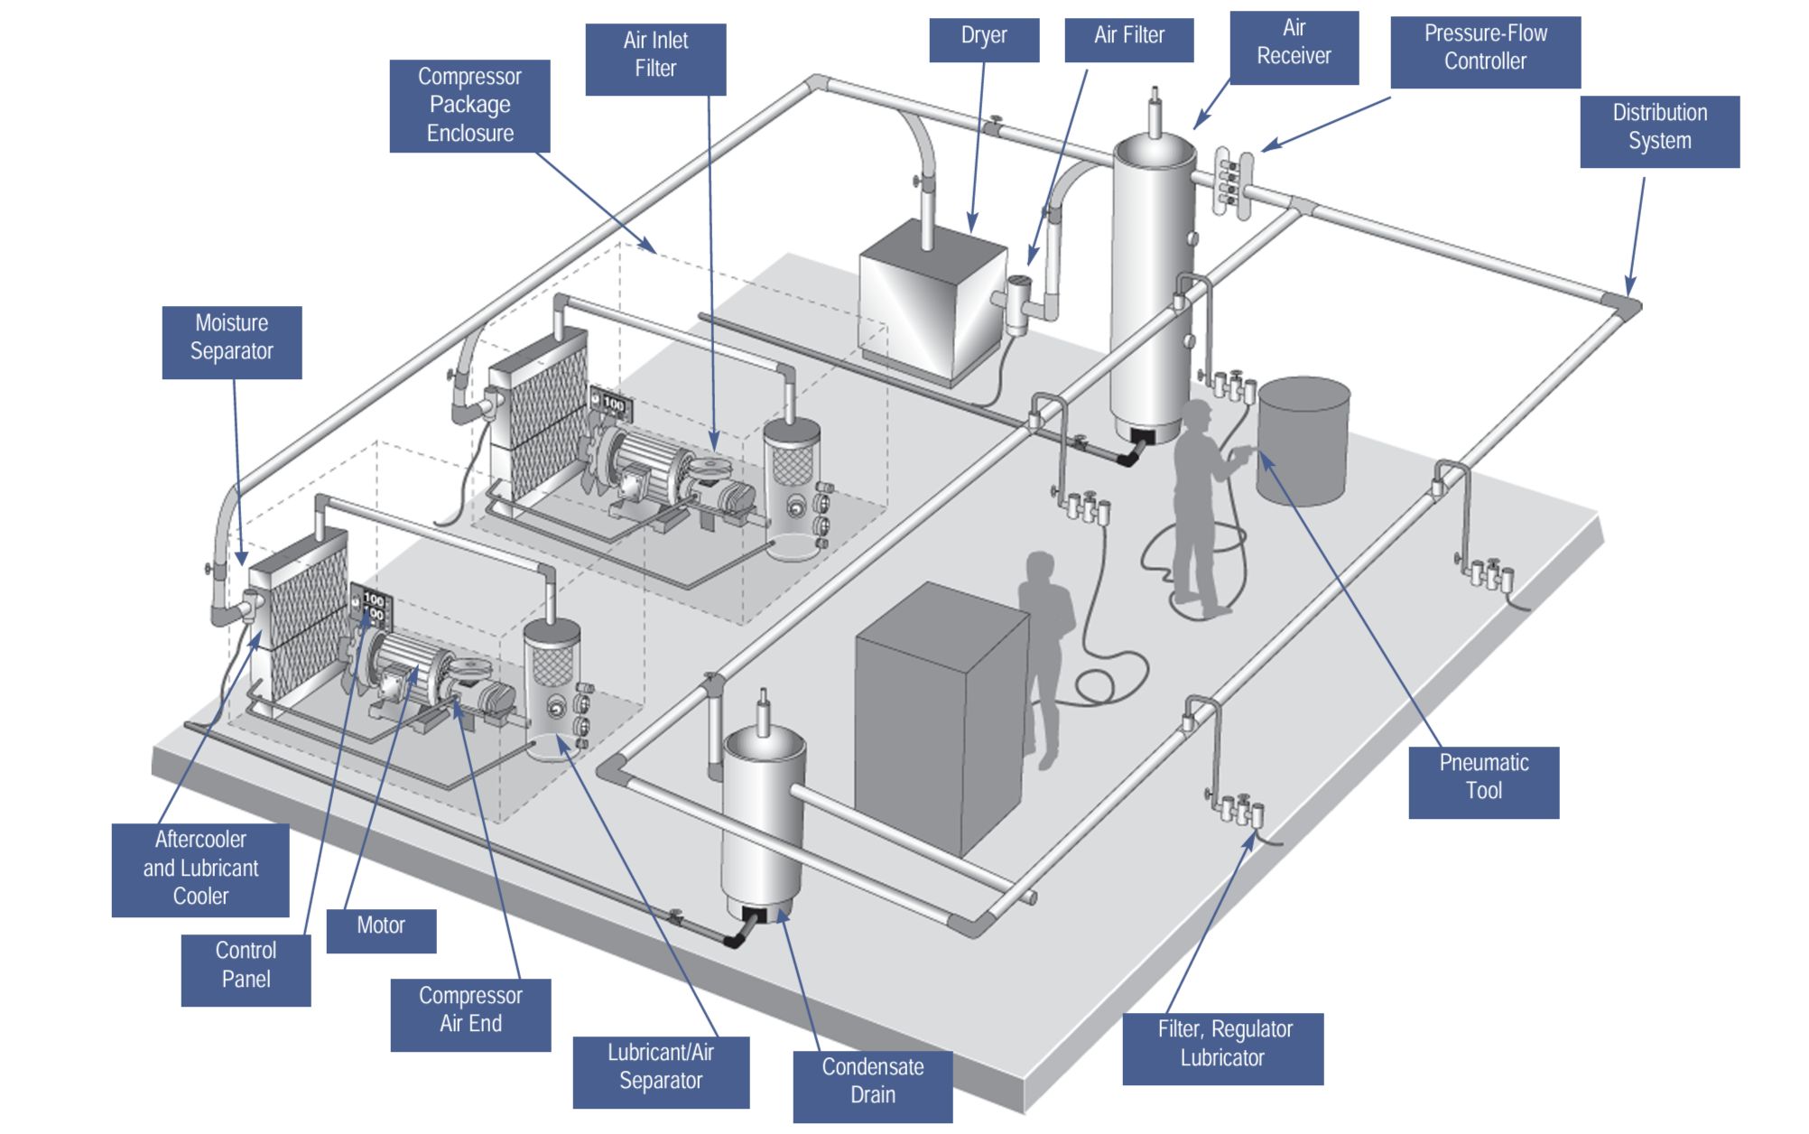
Components of Compressed Air
Fig: Components of Compressed Air
Notes:
The compressor package enclosure is the core, where air is compressed to the desired pressure. Compressed air is then stored in a receiver tank, which stabilizes the system by holding air for peak demands and reducing compressor cycling. A dryer/moisture separator removes moisture from the air to prevent rust, corrosion, and contamination in downstream equipment. Finally, filters clean the air of dust, oil, and other particles, while distribution piping transports the air to tools and machinery across the facility.

Slide 10
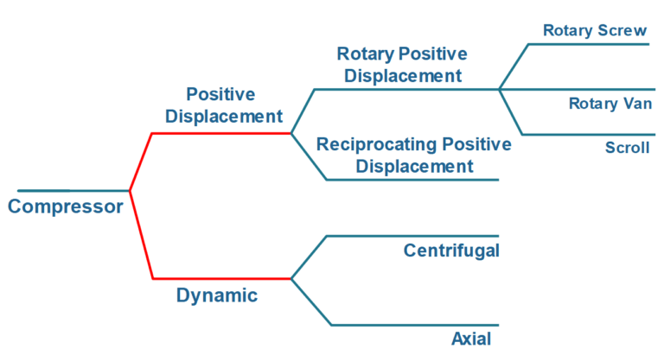
Types of Air Compressor
Fig: Types of Compressor
Notes:
Reciprocating (Piston) compressors use pistons to compress air in cycles and are ideal for intermittent, lower-volume tasks. Rotary Screw compressors are commonly used in industrial settings for continuous, high-demand applications; they compress air through two rotating screws. Centrifugal compressors use high-speed rotating impellers to generate compressed air and are best for large-scale applications requiring a continuous, steady flow. Axial compressors are high-speed compressors commonly used in applications that require large volumes of air at relatively low pressures, such as in jet engines and gas turbines.

Slide 11
Navigating Measure: Compressed Air Systems

Slide 12
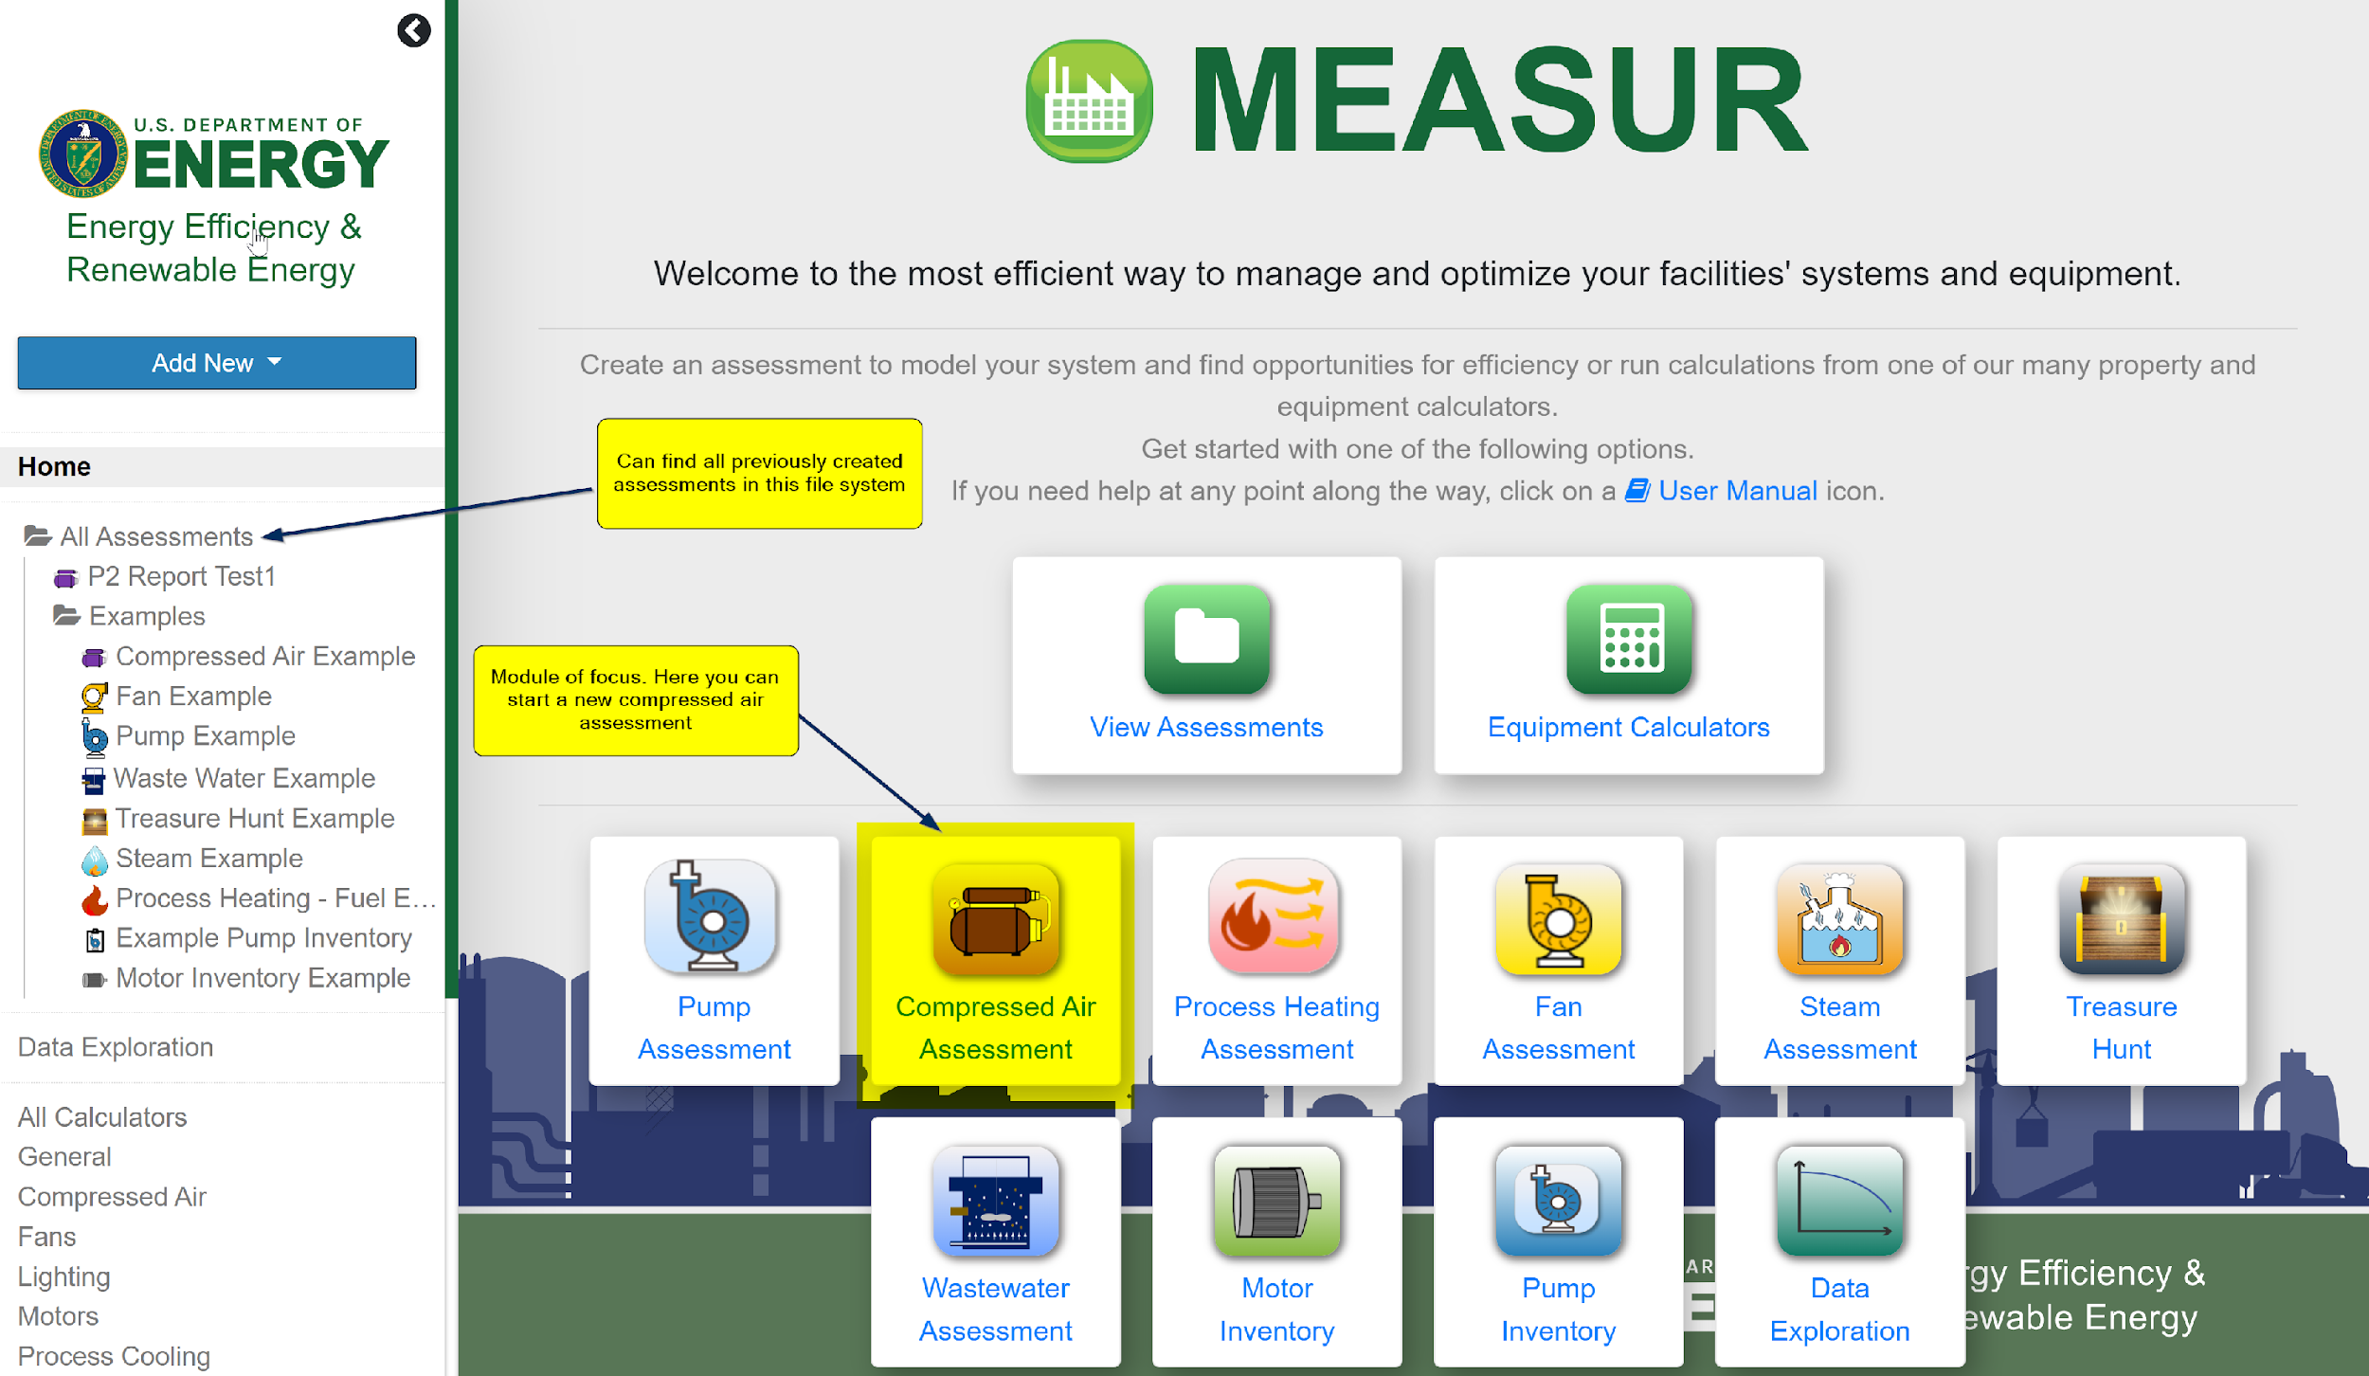
Homepage
Notes:
The Compressed Air Assessment in the MEASUR module is designed to help users analyze and optimize the performance of compressed air systems in industrial facilities. This module provides tools to evaluate energy consumption, identify inefficiencies, and calculate potential energy and cost savings. It allows users to input system-specific data, such as compressor specifications, pressure levels, air demand profiles, and operational schedules. The module also evaluates key performance metrics like system leakage rates, pressure drop, and compressor efficiency.

Slide 13
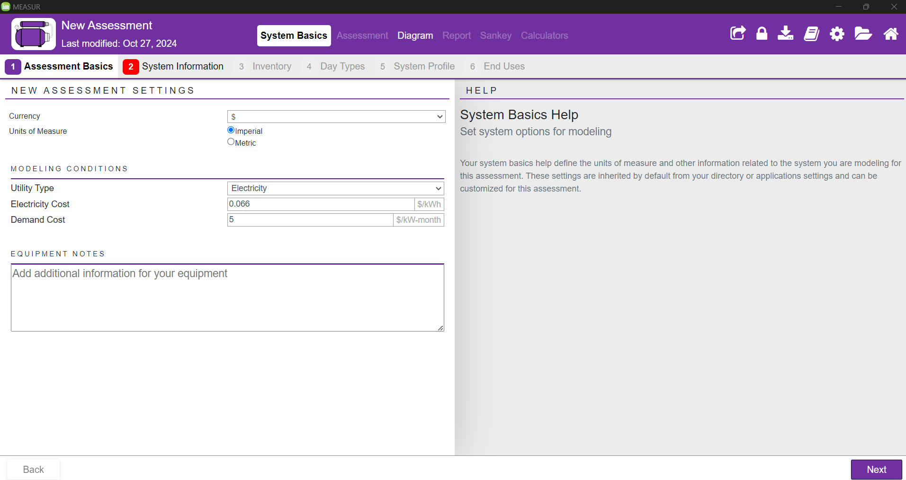
Assessment Basics
Notes:
After you select Compressed Air Assessment, this window will pop up. This consists of System Basics, Assessment, Diagram, Report, Sankey, and Calculators. Get started with the System Setup by providing the properties of your current system or "baseline"! In this step, you need enter the usage and demand cost of electricity. You can find your specific rate through the rate tariffs or by contacting your utility provider.
After you've established your baseline, conduct an Assessment by modifying the conditions of your system to view the potential savings.

Slide 14
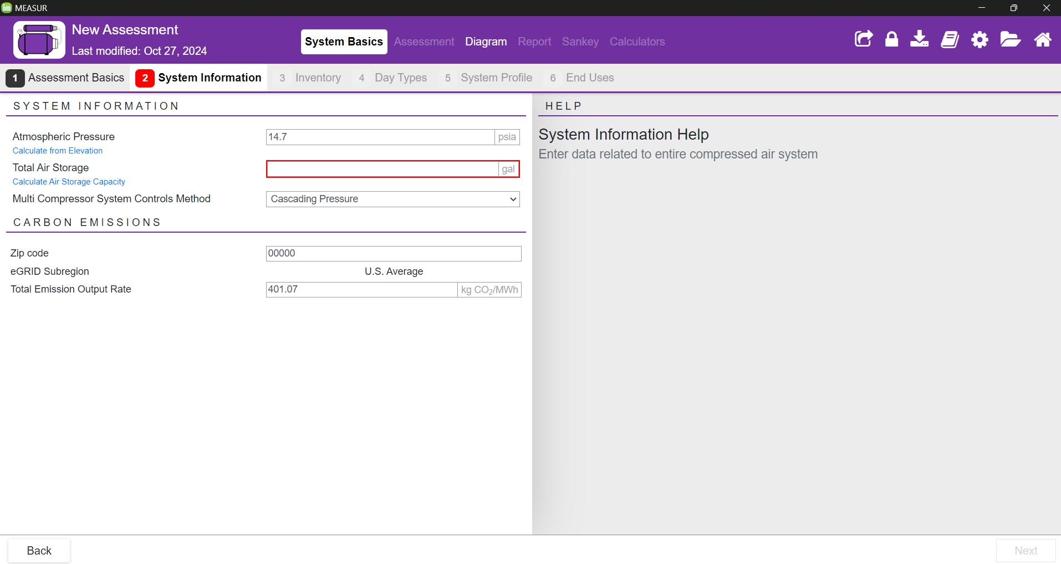
System Information
Notes:
Atmospheric pressure can be found using a barometer or calculated using elevation and total air storage will be found through the dimensions of the pipes and receiver tanks.
Multi compressor system controls method has cascading, target pressure sequencer, isentropic efficiency, and base/trim mode. You can select one of them.
Enter plant Zip Code and eGRID subregion will autofill. Total emission Output Rate has manual input option if known.
Make note of the blue hyperlinks under each part. Hyperlinks lead to calculators which can be used to determine values. Help is found on the right of each calculator after clicking in each input box.

Slide 15
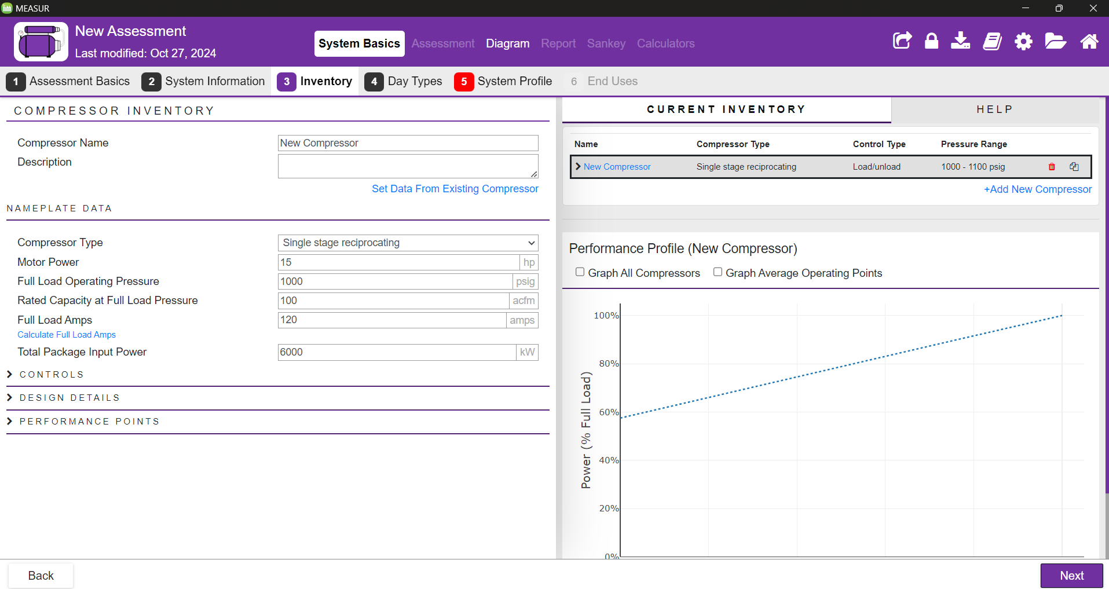
Inventory
Notes:
This consists of data relating to all individual compressors within the system. Each compressor needs its nameplate data, Controls, Design Details, and Performance Points. You can add multiple compressor by clicking on Add New Compressor on right hand side.

Slide 16
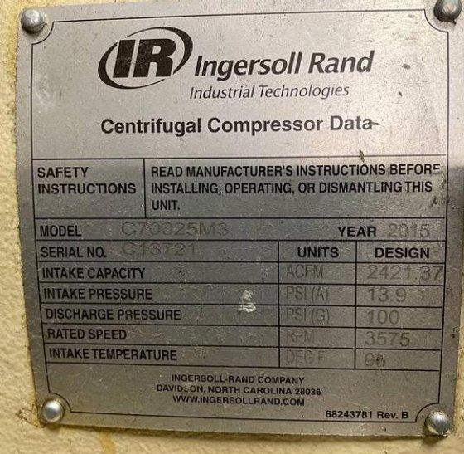
Nameplate Data
Notes:
Key details in nameplate typically include rated horsepower (HP), which indicates the compressor’s power, and maximum operating pressure (PSI or bar), which shows the highest pressure it can safely handle. Other information includes the flow rate (measured in CFM or m³/min), indicating the volume of air it can supply, and the voltage and phase requirements for electrical compatibility. This section also contains option to select the type of compressor.

Slide 17
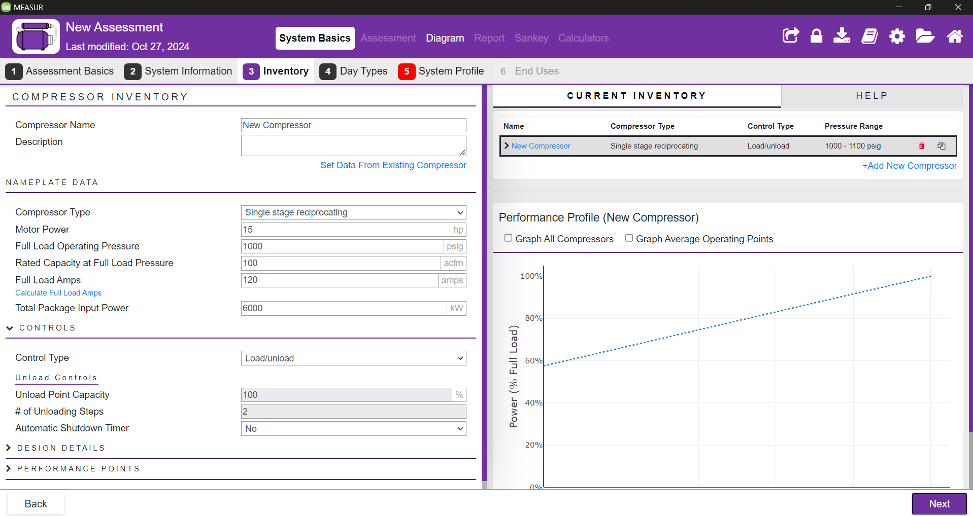
Controls
Notes:
Control type includes Inlet modulation with/without unloading, Load/Unload, Start/Stop, Multi-step unloading, and VFD. Changing the control type will slightly change what inputs are needed. Check the user manual for measuring ‘Unload Sump Pressure’.

Slide 18
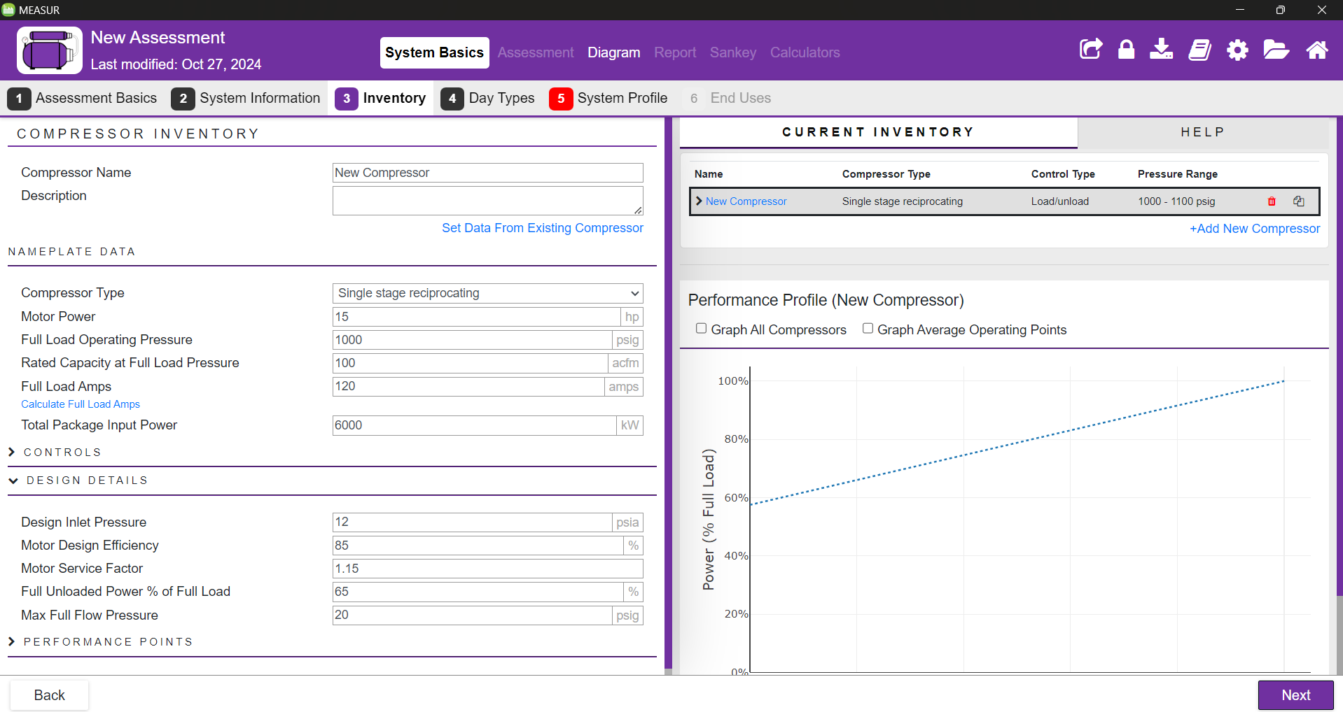
Design Details
Notes:
Many of these attributes should be found on the nameplate, a sticker, or in the user manual. Blowdown Time and Max Full Flow Pressure may need to be measured and will require a timer/stopwatch and/or a pressure gauge to be measured.

Slide 19
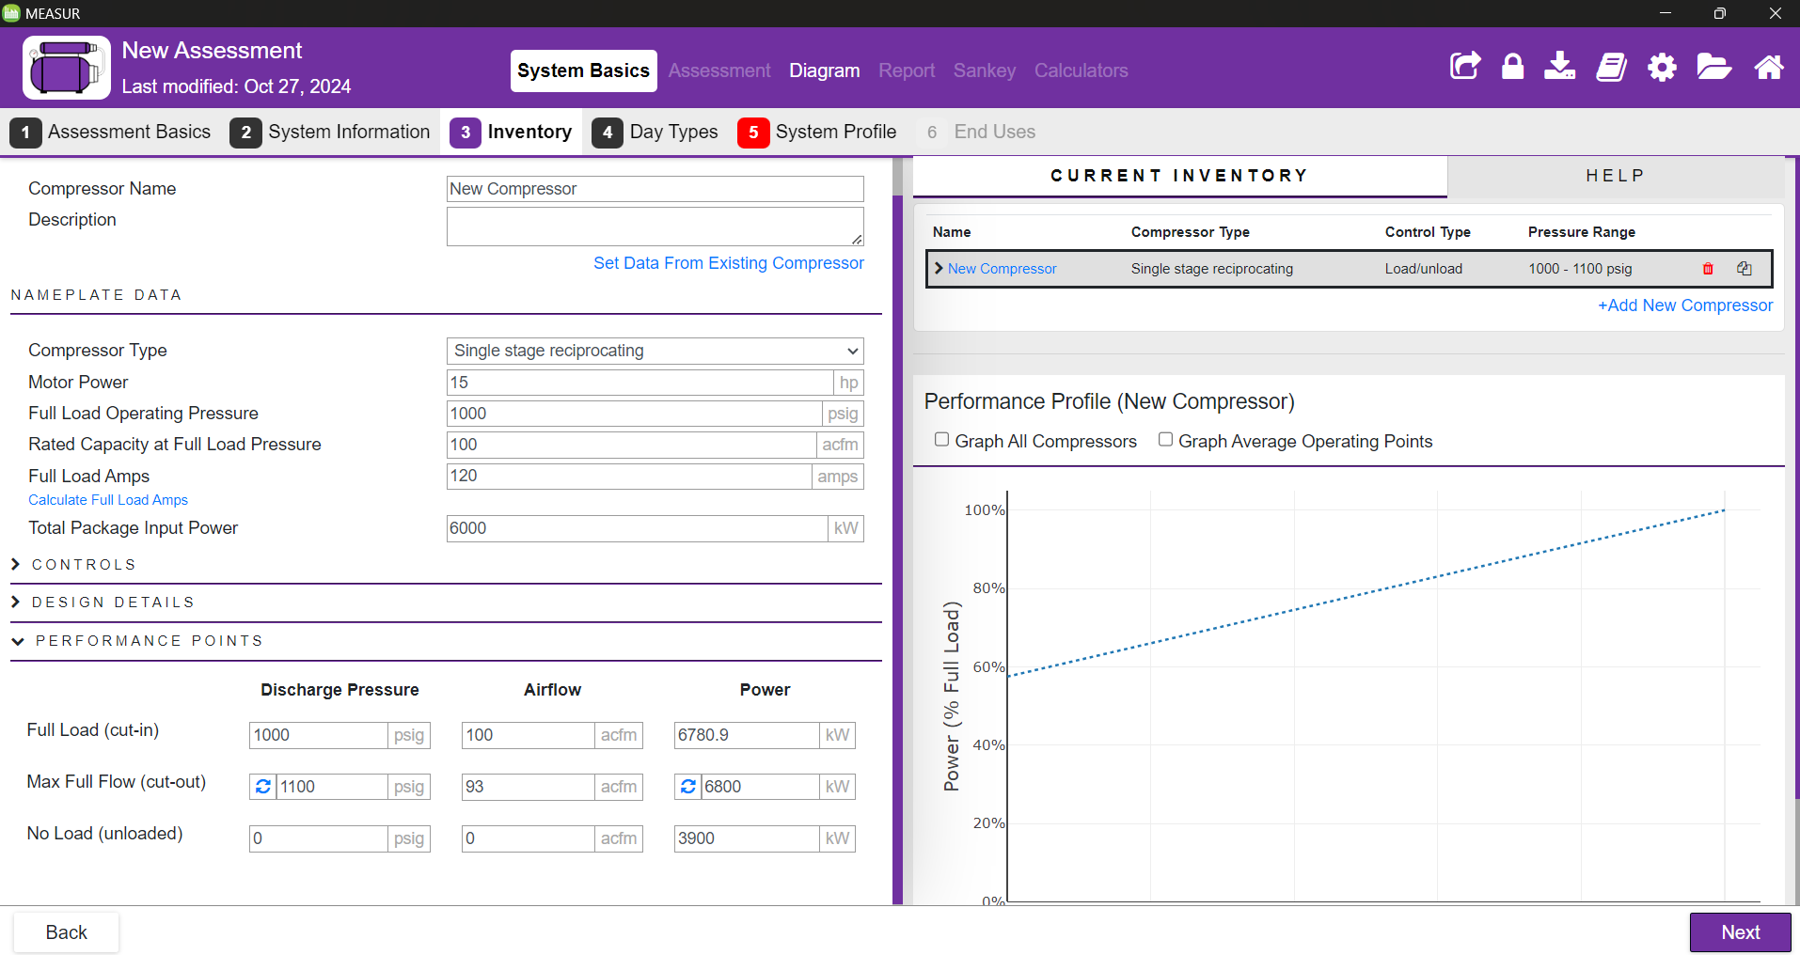
Performance Points
Notes:
Full Load (cut-in): Compressor is ready to begin delivering air
Max Full Flow (cut-out): Compressor has reached max pressure and begins to unload or cut-out
No Load (unloaded): Compressor is unloaded with and completely blown down acfm is “Actual Cubic Feet per Minute”.

Slide 20
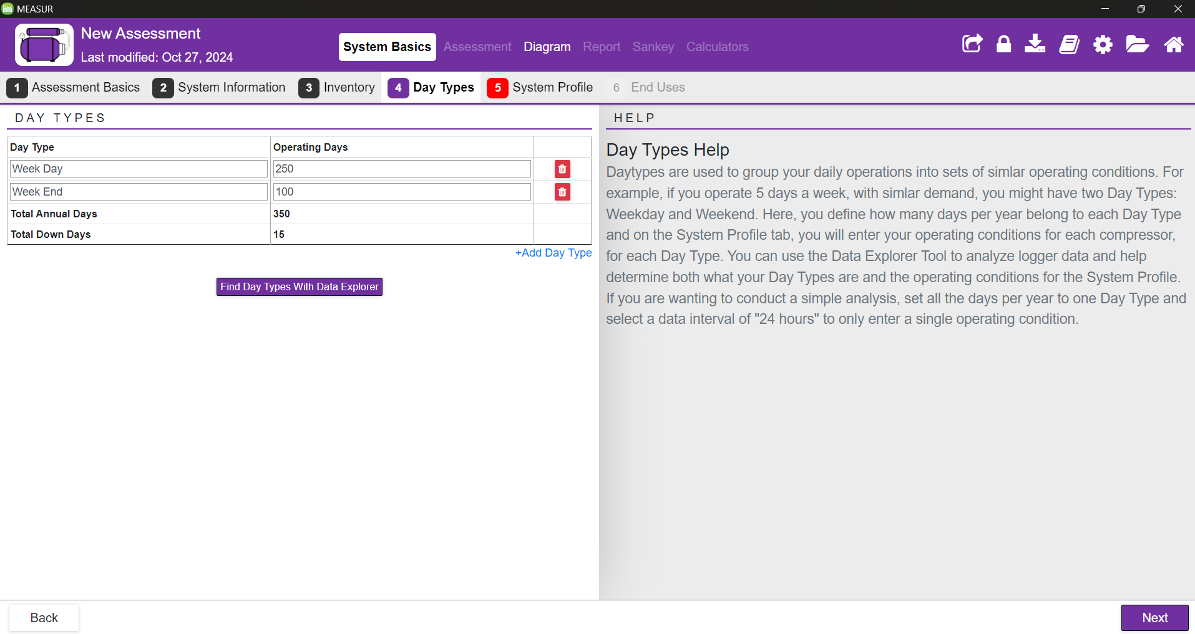
Day Types
Notes:
This allows grouping your daily operations into sets of similar operating conditions based on 365 days (1 year). In this case, we have used 250 operational days annually 100 weekends and 15 total down days.

Slide 21
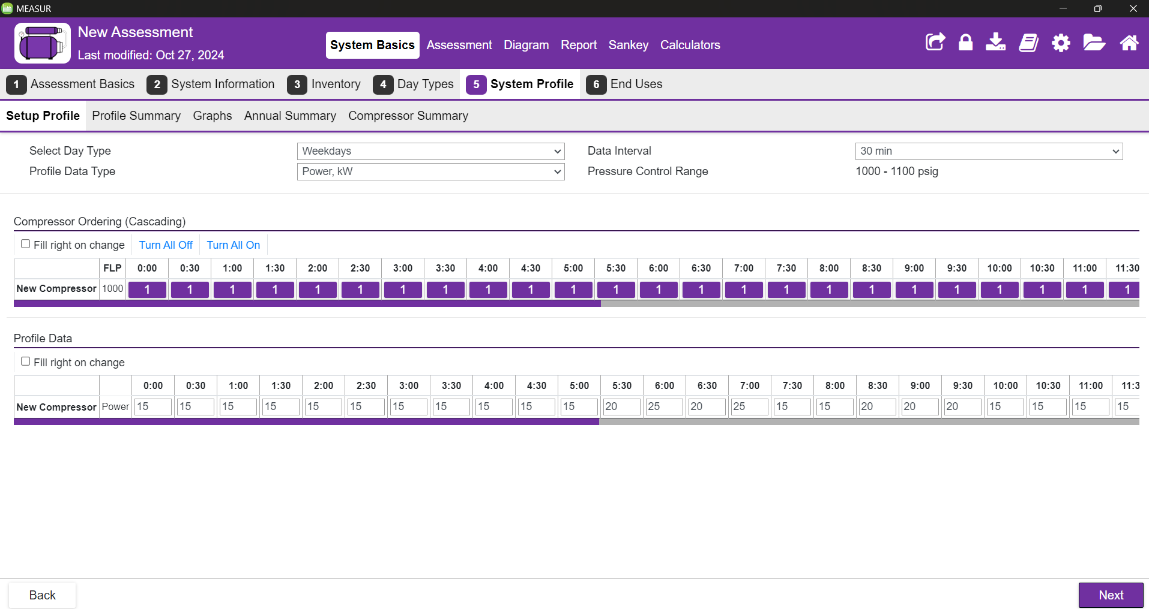
System Profile
Notes:
Mention that this example is for a cascading system and that the data input is Power used and it is just for example purpose however there are several other data fields which should receive inputs and they can be accessed by changing profile data type. You can also find the profile summary, graphs, annual summary, and compressor summary by clicking on the on them.

Slide 22
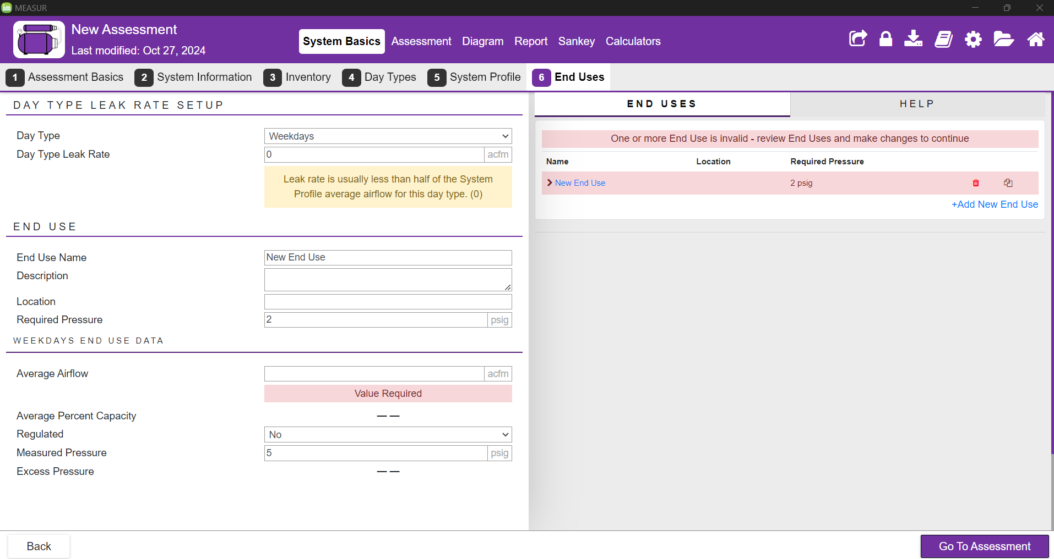
End Uses
Notes:
Data regarding the demand side of the system This example shows 6 end uses Will need to do this for each day type Day type leak rate should be automatically calculated however can also be calculated
V – volume of air in cubic feet
P1 & P2 – initial and final pressures (psig)
T – time in minutes

Slide 23
Assessment

Slide 24
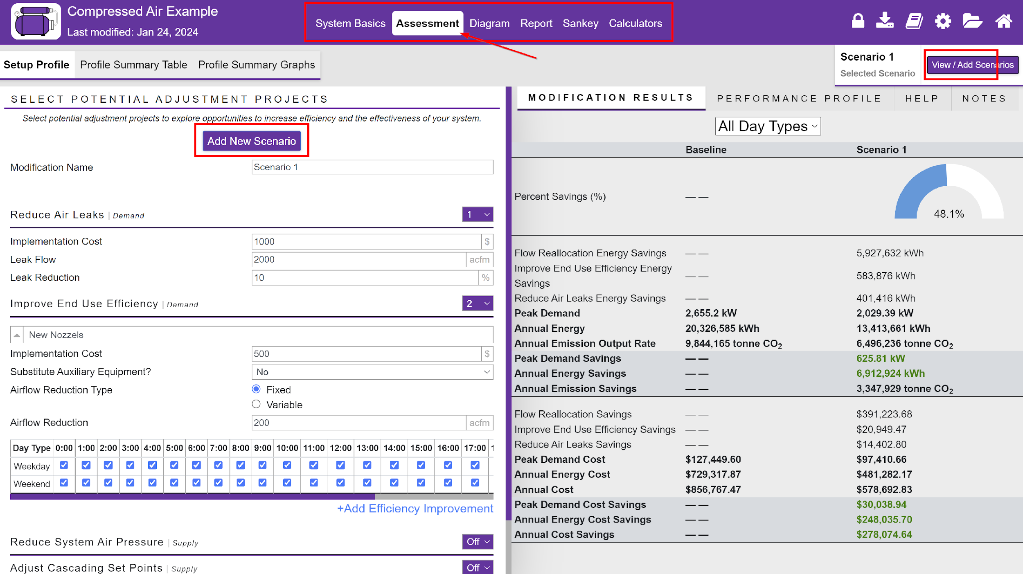
Creating Scenarios
Notes:
Scenarios can be created to reduce air licks, improve end use efficiency, reduce system air pressure, use automatic sequencer, and reduce run time. Just by reducing the air leak by 10% and improving the end use, we can save upto 48.1% of electricity.

Slide 25
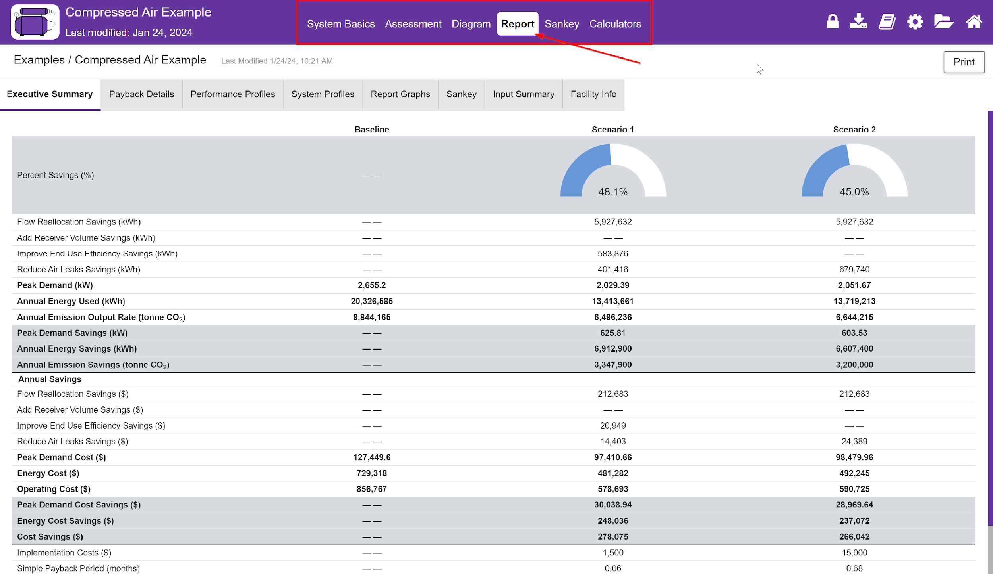
Reporting
Notes:
This gives the summary of the savings after implementing changes. We can also find the total implementation cost, total savings and payback period. Performance profiles, system profiles, graphs, sankey, input summary and facility info can also be found in the reporting section

Slide 26
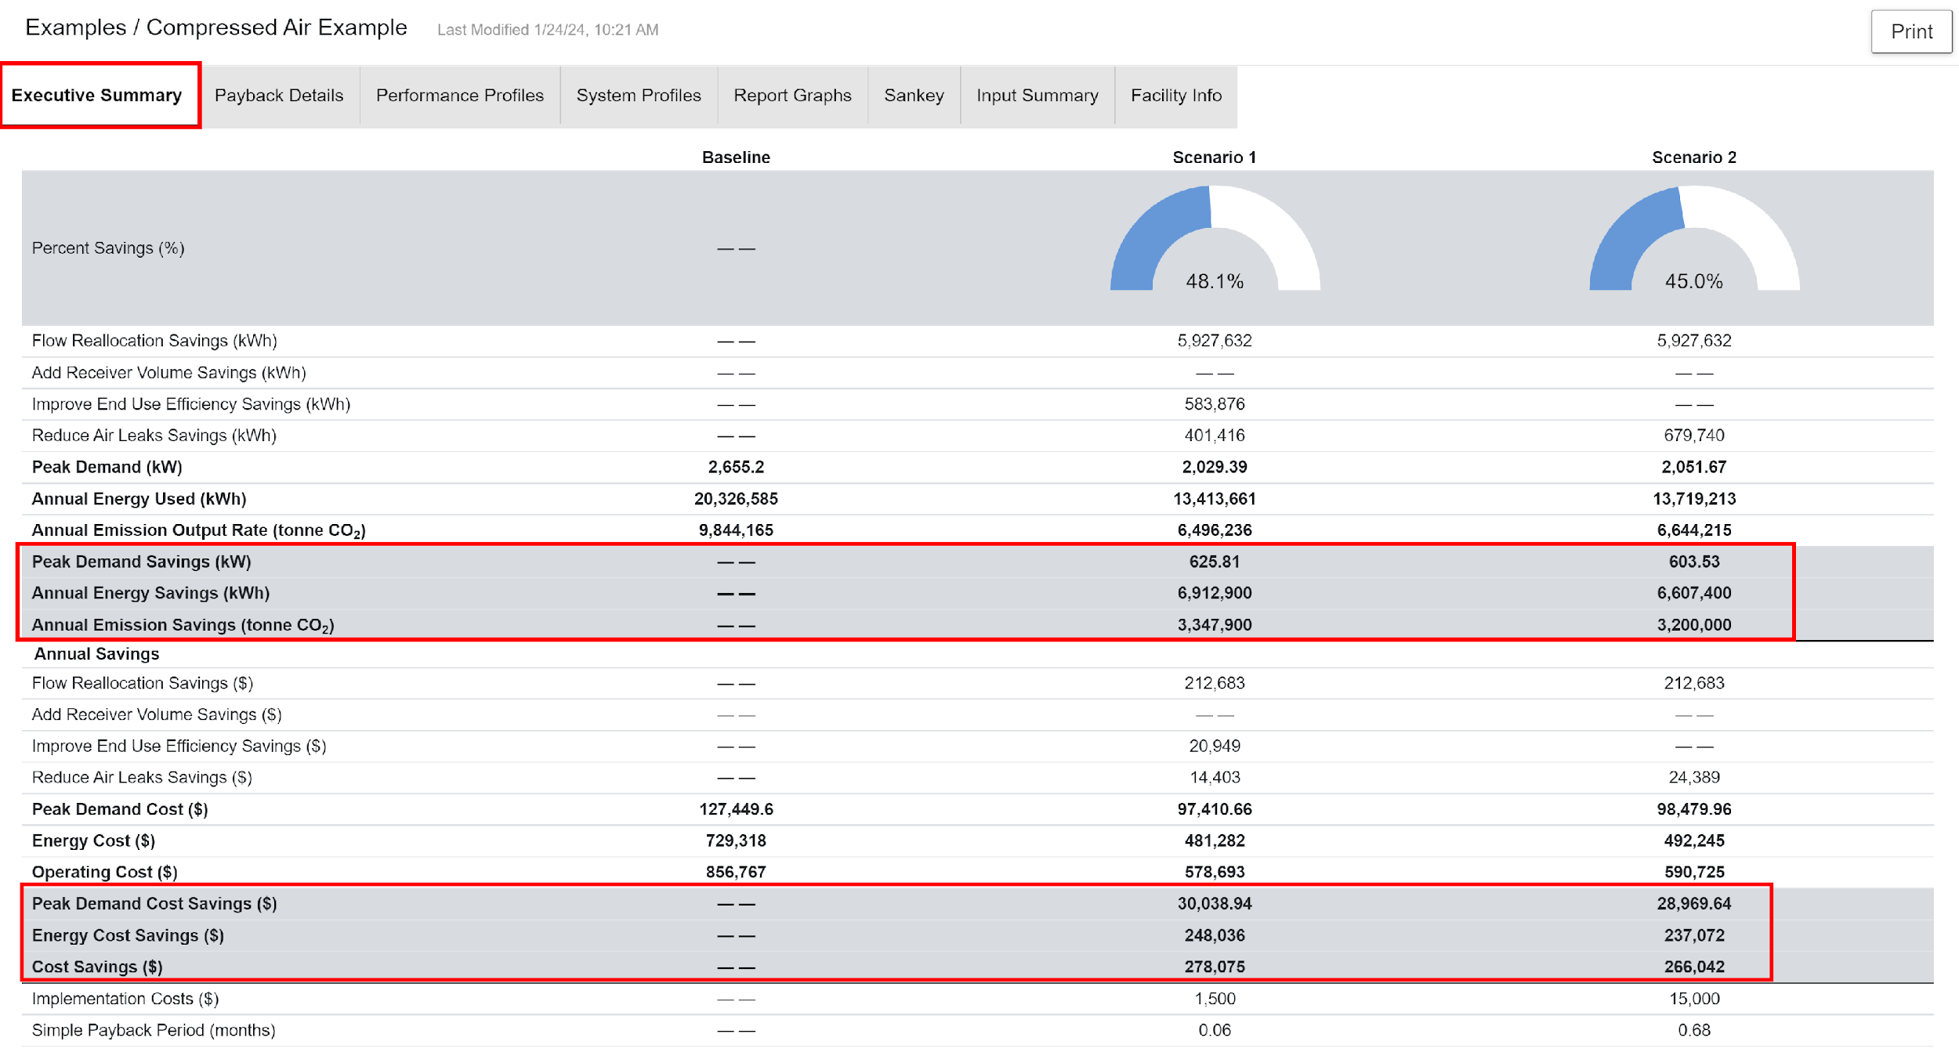
Executive Summary
Notes:
The summary presents the identified energy efficiency opportunities, quantifying potential peak demand savings, annual energy savings, and emissions reductions in terms of kilowatts, kilowatt-hours, and CO₂ equivalents. It also includes the associated cost savings in dollars, offering a clear financial perspective. This high-level summary is designed to communicate the value of the assessment effectively to stakeholders.

Slide 27
Payback Period
Notes:
The report section also includes detailed payback analysis to provide a clear financial perspective on the recommended energy efficiency measures. This section outlines the energy cost savings achieved through reduced energy consumption over a year, as well as peak demand savings, which reflect the reduction in maximum electrical demand charges. Additionally, the implementation cost of each recommended measure is presented, covering expenses such as equipment upgrades, system modifications, or maintenance improvements. Finally, the payback period is calculated, showing the time required to recover the initial investment through energy cost savings. This metric helps prioritize actions by identifying those with the shortest payback periods and the highest return on investment, ensuring decision-makers have the financial insights needed to make informed choices.

Slide 28
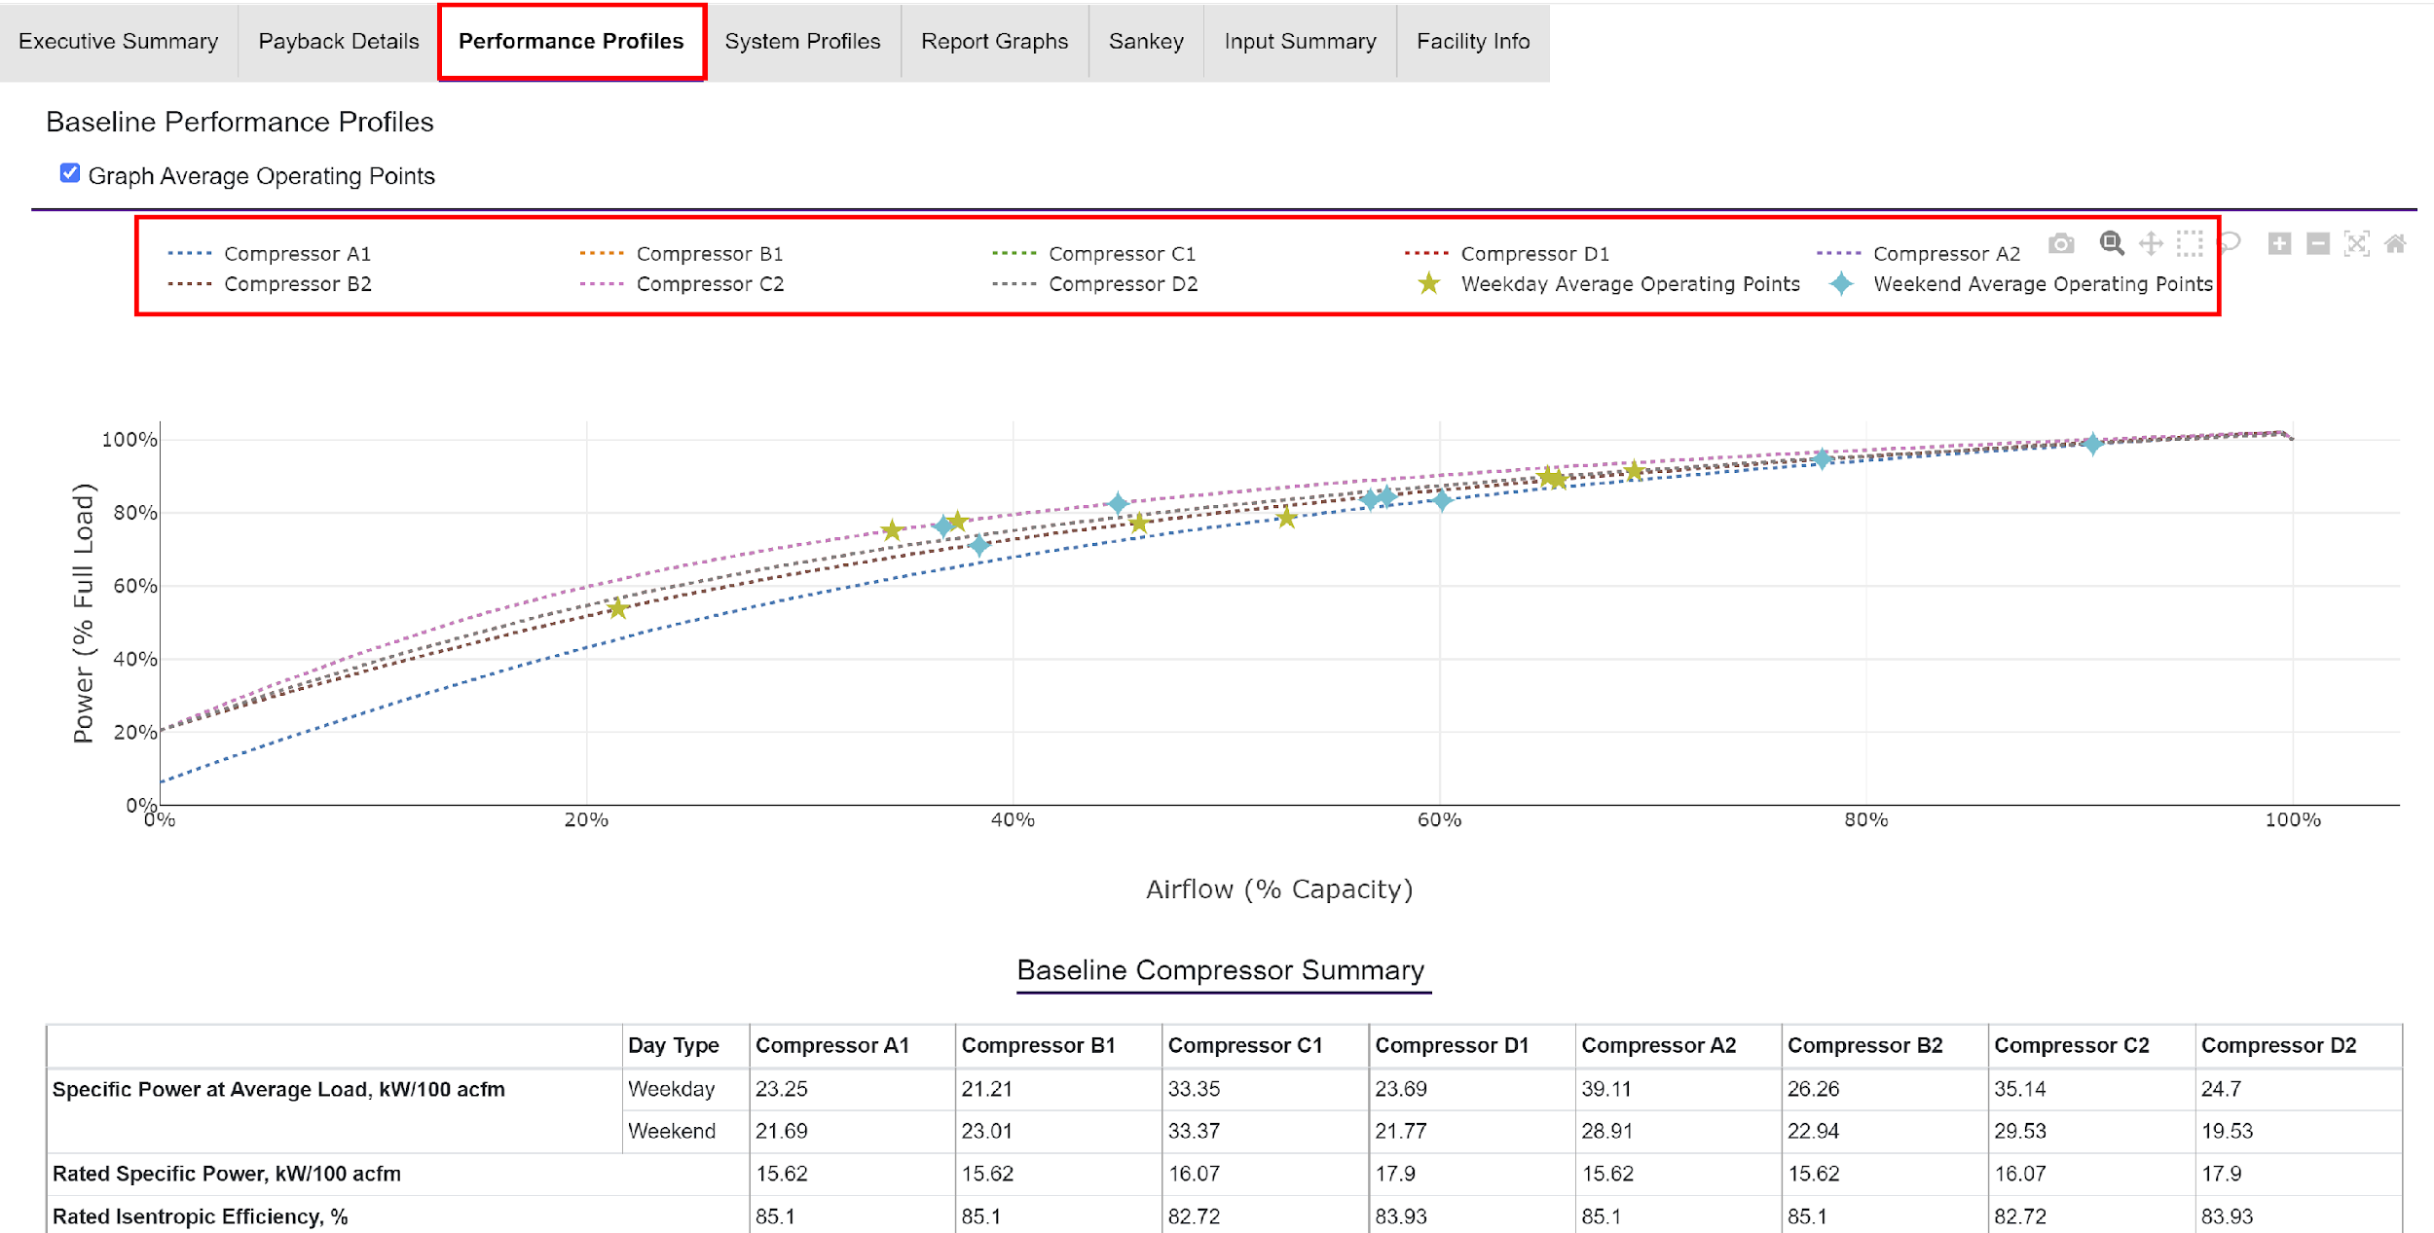
Performance Profiles
Notes:
The performance profiles includes characteristics of each compressors analyzed during the assessment. These profiles provide a detailed evaluation of critical performance metrics, such as the rated specific power (indicating the energy consumed per unit of air delivered) and operational efficiency (highlighting how effectively the compressor converts electrical energy into compressed air). Additional parameters, such as the load/unload cycles, pressure settings, and air delivery capacity, are also summarized to give a comprehensive understanding of each compressor's performance.

Slide 29
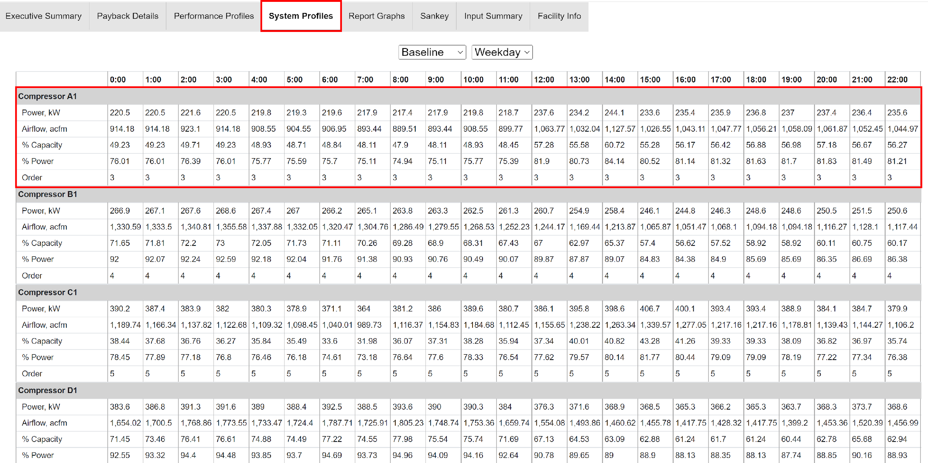
System Profiles
Notes:
Gives the breakdown of all the compressors in the system

Slide 30
Report Graphs
Notes:
Savings due to each modifications: adding primary receiver volume, improving end use efficiency, reducing air leaks, flow reallocation, and adjusted annual cost.

Slide 31
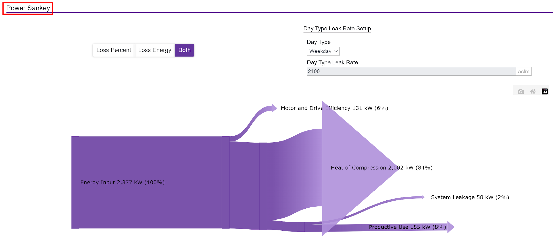
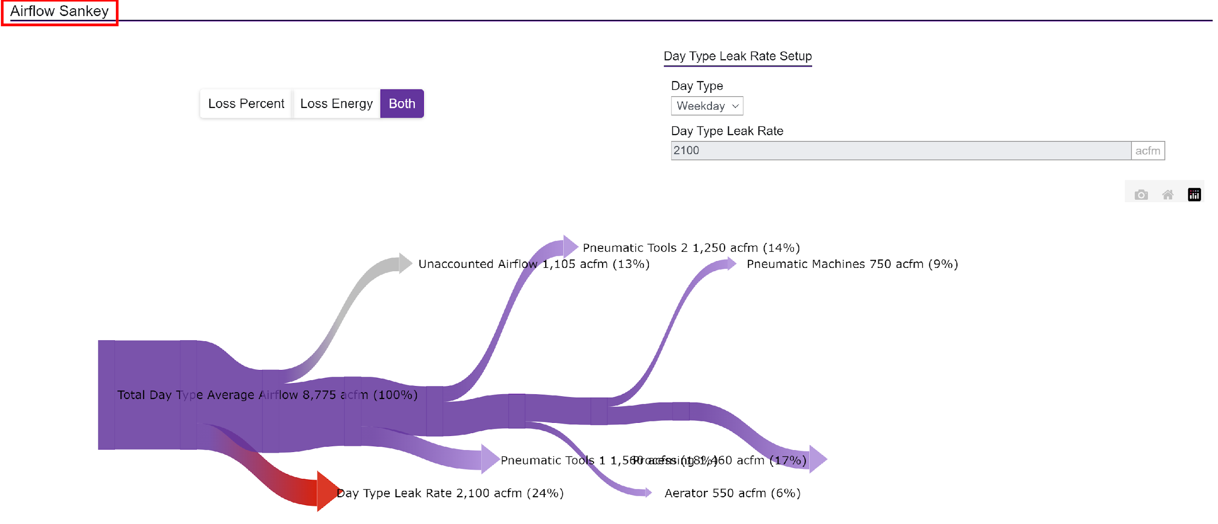
Sankey
Notes:
A Sankey diagram is a type of flow diagram that tracks the flow of energy from raw or primary sources of energy up to the final stage of consumption. The width of the arrows in the diagram is proportional to the flow rate of energy. This diagram shows the losses in our motor and pump system.
Sankey diagrams can also be used to visualize the energy material flow.

Slide 32
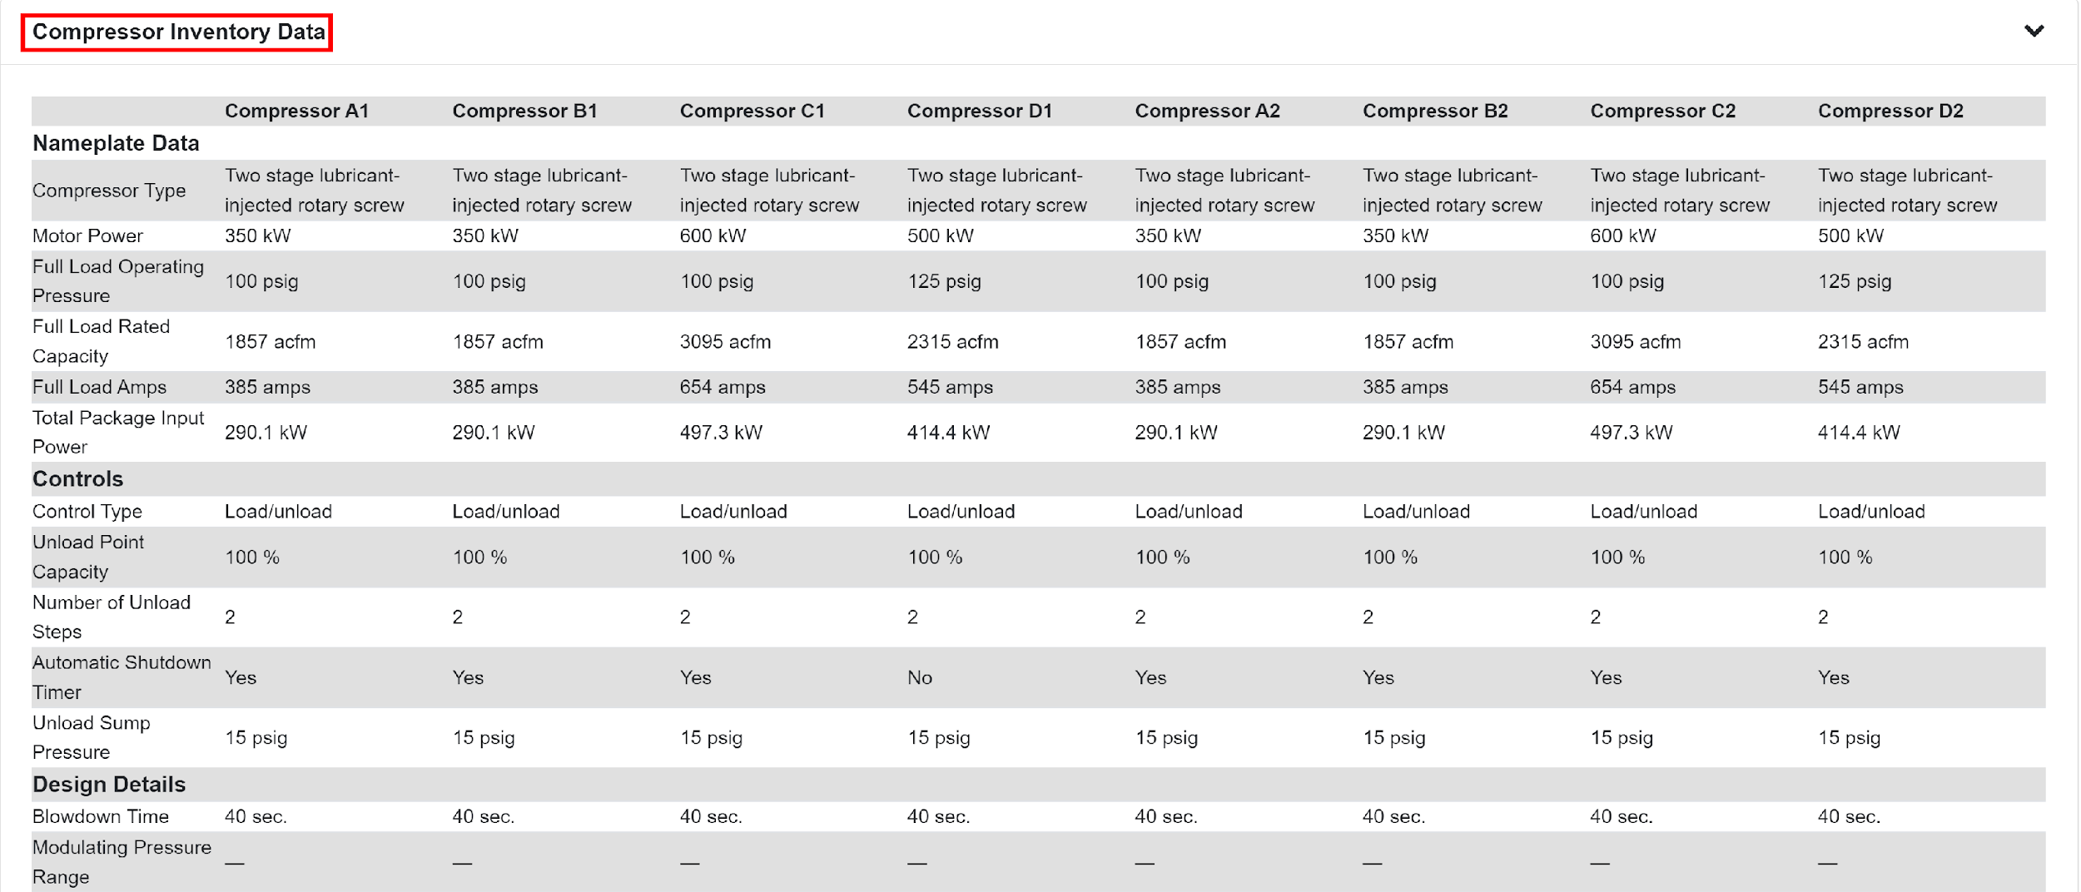
Input Summary
Notes:
The input summary consolidates all the key data used during the assessment. This section provides an overview of the system parameters and operational details entered into the tool, such as compressor specifications (type, size, and rated power), operating conditions (pressure levels, flow rates, and duty cycles), and system configuration (number of compressors, storage capacity, and piping layout). It also captures details about energy costs, including utility rates for energy and demand charges, as well as baseline energy consumption and demand data.

Slide 33
Facility Info
Notes:
Facility info outlines essential context about the site where the assessment was conducted.This includes the facility's location, type of operations, and industry classification.

Slide 34
Enhancing System Efficiency:
Best Practices

Slide 35
Key Areas of Waste
Leaks
Flow Restrictions
Over-pressurization
Inadequate Air Storage
Matched Supply and Demand
Inappropriate Use
Inappropriate piping tees
Jamming of Filters
Improperly sized pipings
Pressure Drop
Notes:
Losses in compressed air systems include air leaks, which are the most common source, wasting significant energy as pressurized air escapes from worn seals, connections, or fittings.
Pressure drops occur when air flows through pipes, flow restriction, filters, and dryers, requiring higher compressor output to maintain necessary pressure levels.
Inadequate maintenance can lead to inefficient performance, with clogged filters, worn parts, or outdated equipment consuming more energy.
Inappropriate uses of compressed air—such as using it for cooling or cleaning instead of more efficient alternatives—can lead to unnecessary energy waste.
Undersized pipes create high pressure drops, forcing the compressor to work harder to deliver the required pressure.
Improperly placed tees and elbows in the piping system cause turbulent airflows and additional pressure drops.

Slide 36
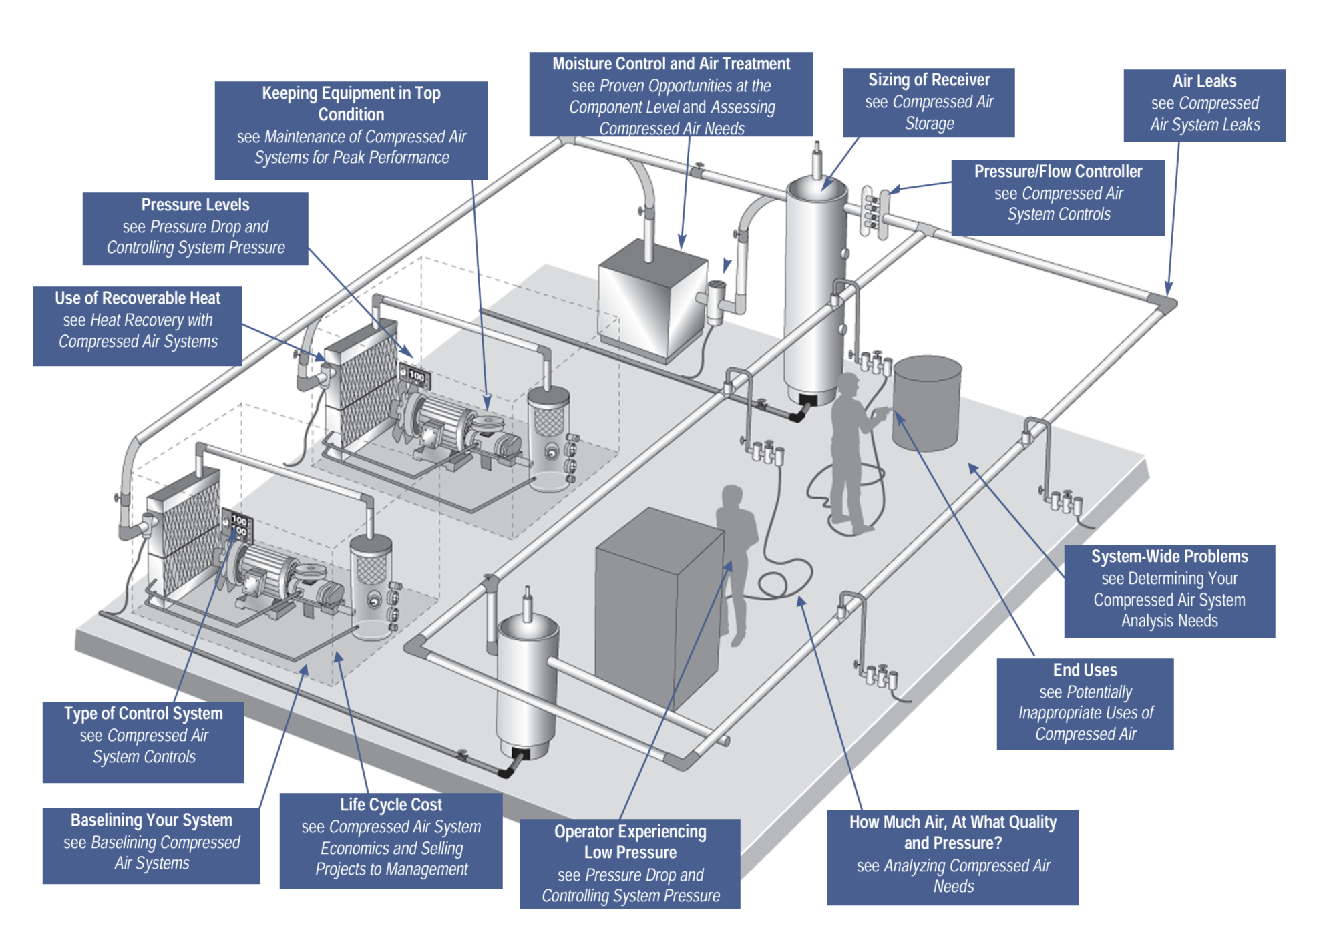
Best Practices
Notes:
Moisture control and air treatment are critical, typically achieved by using dryers and filters to remove moisture and contaminants, which prevents corrosion and damage in piping and end-use equipment.
Proper sizing of the receiver tank helps maintain consistent air pressure, reduces compressor cycling
Preventing air leaks through regular inspections and timely repairs can drastically reduce energy waste, as even small leaks can result in significant efficiency losses over time.
Maintaining end-use equipment ensures that only the necessary amount of compressed air is used for each application, which minimizes overconsumption.
Regular maintenance helps avoid unexpected breakdowns and maintains peak system efficiency

Slide 37
Determining the Best System
Need | Features
Air Quality | Air dryness, contaminant level
Air Quantity | Sum of average air consumption by each tool and process
Pressure Requirements | Optimal pressure discharge considering pressure drop
Demand Load Requirements | Map of air requirements over time to show variation (load profile)
Textiles | Agitating liquids, clamping, automated equipment, loom jet weaving, spinning, texturizing
Notes:
Compressed air systems must maintain optimal air quality, including dryness and contaminant levels, to protect equipment and ensure process quality. Accurate assessment of air quantity based on average consumption across tools and processes is necessary for proper system sizing. Pressure requirements must be optimized by considering pressure drops to ensure energy efficiency and consistent performance. Analyzing demand load requirements through a load profile helps in designing systems that can handle varying demand throughout the day. In industries like textiles, compressed air is used in processes such as agitating liquids, clamping, automated equipment, loom jet weaving, and spinning, all requiring precise air quality, quantity, and pressure for efficient operation.

Slide 38
Action Plan
The seven step action plan includes:
Develop a basic block diagram of your compressed air system.
Measure your baseline (kW, pressure profile, demand profile, and leak load) and calculate energy use and costs.
Work with your compressed air system specialist to implement an appropriate compressor control strategy.
Once controls are adjusted, remeasure to get more accurate readings of kW and pressures, and to determine leak load. Recalculate energy use and costs.
Walk through to check for obvious preventive maintenance items and other opportunities to reduce costs and improve performance.
Identify and fix leaks and correct inappropriate uses – know costs, re-measure, and adjust controls as above.
Begin implementation of continuous improvement programs.
Source: CAC Fundamentals of Compressed Air Systems and DOE
Notes:
The action plan for optimizing a compressed air system begins with developing a basic block diagram to visualize the entire system, including compressors, storage tanks, dryers, and end-use applications. Next, establish a baseline by measuring key parameters such as kW consumption, pressure profile, demand profile, and leak load. This data will provide a reference point for calculating current energy use and costs. Collaborating with a compressed air system specialist is essential to implement an appropriate compressor control strategy, which may involve optimizing settings or upgrading controls. After adjusting controls, re-measure the system to obtain more accurate readings of kW, pressures, and leak load, and recalculate energy use and costs to assess improvements. A thorough walkthrough of the system should be conducted to identify preventive maintenance needs and additional opportunities for reducing costs and improving performance. Identifying and fixing leaks, along with correcting inappropriate uses of compressed air, is crucial for optimizing the system. Re-measure after these corrections, adjust controls accordingly, and continue to implement continuous improvement programs to ensure long-term energy savings, cost reductions, and enhanced system performance.

Slide 39
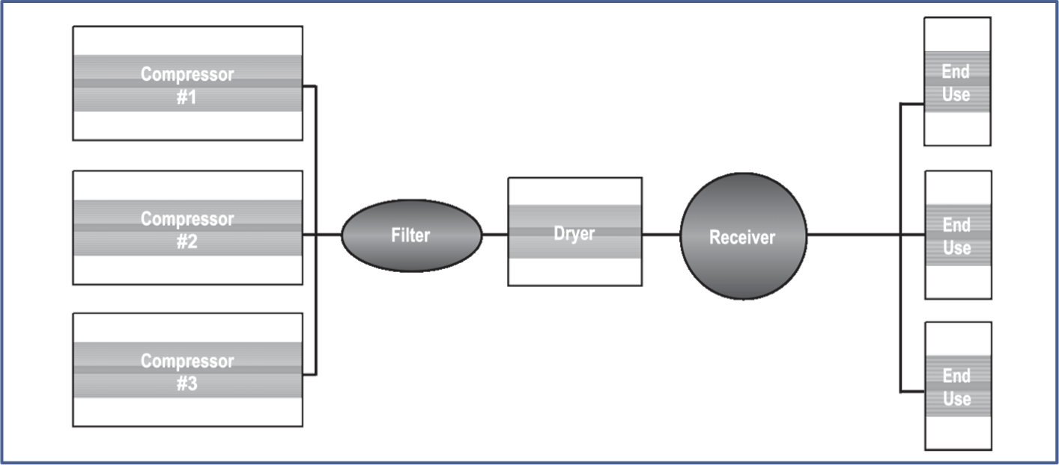
Block Diagram

Slide 40
Efficiency Recommendations in MEASUR
Utilize the data entry features to create a virtual mapping of your system
Locate inefficiencies through the reporting/performance sections
Create scenarios to determine the effects of making positive changes to the system
Notes:
Facilitator’s note: Leverage the data entry tools available to construct a comprehensive virtual representation of your system. This virtual mapping allows you to visualize how different components interact and provides a foundation for in-depth analysis. By exploring the reporting and performance sections, you can identify inefficiencies or areas where the system may not be operating at its optimal level. Once inefficiencies are identified, you can create and simulate various scenarios to assess the potential impact of implementing positive changes. These scenarios help predict outcomes, improve decision-making, and ensure that adjustments lead to enhanced system performance and efficiency.

Slide 41
Summary and Key Takeaways

Slide 42
Summary
MEASUR Compressed Air Module is a software tool designed to analyze and optimize compressed air systems for energy efficiency.
Users can set up their system’s baseline and assess modifications to realize cost, energy, and emissions savings.
Establish a complete baseline before making any system modifications to ensure accurate assessment of potential improvements.
Utilize the “Help” tab on the right panel to ensure proper data input.
Use MEASUR as a tool to follow the “Seven-Step Action Plan” for improving system efficiencies.
Notes:
Facilitator’s note:
The MEASUR Compressed Air Module is a powerful software tool designed to help users analyze and optimize compressed air systems for better energy efficiency. It allows users to set up their system’s baseline and assess potential modifications to identify opportunities for saving on costs, energy, and emissions. It's crucial to establish a complete and accurate baseline before making any system modifications, as this ensures that the improvements can be properly assessed and quantified. To guide you through the process, the 'Help' tab on the right panel is an excellent resource to ensure proper data input, which is vital for accurate analysis. Lastly, MEASUR can be used as a tool to follow the 'Seven-Step Action Plan' to systematically improve system efficiencies, helping you take actionable steps toward long-term energy savings and cost reduction.

Slide 43
References
Bowser, T. J. (2016, July 1). Compressed Air Systems – Waste Reduction. Compressed Air Systems – Waste Reduction | Oklahoma State University. https://extension.okstate.edu/fact-sheets/compressed-air-systems-waste- reduction.html#:~:text=Five%20Steps%20to%20Reduce%20Waste%201%201.%20Analyze,best%20actions%20...%205 %205.%20Track%20results%20
Lawrence Berkeley National Laboratory, & Resource Dynamics Corporation. (n.d.). Improvising Compressed Air System Performance. Energy.gov. https://www.energy.gov/sites/prod/files/2016/03/f30/Improving%20Compressed%20Air%20Sourcebook%20version%203. pdf
Stowe, M. L. (2017, May 17). Compressed Air Basics. AIChE.
https://www.aiche.org/resources/publications/cep/2017/may/compressed-air-basics
U.S. Department of Energy. (2004a, August). Energy tips – compressed air.
https://www.energy.gov/eere/amo/articles/determine-cost-compressed-air-your-plant
U.S. Department of Energy. (2004b, August). Energy tips – compressed air. https://www.energy.gov/sites/prod/files/2014/05/f16/compressed_air4.pdf

Slide 44
Questions?

