Slide 1
Data Exploration in MEASUR

Slide 2
Outline of the Presentation
Understanding Data Exploration
Data Exploration Techniques in MEASUR
Setup
Refine Data
Day Type Analysis
Visualization
Summary and Key Takeaways

Slide 3
Data Exploration

Slide 4
Understanding the Data Exploration
Data exploration involves analyzing and visualizing input data to better understand system performance, identify trends, and uncover hidden inefficiencies.
It is a critical first step in the energy assessment process that enables users to make informed decisions based on data insights.
Notes:
Facilitator’s note: Data exploration is a vital process that involves thoroughly analyzing and visualizing input data to gain a deeper understanding of system performance. This process helps identify patterns and trends that may not be immediately apparent, as well as uncover hidden inefficiencies within the system. By examining the data closely, users can pinpoint areas where improvements can be made and recognize opportunities for optimization. As a foundational step in the energy assessment process, data exploration provides the insights necessary to make informed, data-driven decisions, ensuring that subsequent actions are both strategic and effective.

Slide 5
Data Exploration in MEASUR
The Data Exploration module can be used to create "Day Types" (hourly averages for days with similar operation) used in the Compressed Air analysis module.
MEASUR provides visual tools, such as charts and graphs, to represent energy use and performance metrics for better comprehension.
Through data exploration, MEASUR allows users to simulate energy-saving scenarios and compare them to the baseline.
Notes:
Facilitator Notes:
What is the Data Exploration Module? The Data Exploration module is designed to help users establish Day Types (hourly averages for days with similar operation) for equipment analysis incorporating multiple operating types (e.g. Compressed Air Assessments). It also provides a robust Data Visualization component to allow users to create scatter plots, time plots, and histograms of their data.

Slide 6
Data Exploration in MEASUR

Slide 7
Setup

Slide 8
Setup
Notes:
Facilitator Notes:
Main Tabs are
Setup – Upload and format the data to be used.
Day Type Analysis – Conduct analysis on time interval data to determine day types.
Visualization – Create and customize a variety of graph types based on your uploaded data. *Some of the tabs will be disabled until the Setup is
completed.
The data explorer will take in .csv, .xlsx, or .json data files. Only .json files previously exported from the Data Explorer are permitted. It should be noted that larger data files may take longer to parse and analyze.
1. First, upload the file you wish to explore

Slide 9
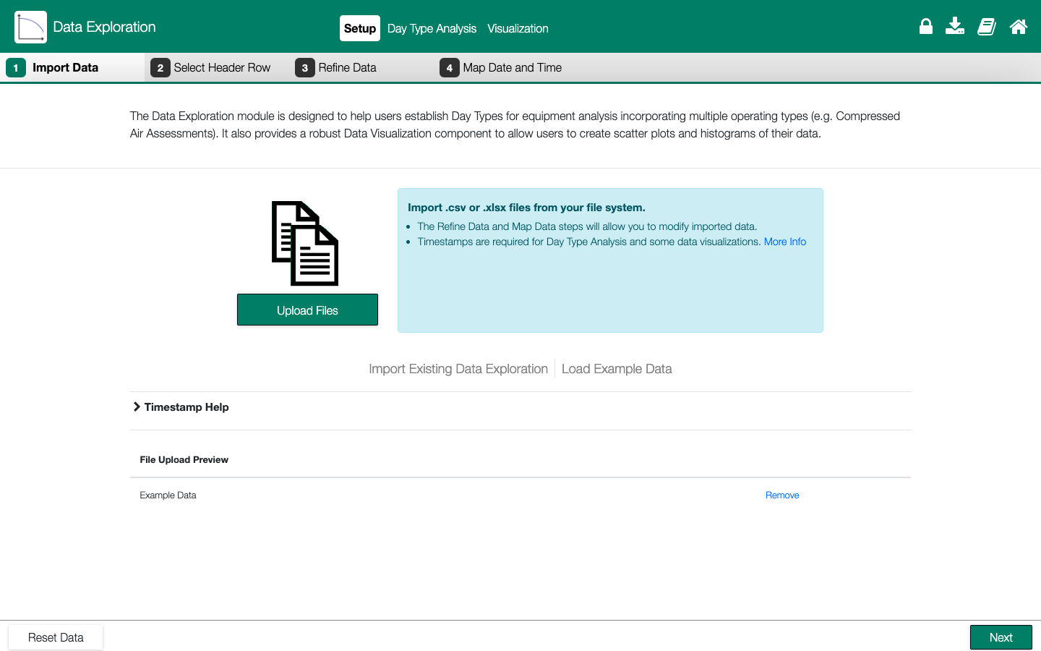
Setup- Import Data
Notes:
Facilitator Notes:
Upload the file to be explored.
The first "true" row of data can be chosen in the module, so data does not need to be prepared before use. For a better experience, combine data files with matching timestamps into one .xlsx file (this will allow full use of the scatter plot abilities). An analysis completed in the Data Exploration Module can also be exported and reloaded using the same upload screen.
The file upload preview will show that a file was successfully uploaded.
Click on Next at the bottom right corner.

Slide 10
Setup- Select Header Row
Notes:
Facilitator Notes:
The color green on the header, indicates that all is good to proceed.

Slide 11
Setup- Refine Data
Notes:
Facilitator Notes:
Check the box on the columns to be used for analysis.
Here you could change the name and
add units to each.

Slide 12
Setup- Map Date and Time
Notes:
Facilitator Notes:
This step can be skipped if not working with time data.
Timestamps are required for Day Type Analysis and time series data visualizations.
Mark "Includes Date" if the column contains a date and time or a date only
Mark "Includes Time Only" if the column contains a time only
In this case only the “Date Time” column is checked since ”DateTime” column contains only a date.

Slide 13
Day Type Analysis

Slide 14
Day Type Analysis
Notes:
Facilitator Notes:
The “Day Type Analysis” section provides the ability to break your data down into “Day Types” or similar days of system operation. A date or time field is required in your data for analysis.
The days and their corresponding day types will be displayed in the calendar at the bottom left of the “Day Type Analysis” screen. Use this calander to manage your day types and their corresponding days by:
Clicking the dates to toggle the day type of that date.
Removing day types completely by clicking the day type labels at the top.
Creating additional day types with the “+Add New” link in the upper right.

Slide 15
Day Type Analysis
Notes:
Facilitator Notes:
The data and day types can be explored in a variety of ways using the menu at the top to:
View the data graphically or as a data table (top left).
Toggle between viewing days or day types (top right).

Slide 16
Day Type Analysis
Notes:
Ability to set workdays, weekends, and excluded days from the data.

Slide 17
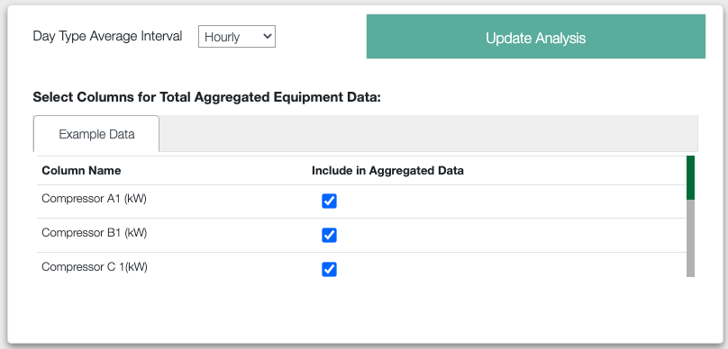
Day Type Analysis
Day Type Average Interval by quarter of an hour, half an hour, hourly, or daily.
Ability to select columns for total aggregated equipment data

Slide 18
Visualization
Notes:
Facilitator Notes
Use the “Visualization” tab to generate time plots, scatter plots and histograms of your data.

Slide 19
Visualization
Notes:
Facilitator Notes
Label the title of the graph
Choose the type of plot you want between “Time Series”, “Histogram”, and “Scatter plot”.
Choose the appropriate data for each axis.
Label the axis titles

Slide 20
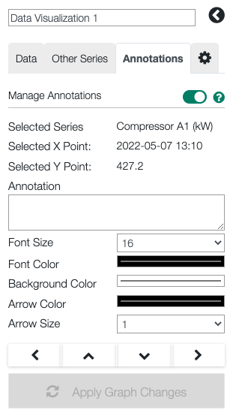
Visualization
Data Summary
A summary of the data in the chart is provided in a table at the bottom of the page.
Annotations
Can annotate the chart by clicking on a data point. Once a data point is selected the “Annotations” section on the left-hand menu will look like the picture above.
Notes:
Facilitator Notes:
Whatever is added to the text box will be added to the chart. Use the options to customize the size and color of the annotation. Use the arrow buttons to move the annotation.
A list of current annotations will appear underneath this window.
If leaving the Visualization screen or changing the data on the graph then the annotations will be removed.
Additionally, some help text with further information can be found underneath the “Help” tab here

Slide 21
References
1. https://www.energy.gov/eere/iedo/measur

Slide 22
Questions?

