Slide 1
An Introduction to the MEASUR Tool Suite

Slide 2
Outline of the Module
Introduction
Introduction to MEASUR Tool Suit
Getting Started with MEASUR
MEASUR Walkthrough
Understanding the Basics of MEASUR
Resource and Support

Slide 3
Introduction

Slide 4
Introduction
Energy Efficiency and Cost Savings: Implementing energy-efficient technologies and practices can lead to significant cost reductions by lowering energy consumption, minimizing waste, and optimizing production processes to be more fuel and power conservative.
Impact on Process and Product Quality: Energy efficiency often involves refining operational processes which can result in consistent product quality. Improved equipment and reduced strain on resources can lead to better control over manufacturing processes, yielding high-quality outcomes.
Environmental Impact: Enhancing energy efficiency reduces the carbon footprint of production, leading to less greenhouse gas emissions and a lower environmental impact. Sustainable practices also foster a positive public image and align with global environmental goals.
Notes:
Facilitator’s note: Improving energy efficiency offers multiple benefits across cost, quality, and environmental impact. Implementing energy-efficient technologies and practices significantly reduces energy consumption, minimizes waste, and optimizes production processes, resulting in substantial cost savings while promoting fuel and power conservation. Additionally, energy efficiency often enhances operational processes, ensuring consistent product quality. Upgraded equipment and reduced strain on resources improve process control and yield better outcomes. From an environmental perspective, energy efficiency reduces the carbon footprint of operations by lowering greenhouse gas emissions and overall environmental impact. These sustainable practices not only support global environmental goals but also enhance a company’s public image.

Slide 5
Introduction to MEASUR Tool Suite

Slide 6
What is MEASUR?
MEASUR (Manufacturing Energy Assessment Software for Utility Reduction) is a toolkit developed by the Department of Energy (DOE).
MEASUR is a series of tools and calculators (in one platform) that can perform investment grade energy analysis
It can also be used as smaller, stand-alone tools to perform simple calculations.
Free and open access
Notes:
Facilitator’s note: MEASUR (Manufacturing Energy Assessment Software for Utility Reduction) is a versatile toolkit developed by the Department of Energy (DOE) to support energy efficiency in industrial operations. It combines a suite of tools and calculators within a single platform to perform investment-grade energy analysis, making it ideal for comprehensive energy assessments. Additionally, MEASUR can function as stand-alone tools for performing quick, simple calculations. The software is free and open access, ensuring it is widely available to help industries optimize energy use, reduce costs, and improve sustainability.

Slide 7
Getting started with MEASUR

Slide 8
Installation Directions
Step-by-step guide on downloading and installing MEASUR.
Web version of MEASUR available at https://measur.ornl.gov/
Users can also download MEASUR from the U.S. DOE website and install it on their devices
GitHub Repository: https://ornl-amo.github.io/
Notes:
Facilitator’s note: This slide outlines the steps for accessing and installing the MEASUR software. Users can utilize the web version of MEASUR, available at https://measur.ornl.gov/, to perform energy assessments directly through their browser without the need for downloading. For offline use, MEASUR can be downloaded and installed from the U.S. Department of Energy website, providing flexibility for users to work on their systems locally. Additionally, the GitHub repository at https://ornl-amo.github.io/ offers access to the source code and additional resources, catering to developers and advanced users who may wish to explore or customize the software. These options ensure that MEASUR is accessible and user-friendly for a variety of needs.

Slide 9
Downloading via DOE Website
https://www.energy.gov/eere/amo/articles/how-download-amo-tools-desktop-v040-better-plants-template

Slide 10
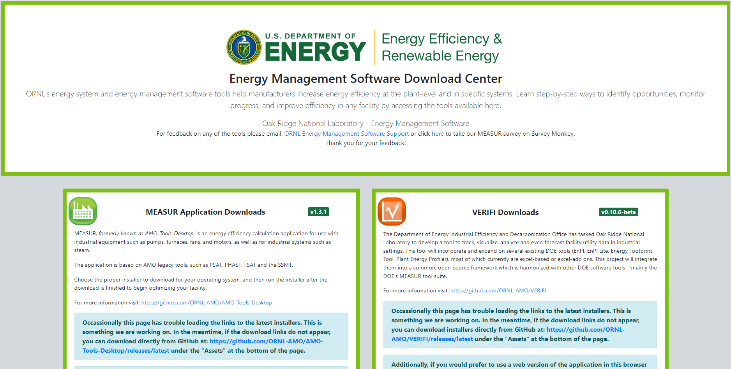
Downloading from Github
Download MEASUR directly from GitHub using this link: https://ornl-amo.github.io/

Slide 11
MEASUR Walkthrough
An overview of the user interface and key features

Slide 12
Welcome Note

Slide 13
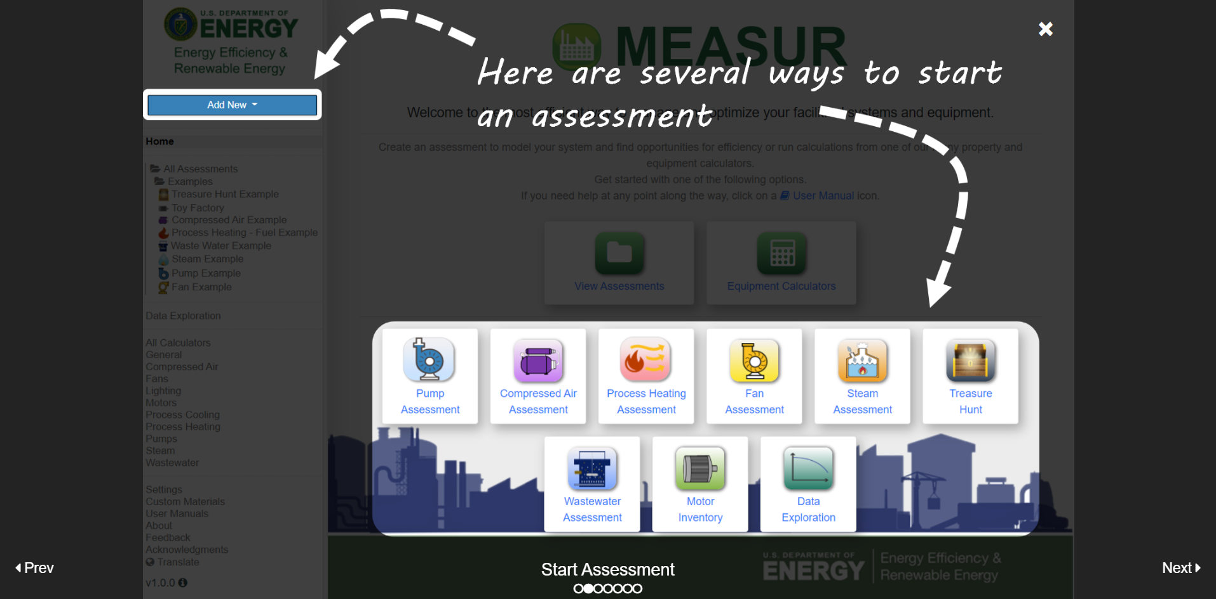
Location Whereabouts
Notes:
Facilitator’s note: This slide introduces the MEASUR interface and demonstrates how to start an assessment. Users can initiate a new assessment by selecting the "Add New" button on the left-hand menu or by choosing from the available modules displayed on the main screen. The highlighted modules include assessments for Pump Systems, Compressed Air, Process Heating, Fan Systems, Steam Systems, Treasure Hunts, Wastewater, Motor Inventory, and Data Exploration. These tools are designed to help users optimize energy efficiency and identify cost-saving opportunities across various systems. The intuitive interface ensures that users can quickly navigate and begin their assessments tailored to their specific needs.

Slide 14
Demo Examples
Notes:
Facilitator’s note: The highlighted area on the left side of the screen shows examples of various assessment types available, such as 'Treasure Hunt Example,' 'Compressed Air Example,' and others. The central highlighted button guides users to access all their assessments through the dashboard. The dashed arrows emphasize how users can navigate to this dashboard for managing and reviewing their energy efficiency assessments effectively. This interface simplifies tracking and organizing energy-related data for streamlined analysis.

Slide 15
Calculators
Notes:
Facilitator’s note: This slide highlights the 'Equipment Calculators' feature in the MEASUR tool. On the left-hand side, the menu showcases a list of all available calculators, such as those for 'Compressed Air,' 'Fans,' 'Motors,' 'Process Cooling,' and more. The central highlighted button allows users to access the 'Equipment Calculators' dashboard directly. The dashed arrows guide the user's attention to where they can explore tools for property and equipment calculations, providing a centralized way to perform energy efficiency and equipment performance analyses. This feature is designed to help users model and optimize their systems efficiently.

Slide 16
More Information
Notes:
Facilitator’s note: The highlighted section in the lower-left corner of the interface provides access to settings, custom materials, user manuals, feedback options, acknowledgments, and translation features.

Slide 17
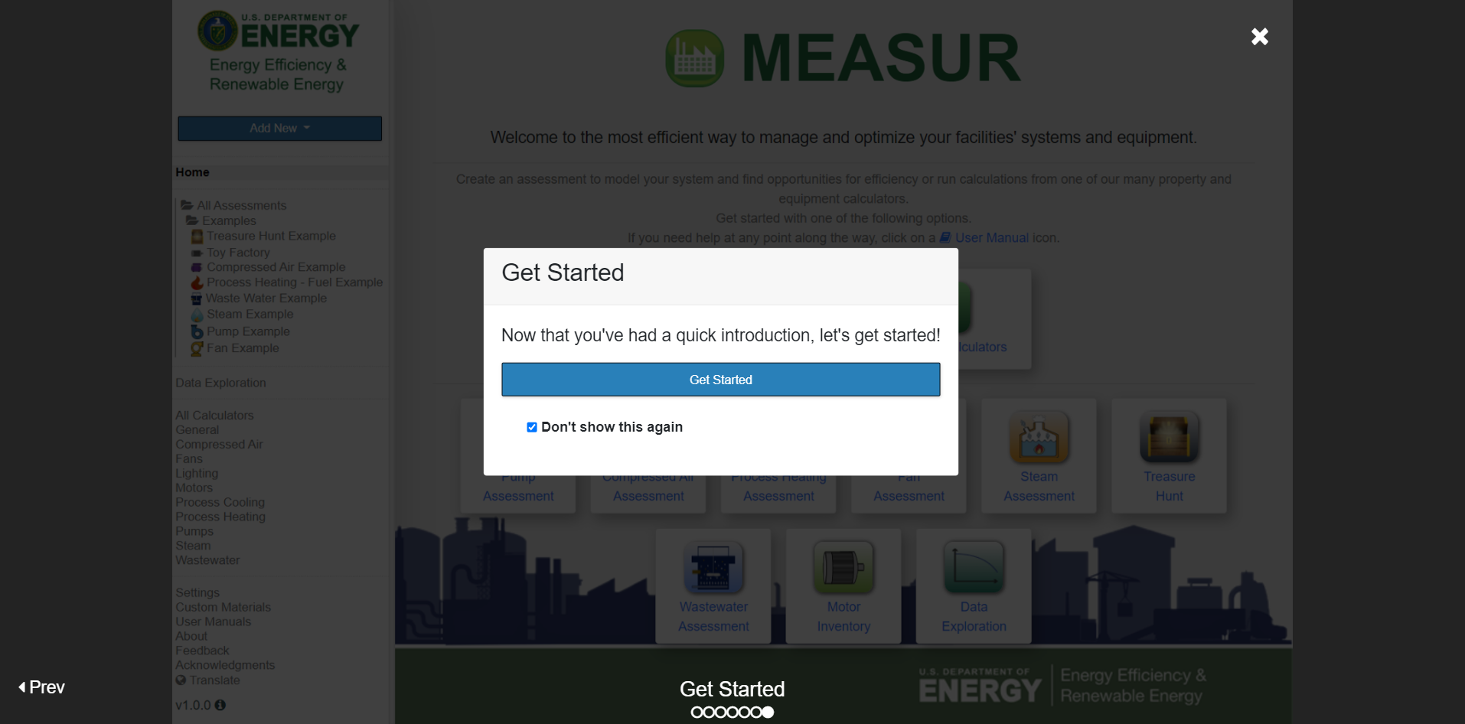

Slide 18
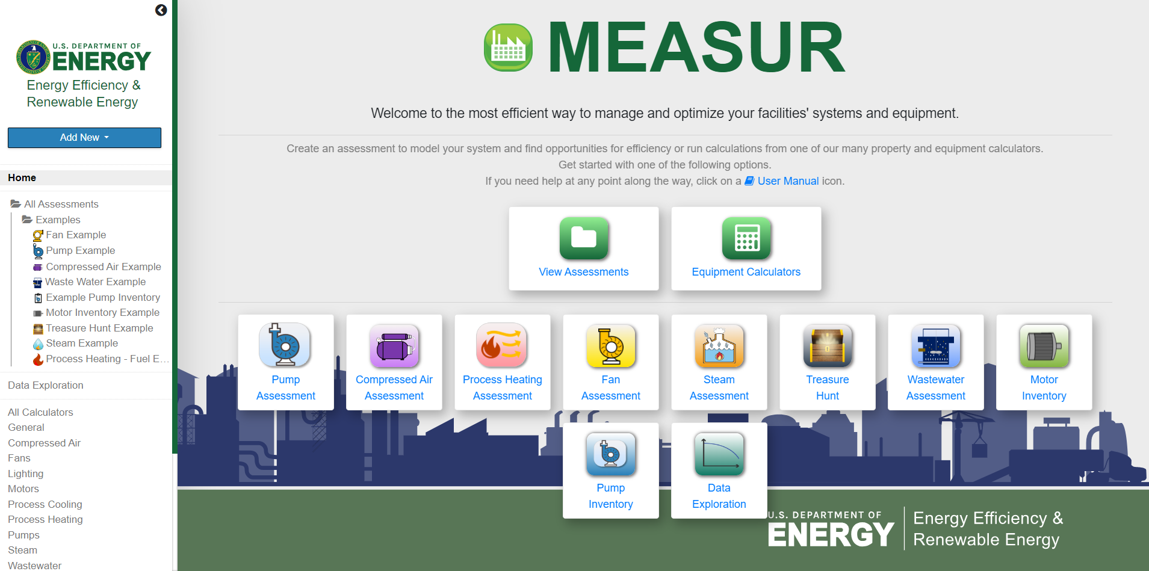
Home Screen
Notes:
Facilitator’s note: This is the main interface of the MEASUR tool, designed to help users manage and optimize energy efficiency for facilities and equipment. At the center, key modules are displayed as icons, offering various functionalities. On the left-hand side, there is a navigation menu featuring: examples, data exploration tools, settings, and additional resources.

Slide 19
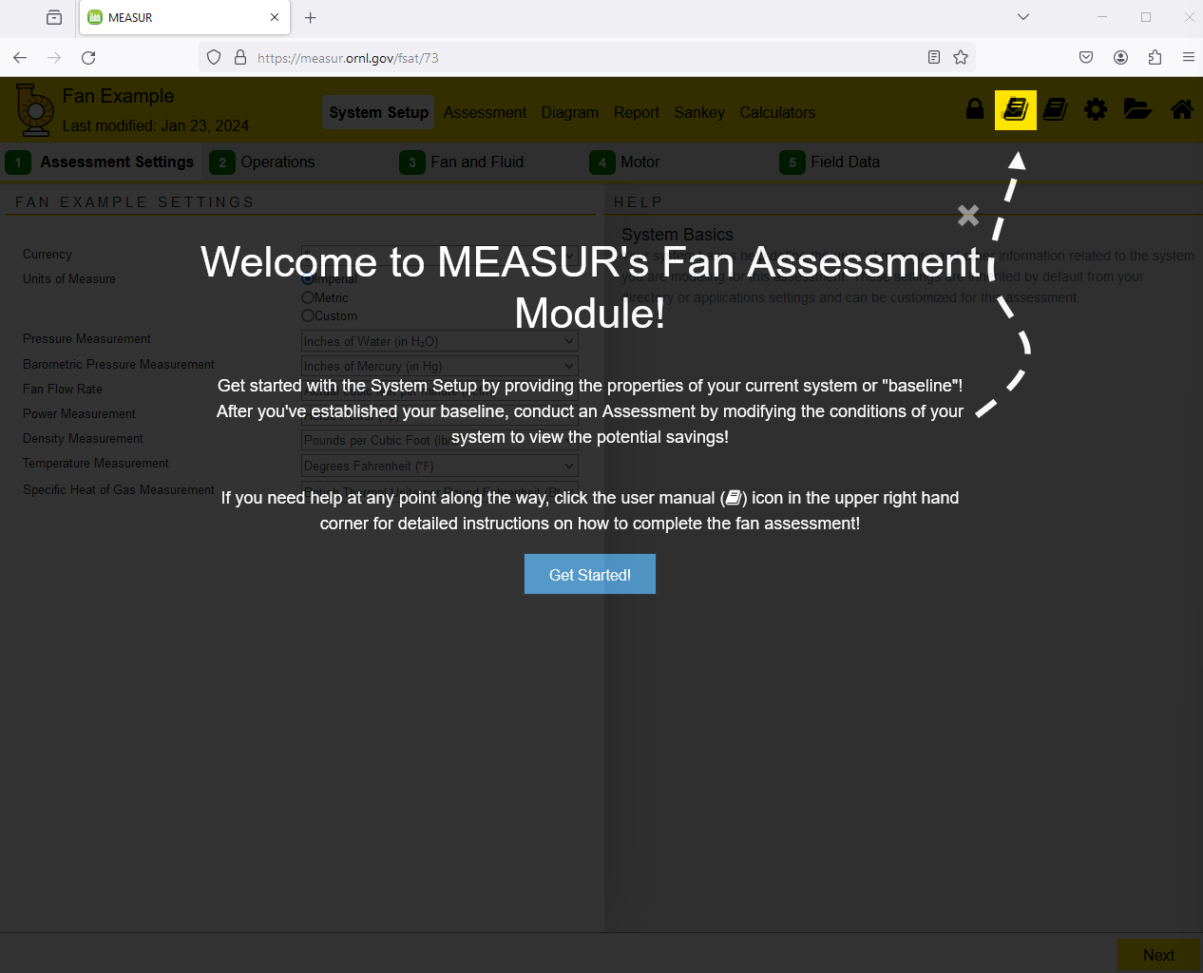
Fan Assessment
Notes:
This is how it looks when you click any of the modules. It will guide you through different settings of the module making it easier to assess your system.

Slide 20
Understanding the basics of MEASUR

Slide 21
Use of MEASUR
USED IN A VARIETY OF WAYS OF ANALYZE AND OPTIMIZE FACILITIES’ ENERGY PERFORMANCE.
CONDUCT ASSESSMENTS OF SYSTEMS AND DO QUICK CALCULATIONS WITH OVER 70 DIFFERENT CALCULATORS.
Notes:
Facilitator’s note: MEASUR is a powerful tool used in a variety of ways to analyze and optimize the energy performance of facilities. It allows users to conduct in-depth assessments of systems such as pumps, fans, compressed air, steam, and more. Additionally, the tool provides quick and efficient calculations with access to over 70 specialized calculators. These calculators cover a broad range of applications, enabling users to evaluate energy usage, identify inefficiencies, and implement strategies for improvement.

Slide 22
Module Navigation
Use the top banner to navigate around the module. A footer bar with “Next” and “Back” button can also be used to move through the System Setup to the Report.
Main Tabs consists of System Setup, Assessment, Diagram, Report, Sankey.
Additional button consists of Book ,Gear ,Folder ,Home
Fig: Top banner of the module
Notes:
Facilitator’s note: The MEASUR tool offers intuitive navigation features to enhance user experience and streamline workflows. The top banner serves as the primary navigation tool, allowing users to move seamlessly between different modules. Additionally, a footer bar with 'Next' and 'Back' buttons enables step-by-step navigation through the workflow, starting from the System Setup phase and continuing to the final Report. The tool is organized into five main tabs: System Setup, for configuring system details; Assessment, for conducting detailed evaluations; Diagram, for visualizing system flow and structure; Report, for reviewing results and summaries; and Sankey, for analyzing energy flow using a Sankey diagram. To further enhance functionality, additional buttons such as the Book (for accessing manuals and reference materials), Gear (for settings and customization), Folder (for file and assessment management), and Home (for returning to the main interface) are available.

Slide 23
Main Tabs
Table 1: Main Tabs in MEASUR Assessment Modules
Main Tab | Explanation
System Setup | Input baseline data for your system, divided into sub-tabs for detailed entry.
Assessment | Modify system scenarios to explore potential savings; options for novice and expert views.
Diagram | View graphical visualization of the current and modified systems.
Report | Access a full breakdown of the system, savings scenarios, and generate printable reports.
Sankey | See a visual representation of energy consumption and production for different scenarios.
Calculators | Use standalone calculators for additional process heating calculations.

Slide 24
Additional Buttons
Table 2: Additional Buttons in MEASUR Assessments Modules
Button | Explanation
Book | Opens the full Process Heating User Manual in a new window.
Gear | Navigates to the global settings page of MEASUR.
Folder | Takes you to the assessment dashboard for the current assessment.
Home | Brings you to the MEASUR home page.
Next/Back | Found in the footer, these buttons allow navigation through the System Setup to the Report sections.

Slide 25
Resources and Support

Slide 26
Resources
MEASUR trainings are provided by WVU Pollution Prevention (P2) Team. Contact Ashish Nimbarte (ashish.nimbarte@mail.wvu.edu) or Chris Moore (chris.moore@mail.wvu.edu) for support or inquiries.
U.S. DOE also provides MEASUR workshops and technical support upon request
DOE YouTube Channel: http://www.youtube.com/@BetterBuildingsDOE

Slide 27
Questions?

