Slide 1
Steam Assessment with MEASUR

Slide 2
Outline of the Presentation
Introduction to Steam Systems
Introduction to MEASUR Module
Navigating MEASUR- Steam Assessment
Enhancing System Efficiency: Best Practices
Applying Efficiency Recommendations in MEASUR
MEASUR Report Analysis
Summary and Key Takeaways

Slide 3
Introduction to Steam System

Slide 4
Introduction of Steam System
Used to generate, distribute, and use steam as a heat source or mechanical power
Produced by boiling water and converting it into vapor, which carries heat energy that can be transferred to various processes
Ideal to use in industries that require high-temperature heating or sterilization
Notes:
Facilitator’s note:
Steam systems are an essential part of many industrial and commercial processes, providing a reliable and efficient source of heat energy or mechanical power. These systems work by boiling water to produce steam, which is then distributed and used across various applications. Steam is particularly well-suited for industries that require high-temperature heating, such as chemical manufacturing, food processing, or sterilization processes in healthcare and pharmaceuticals. The versatility and high energy density of steam make it an indispensable utility in a wide range of operations. By understanding the basics of steam generation, distribution, and usage, industries can optimize their processes for better efficiency and performance.

Slide 5
Uses of a Steam System
Heating
Power Generation
Sterilization
HVAC
Process Steam
Notes:
Heating: Steam is used for heating reactors, tanks, and vessels to control chemical reactions or maintain desired temperatures. It is commonly used for drying paper, textiles, food products, and lumber.
Power Generation: Steam turbines are widely used in power plants to convert thermal energy into mechanical energy for generating electricity.
Sterilization and Cleaning: Industries like pharmaceuticals, hospitals, and food processing use steam for sterilizing equipment and surfaces.
HVAC: Steam is used for heating buildings and providing hot water for commercial and institutional settings.
Process Steam: Used in processes like chemical manufacturing, oil refining, and pulp and paper production, where steam acts as a medium to drive chemical reactions or to heat raw materials.

Slide 6
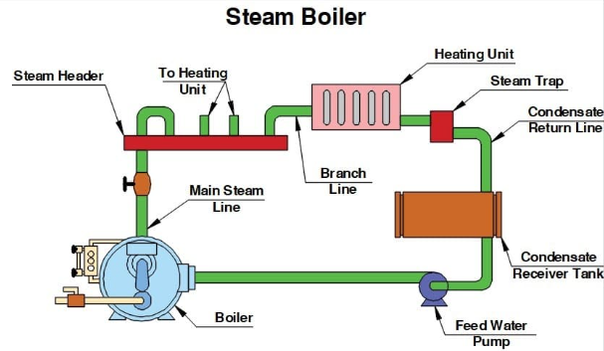
Components of a Steam System
Figure: Components of a steam system
Notes:
Boiler: A device where water is heated to generate steam. Boilers can be powered by fuels like natural gas, coal, oil, or electricity.
Steam Header: Network of pipes, valves, and fittings that transports steam from the boiler to different parts of the facility.
Steam Traps: Devices that remove condensate (water formed when steam cools down) from the system while preventing the escape of live steam.
Heating Unit: Used to transfer heat from steam to other media (like water or air) for heating or process applications.
Condensate Recovery System: Captures condensate and returns it to the boiler to be reheated, reducing water and energy consumption.
Control Systems: Include sensors, controllers, and automation software to monitor and adjust the pressure, temperature, and flow rate of steam.

Slide 7
Navigating Steam Module

Slide 8
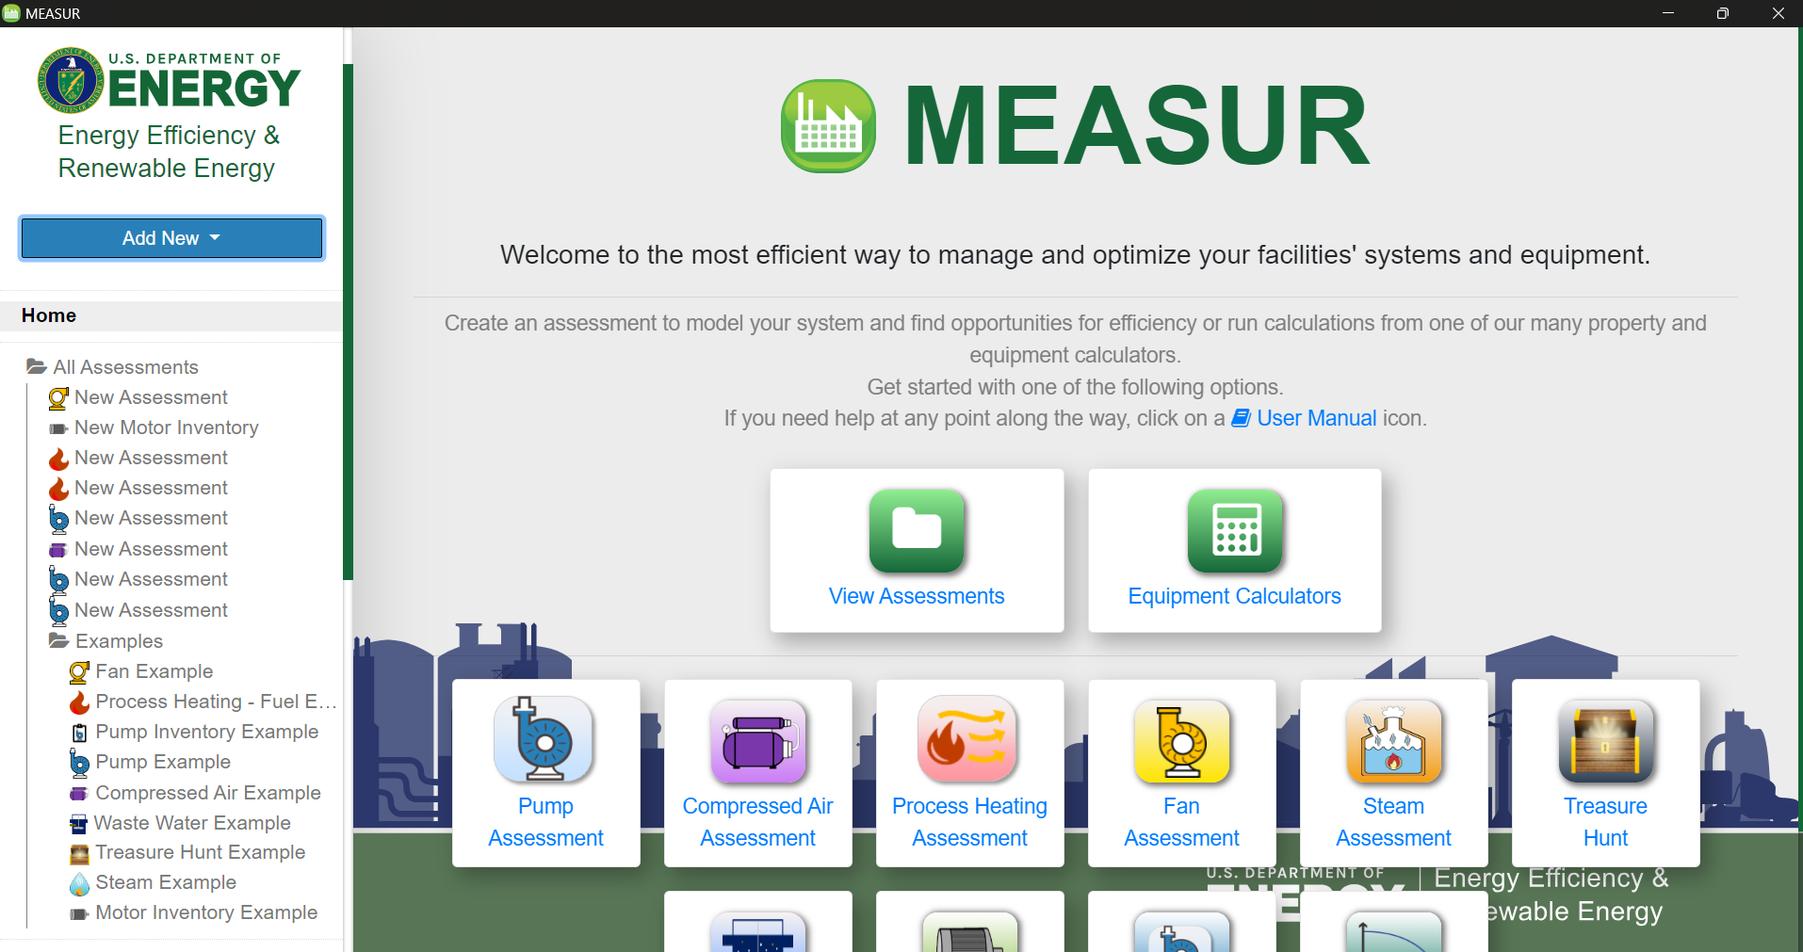
Introduction to MEASUR Module
Notes:
What is the The Steam Assessment Module? This tool helps users identify and evaluate the potential energy savings opportunities in steam systems. Industrial users can better understand the current operating conditions of the components of a steam system, including boilers, turbines and flash tanks. The tool helps estimate the various steam flows throughout the system and test "what-if" scenarios for various opportunities to reduce energy use.

Slide 9
Understanding the Module
Key Features:
Identify Energy Savings:
Evaluates potential energy savings in steam systems.
Comprehensive Analysis:
Assesses boilers, turbines, and flash tanks.
Scenario Testing:
Tests "what-if" scenarios for energy reduction.
Optimize Efficiency:
Helps industrial users improve steam system performance.
Notes:
Facilitator’s note:
The steam system module in MEASUR offers key features to help industries optimize energy efficiency and reduce operational costs. It identifies potential energy savings by thoroughly evaluating steam systems, including boilers, turbines, and flash tanks. The module provides comprehensive analysis capabilities, enabling users to understand system performance and pinpoint areas for improvement. Additionally, it allows users to test "what-if" scenarios to explore the impact of various energy-saving measures. By optimizing steam system efficiency, industrial users can enhance performance, reduce energy consumption, and achieve significant cost savings while minimizing their environmental footprint.

Slide 10
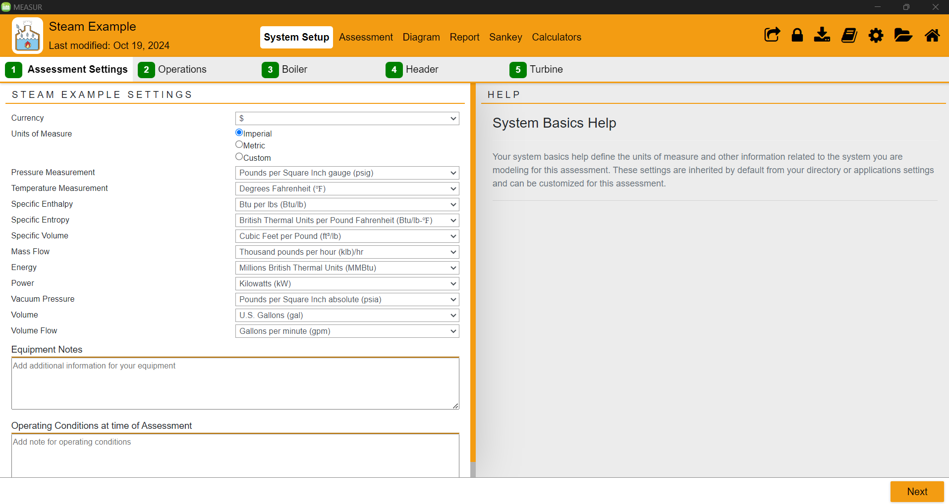
Steam Assessment- System Setup
Select the units you want to work with for the assessment.
Notes:
Start page of the steam module. Use the top banner to navigate around the module. A footer bar with “Next” and “Back” button can also be used to move through the System Setup to the Report. Main Tabs consists of System Setup ,Assessment ,Diagram ,Report ,Sankey. There are sub-categories within the main category. The system setup consists of 5 sub categories: assessment settings, operations, boiler, header, turbine

Slide 11
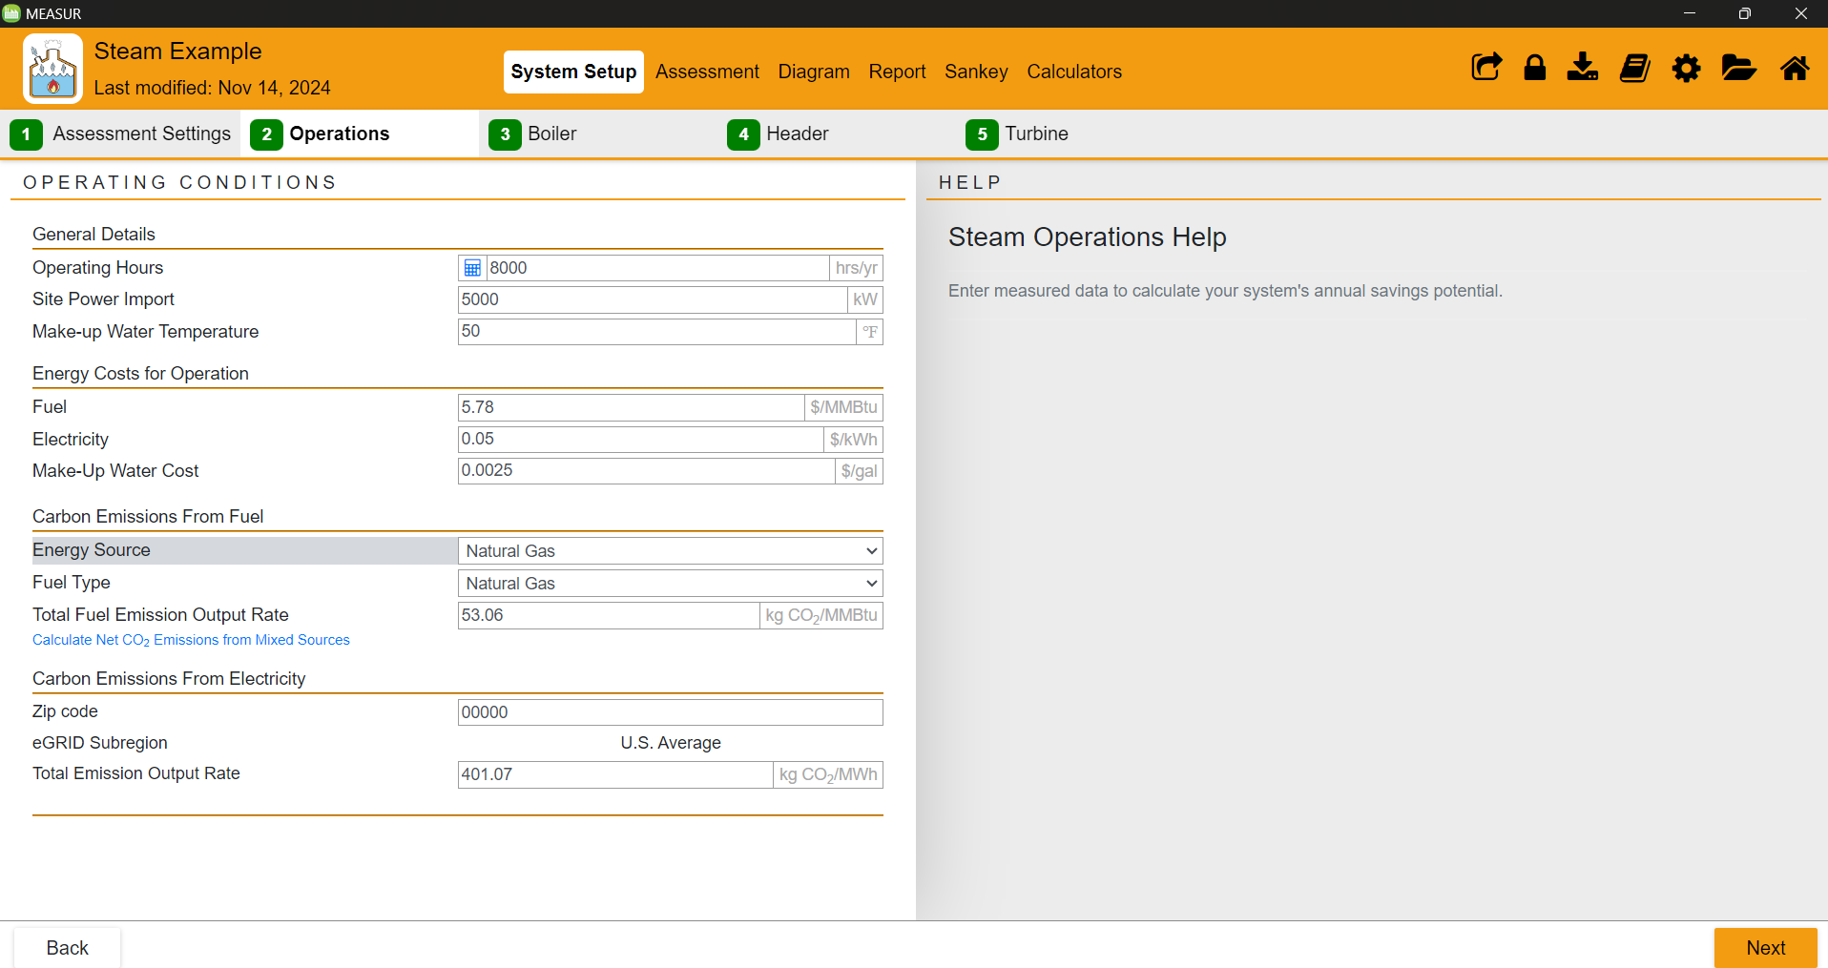
Setup - Operations
Notes:
Input information of your operations including:
Operating hours, site power import/export, make-up water temperature, energy costs, carbon emissions from fuel and electricity (from location).

Slide 12
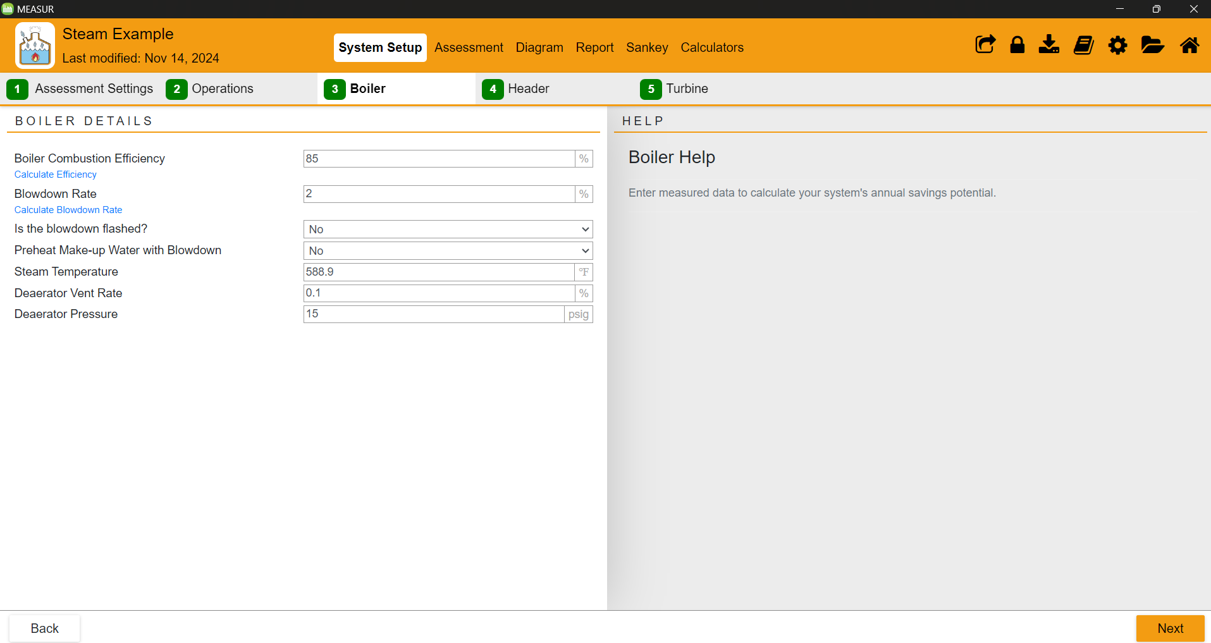
System Setup - Boiler
Notes:
Enter Boiler Efficiency, blowdown rate, steam temperature and other. If you don’t know the value, you can calculate by clicking the blue text.
The right-hand panel contains help text. The panel will show help relating to the field you are currently focused on.
Number will highlight red, and an error message will appear if the data that is entered is invalid.

Slide 13
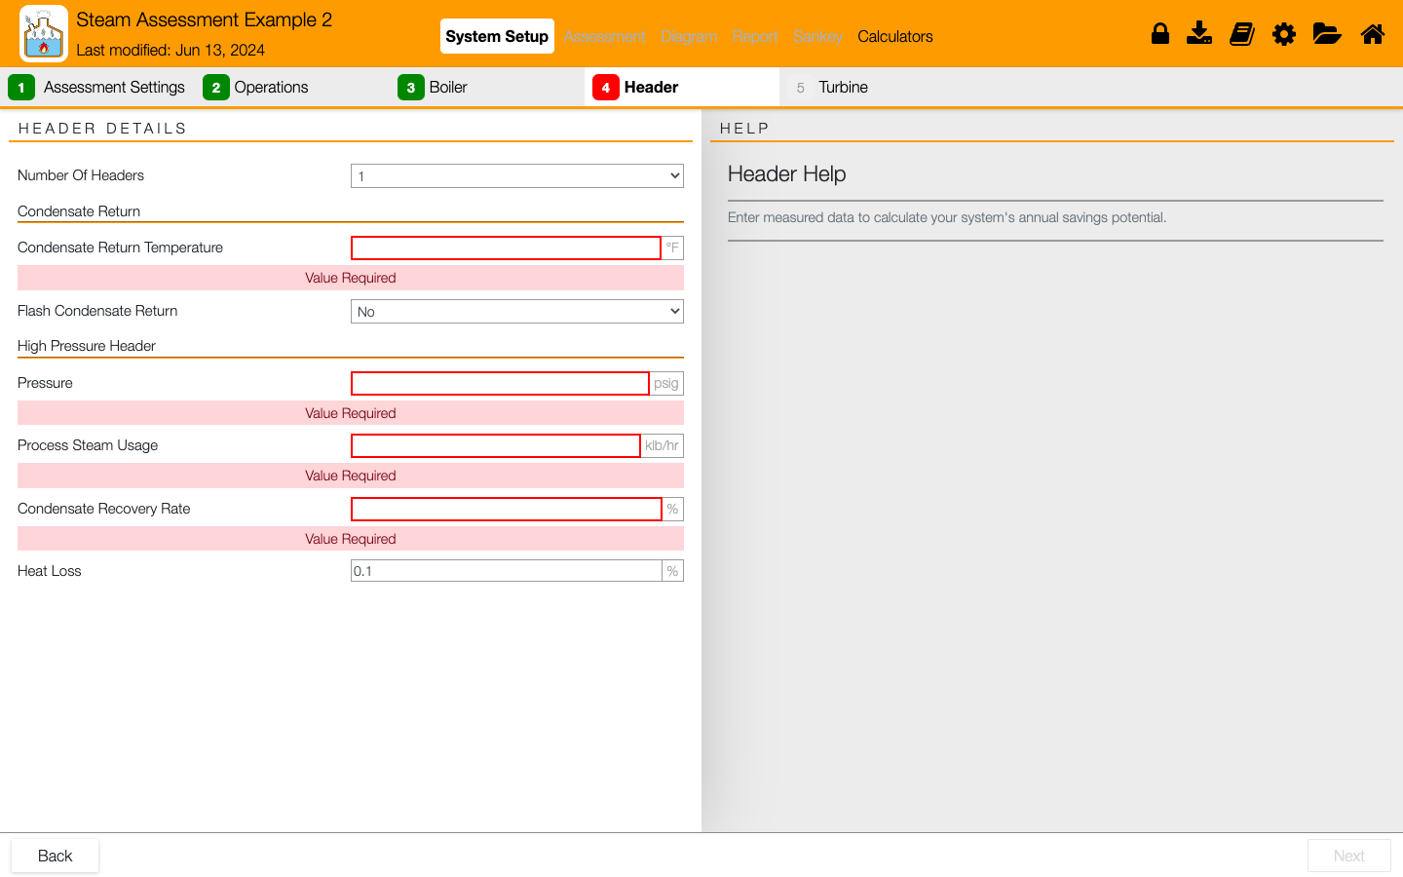
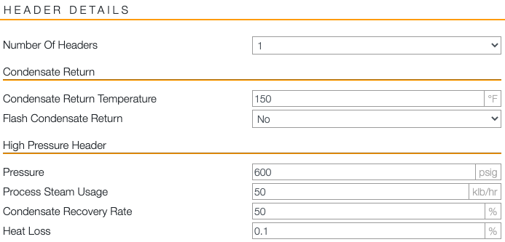
System Setup - Header
Notes:
Enter information of existing steam system header in the left panel. Use the help tab on the right-hand panel for help and definitions.

Slide 14
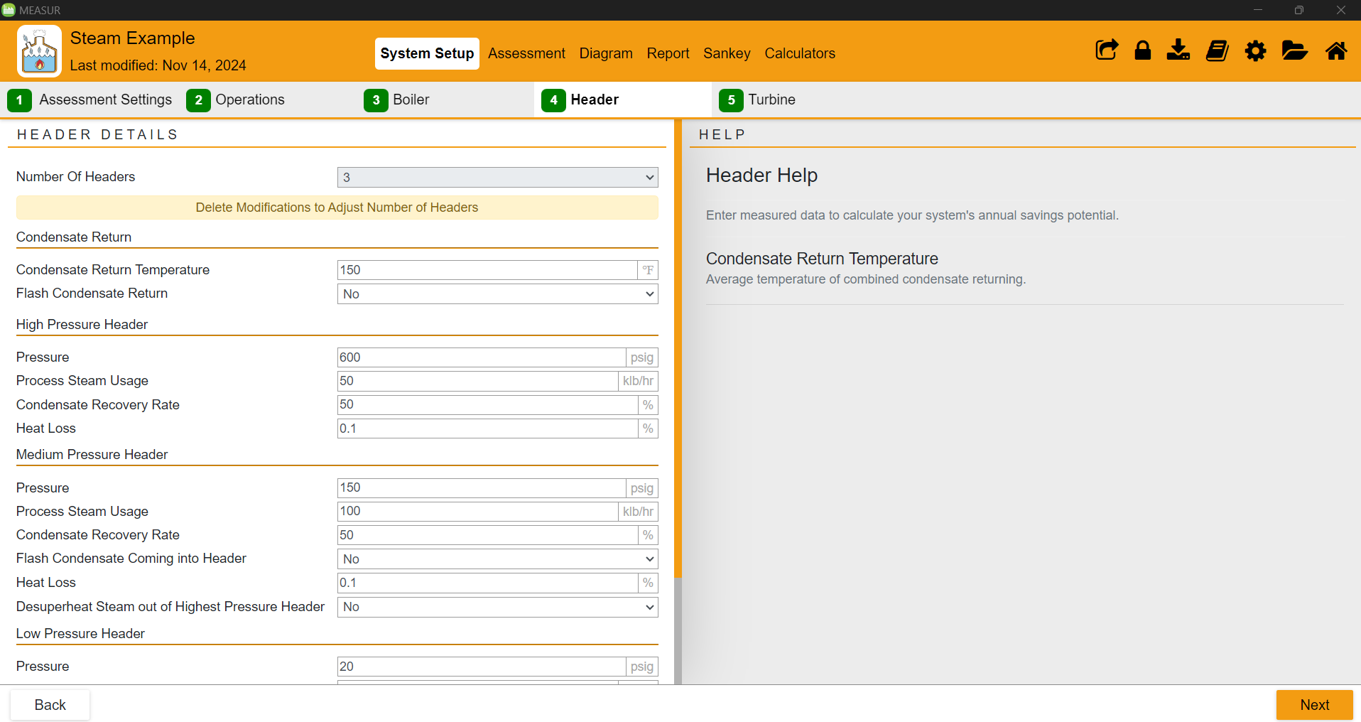
System Setup - Header
Notes:
After filing all the parameters, the header section will look like this.

Slide 15
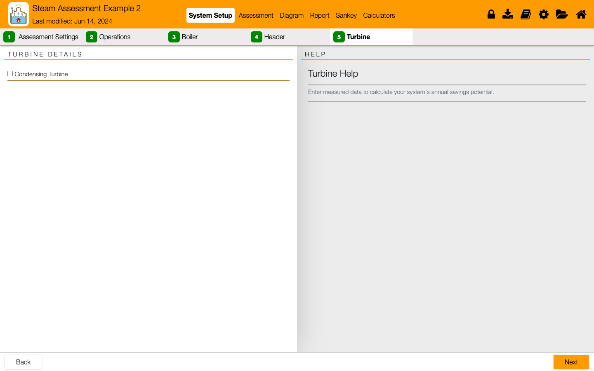
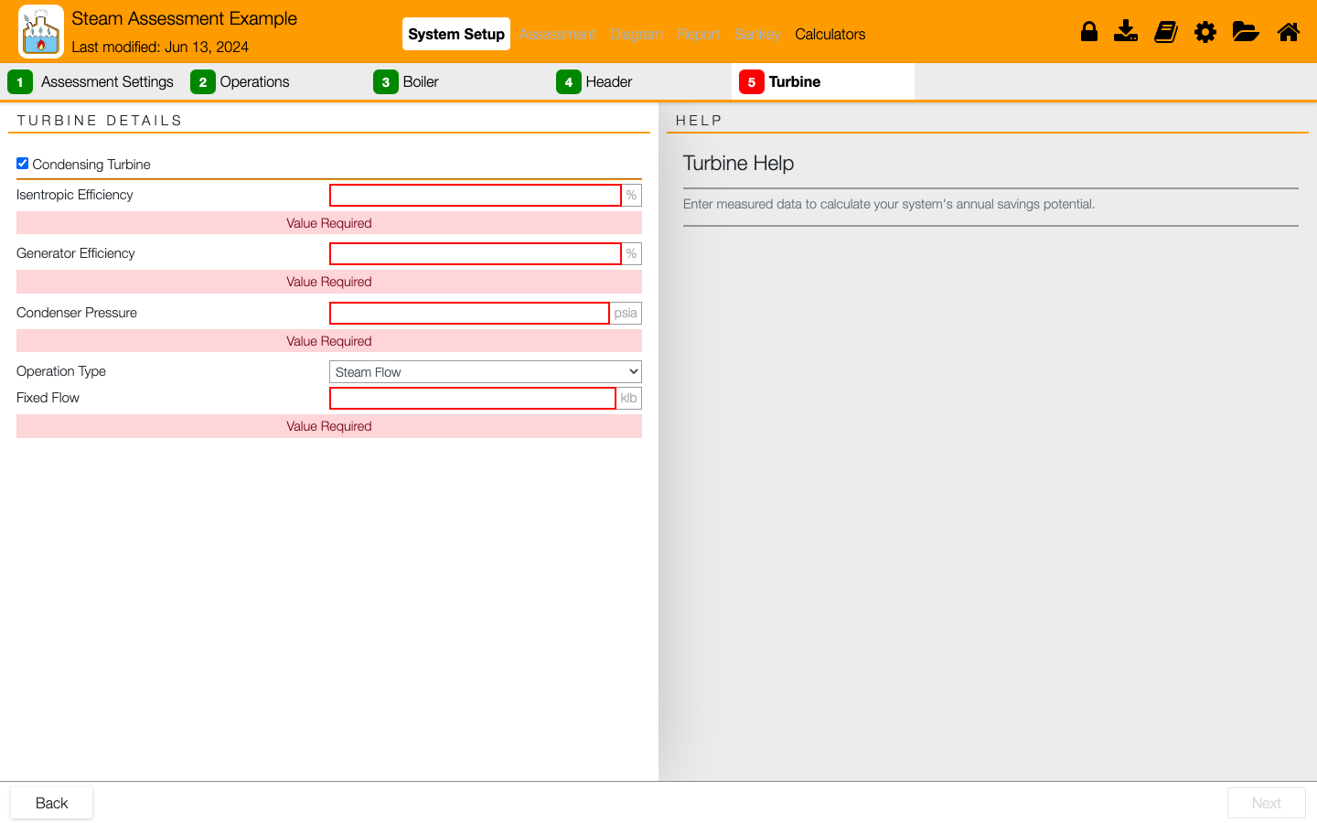
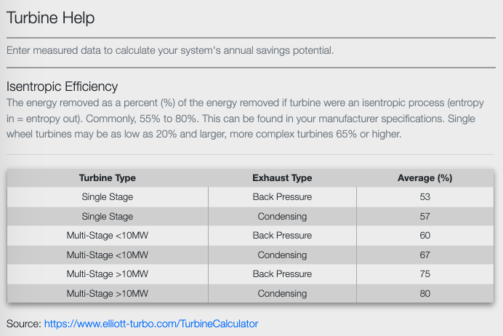
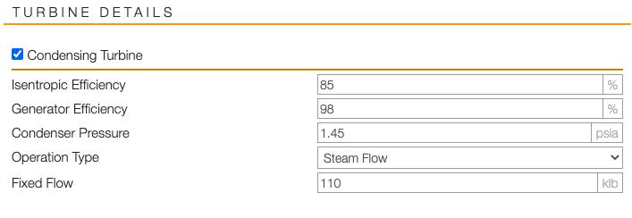
System Setup - Turbine
Notes:
Facilitator Notes:
Turbine details are optional. If the box is checked, required information should be inputted to proceed.
Help tab can be used for guidance when needed.

Slide 16
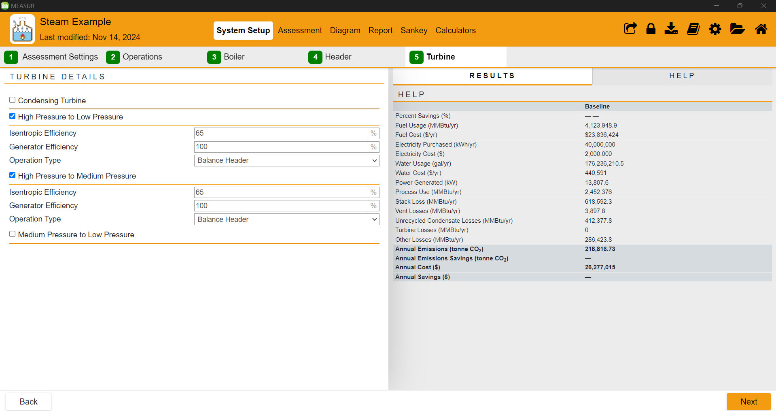
System Setup - Turbine
Notes:
This is how turbine section will look after entering isentropic efficiency, generator efficiency, and operation type. The results on right shows the present scenario.

Slide 17
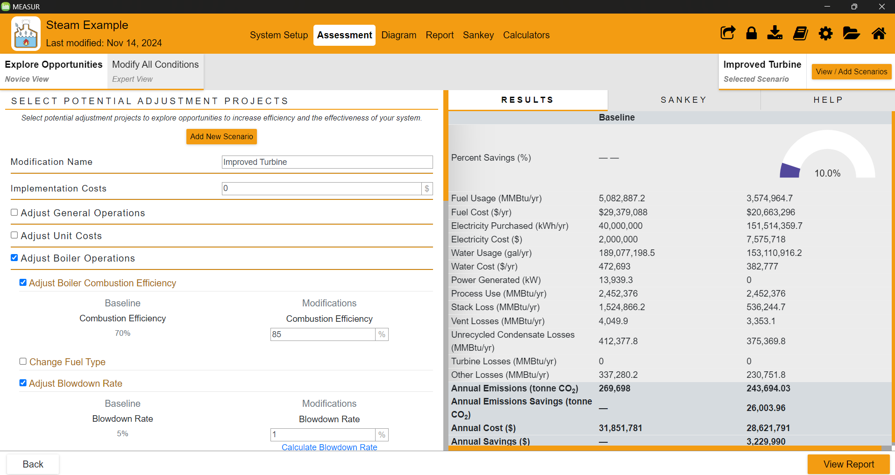
Assessment - Novice View
Notes:
You will create a new scenario in novice view and name it. We’ve created a new scenario named “Improved Turbine”. You can set the value for new scenario in novice view by checking the boxes and entering the new value but generally, expert view is more flexible and convenient.

Slide 18
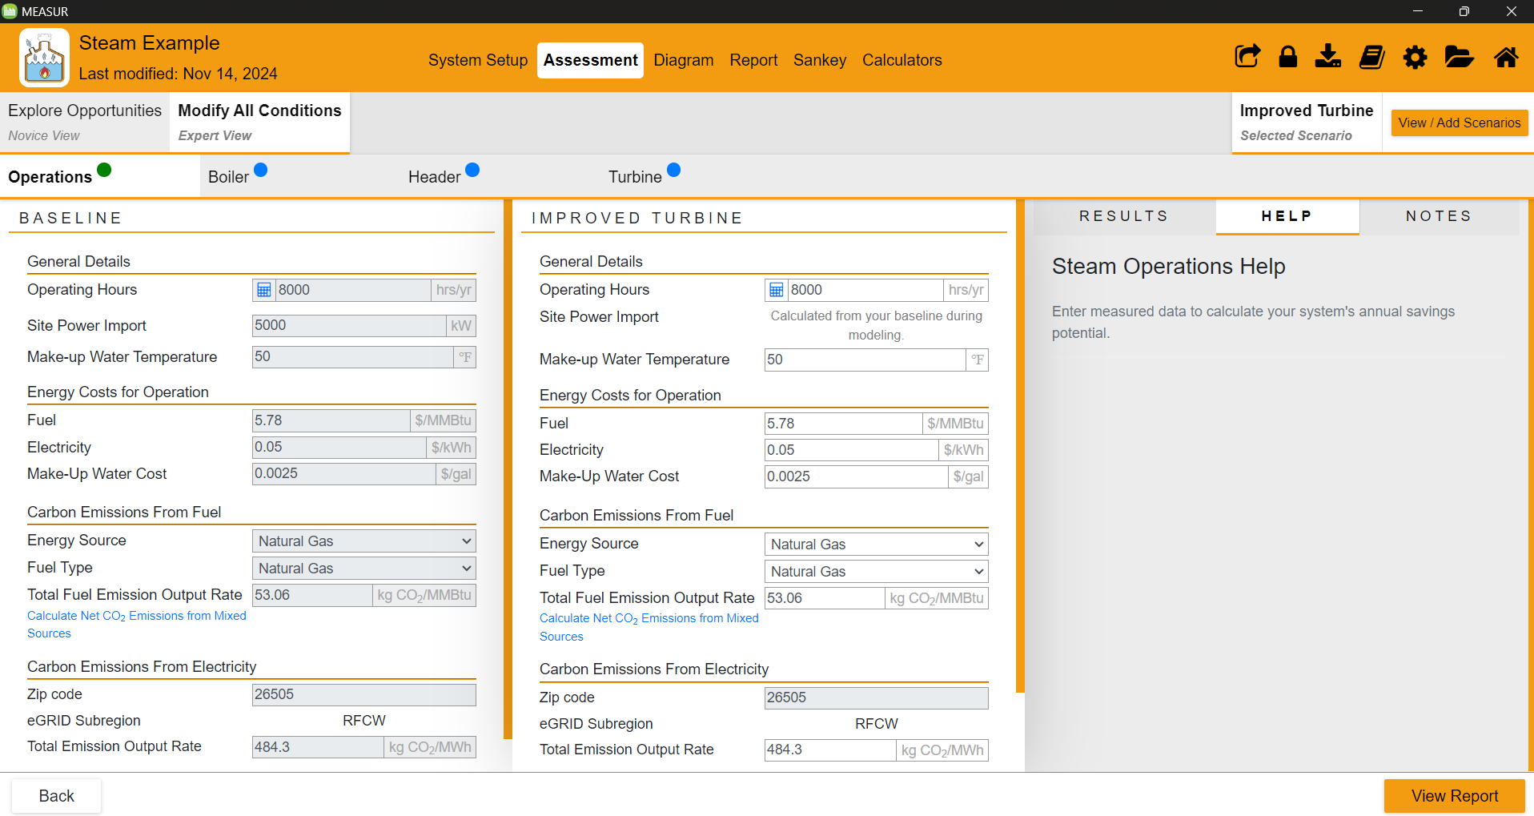
Assessment - Expert View
Notes:
In expert view, you can make changes in operating conditions, boiler, header, and turbine. You’ll see two different sections: ‘baseline’ on left and new scenario named ‘improved turbine’ on right. You can make changes by entering the improved parameters. Green circle indicates that there is no changes in value, blue indicates values are different from baseline, and red indicated the entered values are incorrect.

Slide 19
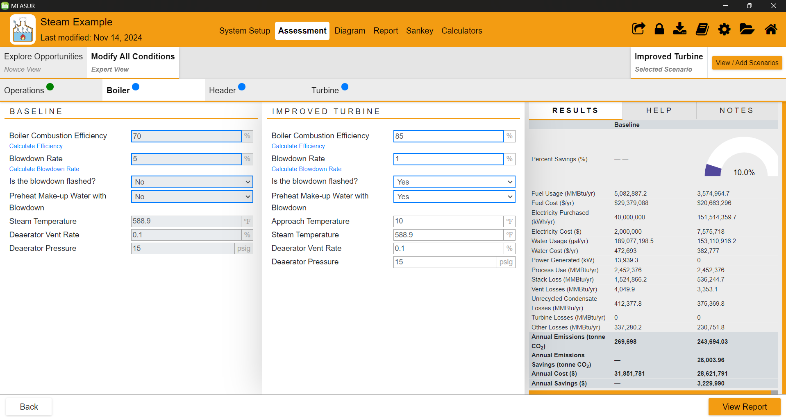
Expert View- Boiler
Notes:
Here, boiler combustion efficiency has been increased from 70% to 85%, blowdown rate has been decreased from 5% to 1%, and the make-up water is preheated by 10 ºF with blowdown water. This has increased the the energy savings by 10% as shown on results section on right.

Slide 20
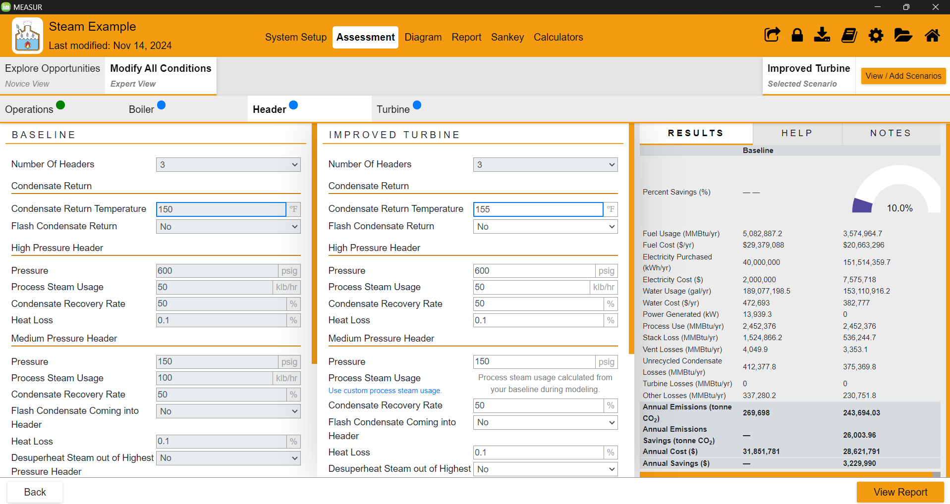
Expert View- Header
Notes:
Here, the condensate return temperature has been increased from 150 ºF to 155 ºF. Other settings have remained same. You can make changes as per your need.

Slide 21
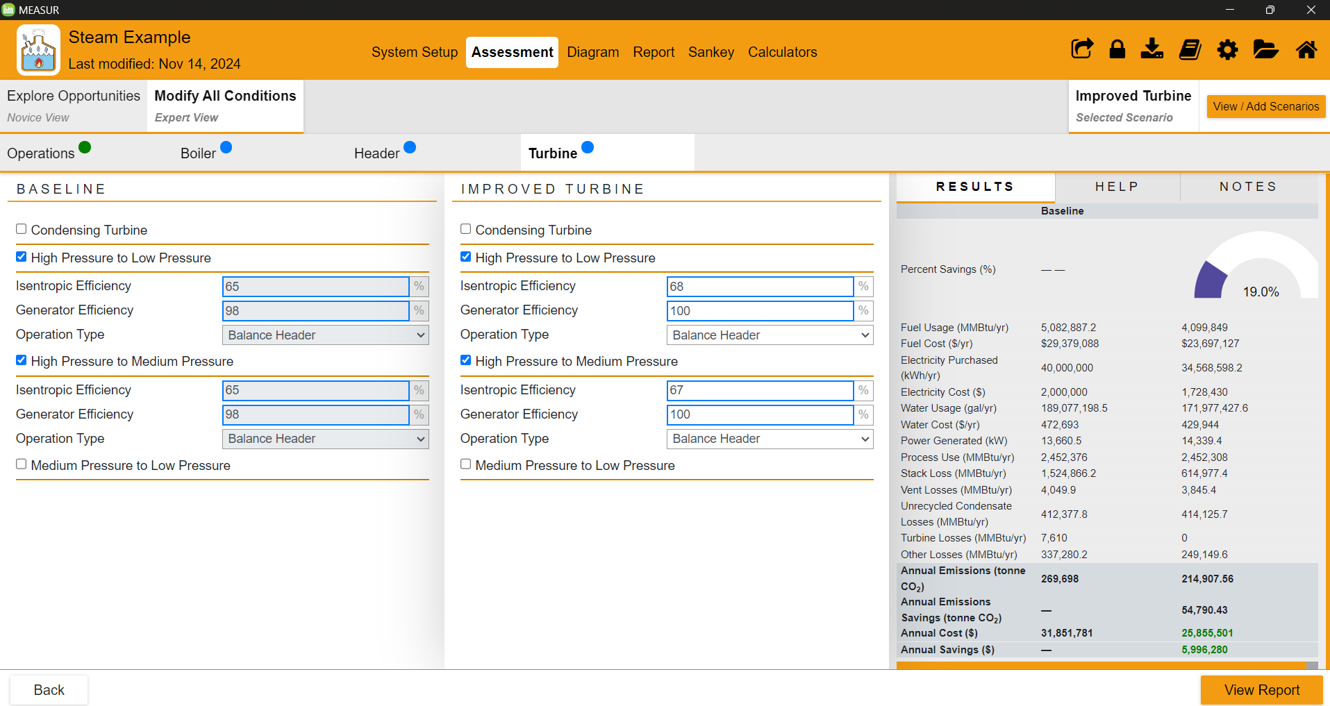
Expert View- Turbine
Notes:
In the improved case, we have made changes in high pressure to low pressure turbine and high pressure to medium pressure. We have increased the isentropic and generator efficiency in both cases which gave us 19% savings in energy which is equivalent to $6000 annually.

Slide 22
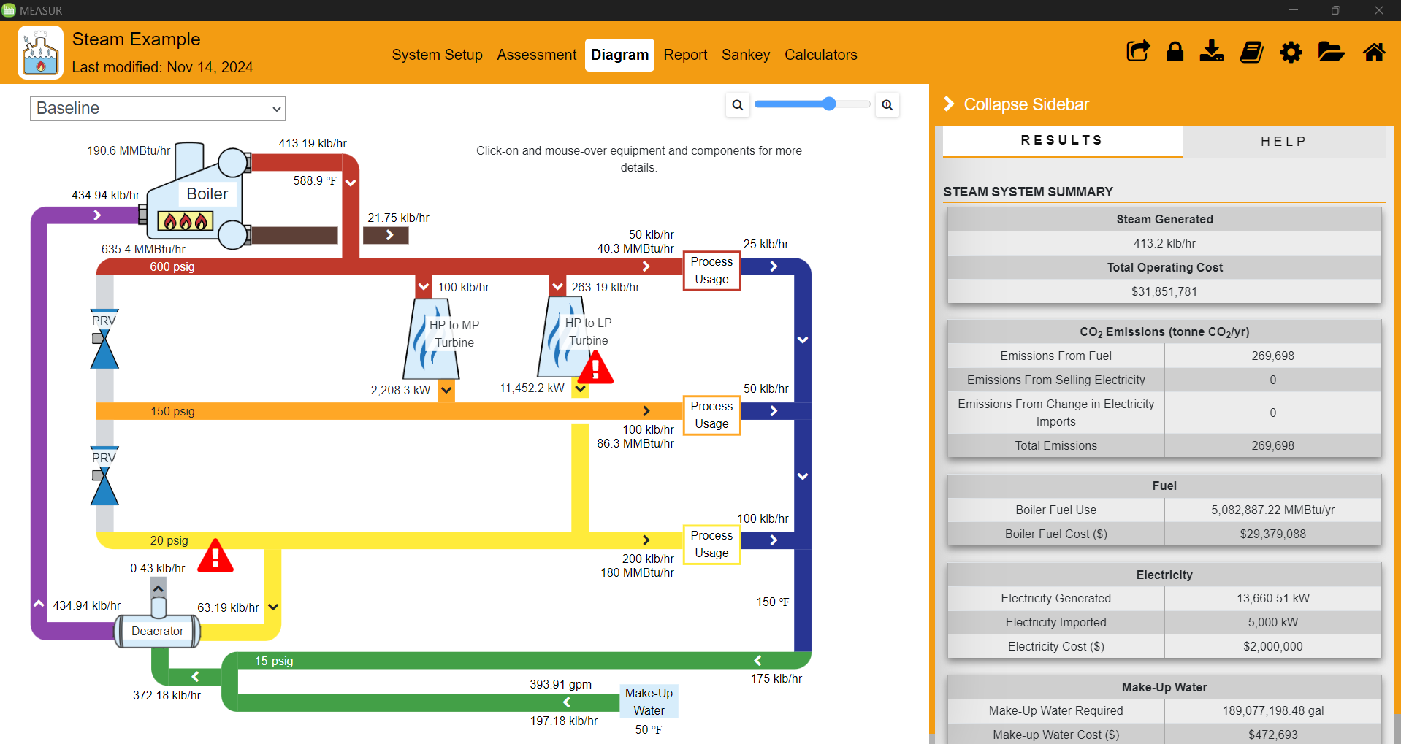
Diagram- Baseline Model
Notes:
Switch between the baseline and modification scenarios. Slider to zoom in and out of the diagram. Use the steam diagram to visualize details of your steam system setup. Explore steam properties for all aspects of your steam system for the baseline setup and all modification scenarios.
Clicking the equipment labels will give further details in the Results tab of the right-hand panel. Underneath the table there will be a “Copy to – Calculator” button that will copy the properties of the selected equipment over to a standalone calculator for further inspection.
The “General Summary” under the results tab will provide a breakdown of the emissions, cost and other consumption details.
The “View More Cost Details” link at the bottom right, will display a table with additional cost details including marginal steam costs.
Here you can quickly view steam mass flows and cost results. Able to get an insight into the cost of steam.

Slide 23
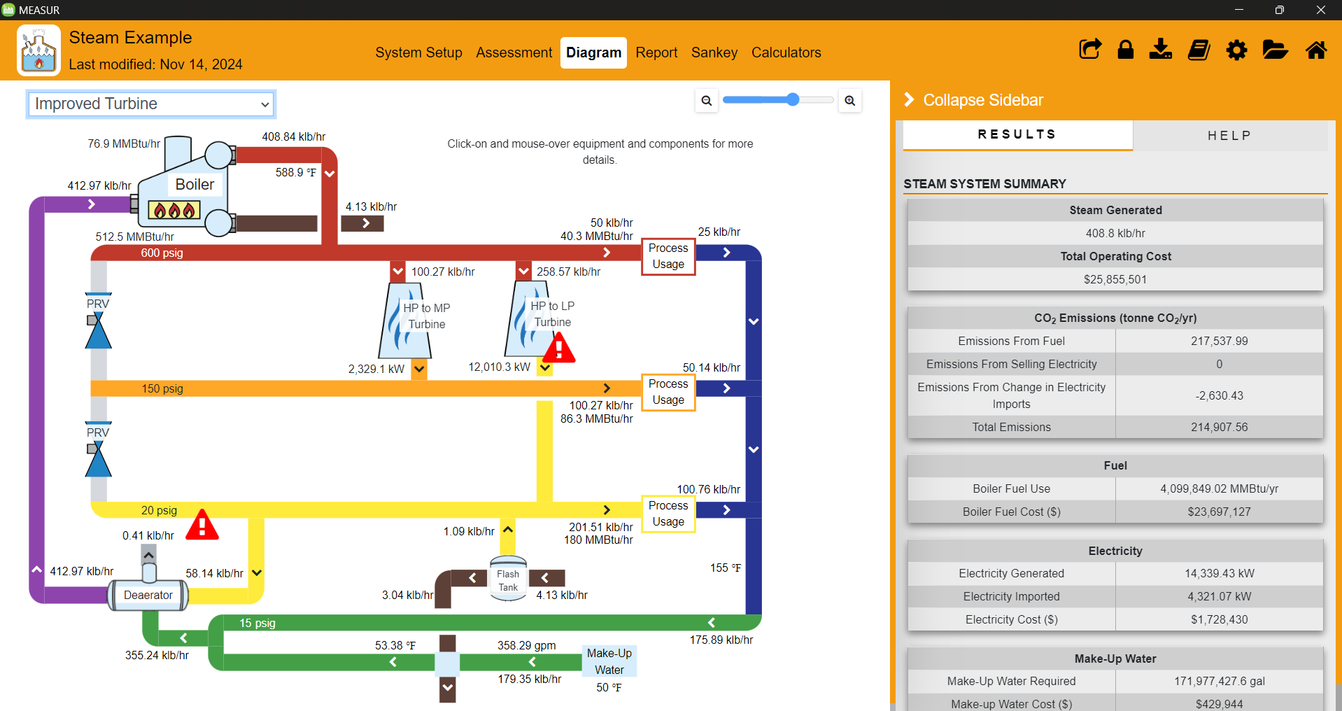
Diagram- Improved Scenario
Notes:
The area highlighted in red shows the preheating make-up water by blow-down.
Use the steam diagram to visualize details of your steam system setup. Explore steam properties for all aspects of your steam system for the baseline setup and all modification scenarios.
Here you can quickly view steam mass flows and cost results. Able to get an insight into the cost of steam.

Slide 24
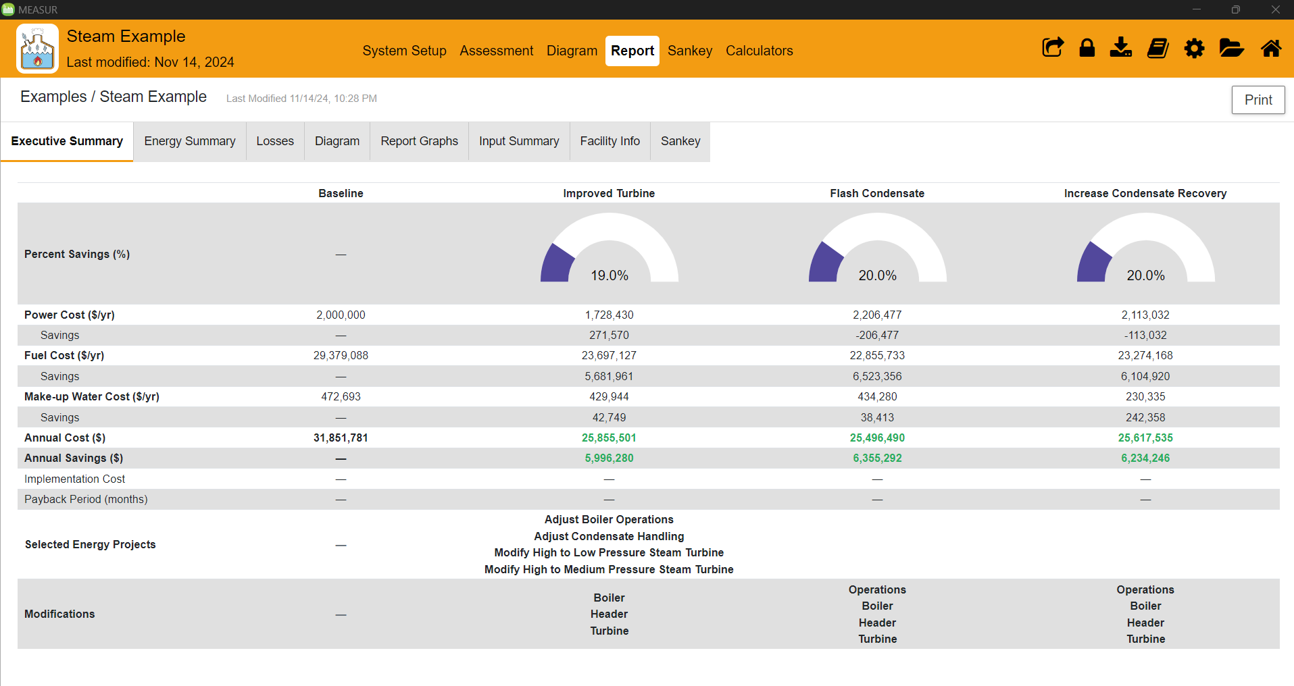
Report- Executive Summary
Notes:
The report is a printable summary of the baseline and scenarios you have created in the assessment. Tables and graphs are provided to analyze the impacts the changes have on each scenario comparatively. There is a secondary set of tabs to navigate to different pieces of the report. The “Print” button in the top right hand corner will generate a PDF report. This section will show all the energy savings, total cost, and payback period for each modifications.
Executive Summary: A financial breakdown of the current setup and modification scenarios. Modification notes will be found here, as well a details of the different modification projects.
Energy Summary: A detailed breakdown of the energy consumption, generation, and emissions in the system.
Losses: A detailed summary of input and output energy and where energy is loss throughout the system.
Diagram: The same system diagrams found in the “Diagram” section of the module.
Report Graphs: A set of graphical representations of the energy in the system.
Input Summary: A table of the input data for the baseline and each scenario.
Facility Info: The facility information provided for the folder that this assessment was created in.
Sankey: The same sankey diagrams found under the “Sankey” section of the module.

Slide 25
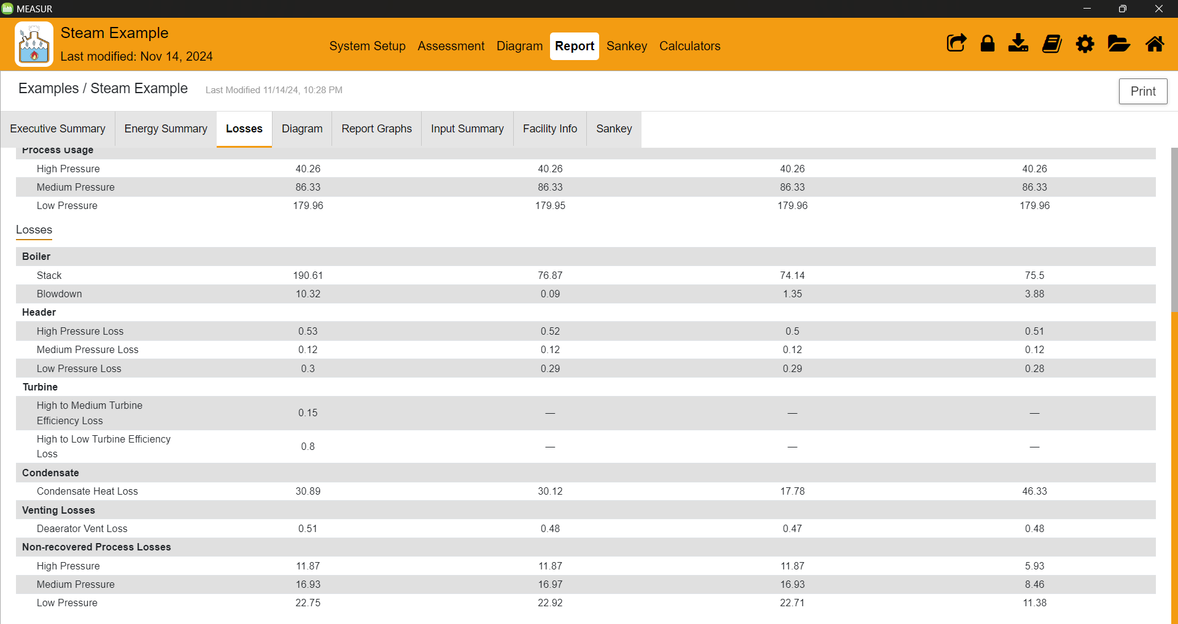
Report- Losses
Notes:
Provides comprehensive losses in boiler, stack, turbine, condensate, venting losses, and non-recovered process losses.

Slide 26
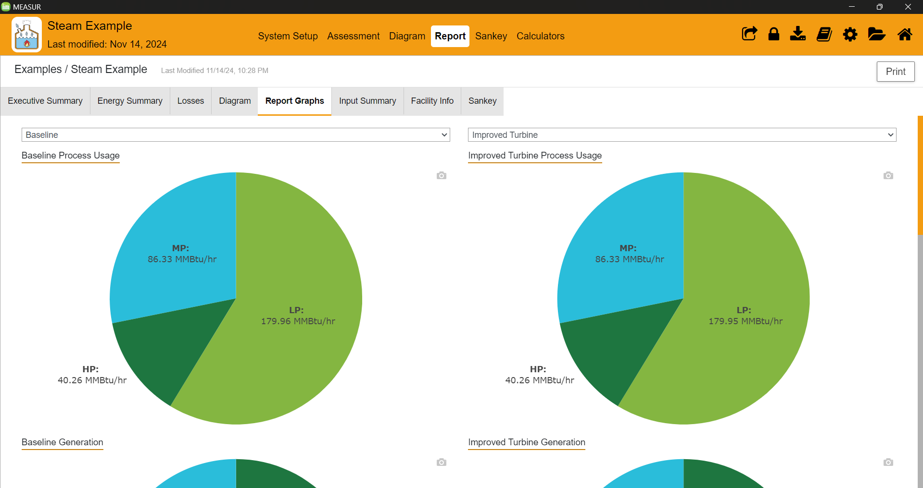
Report- Report Graphs
Notes:
Shows the energy consumption of baseline model and improved models in charts and graphs.

Slide 27
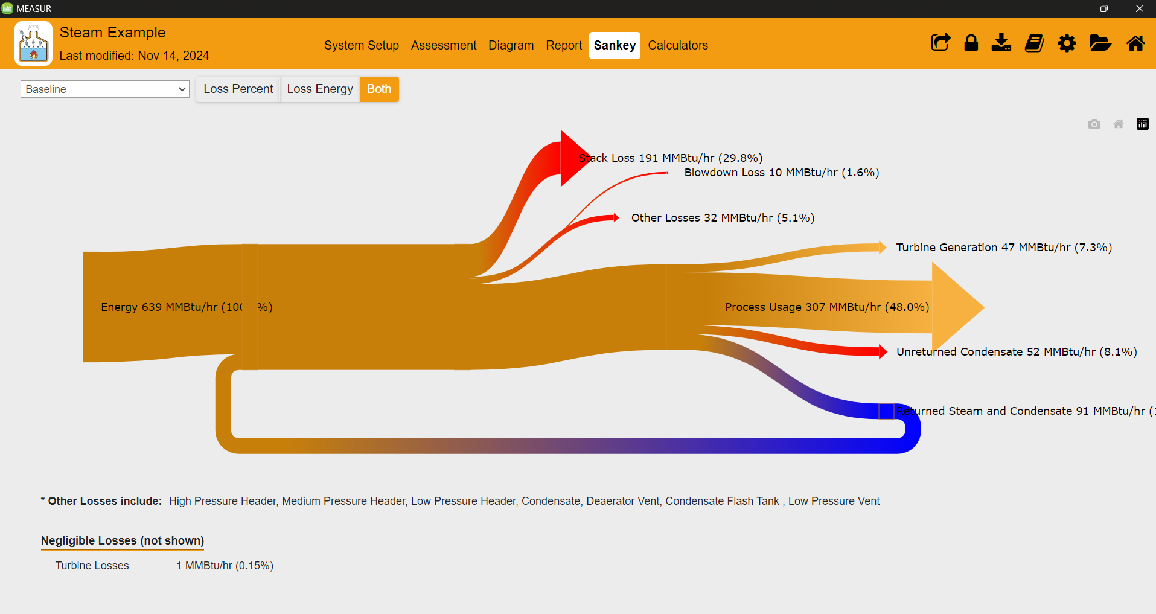
Report- Sankey
Notes:
A Sankey diagram is a type of flow diagram that tracks the flow of energy from raw or primary sources of energy up to the final stage of consumption. The width of the arrows in the diagram is proportional to the flow rate of energy. This diagram shows the losses in the process heating system.
Sankey diagrams can also be used to visualize the energy material flow.

Slide 28
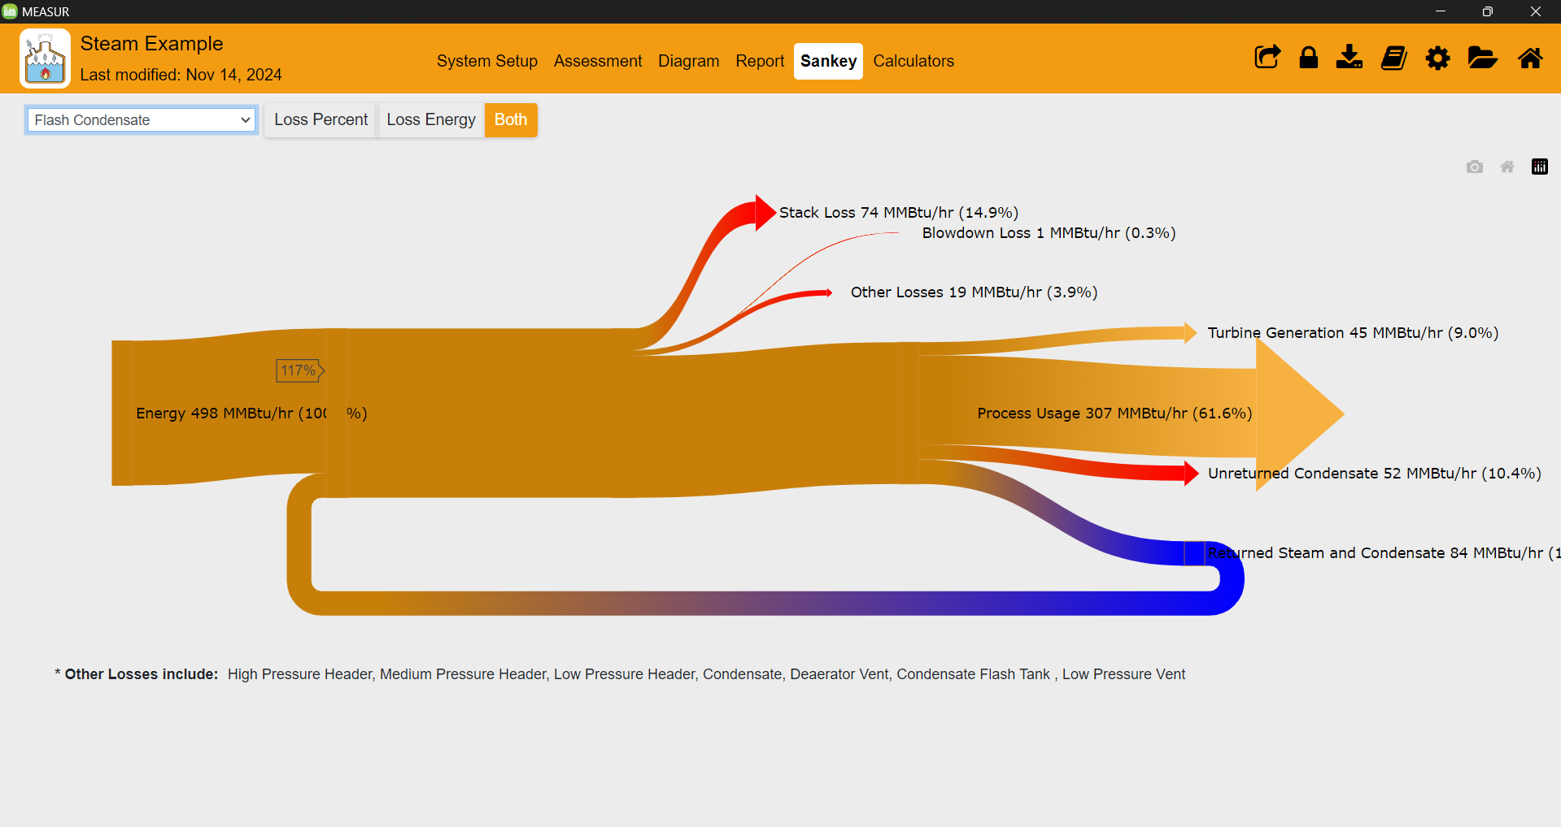
Report- Sankey
Notes:
A Sankey diagram is a type of flow diagram that tracks the flow of energy from raw or primary sources of energy up to the final stage of consumption. The width of the arrows in the diagram is proportional to the flow rate of energy. This diagram shows the losses in the process heating system.
Sankey diagrams can also be used to visualize the energy material flow.

Slide 29
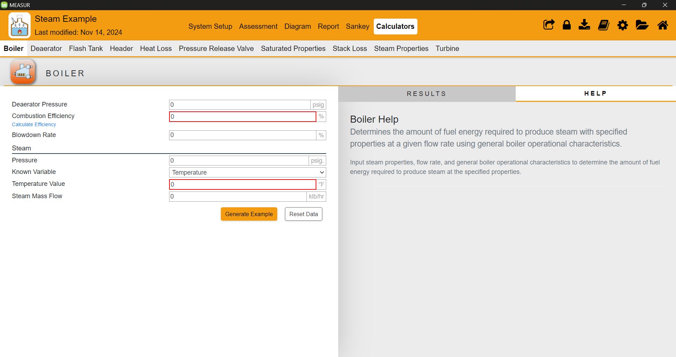
Calculators
Notes:
To calculate various parameters related to Header, Heat Loss, Pressure Release Valve, Saturated Properties, Stack Loss, Steam Properties, Turbine
The “Help” tab on the right panel, provides the user with guidance for the calculator usage.

Slide 30
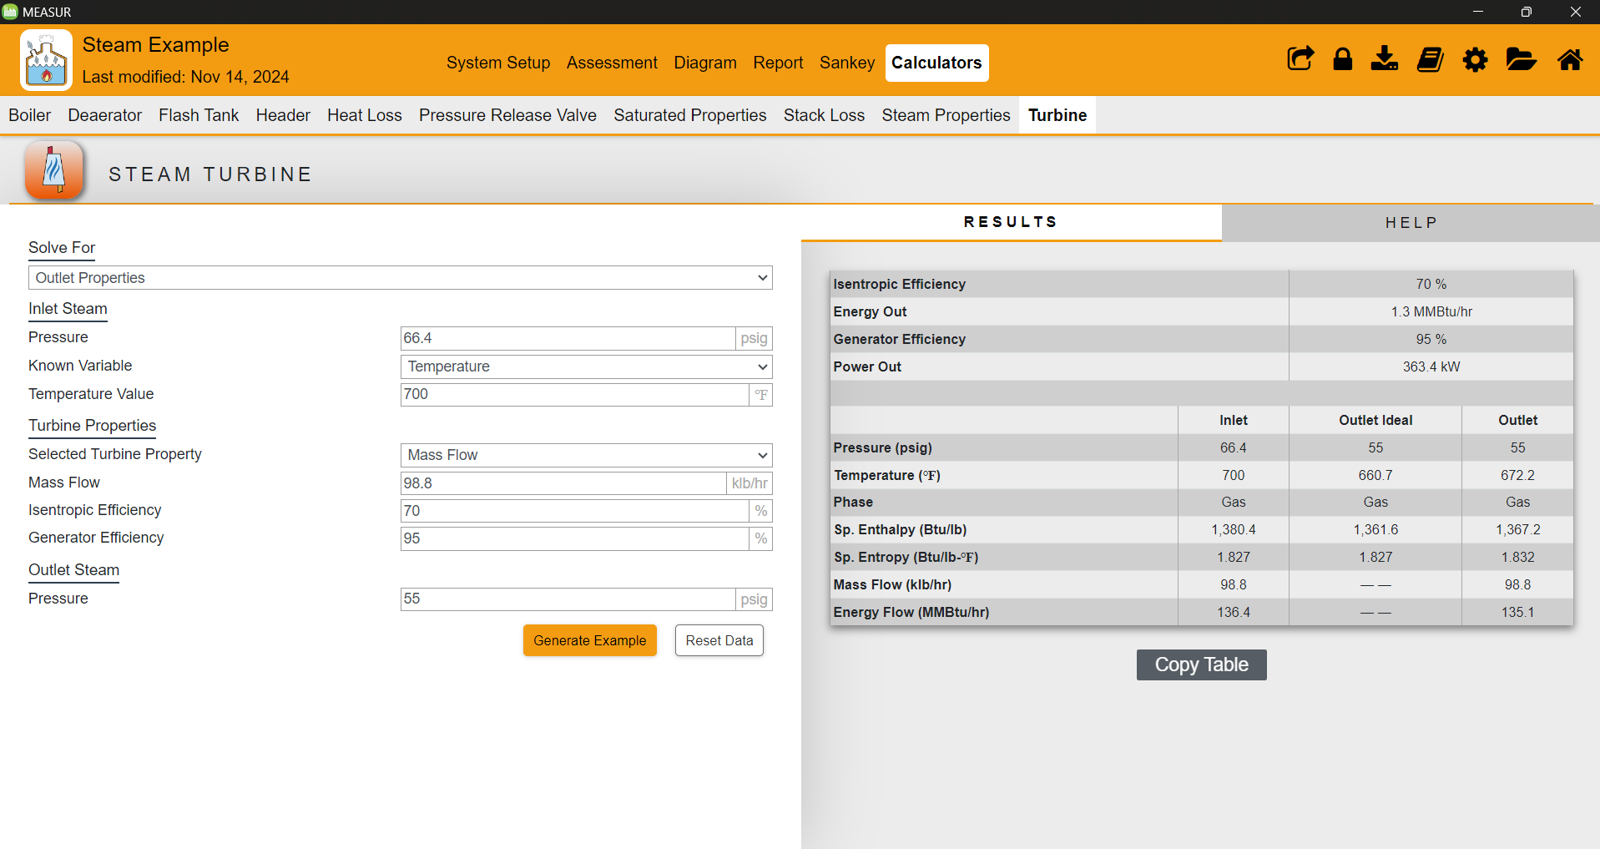
Calculators
Notes:
Calculating different parameters for turbine based on the known value.

Slide 31
Steam Assessment Best Practices
Insulate Steam Lines
Properly insulate steam distribution and condensate return lines to minimize heat loss and improve system efficiency.
Regular Maintenance
Routine inspections and maintenance on boilers, turbines and other steam system components.
Notes:
Facilitator’s note:
Proper insulation of steam distribution and condensate return lines is essential to minimize heat loss and enhance system efficiency. By maintaining adequate insulation, facilities can reduce energy waste and ensure optimal performance. Additionally, conducting regular maintenance, including routine inspections of boilers, turbines, and other steam system components, helps identify potential issues early and ensures reliable and efficient operation over time.

Slide 32
Steam Assessment Best Practices
Optimize Boiler Operation
Adjust boiler controls to maintain optimal combustion efficiency and reduce excess air.
Recover and Reuse Condensate
Implement condensate return systems to recover and reuse condensate, reducing water and energy consumption.
Notes:
Facilitator’s note:
Optimizing boiler operation involves adjusting boiler controls to maintain ideal combustion efficiency and minimize excess air, which reduces energy waste and enhances performance. Additionally, implementing condensate return systems allows for the recovery and reuse of condensate, significantly reducing both water and energy consumption, leading to cost savings and improved overall efficiency.

Slide 33
Steam Assessment Best Practices
Repair Steam Leaks
Leaking steam is lost energy. Regular maintenance and repair of leaks can lead to substantial energy savings.
Install Economizers
Use economizers to capture waste heat from boiler flue gases and preheat boiler feedwater.
Notes:
Facilitator’s note: Repairing steam leaks is essential, as leaking steam represents lost energy and increased costs. Regular maintenance and timely repairs can result in significant energy savings. Additionally, installing economizers captures waste heat from boiler flue gases and uses it to preheat boiler feedwater, enhancing efficiency and reducing overall energy consumption.

Slide 34
Key Takeaways
The MEASUR Steam Assessment is designed to analyze and optimize steam systems for energy efficiency.
Users can set up their system's baseline and assess modifications to realize cost, energy, and emissions savings.
Establish a complete baseline before making any system modifications to ensure accurate assessment of potential improvements.
Utilize the "Explore Opportunities" for guided, simplified data entry and modification suggestions.
Opt for the "Modify All Conditions" tab for detailed control over all system aspects, reflecting more complex changes.
Color-coded indicators on the tabs help track changes and highlight data validity and range issues.The tools such as results tabs, sankey diagrams, field-by-field help, and note-taking sections to support comprehensive system assessments and reporting.
Notes:
Facilitator’s notes:
The MEASUR Steam Assessment tool is designed to help analyze and optimize steam systems for improved energy efficiency, cost savings, and reduced emissions. Users can set up a baseline system to assess potential modifications and identify opportunities for improvement. It's crucial to establish a complete baseline to ensure accurate evaluations. The tool offers two approaches: the "Explore Opportunities" tab for guided and simplified data entry with modification suggestions and the "Modify All Conditions" tab for detailed control over all system aspects, ideal for implementing complex changes. Color-coded indicators assist in tracking modifications and ensuring data accuracy. Additionally, features such as results tabs, Sankey diagrams, field-by-field help, and note-taking options support comprehensive analysis and effective reporting.

Slide 35
References
1. For the Introduction to DOE's MEASUR tool suite:
U.S. Department of Energy, "Introduction to DOE's New Energy Assessment Tool Suite MEASUR," [Online]. Available: https://betterbuildingssolutioncenter.energy.gov/sites/default/files/slides/Introduction%20to%20DOE%27s%20New%20Energy%20Assessment%20Tool%20Suite%20MEASUR.pdf.
2. For energy savings on Steam System:
https://www.energy.gov/eere/iedo/steam-systems
3. For the graphics:
https://www.flaticon.com/icons

Slide 36
Questions?

