Slide 1
Fan Assessment using MEASUR

Slide 2
Contents
Introduction to Fan System
Best Practices for a Fan System
Navigating MEASUR: Pump Assessment
Applying Efficiency Recommendations in MEASUR
Summary and Key Takeaways

Slide 3
Introduction to Fans

Slide 4
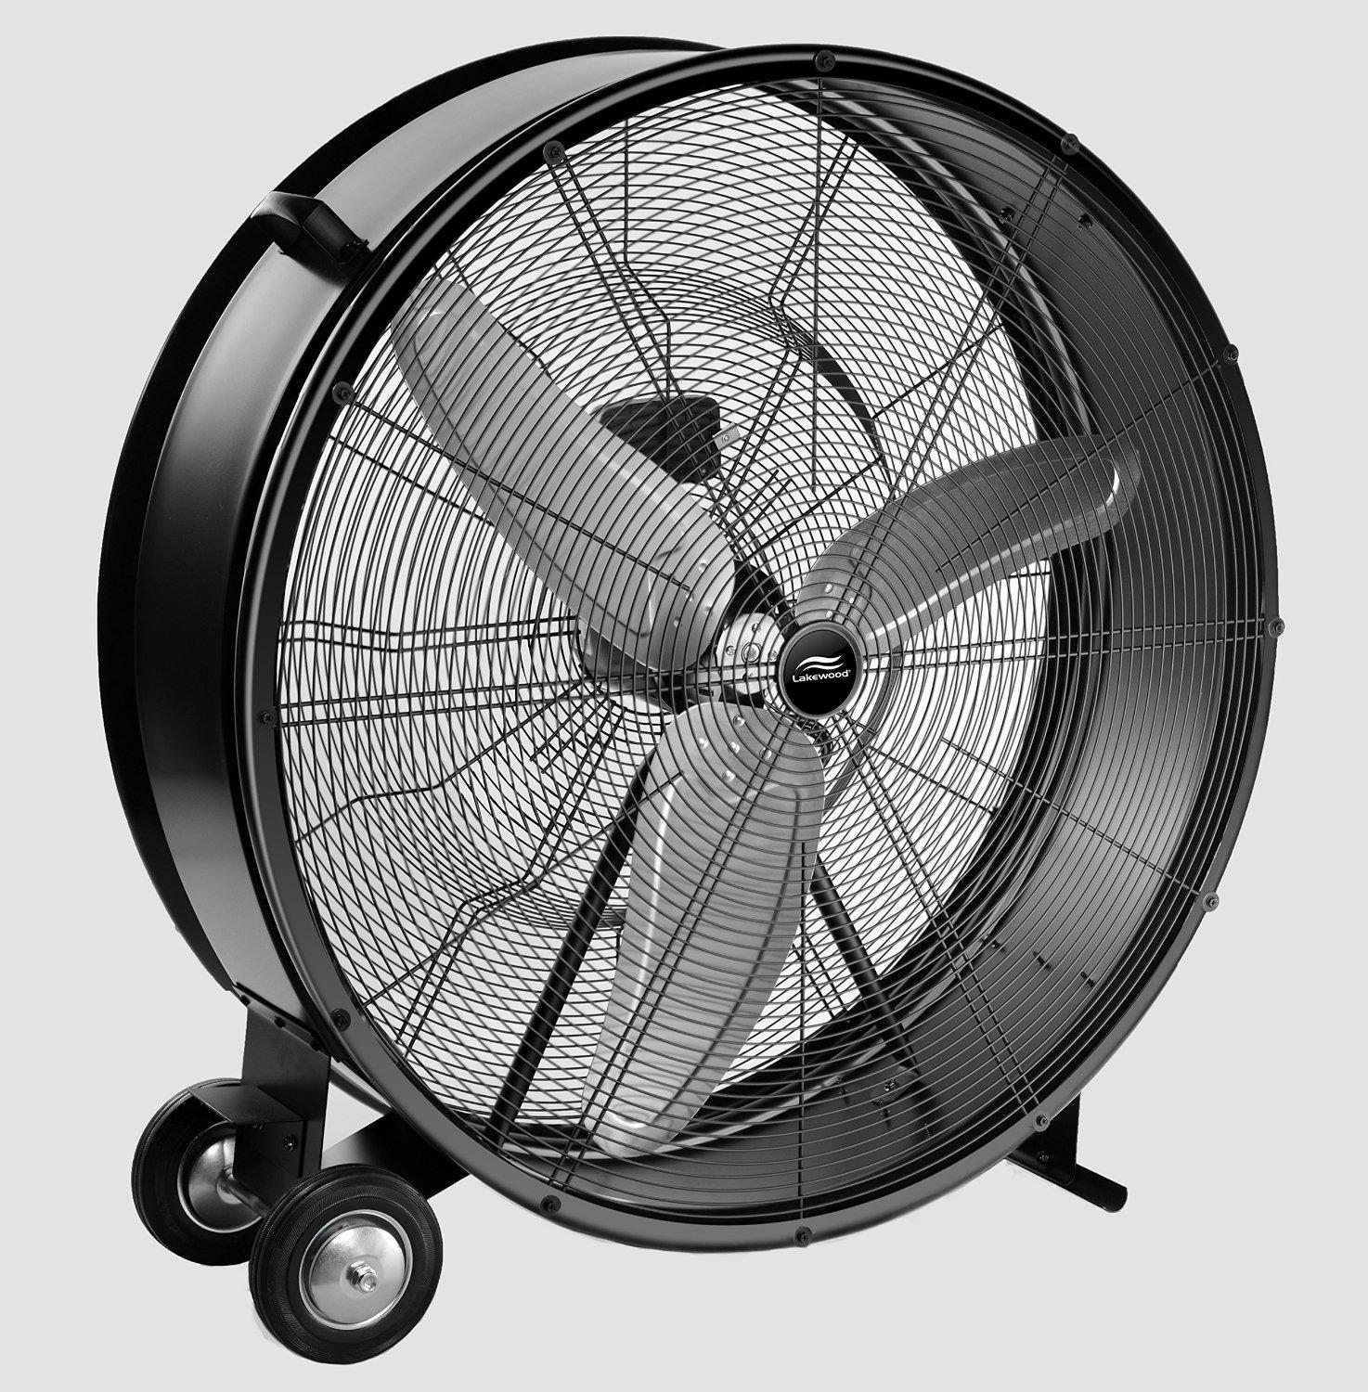
Introduction of Fan
Electro-Mechanical devices used in industrial and commercial applications for ventilation, material handling, air quality maintenance.
Fan operates by creating pressure differential that results in air movement.
Notes:
Facilitator’s note:
Fans are essential for moving air or gases through ventilation, cooling, and exhaust systems, making them crucial in maintaining optimal environmental conditions and supporting various operations. In many industries, fan systems are responsible for controlling air flow, regulating temperature, and ensuring the proper functioning of other equipment. However, despite their importance, fan systems can also be a significant source of energy consumption, especially if they are not properly optimized. Understanding the fundamentals of fan systems, such as their components, efficiency factors, and typical energy demands, is essential for identifying opportunities to improve energy performance, reduce operational costs, and enhance system reliability. In this section, we’ll explore how MEASUR Fan Module can be used as a potential for energy savings through optimization strategies.

Slide 5
Introduction of Fan
Energy consumed by fan systems form a large portion of the energy costs in industrial and commercial processes.
Energy efficiency in fan systems is important for cost savings and environmental impact.
Fan system reliability is crucial. Failure of fan systems can lead to:
plant production shutdown
decrease in worker productivity
decrease in product quality
Notes:
Facilitator’s note:
Fan systems account for a significant portion of energy costs in many industrial and commercial processes, making energy efficiency in these systems critical for both financial savings and reducing environmental impact. Optimizing fan systems not only lowers energy consumption but also contributes to sustainability goals. However, the reliability of these systems is equally important. A failure in the fan system can have severe consequences, such as plant production shutdowns, which can disrupt operations and cause delays. It can also lead to a decrease in worker productivity since cooling or ventilation may be compromised, creating an uncomfortable or unsafe environment. Moreover, a malfunctioning fan system can impact product quality, as processes that rely on precise air flow or temperature control may be affected. Therefore, ensuring fan system efficiency and reliability is essential for maintaining smooth operations, quality standards, and overall productivity.

Slide 6
Understanding the Basics of Fan System

Slide 7
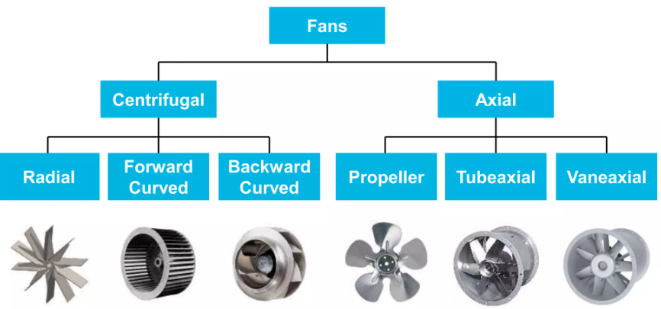
Types of Fans
Figure: Types of Fans
Notes:
Fan systems can be broadly classified into centrifugal fans and axial fans, each serving different applications based on airflow and pressure requirements. Centrifugal fans use a radial motion to move air, with three main types: radial fans, which generate high pressure with lower airflow; forward curved fans, which provide higher airflow at lower pressures and are used in HVAC systems; and backward curved fans, which are efficient for high-pressure systems, commonly found in industrial applications. Axial fans move air along the axis of rotation and are used in applications needing higher flow rates at lower pressures. These include propeller fans, which generate large airflow with low pressure and are often used in ventilation; tubeaxial fans, which have blades within a cylindrical housing for increased airflow and noise reduction, typically used in HVAC systems; and vaneaxial fans, which add vanes to improve efficiency and control airflow, making them suitable for more precise applications requiring both high pressure and flow. The choice between these fan types depends on specific system needs, such as airflow volume, pressure, and efficiency.

Slide 8
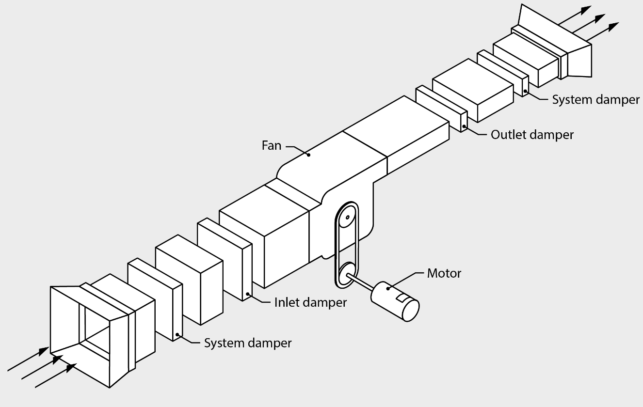
Key Components
Fan
Electric Motor
Drive System
Ducts or Piping
Flow Control Devices
Air Conditioning Equipments
Figure: Components of Fan System
Notes:
Facilitator’s note: The key components of a fan system include the fan, which moves air or gases; the electric motor, which powers the fan; and the drive system, which transfers power from the motor to the fan using belts, pulleys, or direct drive. Ducts or piping channel the airflow, while flow control devices like dampers or variable speed drives regulate air volume and system performance. Additionally, air conditioning equipment, such as cooling coils or filters, may be integrated to control temperature, humidity, or air quality. Together, these components ensure efficient fan system operation.

Slide 9
Best Practices for Fan System

Slide 10
Maintenance
Improper maintenance can lead to fan failure and unscheduled downtime.
Things to know:
Common maintenance tasks for fan systems Maintenance schedules
Predictive maintenance
Recordkeeping
Notes:
Facilitator’s note: Improper maintenance of fan systems can lead to equipment failure and unscheduled downtime, which can disrupt operations and incur significant costs. To avoid this, regular maintenance tasks should be carried out, such as cleaning the fan blades, inspecting the motor and drive system, checking for leaks, and ensuring the system is free from obstructions. Establishing effective maintenance schedules is critical to ensure that these tasks are performed regularly, according to manufacturer recommendations and operational needs. Additionally, predictive maintenance techniques, such as monitoring vibration, temperature, and performance data, can help detect early signs of wear and prevent unexpected failures by addressing issues before they escalate. Finally, thorough recordkeeping is essential for tracking maintenance activities, documenting repairs, and identifying patterns that can inform future maintenance strategies. These practices help maintain fan system efficiency, prolong equipment lifespan, and minimize the risk of costly downtime.

Slide 11
Common Maintenance Task
Timely and periodic inspection of all fan system components
Fan cleaning
Repair, lubricate, or replace bearings, fan belt, and motor
Check for leaks in the fan system
Notes:
Facilitator’s note: Timely and periodic inspection of fan system components is essential to ensure efficient operation and prevent failure. Regular fan cleaning helps maintain optimal airflow and reduces strain on the system. It’s also important to repair, lubricate, or replace bearings, fan belts, and the motor to ensure smooth and efficient operation. Additionally, checking for leaks in the fan system is crucial, as even small leaks can significantly reduce efficiency and increase energy costs. These maintenance tasks help extend the life of the fan system and minimize the risk of unscheduled downtime.

Slide 12
Maintenance Schedules
Length of intervals between maintenance schedules should be based on hours of operation, manufacturer recommendations, or prior experience with fan systems.
Notes:
Facilitator’s note: The length of intervals between maintenance schedules should be determined based on factors such as the hours of operation, manufacturer recommendations, or prior experience with similar fan systems. Regularly assessing the system's usage and performance history helps establish a maintenance schedule that balances the need for preventive care with operational efficiency.

Slide 13
Predictive Maintenance
Vibration monitoring equipment and analysis software can detect early signs of a problem.
Problems can be fixed before they worsen or lead to a complete shut-down.
These devices can be permanently installed with the fan and an alarm or safety shutdown system.
Notes:
Facilitator’s note: Vibration monitoring equipment and analysis software are valuable tools for detecting early signs of issues in fan systems. By continuously monitoring vibrations, these devices can identify irregularities that may indicate wear or potential failure, allowing problems to be addressed before they worsen or cause a complete system shutdown. These monitoring systems can be permanently installed on the fan, with integrated alarms or safety shutdown features that trigger if vibration levels exceed safe thresholds, ensuring timely intervention and preventing costly downtime.

Slide 14
Recordkeeping
Maintain a written log or record of inspection results and other problems, including repair histories, adjustments, and operator observations of working conditions that make the fan operation worse, etc.
Notes:
Facilitator’s note; Maintaining a written log or record of inspection results and any issues is crucial for effective fan system management. This log should include details such as repair histories, adjustments, and operator observations about conditions that could negatively impact fan performance, like unusual noise, vibrations, or environmental factors. By keeping track of these observations, maintenance activities, and the fan's operating history, you can identify recurring issues, plan for future maintenance, and ensure timely corrective actions are taken.

Slide 15
MEASUR: Fan System

Slide 16
What is MEASUR?
MEASUR (Manufacturing Energy Assessment Software for Utility Reduction) is a toolkit developed by the Department of Energy (DOE).
MEASUR is a series of tools and calculators (in one platform) that can perform investment grade energy analysis
It can also be used as smaller, stand-alone tools to perform simple calculations.
Free and open access
Notes:
Facilitator’s note: MEASUR (Manufacturing Energy Assessment Software for Utility Reduction) is a comprehensive toolkit developed by the Department of Energy (DOE). It combines a series of tools and calculators within a single platform to perform investment-grade energy analysis, helping manufacturers optimize energy use and reduce costs. In addition to its full suite of features, MEASUR can also be used as smaller, stand-alone tools to perform simpler, quick calculations for specific energy assessments. The software is free and open access, making it an accessible resource for businesses of all sizes to improve energy efficiency and achieve cost savings.

Slide 17
FSAT (Fan System Assessment Tool
FSAT (Fan System Assessment Tool) is a tool within MEASUR.
FSAT helps users identify and evaluate potential energy savings opportunities in fan systems.
Can also assess various modifications to determine optimal system configurations
Users can test customized “what-if” operating scenarios to minimize energy consumption
Automatic optimizer functionality (based on published fan efficiency and motor performance data)
Notes:
Facilitator’s note: FSAT (Fan System Assessment Tool) is a specialized tool within the MEASUR platform designed to help users identify and evaluate potential energy savings opportunities in fan systems. It allows users to assess various modifications and determine the optimal configuration for improving system efficiency. FSAT also offers the ability to test customized "what-if" scenarios, enabling users to explore different operating conditions and minimize energy consumption. Additionally, FSAT features an automatic optimizer functionality, which uses published fan efficiency and motor performance data to recommend adjustments for achieving the best possible energy performance.

Slide 18
Navigating MEASUR

Slide 19
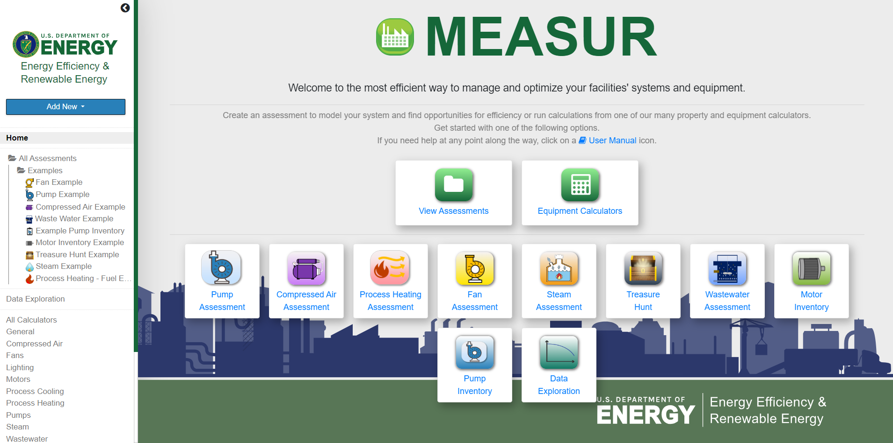
Fan Assessment

Slide 20
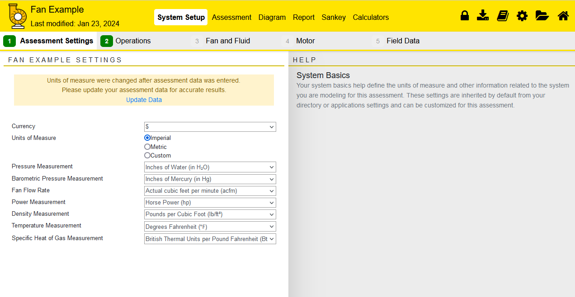
Fan Assessment

Slide 21
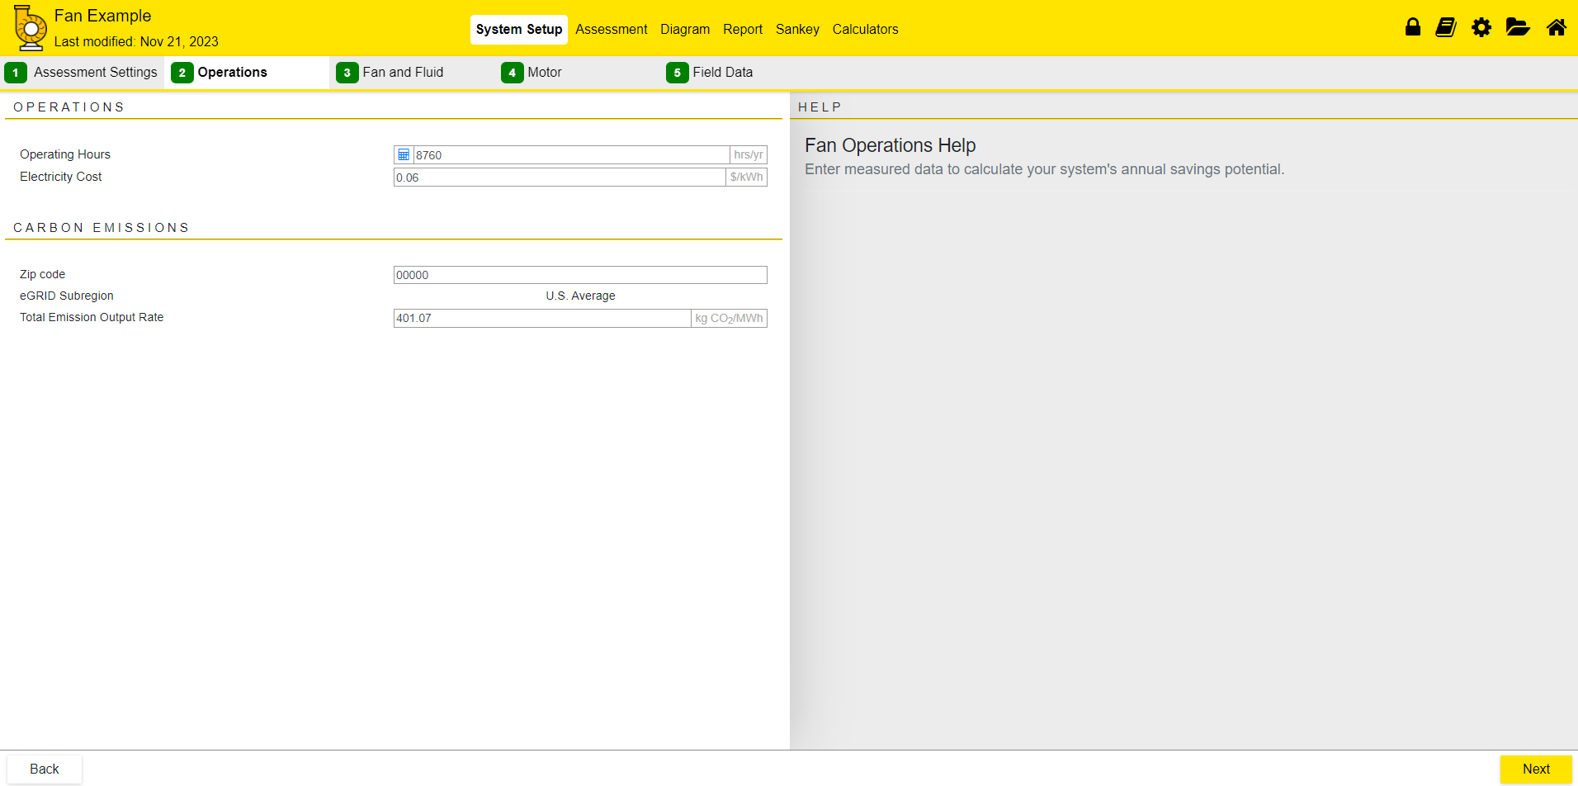
Fan Assessment

Slide 22
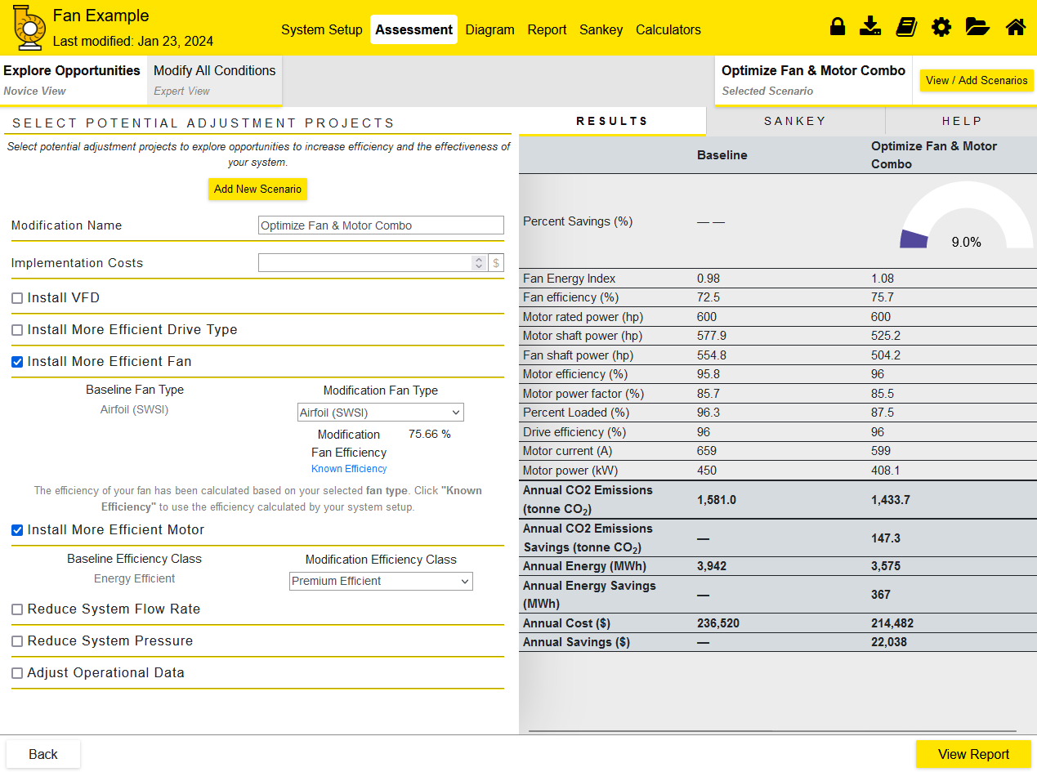
Assessment- Novice View

Slide 23
Assessment- Novice View

Slide 24
Novice View- Results

Slide 25
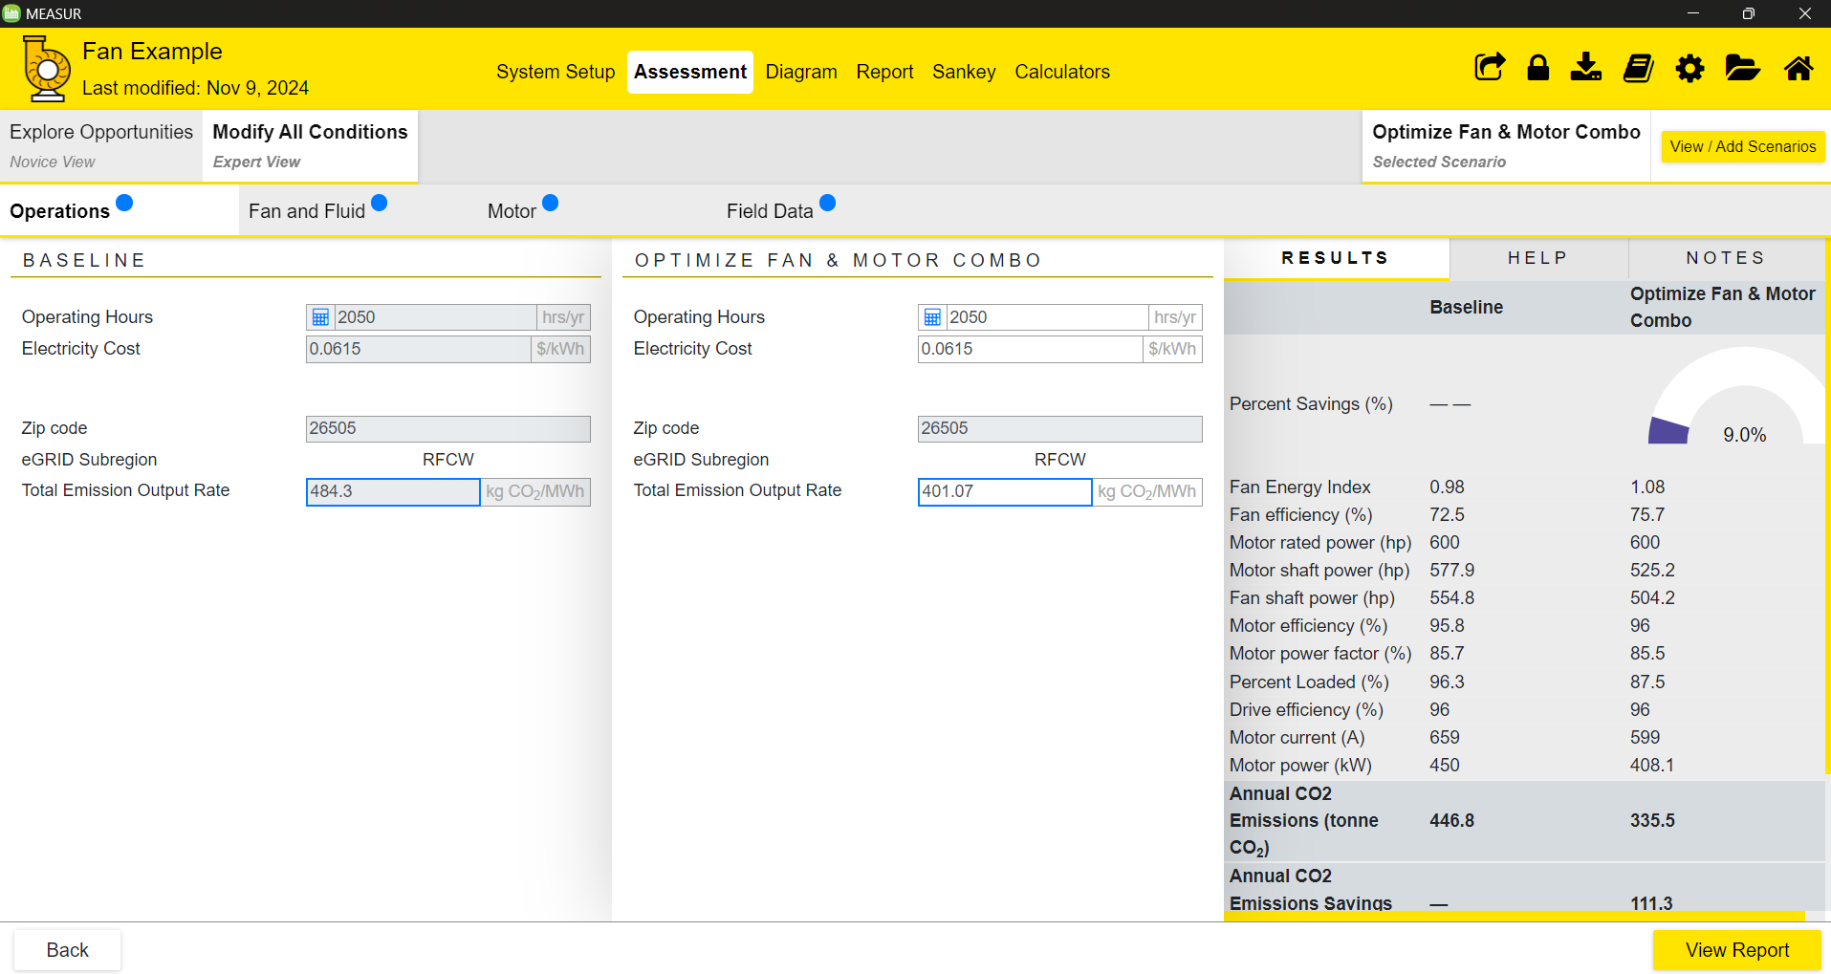
Expert View- Operations

Slide 26
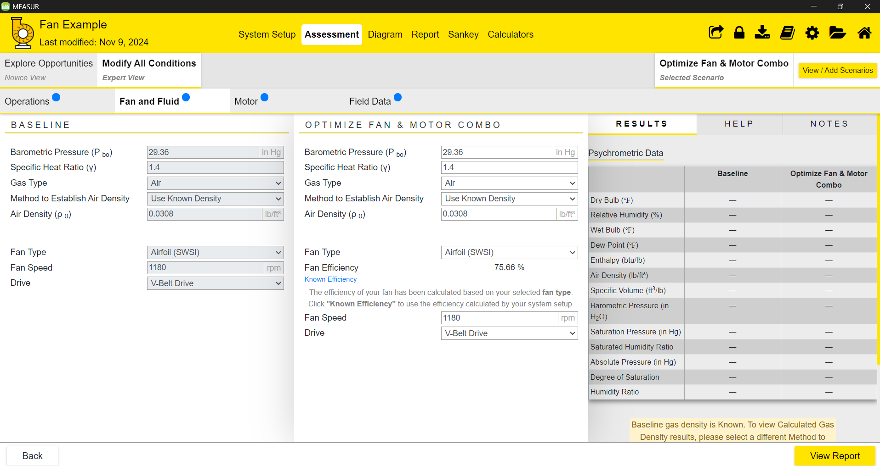
Expert View- Fan and Fluid

Slide 27
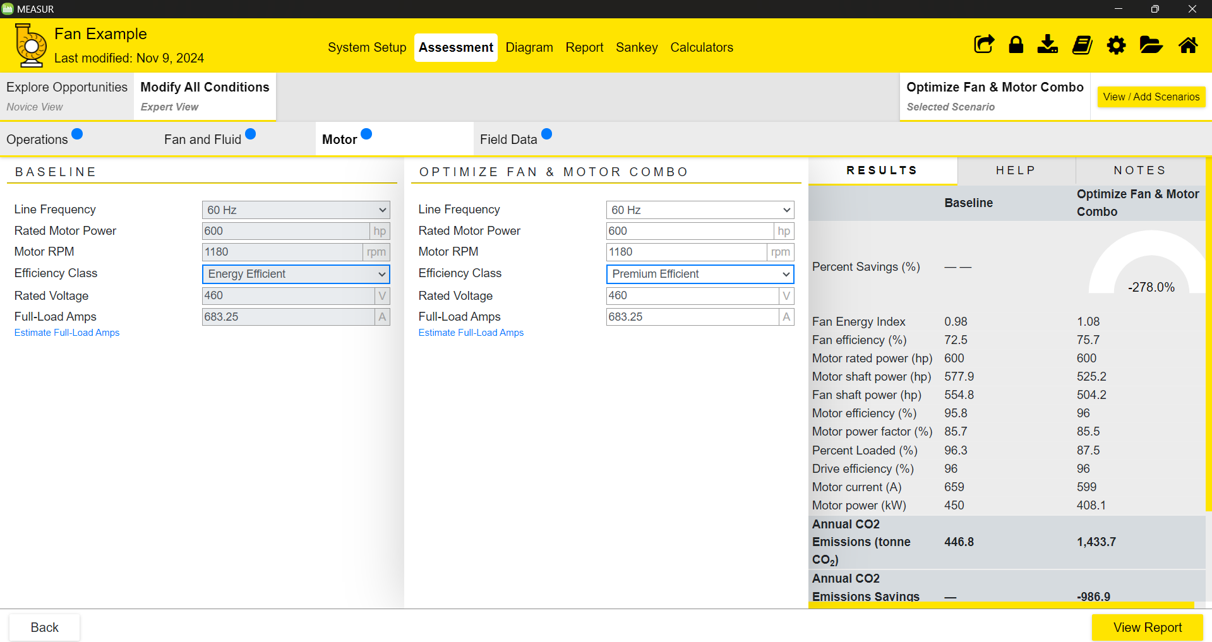
Expert View- Motor

Slide 28
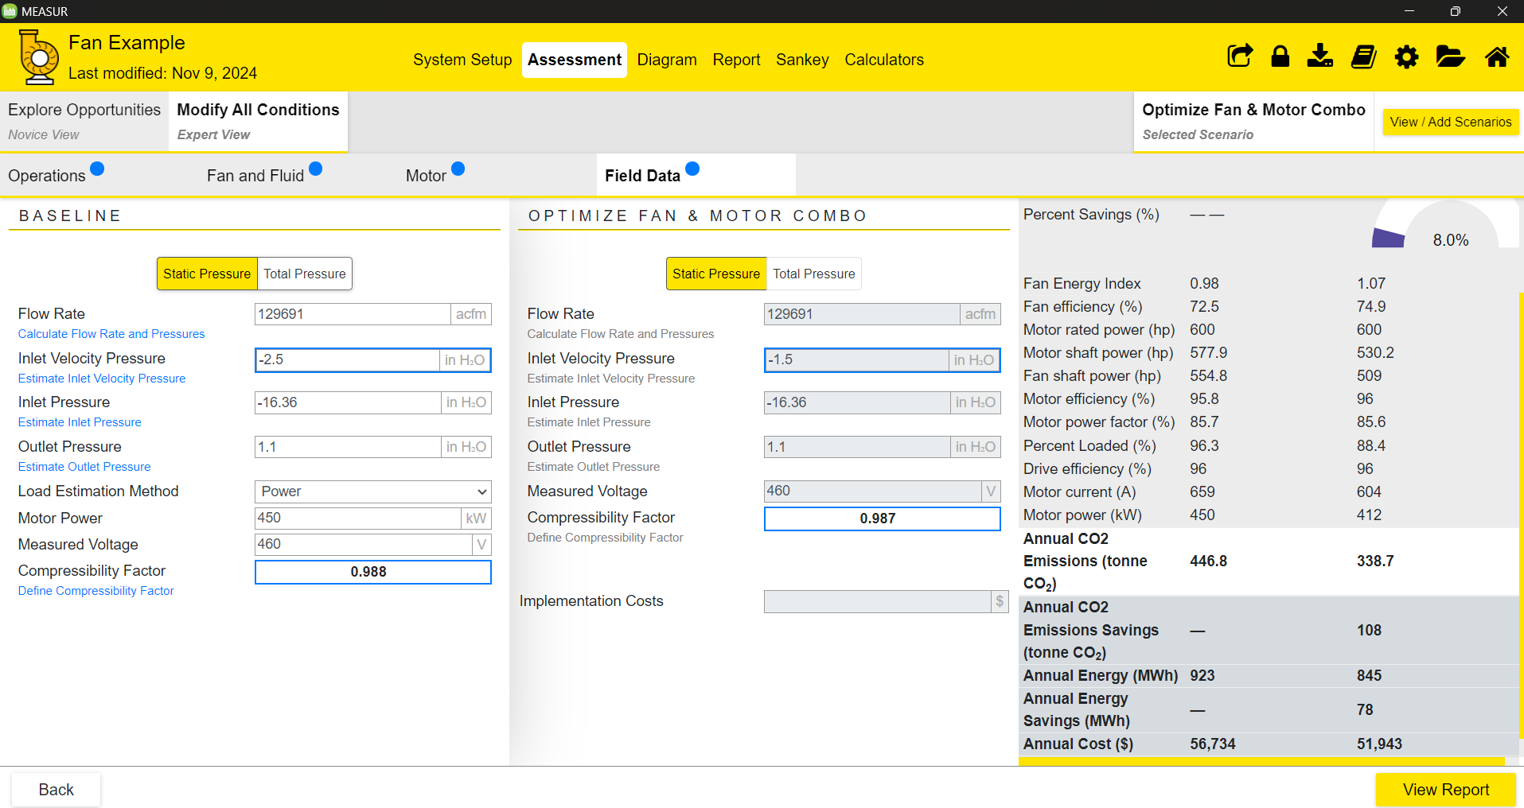
Expert View- Field Data

Slide 29
Results

Slide 30
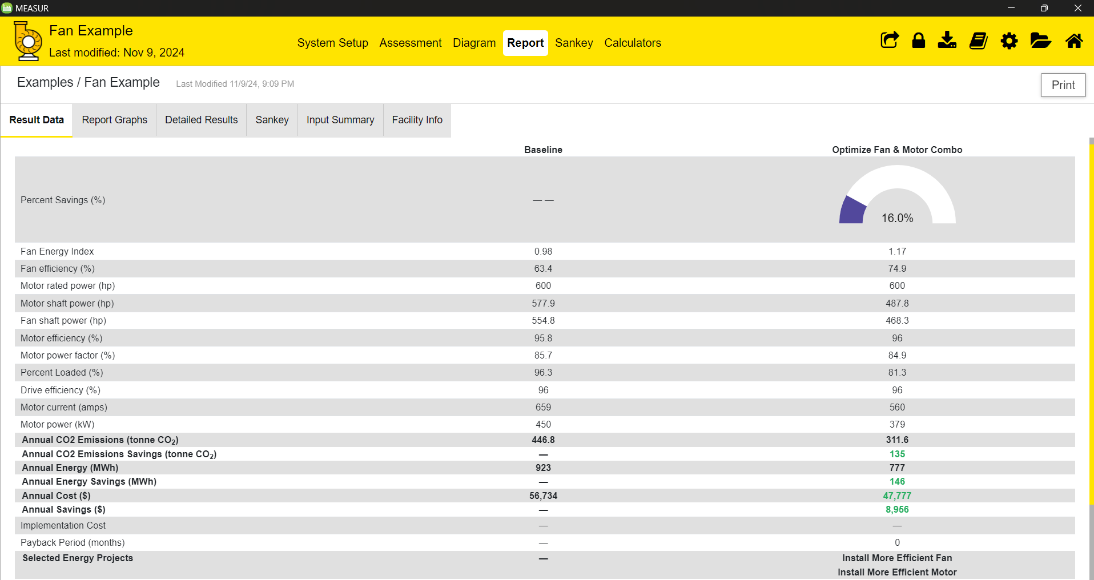
Report- Result Data

Slide 31
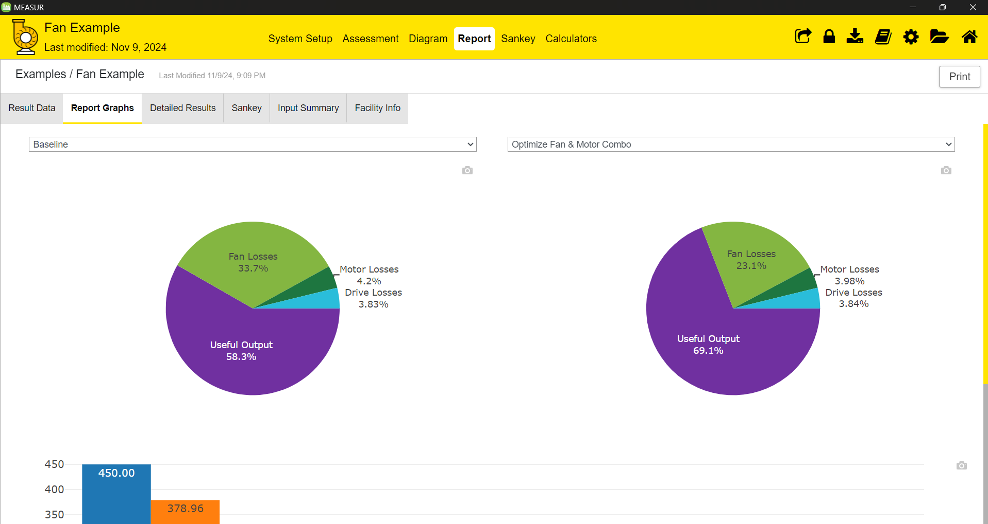
Report- Report Graphs

Slide 32
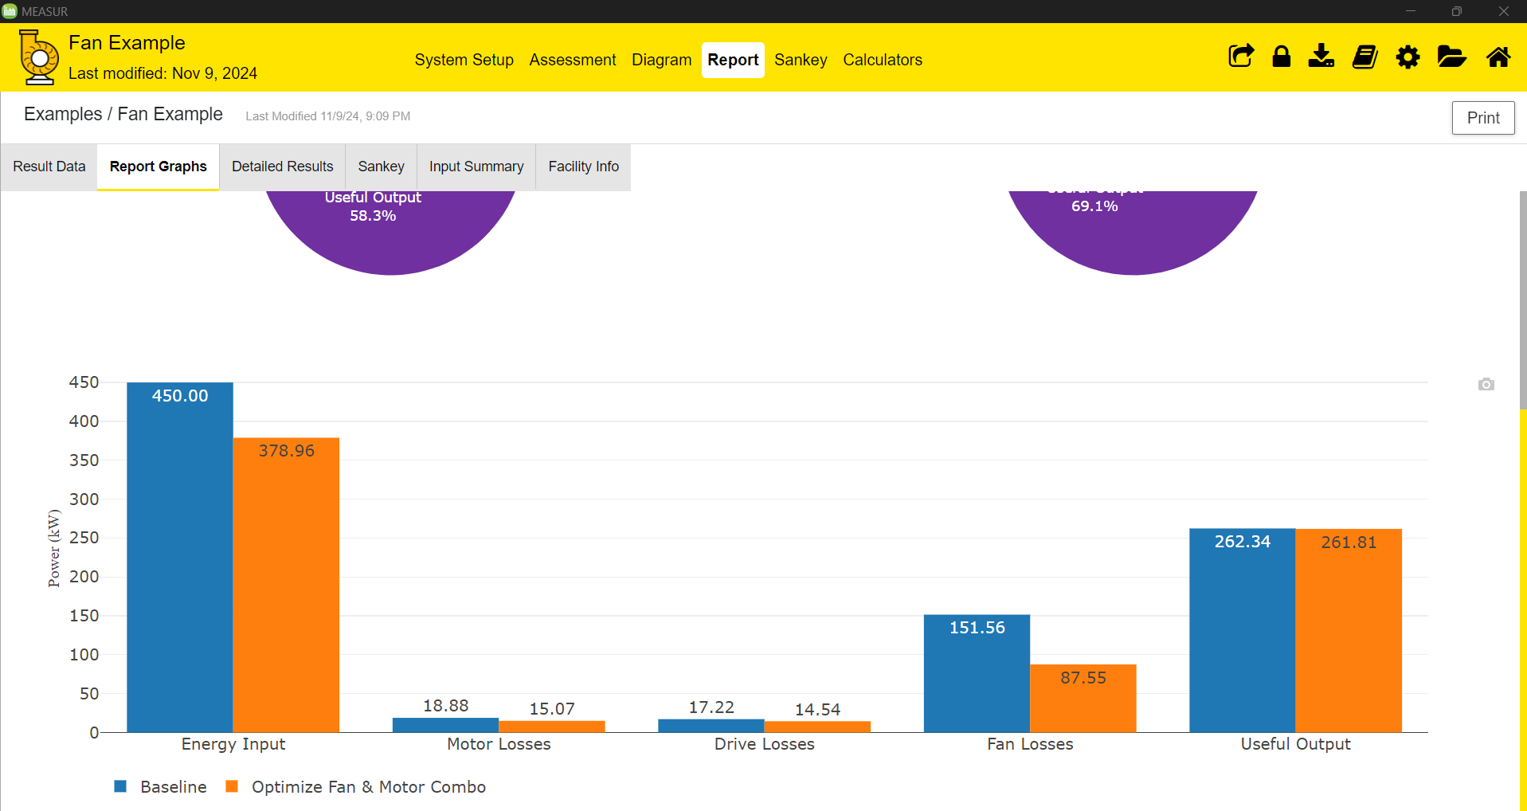
Report- Report Graphs

Slide 33
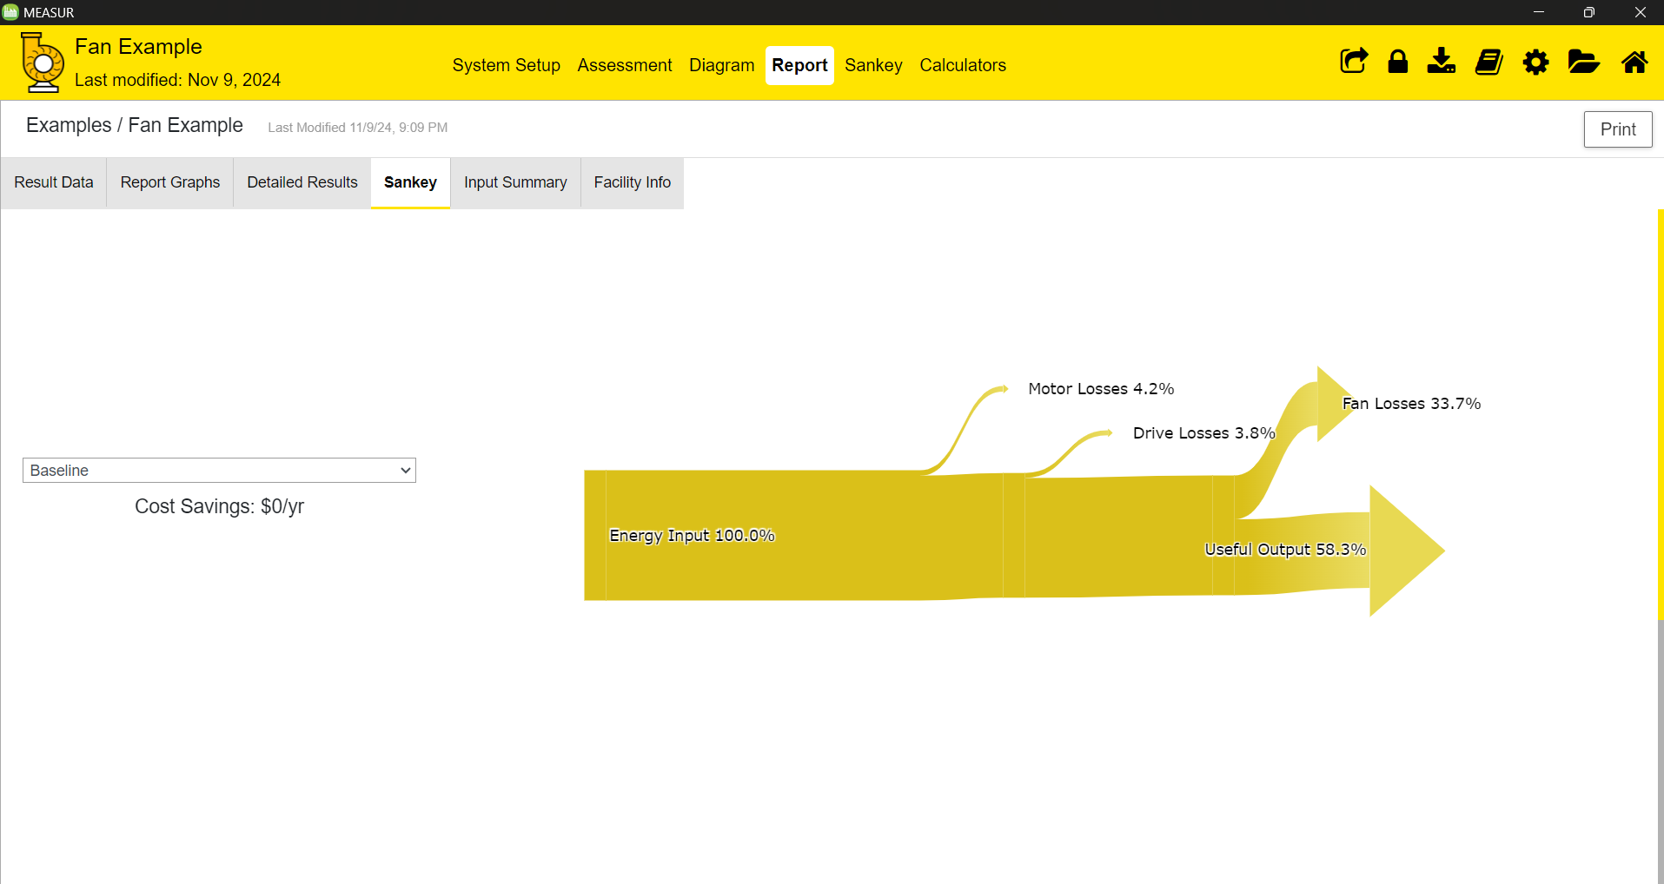
Report- Sankey

Slide 34
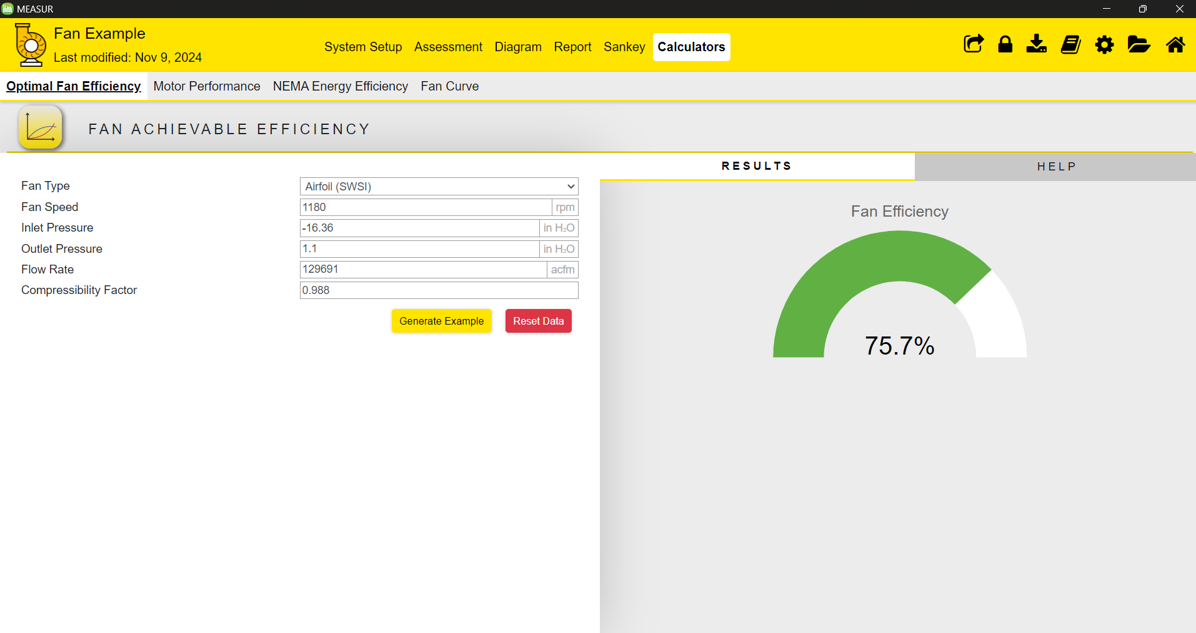
Calculators

Slide 35
Resources and Support

Slide 36
Contacts
MEASUR trainings are provided by WVU Pollution Prevention (P2) Team.
Contact Ashish Nimbarte (asnimbarte@mix.wvu.edu) or Chris Moore (chris.moore@mail.wvu.edu) for support or inquiries.
U.S. DOE also provides MEASUR workshops and technical support upon request
DOE YouTube Channel: http://www.youtube.com/@BetterBuildingsDOE
Fan Systems Assessment User Manual for MEASUR https://measur.ornl.gov/assets/user-manuals/Fans-User-Manual.pdf

Slide 37
References
https://www.nrel.gov/docs/fy03osti/29166.pdf (U.S. DOE)
Centrifugal Industrial Fans | Greenheck
Industrial Fans & Blowers - Hartzell Air Movement
Fan Systems | Department of Energy
Fans | Better Buildings Initiative

Slide 38
Questions?

