Slide 1
Treasure Hunt with MEASUR

Slide 2
Outline of the Presentation
Introduction to Treasure Hunt
Treasure Hunt in MEASUR Module
Navigating MEASUR
Finding Treasure
Treasure Hunt Reporting
Summary and Key Takeaways

Slide 3
Introduction to Treasure Hunt

Slide 4
Introduction to Treasure Hunt
A Treasure Hunt in energy efficiency is a collaborative and cost-effective process to identify and implement quick, low-cost measures that enhance energy efficiency within an organization or facility.
It involves observing the facility during idle / partially idle time periods to identify energy waste
Easy Wins
Cost Savings
Sustainability Impact
Figure 1: Treasure Hunts main points
Notes:
Facilitator Notes:
What is a Treasure Hunt?
A Treasure Hunt in energy efficiency is a collaborative and cost-effective approach to quickly identify and implement low-cost measures that improve energy efficiency in an organization or facility.
Usually involves observing the facility during idle time periods to identify energy waste.
Treasure Hunts are all about:
-Easy wins
-Cost Savings
-Sustainability impact

Slide 5
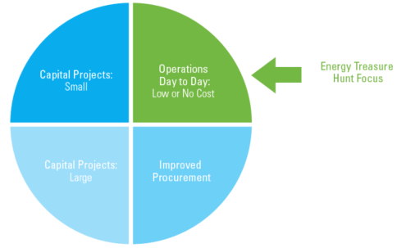
Introduction to Treasure Hunt
Operational Opportunities Focused e.g.:
Turning off equipment when not in use.
Adjusting setpoints for heating, ventilation, and air conditioning (HVAC) systems.
Optimizing equipment scheduling and usage patterns.
Implementing energy-saving behaviors among employees.
Figure 2: Areas of Energy Efficiency Improvement (U.S. DOE)
Notes:
Facilitator Notes:
Energy saving behaviors such as closing doors and windows to minimize heat loss or using natural ventilation instead of mechanical cooling, turning off lights, reducing phantom loads, etc. are some of the operational opportunities that Treasure Hunts focus on.
Although some upgrades may involve upfront costs. However, the long-term energy savings and potential reductions in operational costs often justify these investments.
Overall, Treasure Hunts aim to identify a mix of low-cost, no-cost, and investment opportunities to optimize energy efficiency and reduce operational expenses.

Slide 6
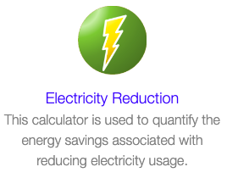
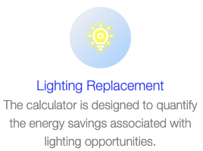
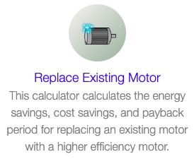
Treasure Hunts bring easy and quick savings with P2 Best Practices
Advantages of Treasure Hunt
Lighting Replacement - Electricity Reduction:
Upgrading fluorescent and incandescent lighting to LED lighting.
Installing occupancy sensors in low occupancy areas or ensuring that areas are not over-lit.
Replacing an Existing Motor:
Upgrading to energy-efficient motors to reduce electricity consumption and heat generation.
Properly dispose of or recycle old motors to prevent environmental impact.
Compressed Air Reduction:
Upgrading and maintaining compressed air systems, conducting regular leak surveys, and implementing energy-efficient controls.
Notes:
Facilitator’s note: The Treasure Hunt module in MEASUR offers a practical and efficient way to identify quick wins and cost savings by applying P2 (Pollution Prevention) best practices. One area for immediate impact is Lighting Replacement—switching from fluorescent or incandescent lighting to energy-efficient LED lighting significantly reduces electricity consumption. Additionally, installing occupancy sensors in low-traffic areas or ensuring spaces aren’t over-lit enhances efficiency further. Another opportunity lies in Replacing Existing Motors—upgrading to energy-efficient motors not only cuts electricity use but also minimizes heat generation, contributing to better system performance. It's important to properly dispose of or recycle old motors to avoid environmental harm. Lastly, Compressed Air Reduction can yield substantial savings through regular leak surveys, upgrading system components, and implementing energy-efficient controls. These actions not only reduce costs but also enhance overall system performance and sustainability. The Treasure Hunt approach ensures these opportunities are easily accessible, bringing immediate benefits to energy and resource management.

Slide 7
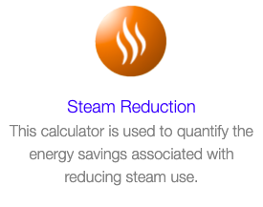
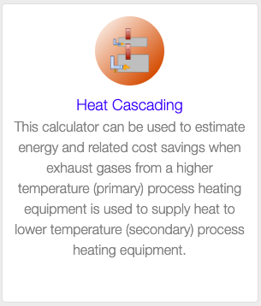
Treasure Hunts bring easy and quick savings with P2 Best Practices
Advantages of Treasure Hunt
Steam Reduction:
Implement steam trap maintenance programs to prevent steam leaks and improve efficiency.
Heat Cascading:
Exploring opportunities for cascading heat from one process to another, utilizing heat exchangers for efficient heat transfer, and maximizing energy use.
Boiler Blowdown Rate:
Optimizing boiler blowdown rates to minimize water and heat loss, implementing blowdown heat recovery systems, and reducing overall energy consumption.
Water Reduction:
Implementing water-efficient technologies, capturing and reusing water where feasible, and optimizing water consumption practices.
Notes:
Facilitator’s note: Steam Reduction can be achieved by implementing steam trap maintenance programs, which help prevent steam leaks and improve system efficiency. Heat Cascading involves exploring opportunities to cascade heat from one process to another, utilizing heat exchangers for efficient heat transfer, and maximizing the use of available energy. Optimizing the Boiler Blowdown Rate reduces water and heat loss, and installing blowdown heat recovery systems further decreases energy consumption. In terms of Water Reduction, adopting water-efficient technologies, capturing and reusing water, and optimizing consumption practices can lead to significant resource and cost savings. These strategies collectively enhance operational efficiency and sustainability while reducing environmental impact.

Slide 8
Treasure Hunt in MEASUR

Slide 9
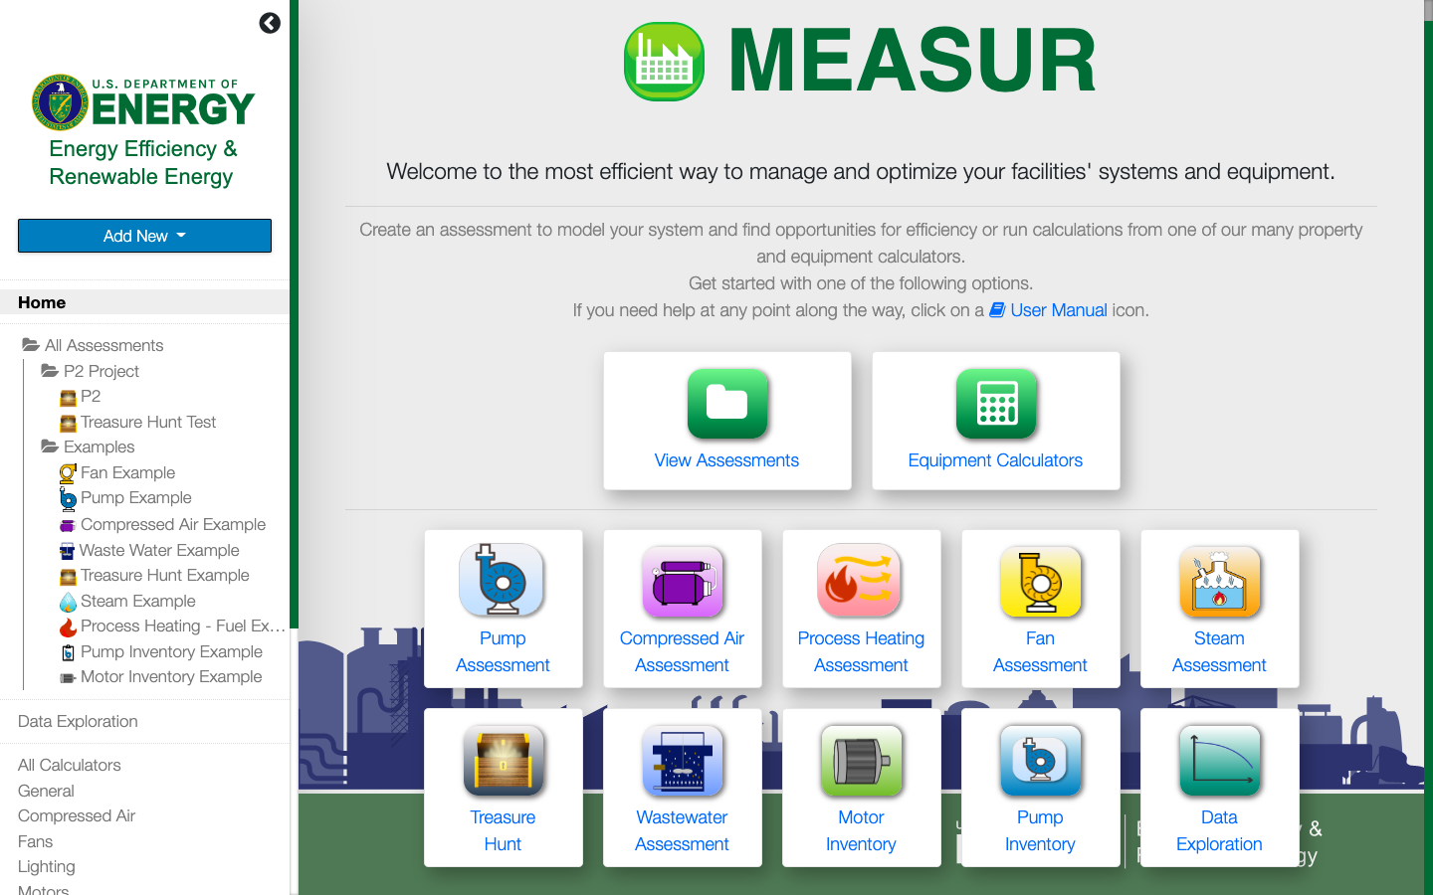
Treasure Hunt in MEASUR
Figure 3: MEASUR’s Landing Page
Notes:
Facilitator Notes:
This is how MEASUR’s landing page looks like. Treasure Hunt Module is highlighted in red.

Slide 10
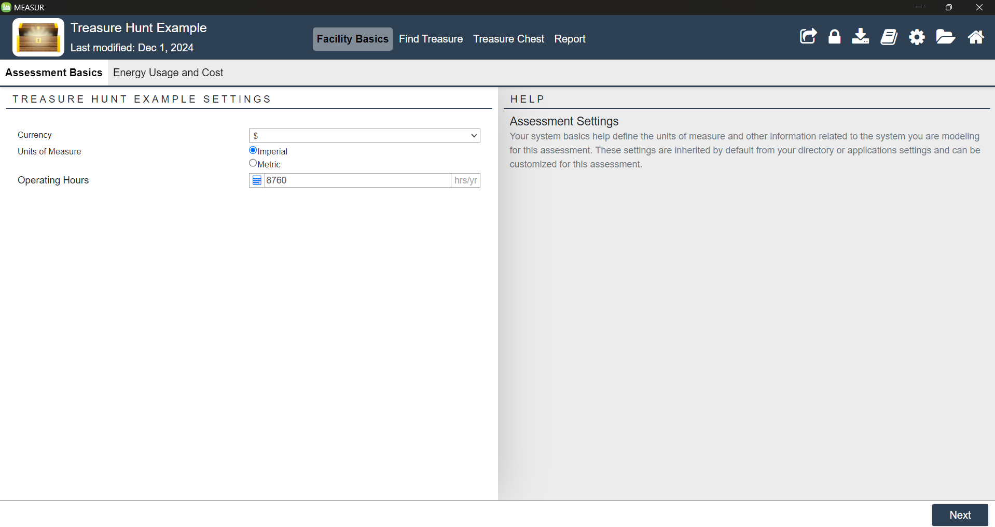
Treasure Hunt in MEASUR- Navigation
Figure 4: Treasure Hunt Main Tabs
Notes:
Facilitator Notes:
Briefly explain each main tab.
Facility Basics – Setup your assessment and establish your baseline energy usage and cost.
Find Treasure – Use calculators to find and quantify savings opportunities.
Treasure Chest – An overview of identified opportunities.
Report – Full printable breakdown potential saving scenarios.

Slide 11
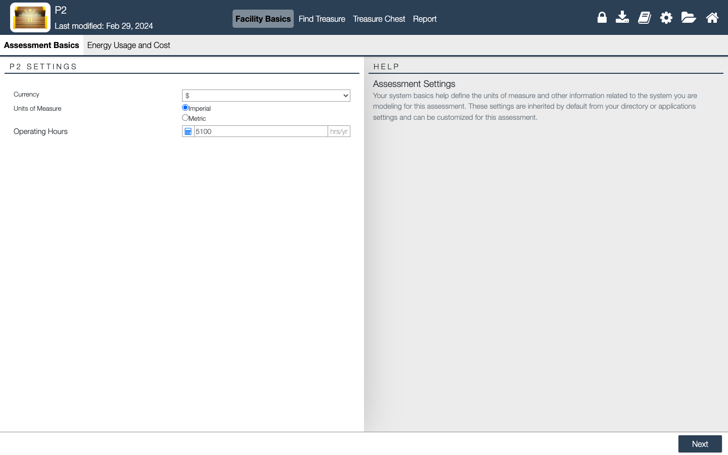
Treasure Hunt in MEASUR- Facility Basics
1
Figure 5: Facility Basics – Assessment Basics
Notes:
Facilitator Notes:
The facility basics tab is where you setup your assessment and establish your baseline energy usage and costs. In “Assessment Basics”, set your Operating Hours and the units of measure you want the opportunity calculators to be in.

Slide 12
Treasure Hunt in MEASUR- Facility Basics
Figure 6 & 7: Facility Basics & Energy Usage and Cost
Notes:
Facilitator Notes:
In the Energy Usage and Costs click the checkboxes to include a utility. Then specify current utility costs, annual consumption and emissions rates. Help text is provided in the right-hand panel.
Only use Compressed Air and Steam if you receive them as a utility, not generated on-site.

Slide 13
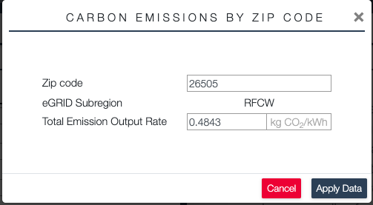
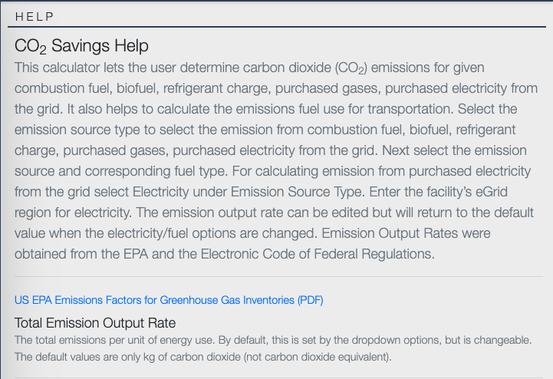
Treasure Hunt in MEASUR- Facility Basics
Figure 8 & 9: Facility Basics & Energy Usage and Cost – Help Tab
Notes:
Facilitator Notes:
After all utilities have been selected, input all information such as costs and annual consumption. The sentences in blue assist with calculations and estimations. Also, the help tab is a resource that explains the meaning/definition of each point. Example of the “Help” tab on the bottom right (When clicking the box of Total CO2 Emission Output rate) that is what the help tab would show.

Slide 14
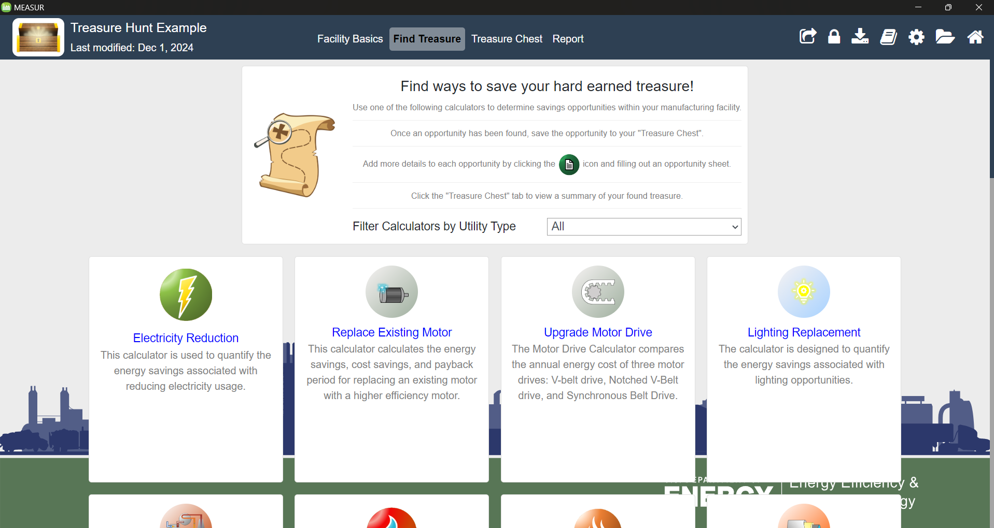
Finding Treasure
Figure 10: Finding Treasure
Notes:
Facilitator Notes:
Use the “Find Treasure” tab to discover potential savings opportunities. Select from a series of calculators to quantify savings opportunities.
Each card represents a calculator, and each calculator can be used to find savings opportunities tied to a specific utility type.
Use the dropdown to filter the calculator options by utility type.
The “Custom Savings Opportunity” calculator can be used if you already know the savings potential of a given project and want to directly include it. You can find it at the end of the list of calculators.

Slide 15
Treasure in MEASUR
Electricity Reduction
Replace Existing Motor
Upgrade Motor Drive
Lighting Replacement
Waste Heat
Natural Gas Reduction
Steam Reduction
Pipe Insulation
Tank Insulation
Flue Gas
Opening Loss
Wall Loss
Leakage Loss
Heat Cascading
Air Heating Using Flue Gas
Vent Steam To Heat Water
Boiler Blowdown Rate
Compressed Air Reduction
Compressed Air Pressure Reduction
Compressed Air - Leak Survey
Water Reduction
Cooling Tower Makeup Water
Chiller Staging
Chiller Performance
Cooling Tower Fan Energy
Cooling Tower Basin Heater Energy
Notes:
Facilitator Notes:
List of all Treasure Hunt Calculators. Note the symbols, the colored symbol represents the utility being saved; whereas the greyed-out symbol represents that utility not being saved. (Electricity, Natural Gas, and Water)

Slide 16
Lighting

Slide 17
Lighting Treasure
Lighting upgrades save electricity and reduce energy costs.
By turning off excess lighting where possible.
By implementing shut down procedures and/or installing occupancy sensors.
Transitioning to LED lighting can yield up to 60% savings compared to T12 fluorescent bulbs.
LED lighting offers high efficiency and longer lifespan, minimizing maintenance costs.
Notes:
Facilitator Notes:
These are some of the Pollution Prevention Best Practices for Lighting.
Upgrading lighting systems can significantly reduce electricity consumption and lower energy costs. This can be achieved by eliminating unnecessary lighting, implementing shutdown procedures, or installing occupancy sensors. Switching to LED lighting can provide savings of up to 60% compared to T12 fluorescent bulbs. LEDs also offer higher efficiency and a longer lifespan, which helps minimize maintenance expenses over time.

Slide 18
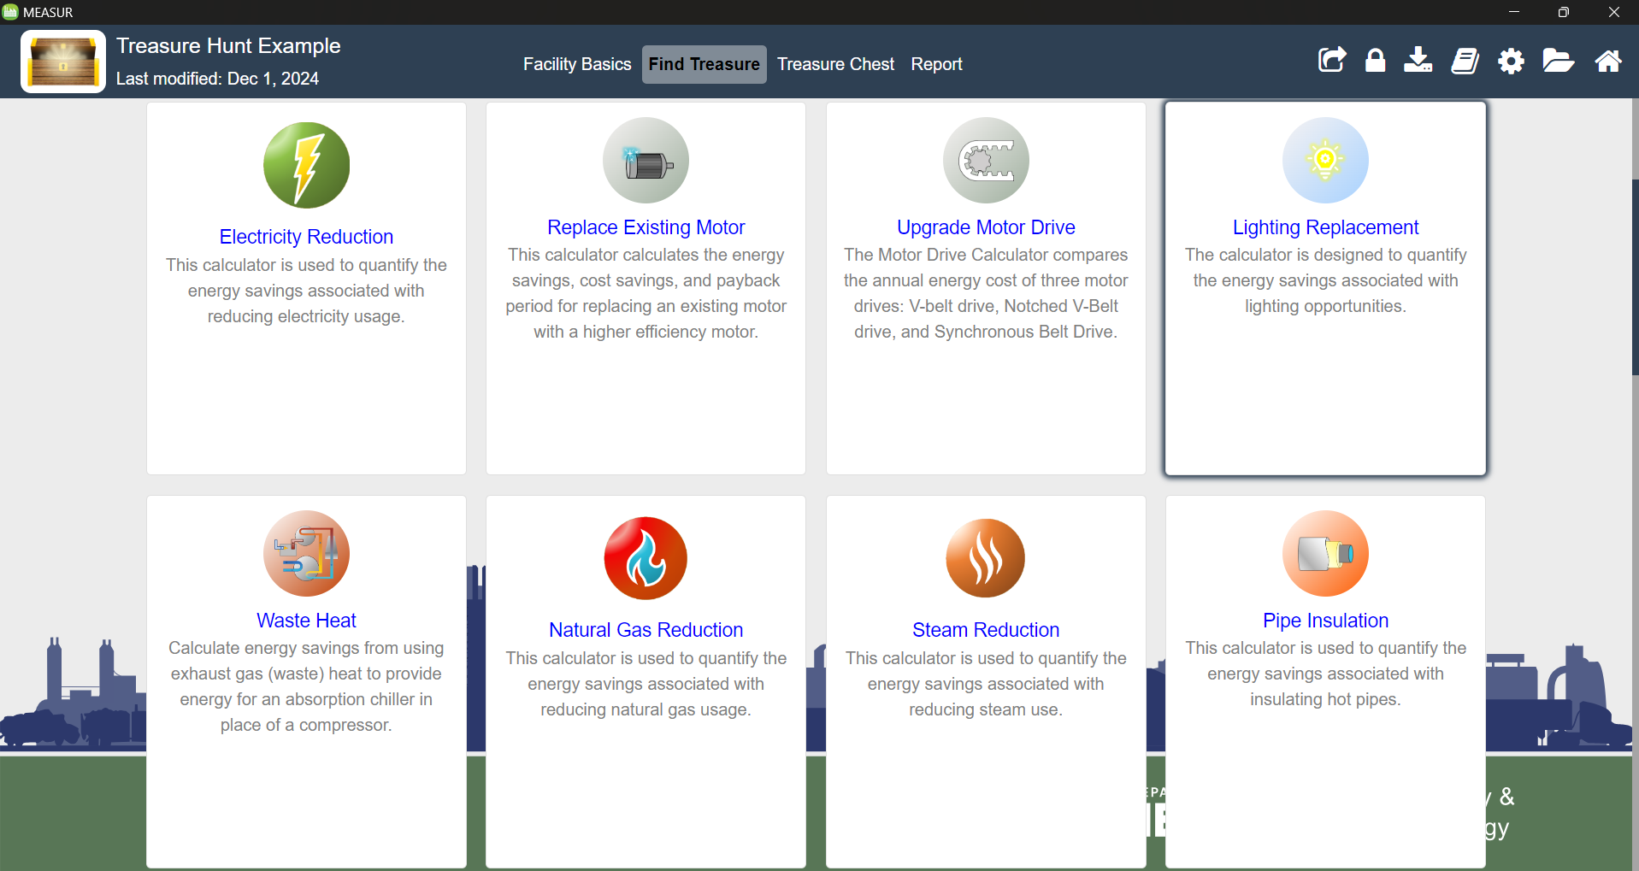
Lighting Treasure
Figure 11: Lighting Upgrade Calculator
Notes:
Facilitator Notes:
Moving on to the first example – Lighting replacement which is designed to quantify the energy savings associated with lighting opportunities.

Slide 19
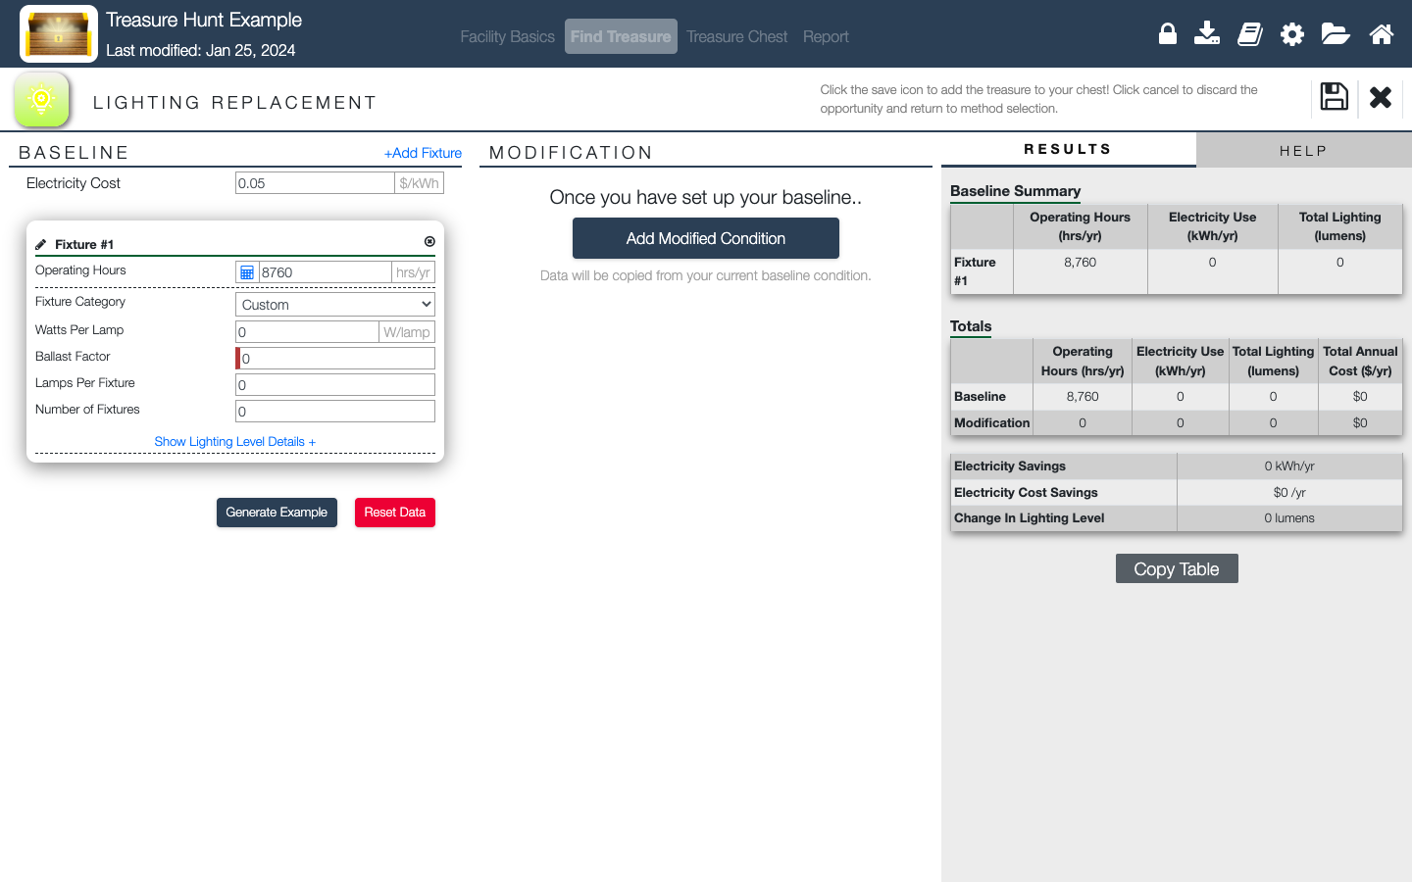
Lighting Upgrade
Figure 12: Lighting Replacement Calculator
Notes:
Facilitator Notes:
Quick Overview: First, establish the baseline for your current system setup in the left-hand panel and then apply modifications for savings in the middle panel.
The right-hand panel will contain a detailed table of the baseline, modification and potential savings.
Explain in detail next slide.

Slide 20
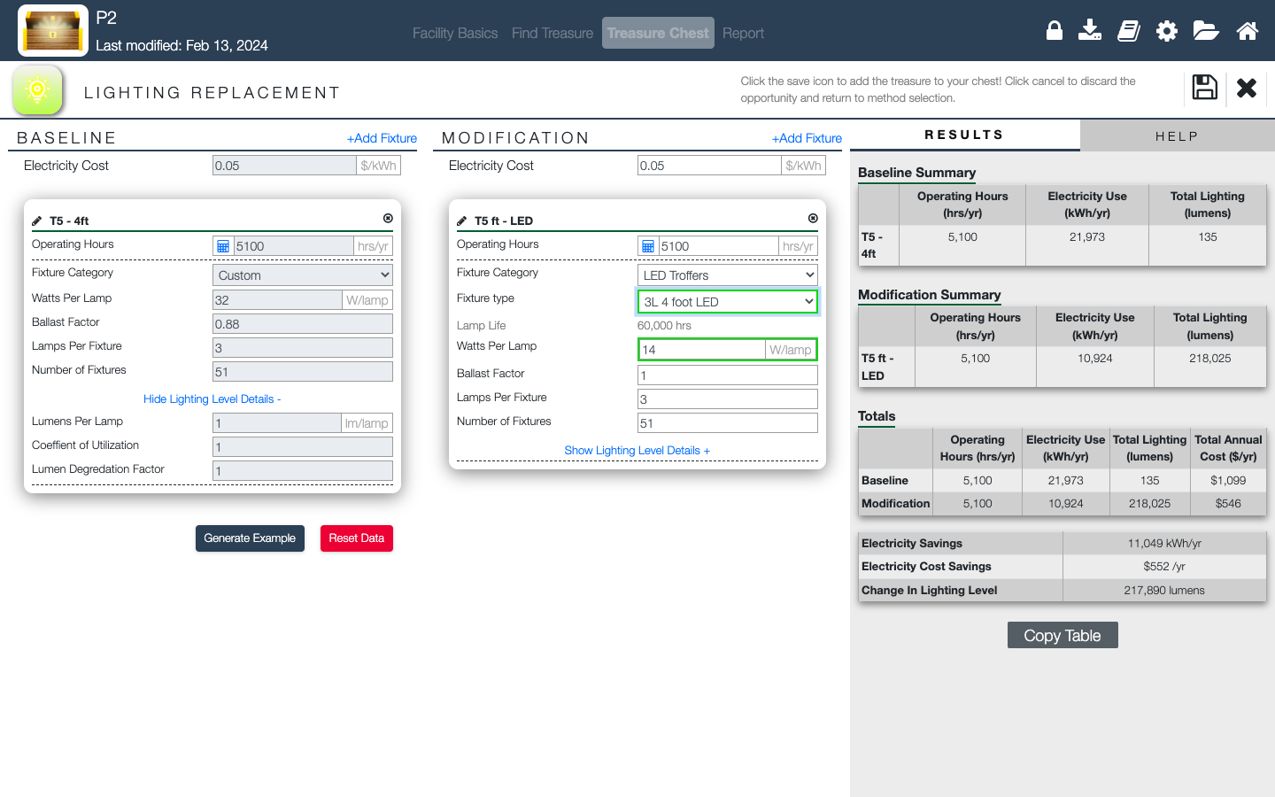
Lighting Upgrade
Figure 13 & 14: Lighting Replacement Calculator, Lighting Upgrade Case Study
Notes:
Facilitator Notes:
First: Baseline filled with information gathered (refer to table in the bottom ”Actual Lighting”).
Then: Fill modification with the upgrade information (refer to table in the bottom ”Proposed Lighting”)
Next: Results information. Compare electricity use, costs and savings after upgrade.
Last: Hit the save button.

Slide 21
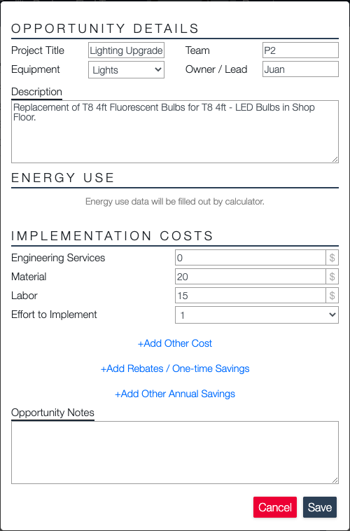
Opportunity Sheet
Figure 16 & 17: Lighting Replacement Calculator Opportunity Sheet
Notes:
Facilitator Notes:
Use the opportunity sheet to provide additional information about the opportunity you are adding to your “Treasure Chest”. This will appear whenever a new opportunity is being saved and can be modified inside of the “Treasure Chest”.
Name the project.
Specify location, identifying team.
Provide additional details and description.
Add implementation costs and rebates.

Slide 22
Motors

Slide 23
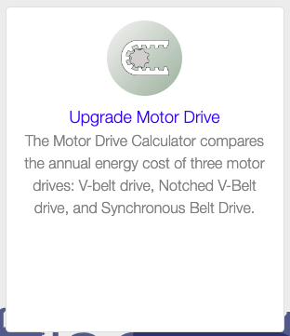
Improving Motors
According to the U.S. Environmental Protection Agency (EPA), replacing older, inefficient motors with high-efficiency models can result in energy savings of up to 30%, translating to substantial cost savings and reduced greenhouse gas emissions over the lifespan of the equipment. ¹
Upgrading motor drives allows for better control and optimization of motor performance while improving overall system reliability and performance.
Notes:
Facilitator Notes:
These are some of the Pollution Prevention Best Practices for Improving Motors.
The U.S. Environmental Protection Agency (EPA) states that switching out outdated, inefficient motors for high-efficiency ones can lead to energy savings of as much as 30%. This change not only reduces costs but also lowers greenhouse gas emissions throughout the equipment's lifetime. Additionally, upgrading motor drives enhances control and optimization, boosting both the reliability and performance of the entire system.

Slide 24
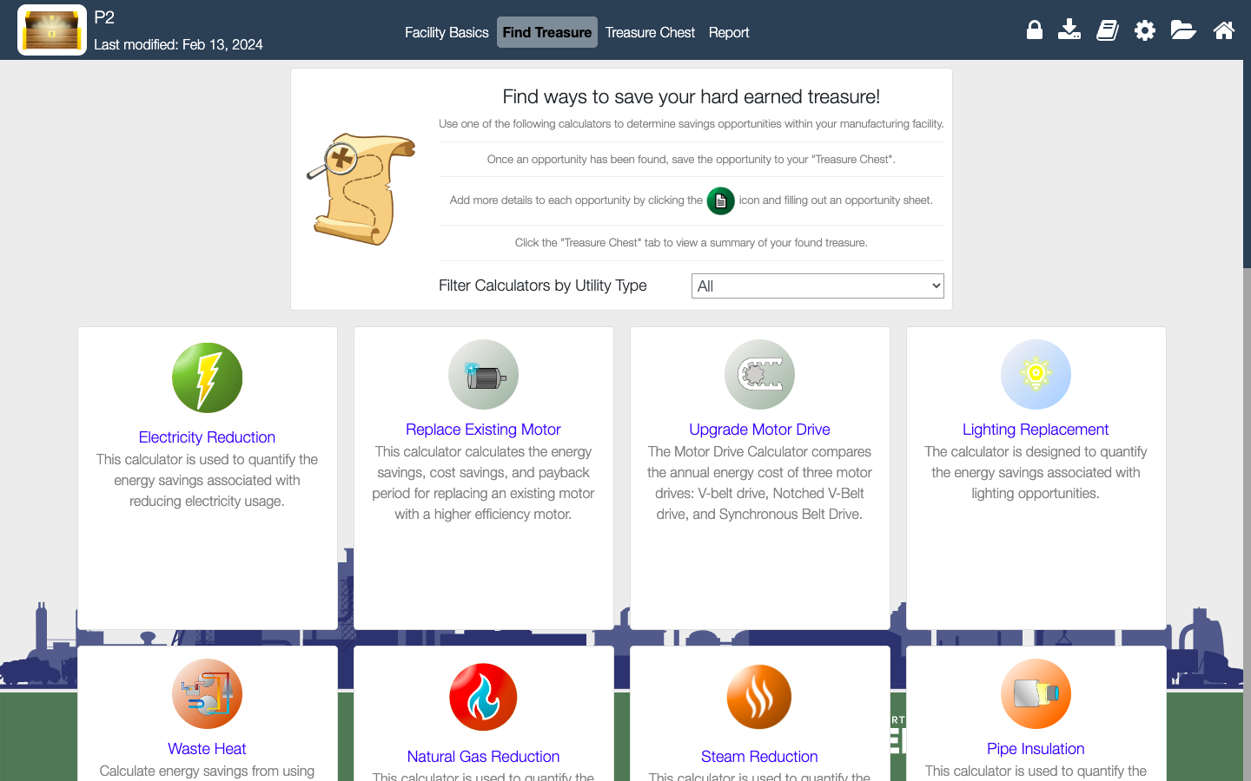
Finding Treasure- Replacing Existing Motors
Figure 18: Replace Existing Motor Calculator
Notes:
Facilitator Notes:
Replacing Existing Motor Calculator is highlighted in red.

Slide 25
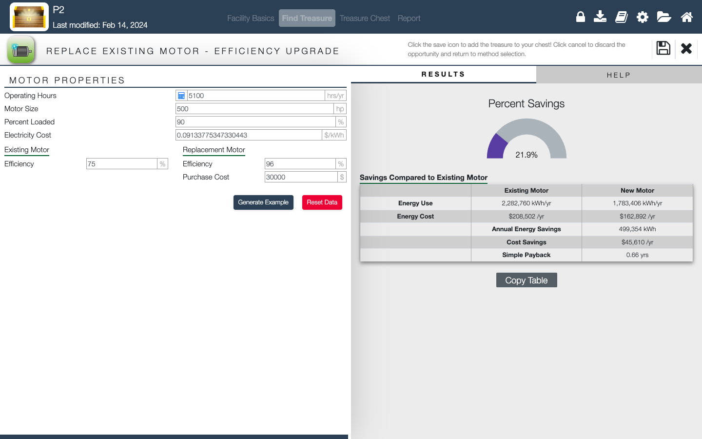
Replacing Existing Motor Example
Figure 19: Replacing Existing Motor Calculator
Notes:
Facilitator Notes:
This is what the interface looks like for replacing existing motor. Enter the specifications of currently operating motor (operating hours, motor size, percent loaded, electricity cost, efficiency).

Slide 26
Heat Loss

Slide 27
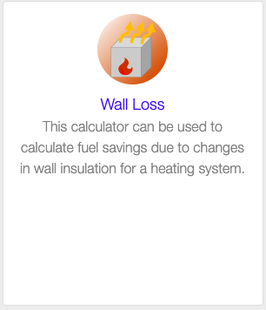
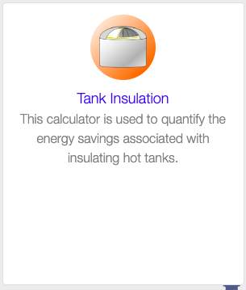
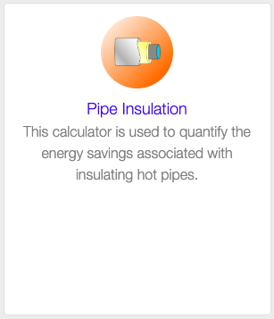
Reducing Heat Loss
According to the U.S. Department of Energy, reducing heat loss through insulation can lead to electricity savings of up to 30% and natural gas savings of up to 20%. ²
Pipe insulation helps prevent heat loss during the transportation of hot fluids, reducing energy consumption and improving system efficiency.
Tank insulation minimizes heat loss from stored liquids, optimizing thermal performance and reducing the need for continuous heating.
Addressing opening and wall losses through proper sealing and insulation helps maintain indoor temperatures and reduces the load on heating and cooling systems.
Notes:
Facilitator Notes:
These are some of the Pollution Prevention Best Practices for Reducing Heat Loss
The U.S. Department of Energy reports that reducing heat loss with insulation can result in up to 30% savings in electricity and up to 20% savings in natural gas. Pipe insulation prevents heat loss when transporting hot fluids, which lowers energy consumption and enhances system efficiency. Insulating tanks reduces heat loss from stored liquids, improving thermal performance and decreasing the need for constant heating. Proper sealing and insulation of openings and walls help maintain consistent indoor temperatures, easing the demand on heating and cooling systems.

Slide 28
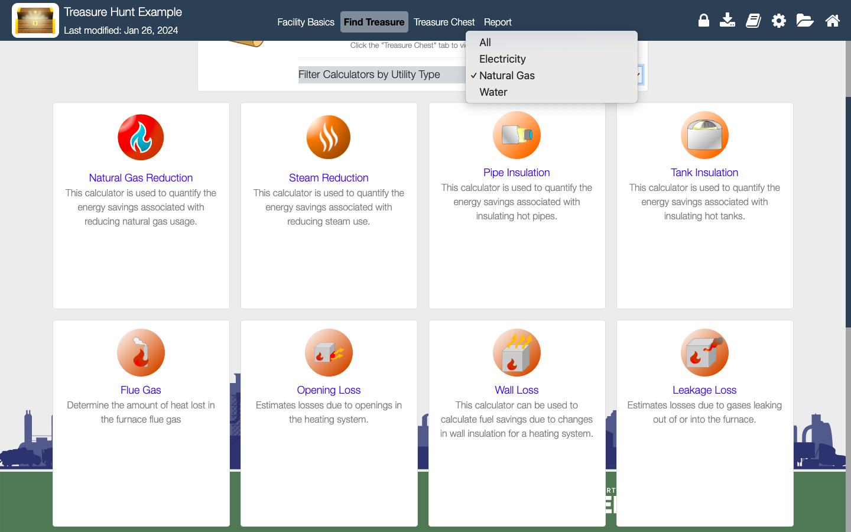
Finding Treasure- Pipe Insulation
Figure 20: Pipe Insulation Calculator
Notes:
Facilitator Notes:
Pipe Insulation Calculator

Slide 29
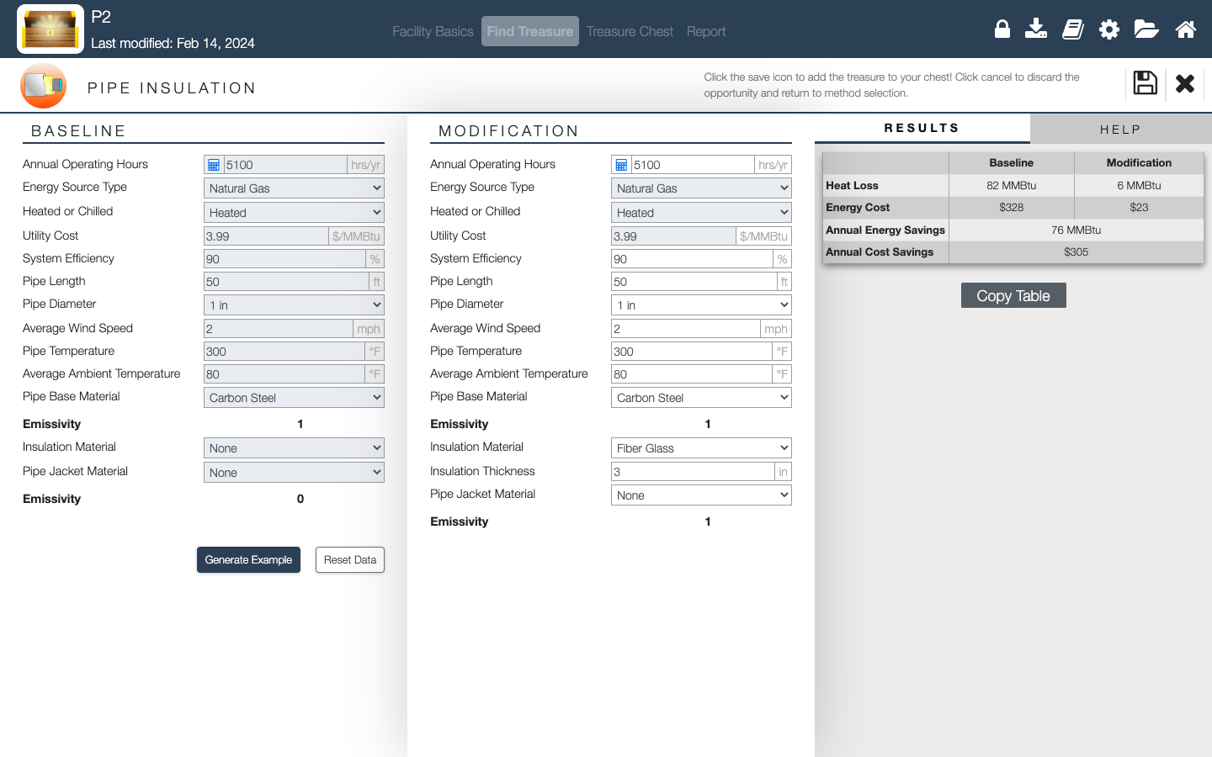
Finding Treasure- Pipe Insulation
Figure 21: Pipe Insulation Calculator
Notes:
Facilitator Notes:
Enter the value for baseline conditions and modifications. Results can be seen on the right side of the window in terms of annual energy savings and cost savings.

Slide 30
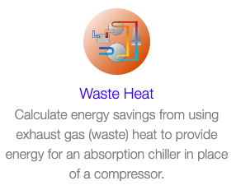
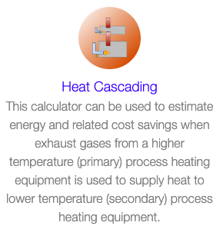
Recovering Waste Heat
According to the U.S. Environmental Protection Agency (EPA), implementing heat recovery measures such as heat cascading and waste heat utilization can lead to significant reductions in electricity and natural gas consumption, with potential energy savings ranging from 10% to 50% depending on the application and technology used. ³
Heat cascading involves capturing and reusing waste heat from one process to fulfill heating needs in another, maximizing energy utilization and minimizing waste.
Utilizing waste heat generated from industrial processes for heating or power generation purposes can significantly reduce the reliance on conventional energy sources and lower overall energy consumption.
Notes:
Facilitator Notes:
These are some of the Pollution Prevention Best Practices for Reducing Waste Heat.
The U.S. Environmental Protection Agency (EPA) indicates that applying heat recovery strategies, such as heat cascading and waste heat utilization, can result in substantial reductions in electricity and natural gas use, with energy savings ranging from 10% to 50%, depending on the specific application and technology. Heat cascading captures and reuses waste heat from one process to meet heating needs in another, optimizing energy use and minimizing waste. Additionally, using waste heat from industrial processes for heating or power generation can greatly reduce dependence on traditional energy sources and lower total energy consumption.

Slide 31
Finding Treasure- Waste Heat
Figure 22: Waste Heat Calculator
Notes:
Facilitator Notes:
Waste Heat Calculator

Slide 32
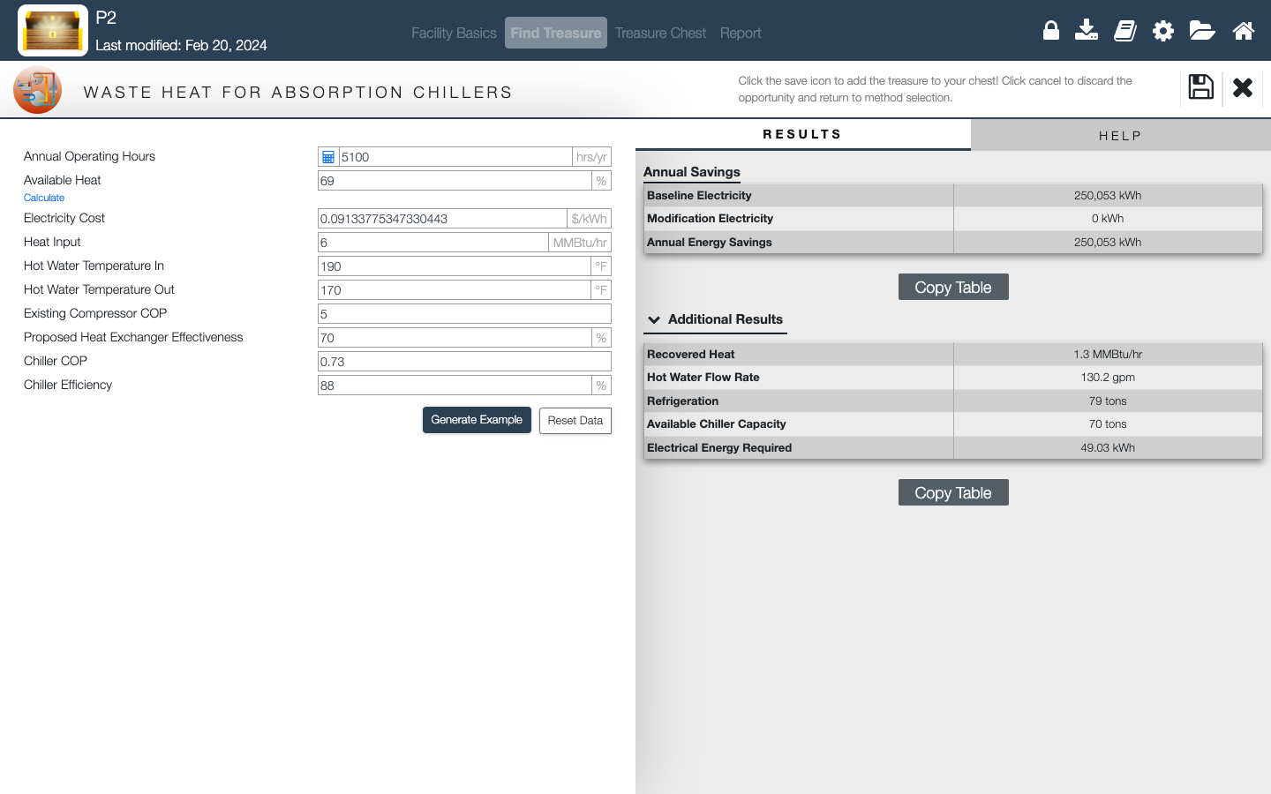
Waste Heat Recovery
Figure 23: Pipe Insulation Calculator
Notes:
Facilitator Notes:
Enter the current conditions of your facility and you can see the energy and cost savings results instantly on your right highlighted in red.

Slide 33
Compressed Air

Slide 34
Compressed Air
According to the U.S. Department of Energy, implementing compressed air optimization measures such as reducing compressed air usage, lowering compressed air pressure, and conducting leak surveys can lead to electricity savings of up to 10% to 20%, resulting in significant cost savings and environmental benefits for industrial facilities. ⁴
Notes:
Facilitator Notes:
These are some of the Pollution Prevention Best Practices for Reducing Waste Heat.
The U.S. Department of Energy highlights that optimizing compressed air systems by reducing air usage, lowering pressure, and conducting leak surveys can result in electricity savings of 10% to 20%. These measures not only lead to significant cost savings but also provide environmental benefits for industrial facilities.

Slide 35
Finding Treasure- Compressed Air
Figure 24: Compressed Air Reduction Calculator
Notes:
Facilitator Notes:
Compressed Air Reduction Calculator

Slide 36
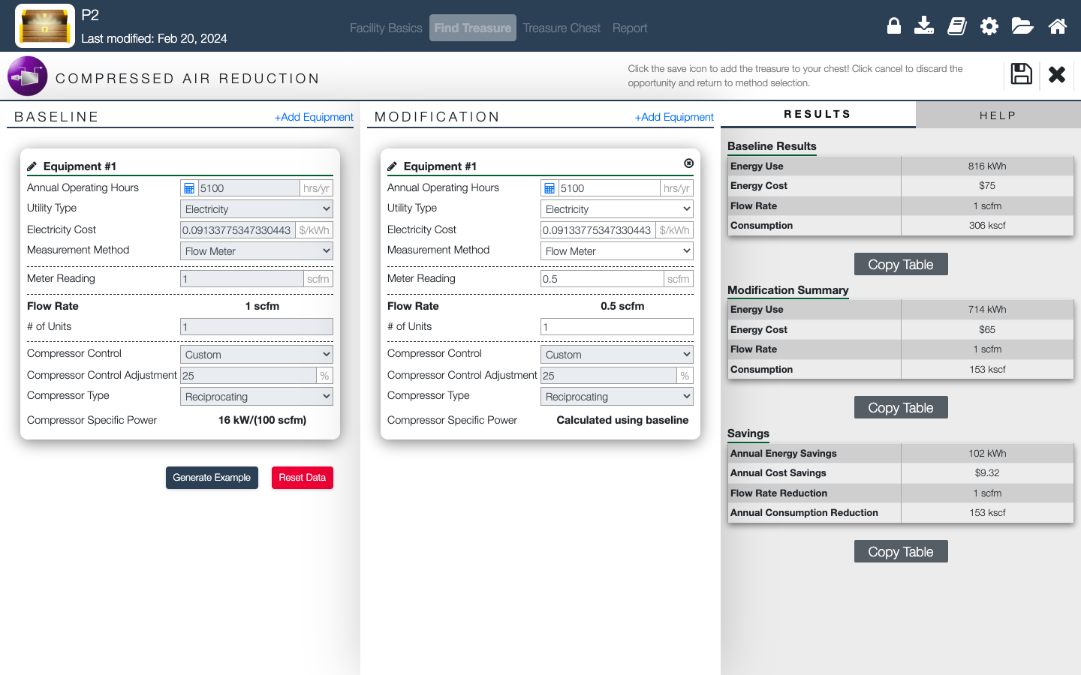
Compressed Air Reduction
Figure 25: Compressed Air Reduction Calculator
Notes:
Facilitator Notes:
Enter the baseline and modifications parameters.

Slide 37
Water Reduction

Slide 38
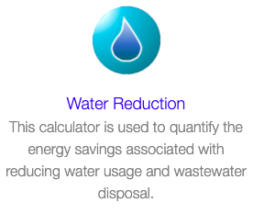
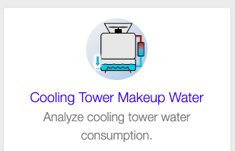
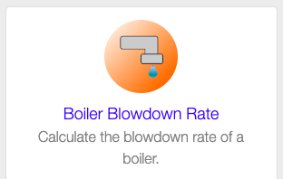
Saving Water
Implementing water reduction measures, such as optimizing water usage, boiler blowdown rate, and cooling tower makeup water, presents opportunities to conserve water resources and reduce operational costs.
Optimizing boiler blowdown rates helps minimize water wastage and improve boiler efficiency, resulting in lower energy consumption and operational costs.
According to the U.S. Environmental Protection Agency (EPA), implementing water conservation measures such as optimizing boiler blowdown rates and minimizing cooling tower makeup water usage can result in water savings of up to 20% or more, contributing to water resource sustainability and cost savings for facilities. ⁶
Notes:
Facilitator Notes:
These are some of the Pollution Prevention Best Practices for Water Reduction.
Implementing water reduction strategies, such as optimizing water usage, boiler blowdown rates, and cooling tower makeup water, offers opportunities to conserve water and reduce operational costs. By optimizing boiler blowdown rates, water wastage is minimized, and boiler efficiency improves, leading to reduced energy consumption and lower operational expenses. The U.S. Environmental Protection Agency (EPA) states that applying water conservation measures like optimizing boiler blowdown and minimizing cooling tower makeup water usage can result in water savings of 20% or more, promoting sustainability and cost savings for facilities.

Slide 39
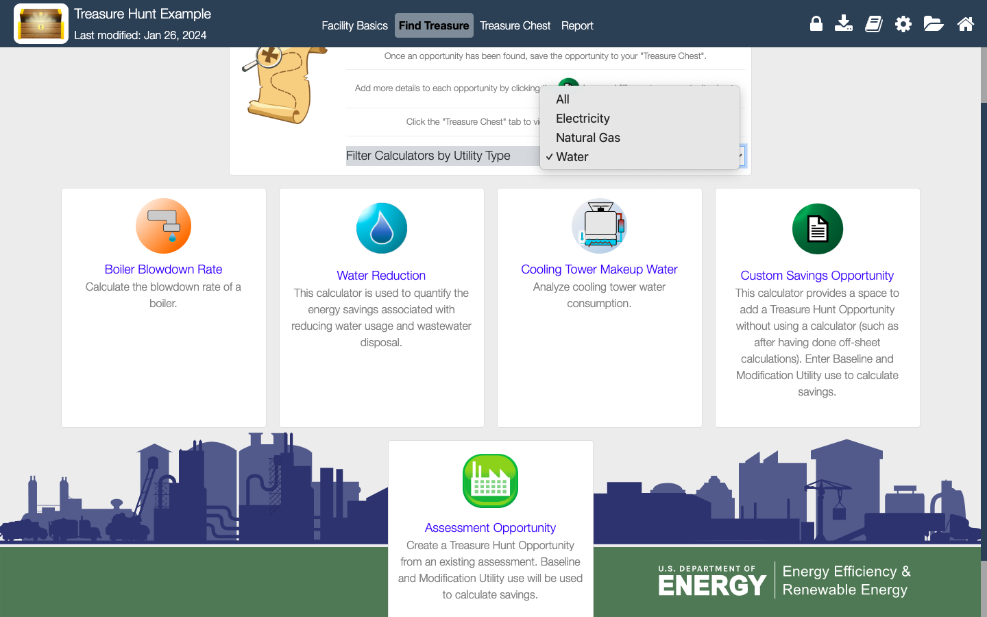
Finding Treasure- Water Reduction Example
Figure 26: Water Reduction Calculator
Notes:
Facilitator Notes:
Water Reduction Calculator

Slide 40
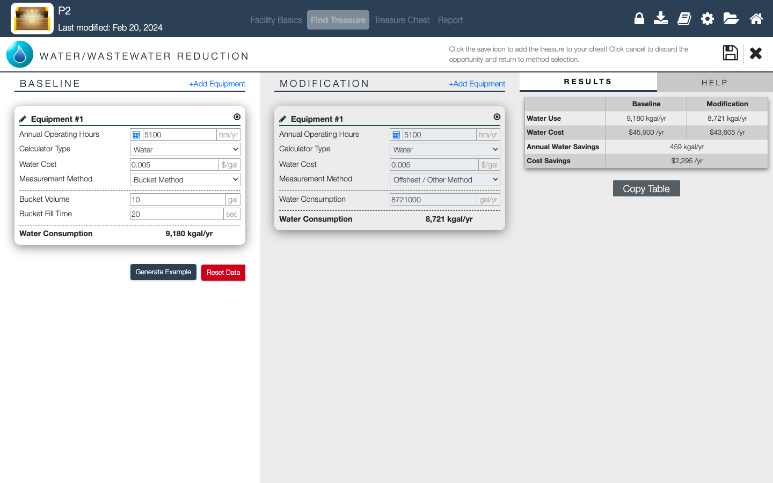
Finding Treasure- Water Reduction Example
Figure 27: Water Reduction Calculator
Notes:
Facilitator Notes:
Enter the baseline and modifications parameters.

Slide 41
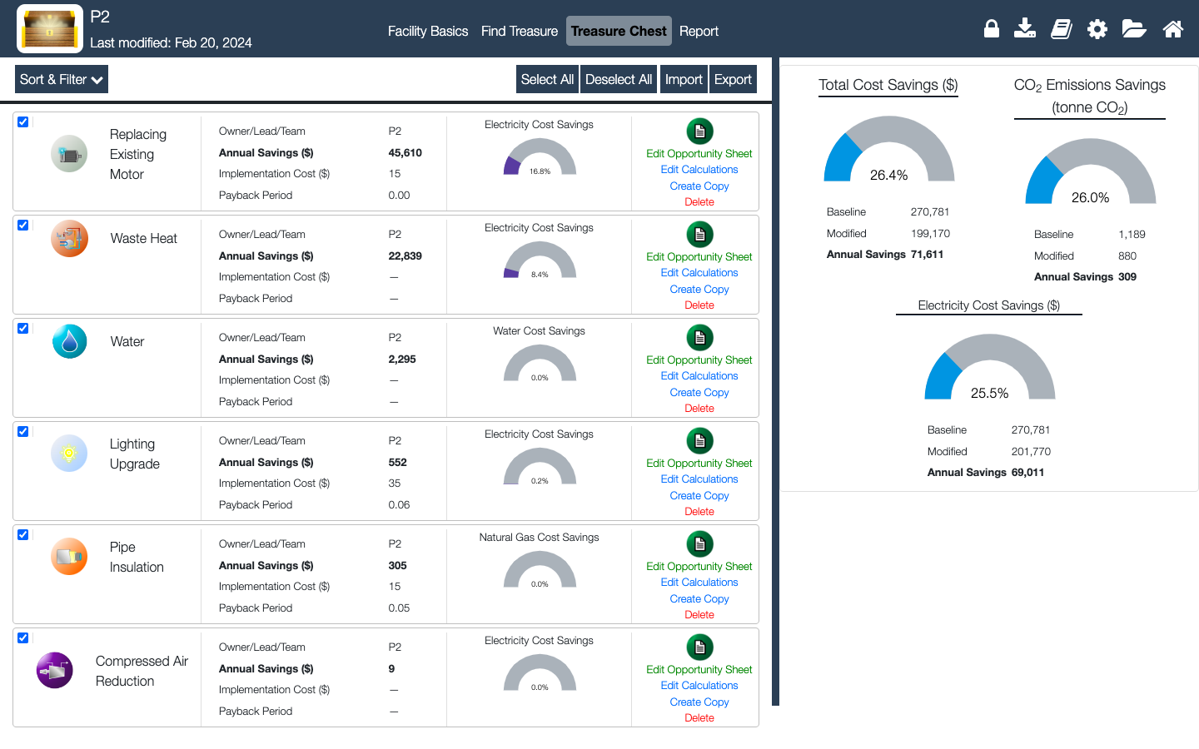
Treasure Chest Summary
Figure 28: Treasure Chest
Notes:
Facilitator Notes:
Explain what the treasure chest tab shows now with the three examples together.

Slide 42
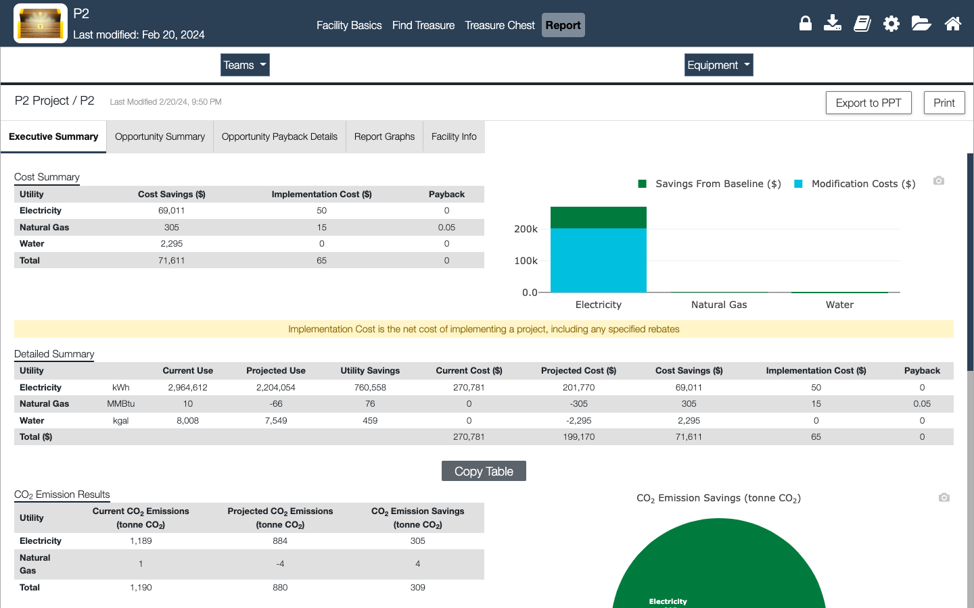
Treasure Hunt Report
Notes:
Facilitator Notes:
Explain what the report tab shows

Slide 43
Key Takeaways
Treasure Hunts bring “easy” and “quick” projects.
Treasure Hunts offer practical solutions for energy efficiency improvements.
Implementation treasures found can lead to significant cost savings.
T.H. engages employees in energy-saving practices.
Notes:
To conclude, Treasure Hunts offer effective solutions for enhancing energy efficiency within organizations.
The implementation of operational adjustments identified through Treasure Hunts enables substantial cost savings and environmental advantages.
It's imperative to involve employees in energy-saving behaviors to maintain these enhancements over the long haul.

Slide 44
References
- https://www.energy.gov/eere/iedo/measur
-https://betterbuildingssolutioncenter.energy.gov/better-plants/energy-treasure-hunts
-https://betterbuildingssolutioncenter.energy.gov/better-plants/getting-started-energy-efficiency-your-facility

Slide 45
Questions?

